Slide 1
How to benefit from the
International Summer School on Grid Computing 2009
Alain Roy

Slide 2
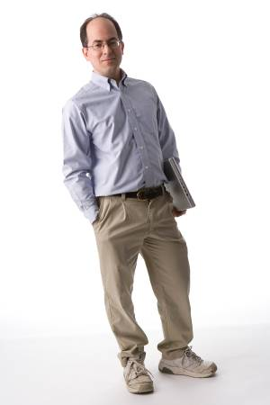
Who am I?
OSG Software Coordinator
Long-time Condor team member
  At ISSGC, I represent Condor and OSG
This will be my fifth year lecturing at the ISSGC
Will arrive on Monday, July 6 & stay until the end of the school

Slide 3
What is ISSGC?

Slide 4
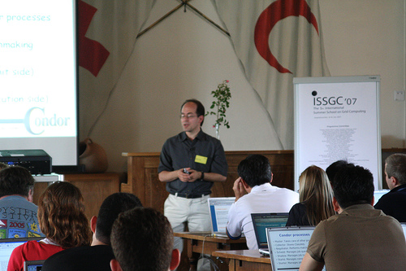
Interesting Lectures

Slide 5
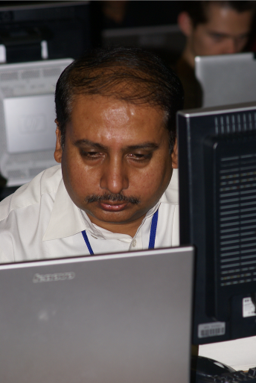
Informative Hands-On Exercises

Slide 6
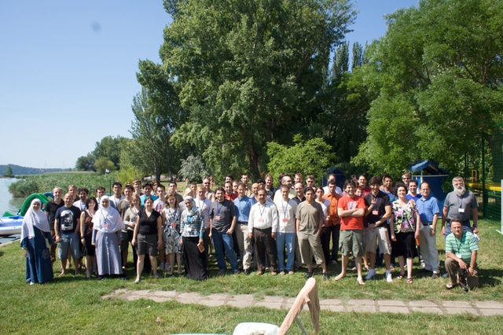
Community

Slide 7
Schedule
Most days:
  Morning lectures
  Afternoon exercises
Integrating exercises
  Challenges you to use all technologies
Warning: days are long, you will be tired

Slide 8
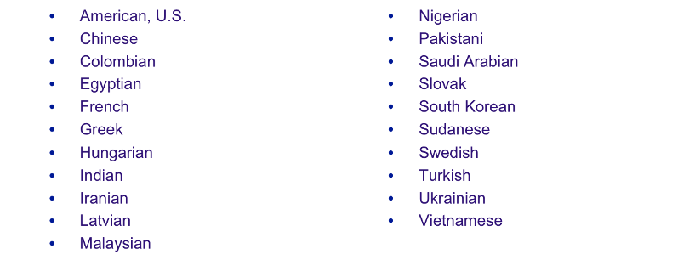
Wide mix of students
49 students accepted, 21 nationalities
Mix of backgrounds:
  Many application scientists
  Some CS background

Slide 9
How can you benefit the most?
Most lectures will be broad, not deep
  Ask yourself, “how does this fit together?”
  Try to understand underlying principles
    The principles will live longer than the software
    You’ll forget half the details anyway
Ask questions
  Don’t be shy!
  Ask lecturers “why?” to understand design choices
  Plenty of opportunities to ask questions at breaks and meals

Slide 10
How can you benefit the most?
Become a part of the community
  You will be assigned a group
  Work with your group
  Socialize with everyone
  Connect at mealtime and events
You’ll get out of it what you put into it
Many students bring laptops—not needed, but you’re welcome to do so.

Slide 11
Talk to me me!
I’ll be there for almost the whole school.
If I can do anything to help your experience be better, let me know.
If you’re unhappy with the school, say something! The school can adapt to meet your needs.

Slide 12


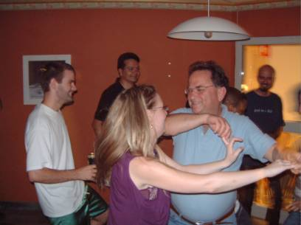
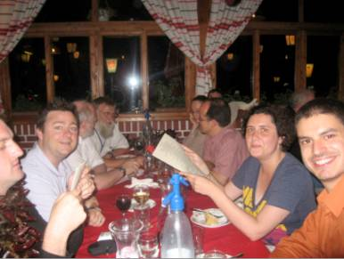
Have Fun!

