Slide 1
OSG and ATLAS
OSG Council Meeting
LIGO Livingston
5 March 2009

Slide 2
The Open Science Grid(OSG) and U.S. ATLAS
U.S. ATLAS has been running managed simulation/reconstruction jobs on OSG infrastructure for the entire year of 2008 using PanDA.
  Also using the same tools to run re-processing at Tier 1 centers
OSG is delivering more than the minimal required
  See next slides on Simulation Production
    Using “opportunistic” resources on OSG
  U.S. ATLAS (and overall ATLAS) rely on a robust OSG.
The success of PanDA (ATLAS-wide adoption) was in part due to OSG
New features in Workload Management System (“extensions” to PanDA and CONDOR) will be key as we scale up to full LHC data rates
  Help with security (OSG and EGEE requirements)
  PanDA development team + OSG Workload Management System team working together
    Benefits both ATLAS and OSG
SRM/dCache
  Vital for ATLAS operations, but more needed for full U.S. ATLAS storage system:
    PROOF/Bestman/Xrootd
Notes:
BTeV Talk
For January Collab Meeting

Slide 3
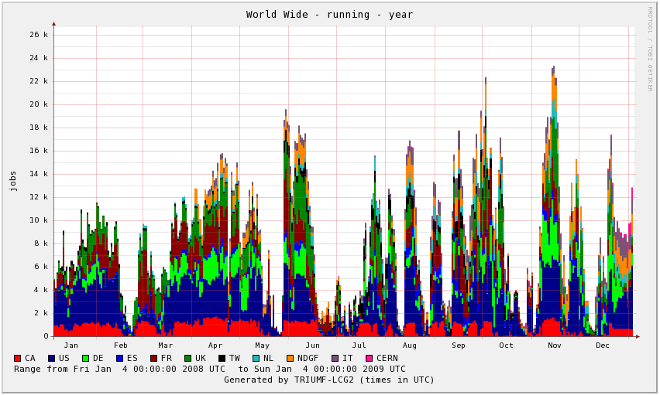
PanDA production (Monte Carlo Simulation/Reconstruction) for 2008
Notes:
BTeV Talk
For January Collab Meeting

Slide 4
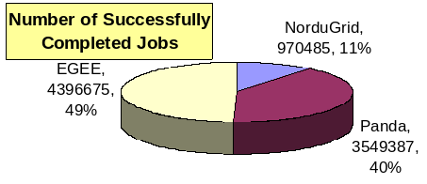
U.S. ATLAS Production Tier 1 and Tier 2s
For past ~3 months Panda includes some EGEE sites
Total Walltime usage (successful jobs): 6,000 CPU years, since 2006.
Notes:
BTeV Talk
For January Collab Meeting
Needs updating – ask Kaushik…

Slide 5
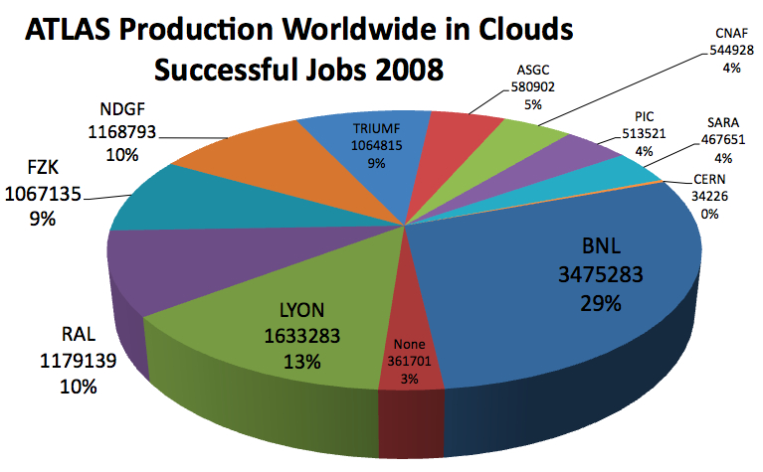
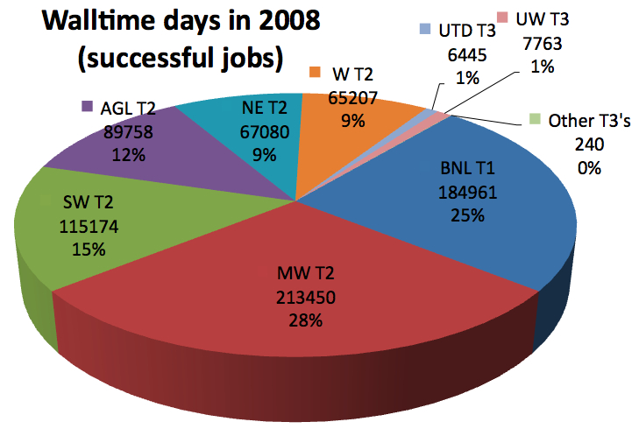
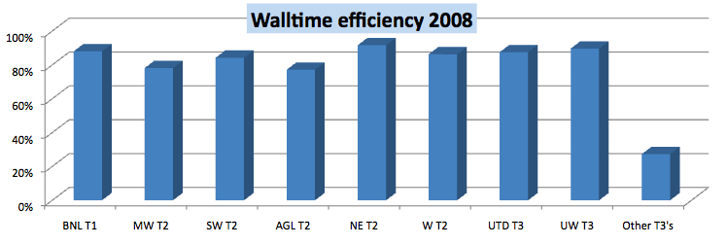
U.S. Production in 2008
More than our share—indicates others not delivering their expected levels
J. Shank DOE/NSF Review 9-12 Feb., 2009 Princeton

Slide 6
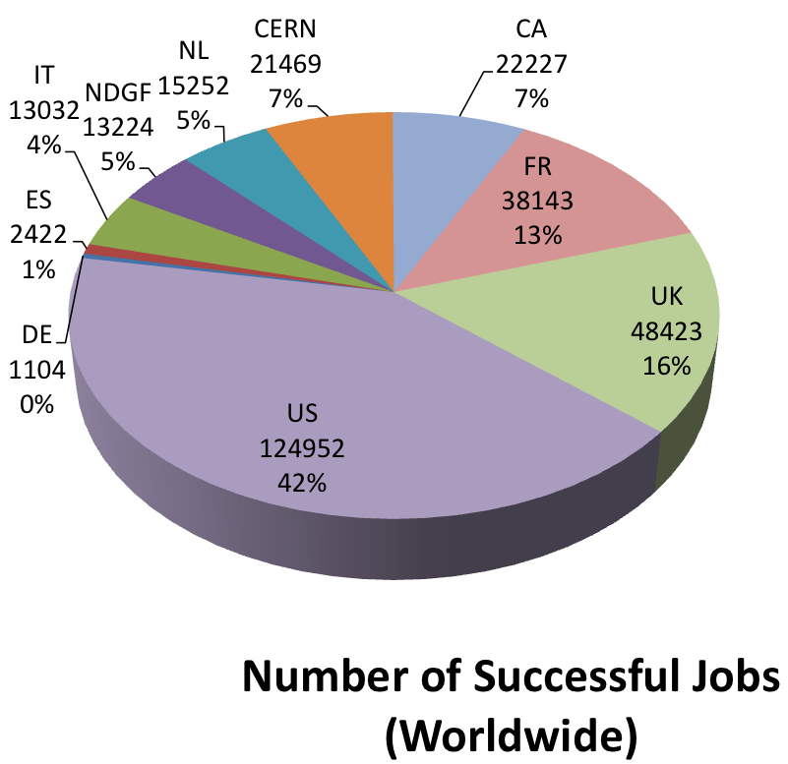
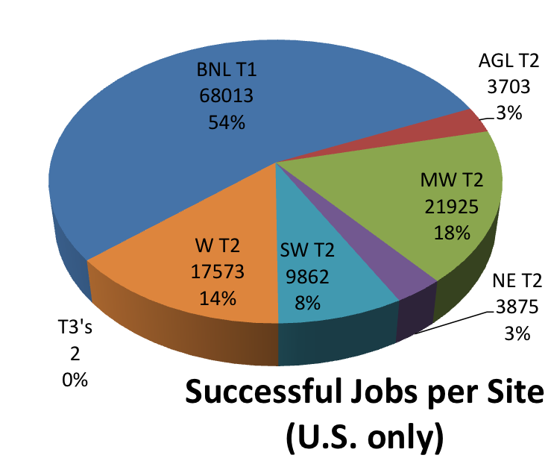
December 2008 Cosmic Data Reprocessing
J. Shank DOE/NSF Review 9-12 Feb., 2009 Princeton

Slide 7
Organization and Participation
Three distinct, coherent, coordinated PanDA activities:
  PanDA Project
  ATLAS PanDA/Prodsys development activity
  OSG Workload Management
    PanDA is supported by OSG as a workload management system (WMS) for use by OSG VOs
    OSG WMS program is part of the OSG Applications Area led by F. Wuerthwein and T. Wenaus
      OSG WMS program is coordinated by M. Potekhin in T. Wenaus’ group at BNL
    Two BNL PAS group members are supported by OSG to work full-time on PanDA for OSG and ATLAS
      M. Potekhin, J. Caballero
    OSG also supports one UTA student (A. Thor)

Slide 8
Collaborative Problem Resolution
PanDA has (by design) a small number of dependencies but a crucial one is CondorG
Much of the power of PanDA as a global yet operationally centralized WMS comes from CondorG as the basis for reliable, scalable pilot submission across the grid(s)
But PanDA is good at uncovering scaling limitations, including in CondorG/Globus
Intensive collaboration took place through much of 2008 between the PanDA team, BNL ACF, and the Condor team to understand and resolve CondorG scaling issues arising from the pilot job use case (relatively new to Condor)
Successfully resolved in the last three months through
  Functional additions to PanDA to partially offload CondorG functions with scaling problems (job state monitoring)
  A series of meetings and joint work sessions between the three teams to identify problems and define a workplan to address them
  A series of CondorG fixes/modifications delivered from the Condor team (including a comprehensive upgrade to CondorG’s treatment of the pilot use case, received last week)
Kudos to ACF and especially the Condor team for very effective collaboration
  This is an example of why we’re happy & enthusiastic Condor users!

Slide 9
PanDA in 2008 - Security
PanDA uses standard grid certificate based authentication/authorization
Extending security beyond basic cert-based authorization has been a major 2008 activity
Work supported by OSG, performed by the BNL OSG WMS team
  An OSG deliverable that is also a valuable contribution to ATLAS
Major development of the year: glExec integrated into the pilot to switch pilot identity to that of the downloaded user analysis job
  Required by EGEE policy (but glExec not yet supported on EGEE sites)
  Requires a proxy management infrastructure (also implemented, using MyProxy)
Limited proxy (pilot role) implemented to restrict pilot capabilities
  Prevent users from gaining access to extensive rights via the pilot proxy
Further security enhancements to come
  Authentication/authorization of pilot schedulers and pilots via time-limited token
  Client<->Server validation, payload validation
    Drawing on CMS/FNAL work
    Will prevent hijacking PanDA pilots to run unauthorized jobs

Slide 10
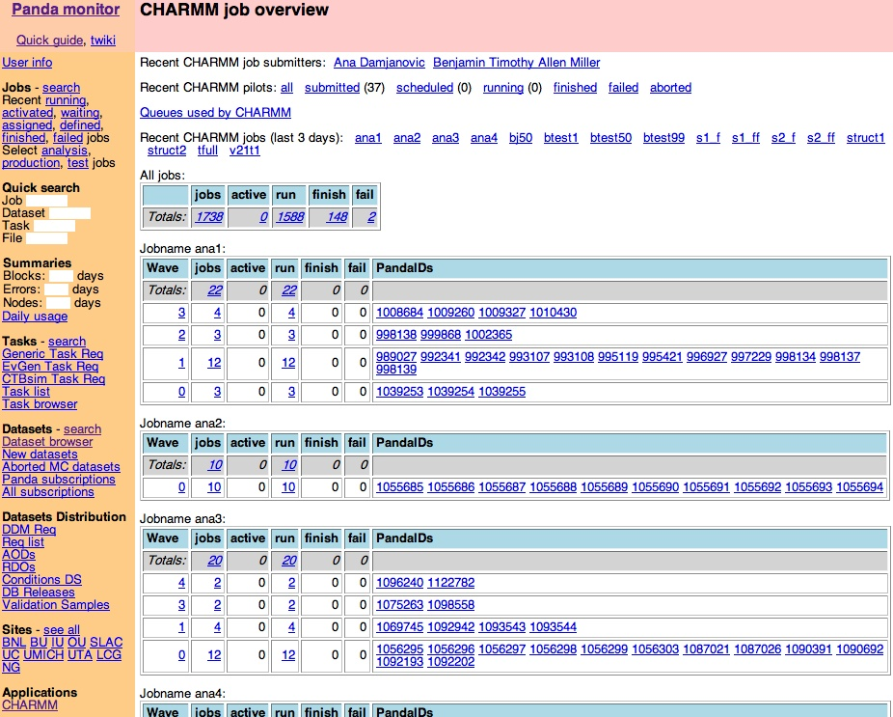
Beyond ATLAS: PanDA for OSG
Currently used by CHARMM protein folding application
User/VO does
- Job submission, using simple Python client
- Pilot submission, so pilots carry their identity
- Site/queue selection
BNL/CERN/ATLAS/OSG provides
- PanDA services; same as used by ATLAS
- Panda monitoring, VO customized
- Site/queue availability database
- Machine for VO pilot submission (@Madison)
- Support from BNL OSG personnel
- In progress: Data mgmt and data-driven workflow

Slide 11
Facilities
U.S. ATLAS is adding 1/2 FTE to the SRM/dCache V2 development effort
  to work specifically on performance/stability enhancements.
  He will be closely working with the FNAL and DESY core developers.
Exploring PROOF/Xrootd
U.S. ATLAS has a Facility Integration Program in place (Rob Gardner/Michael Ernst)
  adding Virtual Organization-specific(ATLAS) site availability tests to the suite of tests OSG.
    currently being developed
    expected to be compliant with WLCG.
Notes:
BTeV Talk
For January Collab Meeting

Slide 12
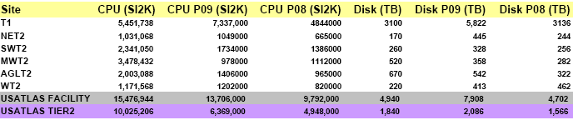
U.S. ATLAS Facility Capacities
2008 and 2009 Pledges for CPU and Disk (P08, P09), and currently installed capacities
The currently installed CPU capacity allows to simulate 12M fast simulated or 500k full simulated events per day
T1 U.S. ATLAS Tier-1 Center at BNL
NET2 North East Tier-2 Center at Boston University and Harvard University
SWT2 Southwest Tier-2 Center at University of Texas at Arlington and Oklahoma University
MWT2 Midwest Tier-2 Center at University of Chicago and Indiana University
AGLT2 ATLAS Great Lakes Tier-2 Center at University of Michigan and Michigan State University
WT2 Western Tier-2 Center at SLAC
M. Ernst OSG Council
5 March, 2009

Slide 13
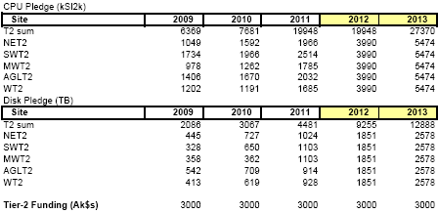
Projected Tier-2 Capacity Development
M. Ernst OSG Council
5 March, 2009

Slide 14
Drivers for 2009 - and beyond
The 2007/2008 drivers were primarily designed to
Demonstrate the functionality of the computing model elements and to improve the stability of the services while scaling to nominal performance level
  Service disruptions still too frequent
Participation in global ATLAS operations
  Data Taking and (centrally managed) Data Processing
  ATLAS data analysis
Goal is to have end-to-end data collection, distribution, and access
  Includes DAQ and Tier-0 elements, Tier-1 and Tier-2 data replication and support for end-user analysis at Tier-3’s
  Application services
    Analysis at the Tier-2 Centers, and beyond …
      Infrastructure in place since early 2008
      Data relevant to Analysis available at Tier-2’s
      Understand and (help) implement end user analysis facility components
    Integration of Tier-3’s/End-User Analysis services with U.S. ATLAS Computing Facility
Continuous operation with increasing functionality and activity level
  Required integrated reliability over a month is >90% for Tier-2 centers
    No more than 3 days per month should be lost due to unscheduled outages
M. Ernst OSG Council
5 March, 2009

Slide 15
US ATLAS Needs
Throughput goals:
  200 Mbytes/sec data distribution per Tier-1/Tier-2 pair - robust, sustained.
  20,000 simultaneous jobs (10,000 simultaneous jobs 6/2009; must scale with number of CPUs)
Middleware needs:
  Dependable deployment, installation and configuration of job submission infrastructure compatible with PANDA,
  Software for dCache, Bestman ad xRootD to meet SRM V2.2 spec WLCG SRM MOU & addendum.
  Support from centralized expert group for use of storage on OSG sites
  Glexec integrated with PANDA and accepted by EGEE sites.
  Support for software in the VDT and coordination of requirements and deliverables of external software providers as needed by PANDA and US ATLAS.
  Support for PANDA deployment, monitoring, installation and extensions to meet ATLAS needs
  Support for OS needed by the experiment, expect to move to Scientific Linux 5 ~mid 2009
  User and Worker Node Client tools consistent with EGEE and providing interoperability at all levels.
Contributions to the WLCG
  Contributions to the WLCG deployment of PANDA/pilot job infrastructure.
  Support for Physics Analysis based on PROOF: Multi-User (interactive and batch) support in general purpose Processing Farm environment
  Integration of EGEE-compatible Security across various Storage, File Transfer, Globus, Pilot Jobs.
M. Ernst OSG Council
5 March, 2009

Slide 16
US ATLAS Service Needs
Critical? |  | Interface to WLCG?
Y | Security monitoring, incident response, notification and mitigation | Communicate and collaboration with EGEE, WLCG to the extent possible.
Y | Accounting - CPU, Storage & Efficiencies | Yes
Y | US ATLAS specific accounting reports | No
Y | Reliability and Availability monitoring | Yes
Y | Integration and system validation of new and updated middleware. | Test interoperation of new releases with EGEE infrastructure.
N | VO monitoring and validation using the RSV infrastructure | Yes
Y | Ticket Handling | Bi-directional:US ATLAS <-> OSG <-> GGUS, including alarms.
Y | SRM V2.2 Storage at Tier-2s | Track WLCG requirements
Y | Grid Job Submission interface to meet ATLAS throughput needs | No
Y | Reporting of trends in usage, reliability, job state, job monitoring.
Y | Grid wide Information system accessible to ATLAS applications. | No
M. Ernst OSG Council
5 March, 2009

Slide 17
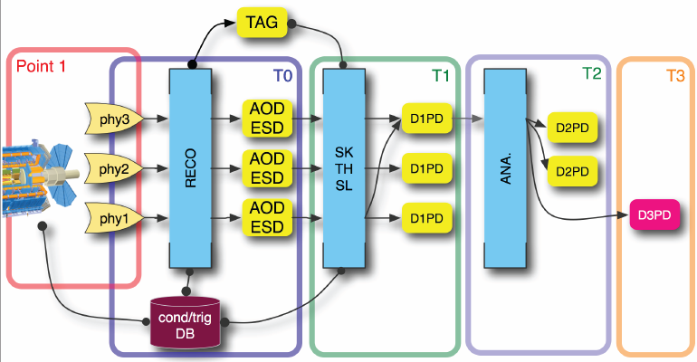
Analysis – From HLT to D3PD
Now that (we believe) we understand Facility Services up to the Tier-2 Level we are working on Facility related End User Analysis issues
Akira Shibata
M. Ernst OSG Council
5 March, 2009

Slide 18
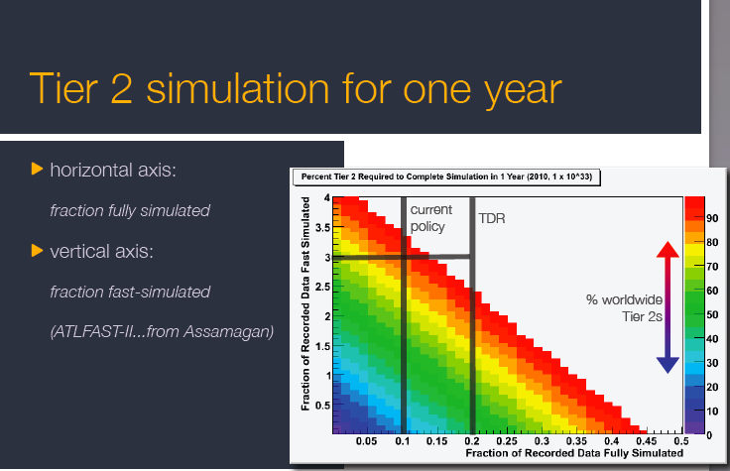
M. Ernst OSG Council
5 March, 2009

Slide 19
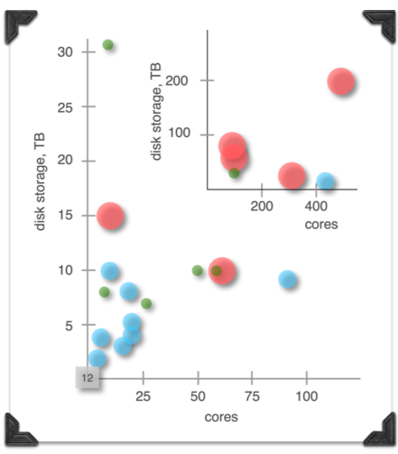
U.S. ATLAS Tier-3’s today
M. Ernst OSG Council
5 March, 2009

Slide 20
Possible Tier-3 Architectures
Tier-3 w/ Grid Services
  Campus-based Cluster w/ grid resources to support pAthena job queues and DQ2 clients
  Provide privileged access to Groups who own resorurces
Tier-3 w/ Grid Data Access
  E.g. desktop cluster w/ storage to support large datasets, DQ2 client
  Dedicated Tier-2 to provide Site Services, Catalog Services
Tier-3 Workstations
  Individual Workstations running ATLAS S/W for ROOTtuple Analysis
  Submission of pAthena jobs for processing and storage elsewhere
Tier-3 hosted at national Analysis Facility
  Arrangement w/ large Tier-3 or National Laboratory
Major concern is support
M. Ernst OSG Council
5 March, 2009

Slide 21
Conclusions on OSG
OSG is delivering the CPU cycles we need
  Robust and stable fabric
Our production system (PanDA) has now been extended to all ATLAS sites worldwide and to non ATLAS OSG resources.
OSG extension work to solve some known bottlenecks well underway
  Extending CONDOR glide-in technology for pilot factories
Addressing Security concerns over Pilots
  Principle focus of ATLAS/OSG extensions work--good synergy
Continued support of grid Storage Elements needed
  SRM/dCache and PROOF/Bestman/Xrootd
Notes:
BTeV Talk
For January Collab Meeting

Slide 22
Backup
The rest is backup/background stuff

Slide 23
Year 3 Deliverables for US ATLAS
WLCG client tools
  What does Panda need in worker-node client
    LCG-Utils (for lcg-cp)
    LFC client and interfaces
  What do US ATLAS users need for data access (for dq2-client)
    wlcg-client dependencies resolved cleanly in VDT
  http://www.usatlas.bnl.gov/twiki/bin/view/Admins/ClientTools.html

Slide 24
Year 3 Deliverables for US ATLAS
Network performance monitoring tools in VDT
  Kits as prescribed by Rich Carlson’s group
  Perhaps smaller lightweight (less than full OS install) suitable for Tier 3?

Slide 25
Site and VO Operations
Monitoring: Integrated monitoring for CEs and SEs of OSG sites. Easy access to comprehensive facility monitoring data (RSV, Gratia, data transfer statistics, etc.) for site administrators and users.
  Gratia-WLCG accounting services
    Continued support for Gratia accounting data forwarding to WLCG
  RSV-WLCG (SAM) services
    Continued support for RSV probe execution and forwarding of data to WLCG-SAM
  US ATLAS-OSG metrics displays
    Set of US ATLAS defined views of RSV, Gratia data for production statistics and availability data summaries
  Milestone: Availability of diverse service monitoring via a single entry point providing a comprehensive overview with the capability to drill down for details
  Due: First quarter 2009
Downtime Announcement: Tool that allows announcing downtimes of CE and SE via the information system to WLCG.
  Web-access for ATLAS DDM dashboard team for marking sites offline
  Milestone: Implementation compliant with EGEE definitions and conventions.
  Due: Fourth quarter of 2008

Slide 26
Support for CE and SE Operations
Full support of Computing and Storage Element operations. The production and analysis efficiency of sites is primarily dependent on reliably operating Computing and Storage Elements. According to recent observations US ATLAS Tier-2 sites and the few Tier-3 sites that exist so far are lacking the necessary stability and too much time, and effort at the site administrator level is needed to restore the service. This applies to the technologies used as Storage Elements in particular. Expectations include active and timely participation of members from the OSG Storage Team in debugging issues observed at sites with them eventually communicating the issues to the respective developers (and service integrators) for a resolution.
  Milestone: Procedure in place that allows to debug production systems, analyze problems including initiation and follow-up of problem resolution
  Due: Second quarter 2009
Bestman-Xrootd storage element
Packaged and supported on the same footing as SRM-dCache by October 1, 2008
  xrootd: 20080722-1249 or later at http://xrootd.slac.stanford.edu
  xrootdFS: 2.0 or later at http://wt2.slac.stanford.edu/xrootdfs/pkgs
  Bestman: 2.2.1.0 or later at http://datagrid.lbl.gov/bestman/
LFC catalog client and server packaging
  In VDT by September 1, 2008

Slide 27
Cyber Security Incident Handling
Continuous availability (24x7) of an OSG point of contact to handle Grid and local Cyber Security incidents that may arise in the global grid environment. According to recent experience incident handling has worked well, however, it is felt that more integration with routine GOC operations is needed.
  Milestone: Cyber Security incident handling integrated with GOC operations
  Due: Fourth quarter 2008

Slide 28
OSG Operations
OSG Facility Management should make an assessment as to the scalability of the operations capabilities
  Milestone: Provide scalability metrics and associated numbers (# of sites, services, complexity etc.)
  Due: First quarter 2009
OSG Centrally Managed Components
BDII: US ATLAS operations is extremely dependent upon stable and scalable operations of the OSG BDII communicating with the WLCG BDII.
  Milestone: Provide an assessment (based on results from continuous monitoring and good practice) as to when the server needs to be upgraded / replaced and work out a solution that allows for a reliable automatic fail-over.
  Due: Second quarter 2009

