Slide 1



Clemson Campus Grid
Sebastien Goasguen –sebgoa@clemson.edu
School of Computing
Clemson University, Clemson, SC

Slide 2
Outline
Campus Grid Principles and motivation
A user experience and other examples
Architecture

Slide 3
Grid
Collection of resources that can be shared among users.
Resources can be computing systems, storage systems, instruments…most of the focus is still on computing grid.
Grid services help monitor, access and make effective use of the grid.

Slide 4
Campus Grid
A collection of campus computing resources shared among campus users
  Centralized (IT operated)
  De-centralized (IT + dpt resources)
HPC resources and HTC resources
Evolution of Research Computing groups that exists on some campuses.

Slide 5
Why a Grid ?
Don’t duplicate efforts
  Faculty don’t really want to be managing clusters
Users need more…always
  First on campus, then in the nation..
Enable partnerships
Generate external Funding
  Building a grid is a spark to collaborative work and a partnership between IT and faculty
  CI is in a lot of proposal now, and faculty can’t do it alone

Slide 6
Campus Compute Resources
HPC (High Performance Computing)
  Topsail/Emerald (UNC), Sam/HenryN/POWER5 (NCSU), Duke Shared Cluster Resource (Duke)
HTC (High Throughput Computing)
  Tarheel Grid, NCSU Condor pool, Duke departmental pools

Slide 7
Why HTC ?
Because if you don’t have HPC resources, you can build a HTC resource with little investment
You already have the machines in your instructional labs
Even Research can happen on Windows:
  Cygwin
  Co-Linux
  VM setup

Slide 8
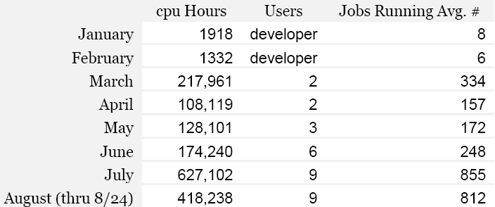
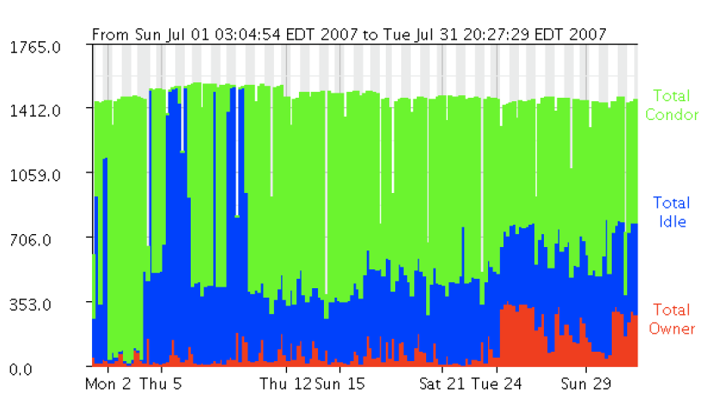
Clemson Campus Condor Pool
Back to 2007:
Machines in 50 different locations on Campus
~1,700 job slots
>1.8M hours served in
6 months

Slide 9
Clemson (circa 2007)
1085 windows machines, 2 linux machines (central and a OSG gatekeeper), condor reporting 1563 slots
845 maintained by CCIT
241 from other campus depts
>50 locations
From 1 to 112 machines in one location
Student housing, labs, library, coffee shop
Mary Beth Kurz, first condor user at Clemson:
    March 215,000 hours, ~110,000 jobs
    April 110,000 hours, ~44,000 jobs

Slide 10
The world before Condor
1800 input files
3 alternative genetic algorithm designs
50 replicates desired
Estimated running time on 3.2 GHz machine with 1 GB RAM: 241 days
Slides from Dr. Kurz

Slide 11
First submit file attempt
Monday noon-ish
Used the documentation and examples at Wisconsin condor site and created:
    Universe = vanilla
    Executable = main.exe
    log = re.log
    output = out.$(Process).out
    arguments = 1 llllll-0
    Queue
Forgot to specify Windows and Intel and also to transfer the output back (thanks David Atkinson)
Got a single submit file to run 2 specific input files by mid-afternoon Tuesday
Slides from Dr. Kurz

Slide 12
Tuesday 6 pm – submitted 1800 jobs in a Cluster
Universe = vanilla
Executable = MainCondor.exe
requirements = Arch=="INTEL" && OpSYS=="WINNT51"
should_transfer_files = YES
transfer_input_files = InputData/input$(Process).ft
whenToTransferOutput = ON_EXIT
log = run_1/re_1.log
output = run_1/re_1.stdout
error = run_1/re_1.err
transfer_output_remaps = "1.out = run_1/opt1-output$(Process).out"
arguments = 1 input$(Process)
queue 1800
200 ran at a time, but that eventually got resolved
Slides from Dr. Kurz

Slide 13
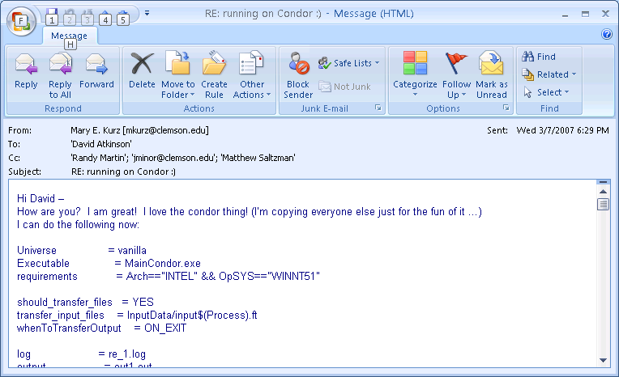
Wednesday afternoon: Love notes
Slides from Dr. Kurz

Slide 14
Since Mary-Beth….Much more Research

Slide 15
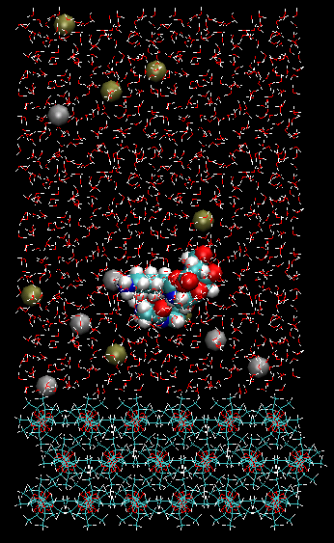
Bioengineering Research
Replica Exchange Molecular Dynamics simulations to provide atomic-level detail about implant biocompatibility.
The body's response to implanted materials is mediated by a layer of proteins that adsorbs almost immediately to the crystalline polylactide surface of the implant.
Chris O’Brien
Center for Advanced Engineering Fibers and Films

Slide 16
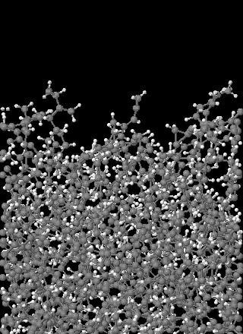
Atomistic Modeling
Molecular dynamics simulations to predict energetic impacts inside a nuclear fusion reactor.
Model ~2800 atoms
Simulate 20,000 time steps per impact
Damage accumulates after each impact
Simulate 12,000 independent impacts to improve statistics
Steve Stuart
Chemistry Department

Slide 17
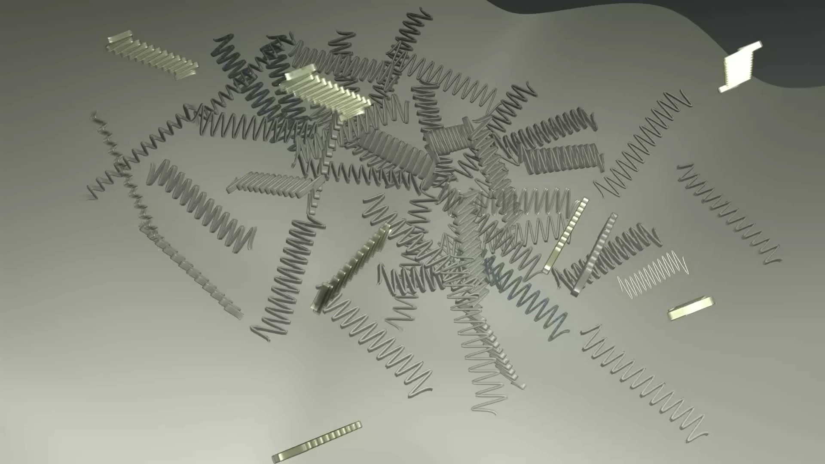
Visualization - Blender
Research Experience for Undergraduates at CAEFF
Render high definition frames for a movie using Blender, an open source 3D content creation suite.
Used PowerPoint slides from workshop to get up and running
Brian Gianforcano
Rochester Institute of Technology

Slide 18
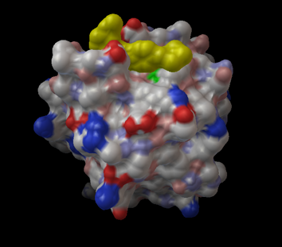
Anthrax
Use Autodock for running molecular level simulations of the effects of using anthrax toxin receptor inhibitors
May Be useful in treating cancer
May be useful in treating anthrax intoxication
Mike Rogers
Childrens Hospital Boston

Slide 19
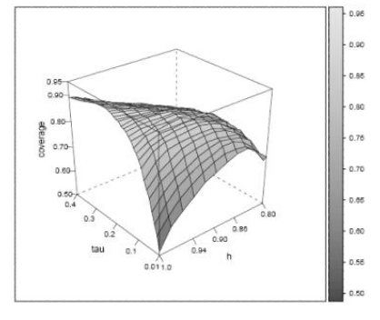
Computational Economics
Three emails then up and running
Data envelopment analysis
Linear programming methods to estimate measures of efficiency production in companies.
Paul Wilson
Department of Economics

Slide 20
How to find users ?
You already know them
  Biggest users in Engineering in Science
  Monte-Carlo (Chemistry, Economics...)
  Parameter Sweep
  Rendering (Arts)
  Data mining (Bioinformatics)
Find a campus champion who is going to go door to door ( Yes, traveling sales man type person)
Mailings to faculty, training events…

Slide 21
Clemson’s pool
  Clemson's Pool
    Orignially mostly Windows, +100 locations on campus.
    Now 6,000 linux slots as well
    Working on 11,500 slots setup, ~120 TFlops
    Maintained by Central IT
    CS dpt tests new configs
    Other dpt adopt the Central IT images
    BOINC Backfill to maximize utilization.
    Connected to OSG via an OSG CE.
Total Owner Claimed Unclaimed Matched Preempting Backfill
INTEL/LINUX 4 0 0 4 0 0 0
INTEL/WINNT51 895 448 3 229 0 0 215
INTEL/WINNT60 1246 49 0 2 0 0 1195
SUN4u/SOLARIS5.10 17 3 0 14 0 0 0
X86_64/LINUX 26 2 3 21 0 0 0
Total 2188 502 6 270 0 0 1410

Slide 22
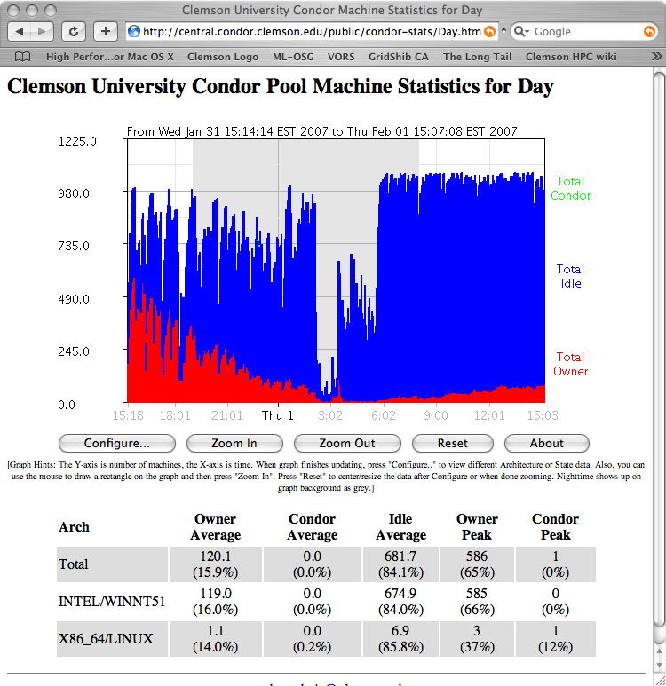
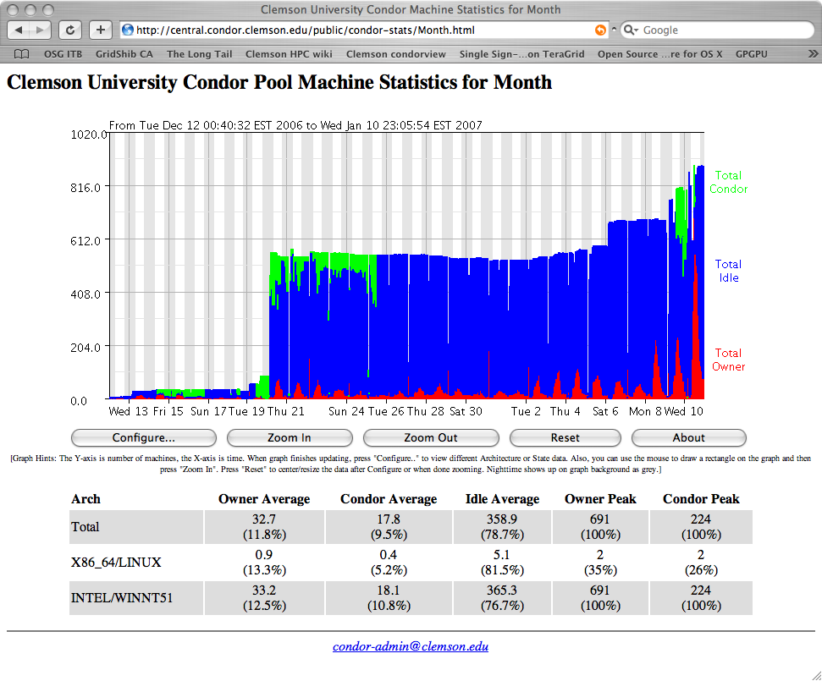
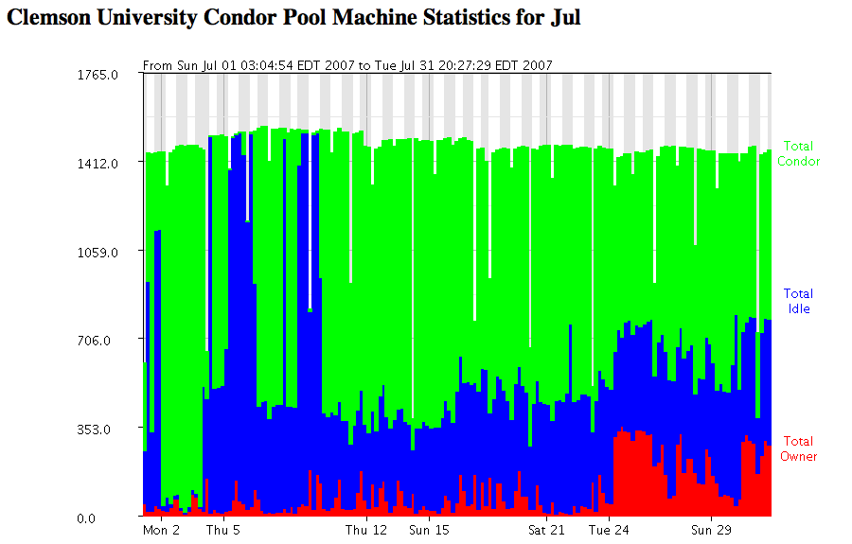
Clemson’s pool history

Slide 23
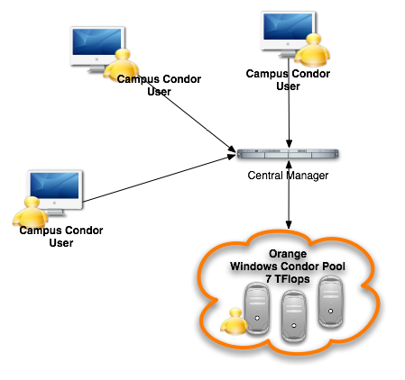
Started with a simple pool

Slide 24
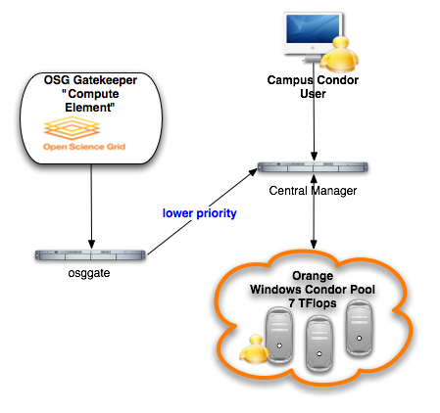
Then added OSG CE

Slide 25
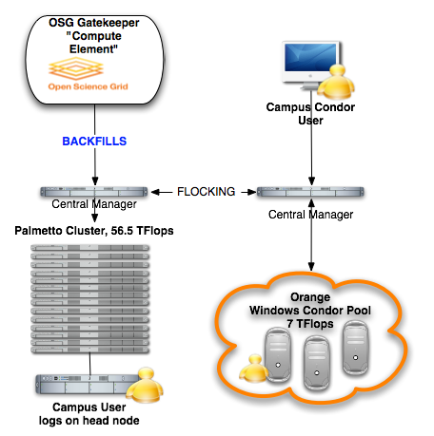
Then added HPC Cluster

Slide 26
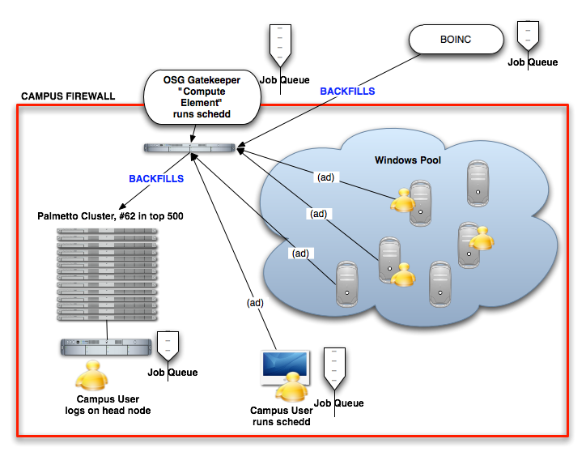
Then added BOINC
  Multi-tier job queues to fill the pool
  Local users, then OSG, then BOINC

Slide 27
Clemson’s pool BOINC backfill
  Put Clemson in World Community Grid, LHC@home and Einstein@home.
  Reached #1 on WCG in the world, contributing ~4 years per day when no local jobs are running
# Turn on backfill functionality, and use BOINC
ENABLE_BACKFILL = TRUE
BACKFILL_SYSTEM = BOINC
BOINC_Executable = C:\PROGRA~1\BOINC\boinc.exe
BOINC_Universe = vanilla
BOINC_Arguments = --dir $(BOINC_HOME) --attach_project http://www.worldcommunitygrid.org/ cbf9dNOTAREALKEYGETYOUROWN035b4b2

Slide 28
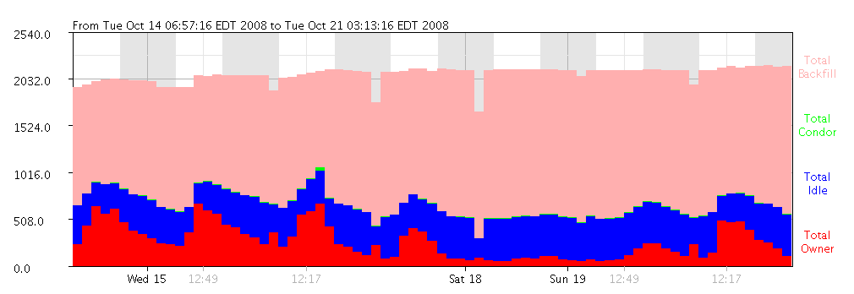
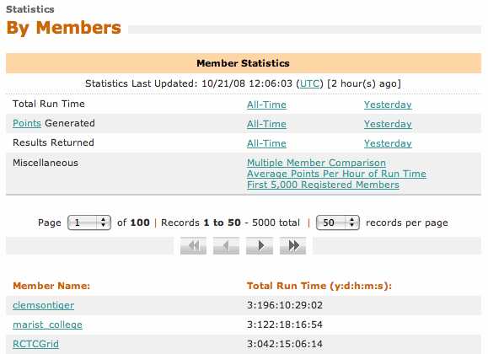
Clemson’s pool BOINC backfill
  Reached #1 on WCG in the world, contributing ~4 years per day when no local jobs are running = Lots of pink

Slide 29
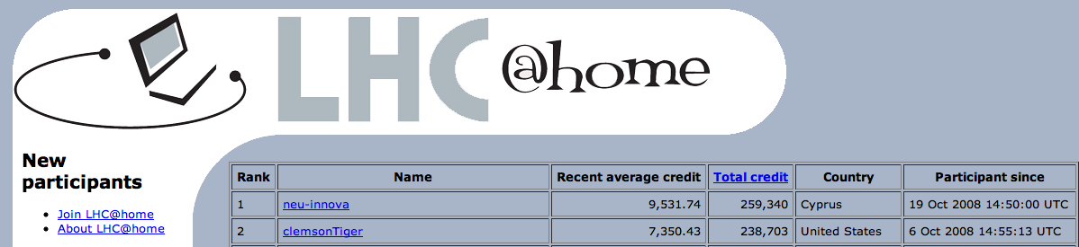
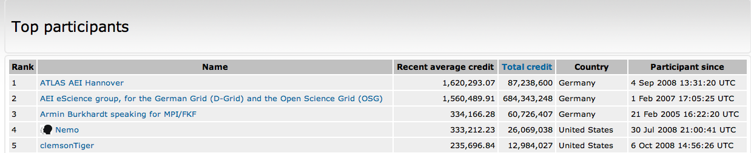
OSG VO through BOINC
    Einstein@home, LIGO VO
    LHC@home, very little jobs to grab

Slide 30
Summary of main steps
Deploy Condor on Windows labs
  Define startup policies
  Define Power usage policy if you want
Deploy Condor as backfill of HPC resources
Setup OSG gateway to backfill Campus Grid
  Lower priority than campus users
Setup BOINC to backfill Windows labs (OSG jobs don’t like windows too well…this may change with VMs)

Slide 31
Staffing
Senior unix admin (manages central manager and OSG CE)
Junior Windows admin (manages lab machines)
Grad or junior staff (tester)
Estimated $35k to build condor pool, since then fairly low maintenance ~.5 FTE (including OSG connectivity).

Slide 32
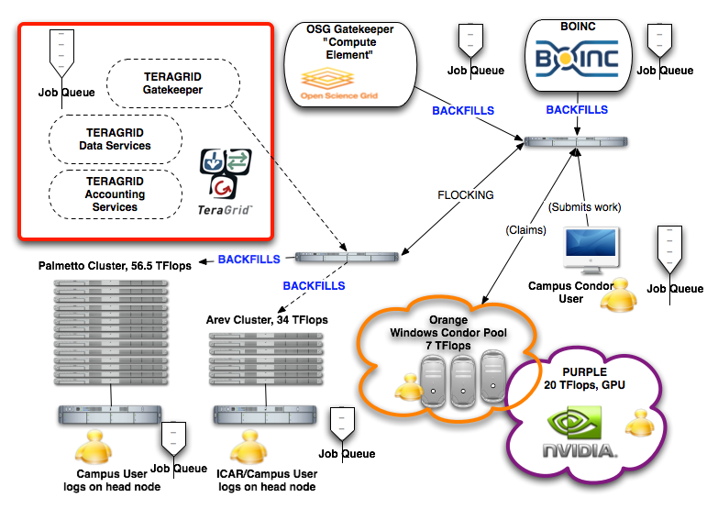
Clemson’s Grid Fall 2009 (Hopefully…)

Slide 33
Usual Questions
Security
  I don’t want outside folks to run on our machines ! (this is actually a policy issue). OSG users are well identified and can be blocked if compromised.
  IP based security (only on campus folks can submit)
  Submit host security (only folks with access to a submit machine can submit)
Why BOINC ?
  NSF sponsored project, very successful at running embarrassingly parallel apps
  Always has jobs to do
  Humanitarian / Philanthropy statement

Slide 34
Usual Questions
Power
  Doesn’t this use more power ?
  People are looking into wake on lan setup where machines are awaken when work is ready.
  Running on windows may actually be more power efficient than on HPC systems (slower but no so slow, might cost less power…)
Why give to other Grid users ?
  Because when you need more than what your campus can afford, I will let you run on my stuff….

Slide 35
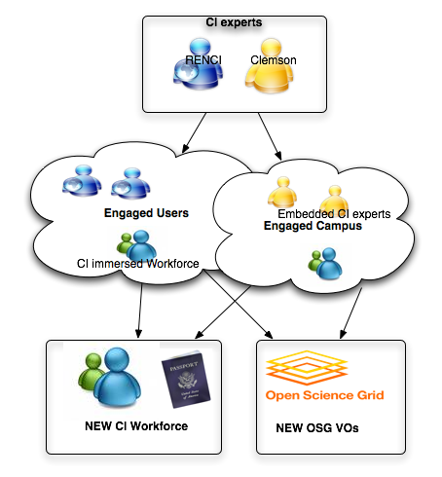
Other Campus Grids
    CI-TEAM is a NSF award to outreach to campuses, help them build their cyberinfrastructure and make use of it as well as the national OSG infrastructure. “Embedded Immersive Engagement for Cyberinfrastructure, EIE-4CI”

Slide 36
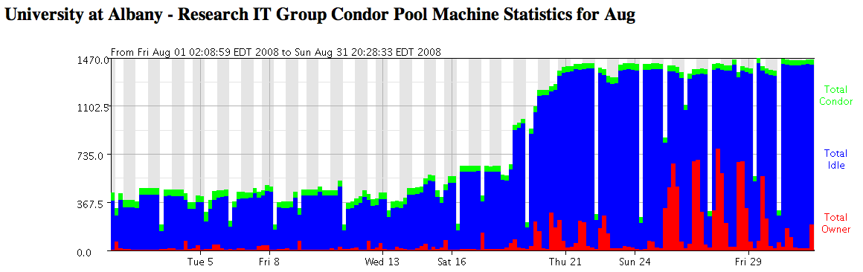
Other Campus Grids
  Other Large Campus Pools
    Purdue –14,000 slots (Led by US-CMS Tier-2).
    GLOW in Wisconsin (Also US-CMS leadership).
    FermiGrid (Multiple Experiments as stakeholders).
    RIT and Albany have created +1,000 pools after CI-days in Albany in December 2007

Slide 37

Purdue is now condorizing the whole campus and soon the whole state
Their CI efforts are bringing them a lot of external funding
They provide great service to the local and national scientific communities
http://www.cs.wisc.edu/condor/PCW2007/presentations/cheeseman_Purdue_Condor_Week_2007.ppt

Slide 38
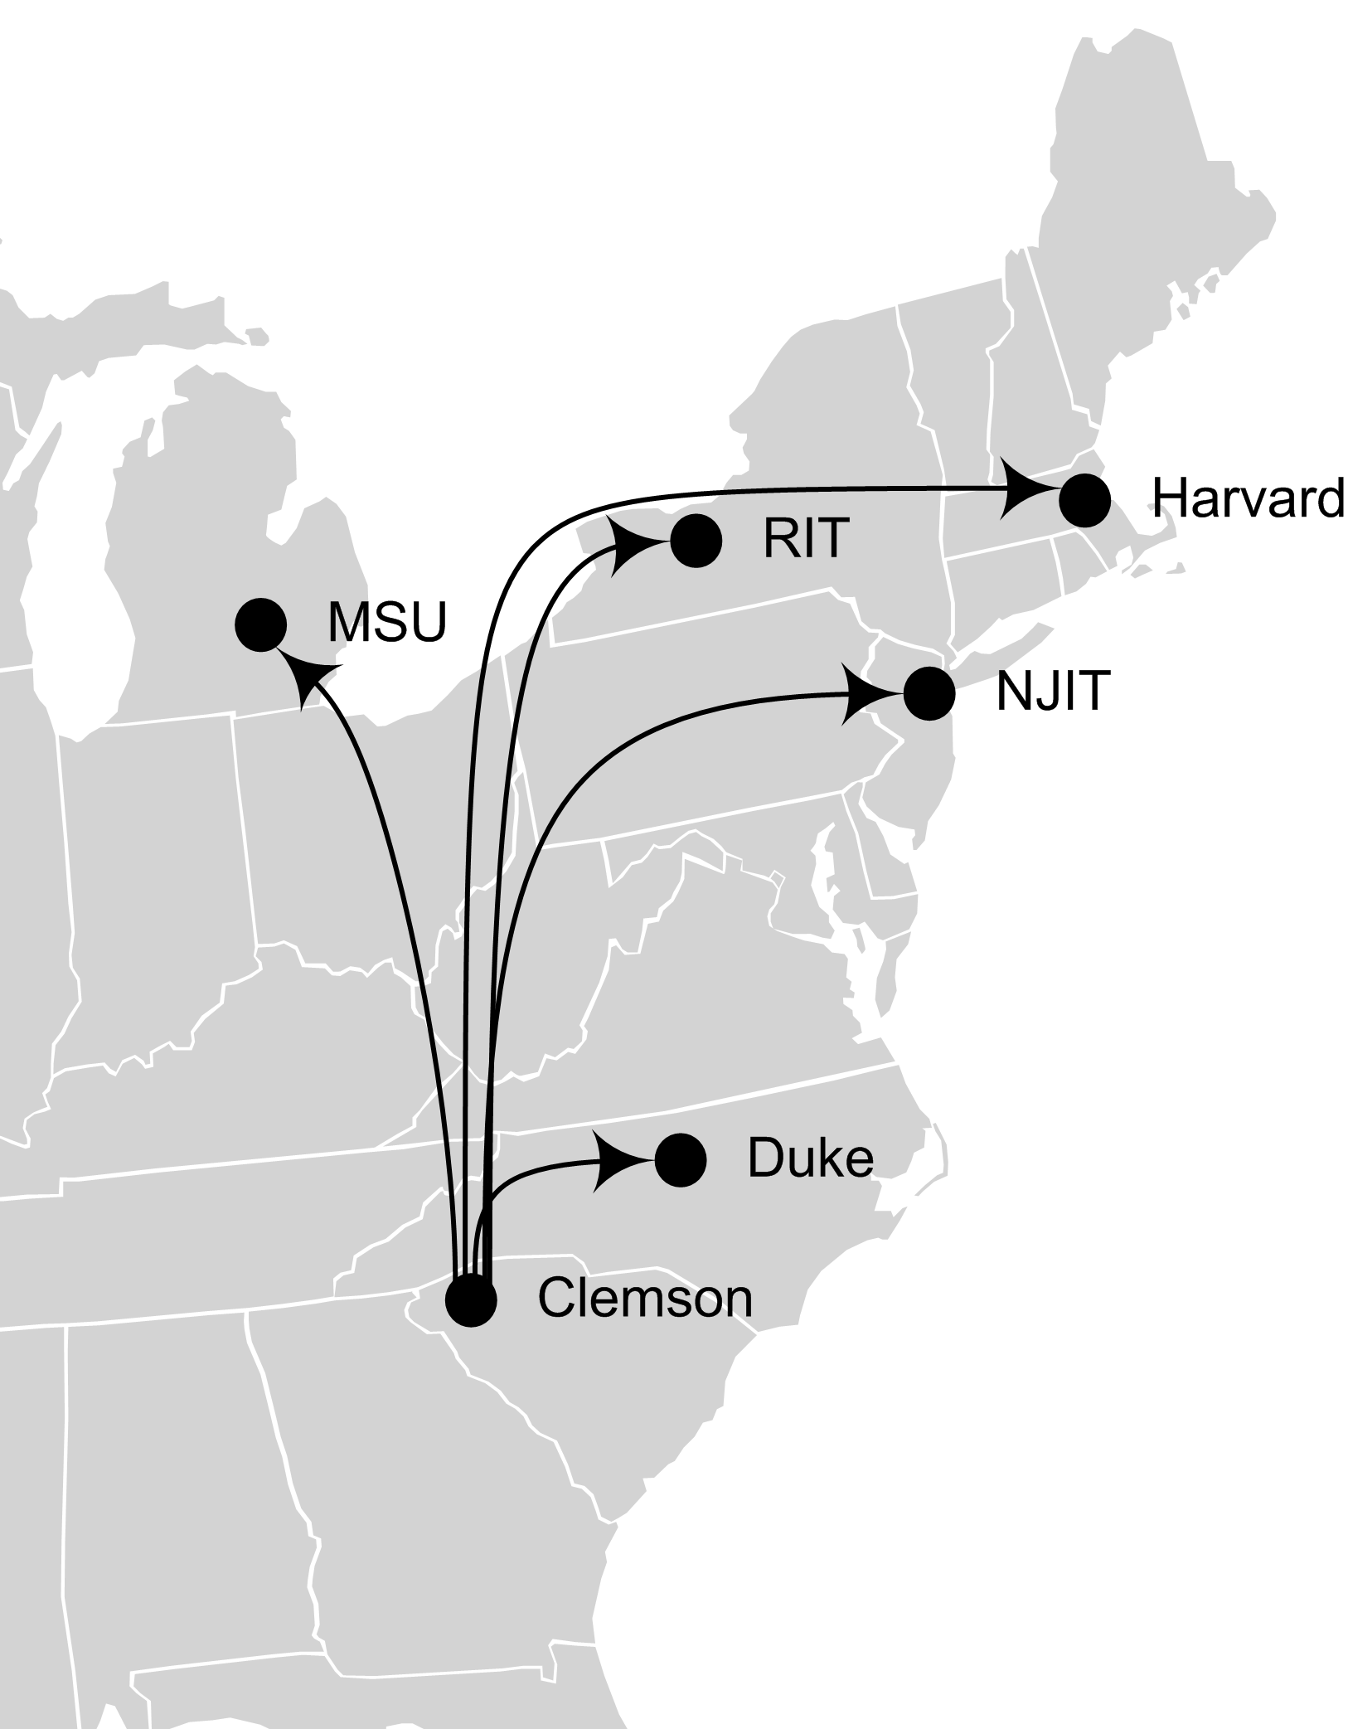
Campus Grid “levels”
    Small Grids (dpt size), University wide (instructional labs), Centralized resources (IT), Flocked resources.
    Trend towards Regional “Grids” (NWICG, NYSGRID,NJEDGE SURAGRID, LONI…) leverage OSG framework to access more resources and share there own resources.

Slide 39
Conclusions
Resources can be integrated into a cohesive unit a.k.a “GRID”
You have local knowledge to do it
You have local users who need it
You can persuade your administration that this is good
Others have done it with great results

Slide 40
E N D

