Slide 1


OSG Area Coordinators
Campus Infrastructures Update
Dan Fraser
Rob Gardner
May 8, 2013

Slide 2
OSG Campus Program
Focus on the Researcher (…or Artist)
  What can we do to increase the throughput of your computing?
Bosco (http://bosco.opensciencegrid.org )
  Help ease the motivated researcher into a distributed environment
    Make Bosco bullet proof
    Broadening the user base
    http://display.opensciencegrid.org
Campus Infrastructure Community
  Community building focal point
    Rob Gardner

Slide 3
Proposed Change for AC Meetings
Campus Infrastructure Community Report
  Rob Gardner
Bosco Report
  Dan Fraser

Slide 4
Bosco Plan (release ~quarterly)
Work on1.2 (April -> May, 2013)
  Focus on reliability, reducing annoyances
    Quickstart update recommendations from Miha
    Simplification for one installed cluster
  Scaling to 1000 submissions
Start on v1.3 (August)
  Gratia Accounting (integrated probe)
  SLURM support
  Native RPG package for Mac
  Additional features TBD

Slide 5
Bosco Developments
Market Interviews (Miha) showing that attracting “Joe the researcher” requires a new approach:
  Integrate with their research environments
  Little interest in learning anything else
Current use cases are more like Sam the System Expert:
  CMS submission without a gatekeeper.
  Pegasus HTPC workflow to XSEDE resources
Bosco invite sent to Condor list
  Results consistent with Market Analysis

Slide 6
Charting a new direction
Explore Bosco integration with “R”
  R is open source, seems straightforward to work with
  Claim ~2,000,000 users
  Multi-disciplinary capabilities (bio, analytics, ..)
Added value:
  Easily add resources to existing R user environments.
  Package would add a cluster And set up an R environment for distributed jobs.

Slide 7
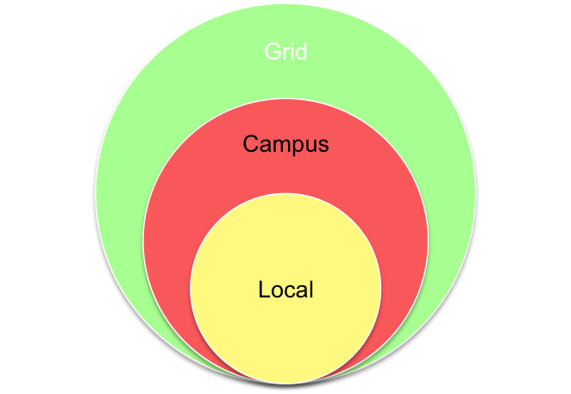
Campus HTC Infrastructure Direction
Help the researcher use local HTC resources
  Run on a local campus cluster
  Run on several local clusters
    Use local authentication credentials
Use/share resources with a
collaborator on another campus
Access to the national cyberinfrastructure
  OSG (and also XSEDE) resources
Submit Locally, Run Globally

