Slide 1
glideinWMS Training @ IU
Glidein startup Internals
and
Glidein configuration
by Igor Sfiligoi (UCSD)

Slide 2
Outline
Glidein_startup internals
Glidein lifetime
Security considerations

Slide 3


Refresher - What is a glidein?
A glidein is just a properly configured execution node submitted as a Grid job
Central manager
glidein
Execution node
Collector
glidein
Execution node
Submit node
Negotiator
Submit node
glidein
Execution node
Submit node
Execution node
glidein
Schedd
Startd
Job

Slide 4

Refresher – Glidein startup
glidein_startup configures and starts Condor
Configure
Condor G.N.
Submit node
Frontend node
Worker node
Monitor
Condor
Submit node
Frontend
glidein
Central manager
Startd
Match
CREAM
Job
Request
glideins
Factory node
glidein
Condor
Execution node
Globus
glidein
Factory
Execution node
Submit
glideins

Slide 5
glidein_startup Internals

Slide 6
glidein_startup tasks
Download scripts, parameters and Condor bins
Validate node (environment)
Configure Condor
Start Condor daemon(s)
Collect post-mortem monitoring info
Cleanup

Slide 7
Downloading files
Files downloaded via HTTP
  From both the factory and the frontend Web servers
  Can use local Web proxy (e.g. Squid)
  Mechanism tamper proof and cache coherent
Factory node
glidein_startup
HTTPd
Load files
from factory Web
Load files
from frontend Web
Run executables
Start Condor
Cleanup
Squid
Frontend node
Startd
HTTPd
Nothing will work
if HTTPd down!

Slide 8
URLs
All URLs passed to glidein_startup as arguments
  Factory Web server
  Frontend Web server
  Squid, if any
glidein_startup arguments defined by the factory
  Frontend Web URL passed to the Factory via request ClassAd

Slide 9
Cache coherence
Files never change, once uploaded to the Web area
If the source file changes, a file with a different name is created on the Web area
  Essentially fname.date
There is a (set of) logical to physical name map files
  *_file_list.id.lst
The names of the list files are in
  description.id.cfg
  The id of this list is passed as an argument to glidein_startup
Frontend ids
passed to the
factory via ClassAd

Slide 10
Making the download tamper proof
Verifying SHA1 hashes
  Each file has a SHA1 associated with it
The hashes delivered in a single file
  signature.id.sha1
  List of (fname,hash) pairs
Signature file id in the description file
The hash of the signature file a parameter of glidein_startup
  This is guaranteed to be secure with GRAM
Description file hash in the signature file
  Still safe even if loaded out of order
Frontend hash
passed to
the factory
via ClassAd

Slide 11
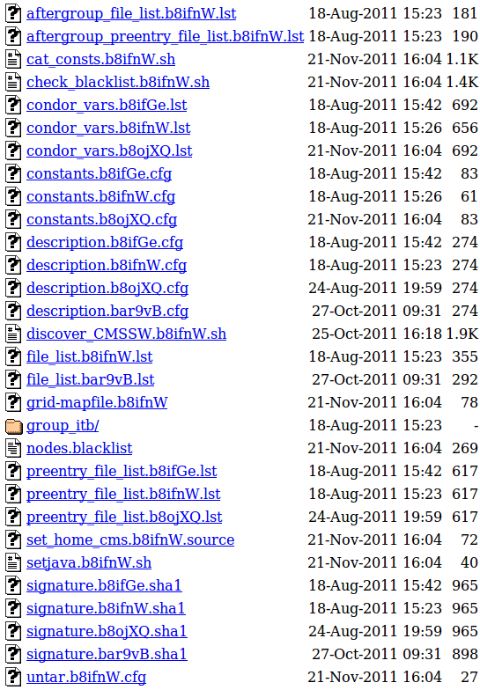
Example Web area
Frontend
Factory
Globus
glidein_startup
.
.
.
.
.
.

Slide 12
Node validation
Run scripts / plugins provided by both factory and frontend
  The map file has a flag to distinguish
  scripts from “regular” files
If a script returns with exit_code !=0, glidein_startup stops execution
  Condor never started → no user jobs ever pulled
  Will sleep for 20 mins → blackhole protection
# Outfile InFile Exec/other
#########################################################
constants.cfg constants.b8ifnW.cfg regular
cat_consts.sh cat_consts.b8ifnW.sh exec
set_home_cms.source set_home_cms.b8ifnW.source wrapper

Slide 13
Condor configuration
Condor config values coming from files downloaded by glidein_startup
  Static from both factory and frontend config files
  More details at http://tinyurl.com/glideinWMS/doc.prd/factory/custom_vars.html
Scripts can add, alter or delete any attribute
  Based on dynamic information
  Either discovered on the WN
  or by combining info from various sources
  More details at http://tinyurl.com/glideinWMS/doc.prd/factory/custom_scripts.html

Slide 14
Example (pseudo-)script
# check if CMSSW installed locally
if [ -f "$CMSSW" ]; then
# get the other env
source "$CMSSW"
else
# fail validation
echo "CMSSW not found!\n" 1>&2
exit 1
fi
# publish to Condor
add_config_line "CMSSW_LIST" "$CMS_SW_LIST"
add_condor_vars_line "CMSSW_LIST" "S" "-" "+" "Y" "Y" "-"
# if I got here, passed validation
exit 0
More details at http://tinyurl.com/glideinWMS/doc.prd/factory/custom_scripts.html

Slide 15
Example Frontend attr
START expression
  As GLIDECLIENT_Group_Start
  Automatically && with Factory provided one
GLIDECLIENT_Group_Start =
(stringListMember(GLIDEIN_SEs,
DESIRED_SEs)=?=True) ||
(stringListMember(GLIDEIN_Site,
DESIRED_Sites=?=True))
More details at http://tinyurl.com/glideinWMS/doc.prd/factory/custom_vars.html

Slide 16
Condor startup
After validation and configuration,
glidein just start condor_master
  Which in turn start condor_startd
It is just regular Condor from here on
  Any policy the VO needs must be part of Condor configuration
Central manager
Submit node
Execution node
Schedd
Collector
glidein_startup
Negotiator
Startd

Slide 17
Post mortem monitoring
After a glidein terminates, the logs are sent back to the Factory
Frontend does not have access to them
  Work in progress for future glideinWMS release
  For now, ask Factory admins if debugging

Slide 18
Cleanup
glidein_startup will remove all files before terminating
  Unless killed by the OS, of course
  Condor does something similar for the user jobs disk area after every job
Users should not expect anything to survive their jobs

Slide 19
Glidein lifetime

Slide 20
Glidein lifetime
Glideins are temporary resources
  Must go away after some time
We want them to go away by their own will
  So we can monitor progress and clean up
  As opposed to being killed by Grid batch system
Condor daemons configured to
die by themselves
  Just need to tell them when

Slide 21
Limiting glidein lifetime
Hard End-of-Life deadline
  Condor will terminate if it is ever reached
  Any jobs running at that point in time will be killed
    Resulting in waste
Deadline site specific
  Set by the Factory
  Controlled by GLIDEIN_Max_Walltime
Condor advertises it in the glidein ClassAd
  Attribute GLIDEIN_ToDie

Slide 22
Deadline for job startup
Starting jobs just to kill them wasteful
  Glideins set an earlier deadline for job startup
  After the deadline, Condor will terminate at job end
  Advertised as GLIDEIN_TORETIRE
Need to know how long is the expected job lifetime
  Should be provided by the Frontend
  Parameter GLIDEIN_Job_Max_Time
  ToRetire=Max_Walltime-Job_Max_Time
Default exists but
don't count on it

Slide 23
Termination due to non-use
glideins will self-terminate if not used, too
  To limit waste
Reasons for hitting this
  No more user jobs (spikes)
  Policy problems (Frontend vs Negotiator)
Typically uniform across the Condor pool
  Can be set by either Frontend or Factory
  Controlled by GLIDEIN_Max_Idle
  Defaults to 20 mins
To give Negotiator
the time to match
the glidein

Slide 24
Finer grained policies
Job_Max_Time is the typical expected job lifetime
  What if not all jobs have the same lifetime?
Use Condor matchmaking to define finer grained policies
  To prevent long jobs from starting if they are expected to be killed before terminating
  This allows (lower priority) shorter jobs to use the CPU
  Or waste just 20 mins (instead of hours)
Job lifetime can be difficult to know
  Even users often don't know
  Can refine after restarts (assuming they are deterministic)

Slide 25
Example START expression
Have two different thresholds
  One for first startup, one for all following
  Useful when wide dynamic range, unpredictable
GLIDECLIENT_Start =
ifthenelse(
LastVacateTime=?=UNDEFINED,
NormMaxWallTime < (GLIDEIN_ToDie-MyCurrentTime),
MaxWallTime < (GLIDEIN_ToDie-MyCurrentTime)
)

Slide 26
Other sources of waste
Glideins must stay within the limits of the resource lease
  Typical limit is on memory usage
  OSG Factory defines GLIDEIN_MaxMemMBs
If user jobs exceed that limit, the glideins may be killed by the resource provider
(e.g. Grid batch system)
  Resulting in the user job being killed, too
  Thus waste

Slide 27
Example START expression
Prevent startup of jobs that are known to use too much memory
  Unless user defines it, known only at 2nd re-run
Also kill jobs as soon as they pass that
  So we don't have to start a new glidein for other jobs
GLIDECLIENT_Start =
ImageSize<=(GLIDEIN_MaxMemMBs*1024)
PREEMPT =
ImageSize>(GLIDEIN_MaxMemMBs*1024)
More details at http://research.cs.wisc.edu/condor/manual/v7.6/10_Appendix_A.html#82447

Slide 28
Security considerations

Slide 29
Talking to the rest of Condor
Glideins will talk over WAN to the rest of Condor
  Strong security a must
Collector and glidein must whitelist each other
Schedd and glidein trusted indirectly
  Security token through Collector
Central manager
Collector
Negotiator
Submit node
Execution node
WAN
Schedd
glidein_startup
Startd

Slide 30
Multi User Pilot Jobs
A glidein typically starts with a proxy that is not representing a specific user
  Very few exceptions (e.g. CMS Organized Reco)
Three potential security issues:
  Site does not know who the final user is
  (and thus cannot ban specific users, if needed)
  If 2 glideins land on the same node, 2 users may be running as the same UID (no system protection)
  User and pilot code run as the same UID (no system protection)

Slide 31
glexec
We have one tool that can help us with all 3
  Namely glexec
glexec provides UID switching
  But must be installed by the Site on WNs
  Only a subset of sites have done it so far
glexec requires a valid proxy from the final users on the submit node
  Or jobs will not match
  Not a problem for long time Grid users, like CMS, but it may be for other VOs

Slide 32


glexec in a picture
Legend
Central manager
Pilot UID
Collector
User UID
Submit node
Negotiator
Submit node
Execution node
Submit node
glidein
Schedd
Startd
glexec
Job

Slide 33
glexec, cont
It is in VO best interest to use glexec
  Only way to have a secure MUPJ system
  Should push sites to deploy it
Some sites require glexec for their own interest
  To cryptographically know who the final users are
  To easily ban users
Note on site banning
  Condor currently does not handle well glexec failures – VO admin must look for this
May be a legal
requirement

Slide 34
Turning on glexec
Factory provides information about glexec installation at site
  Attribute GLEXEC_BIN = NONE | OSG | glite
Frontend decides if it should be used
  Parameter GLIDEIN_Glexec_Use
  Possible values:
    NEVER - Do not use, even if available
    OPTIONAL - Use whenever available
    REQUIRED - Only use sites that provide glexec

Slide 35
THE END

Slide 36
Pointers
The official project Web page is
http://tinyurl.com/glideinWMS
glideinWMS development team is reachable at
glideinwms-support@fnal.gov
CMS AnaOps Frontend at UCSD
http://glidein-collector.t2.ucsd.edu:8319/vofrontend/monitor/frontend_UCSD-v5_2/frontendStatus.html

Slide 37
Acknowledgments
The glideinWMS is a CMS-led project developed mostly at FNAL, with contributions from UCSD and ISI
The glideinWMS factory operations at UCSD is sponsored by OSG
The funding comes from NSF, DOE and the UC system

