Slide 1
Where to go and what to do next — OSG, resources, help, mentors
Thursday afternoon, 4:30pm
Jim Weichel <jweichel@fnal.gov>
OSG Special Projects
Fermi National Laboratory, University of Florida

Slide 2
Open Science Grid
We are a community and people are available to help do science with DHTC
A consortium of users, resource providers, and software providers
We are Open – available to people to use resources, contribute resources, contribute solutions and software, form virtual organizations ….
  Members maintain local authority on their resources
  Interwork with EGI (Europe), NGDF (Nordic), TeraGrid (US)

Slide 3
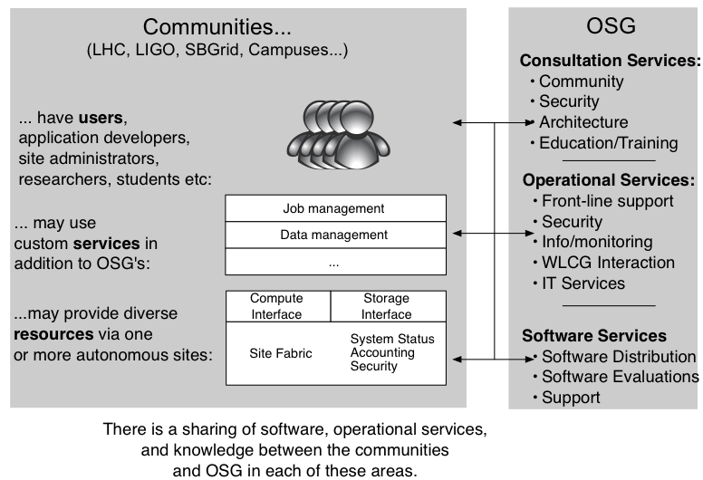
OSG

Slide 4
OSG Facts
~70,000 cores accessible
~29 Petabytes addressable storage
Move 0.6 Petabytes/day, peaks 1.2 PB
Users consume >1.3M CPU hours/day
~400,000 hours/day are opportunistic
Includes 9 campus grids

Slide 5
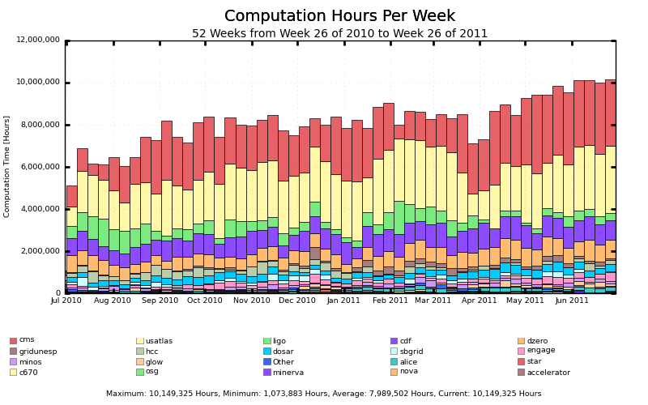
OSG Usage

Slide 6
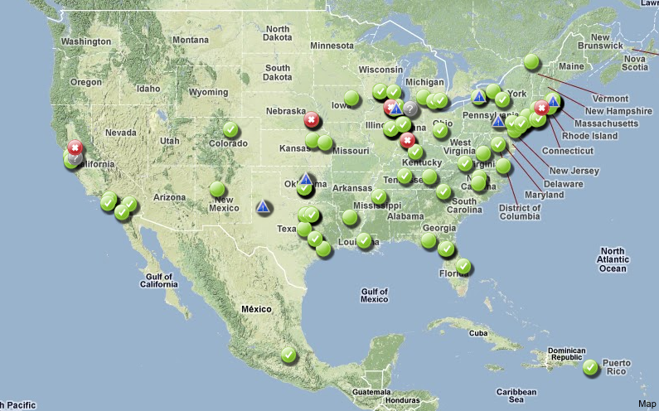
OSG in North America

Slide 7
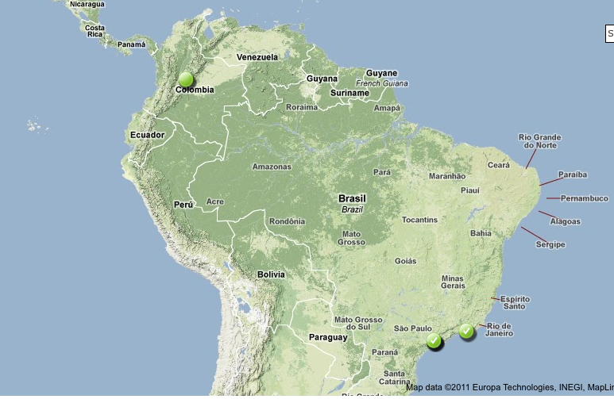
OSG in South America

Slide 8
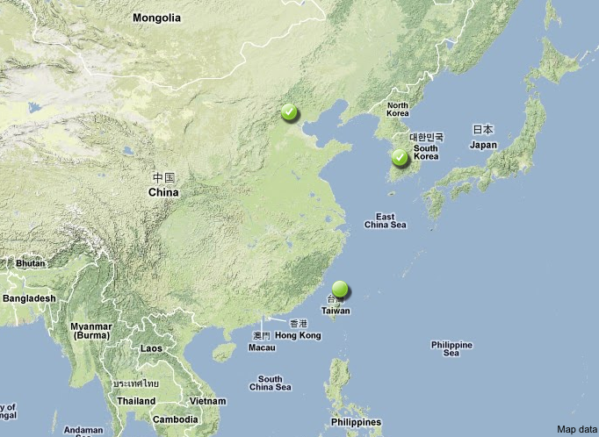
OSG in Asia

Slide 9
For Universities – Campus Grids
Enable campuses to distribute workloads throughout the campus and to OSG
  Campus credentials for campus access, grid credentials enable OSG access with same job submission framework
Uses
  Condor Flocking
  Campus Factory Overlay using glideins
Email: campusgrids@fnal.gov
Info: https://twiki.grid.iu.edu/bin/view/CampusGrids/WebHome

Slide 10
Keep in Contact
TG11 – more later
All Hands Meeting (AHM) – Mar 19-22 in Lincoln, NE – Participate in a session highlighting your work and use of HTC
Condor Week – May 1-4 in Madison
Subscribe to iSGTW for interesting updates on science using distributed computing – www.isgtw.org
Mentors – more later

Slide 11
Final Assignment
Write how you will apply what your learned this week to your science/computational problem.
  Due: End of July
  Send to: Tim cat@cs.wisc.edu, copy your Mentor
  https://twiki.grid.iu.edu/bin/view/Education/OSGSS2011Assignment
Might leverage this to make a poster for TG11
  Poster becomes the assignment
  Contact Laura McGinnis lfm@psc.edu by July 8th, copy Tim, Jim, and Mentor
  Maximum 4’ x 4’ poster

Slide 12
TG11
July 17-22, 2011
Exciting Technology and Science Program
  July 17-22, 2011, Salt Lake City
  https://www.teragrid.org/web/tg11/program/schedule
Many of you are attending & I will also, including tutorials on Monday
  We can meet for dinner on Monday night
  Or arrange to meet at the reception Tuesday

Slide 13
Mentors
Each of you will have a Mentor
  Mentor should work with you on how he can best help
    Use email, periodic phone call ….
    Mentor can help link you to the right person
    We plan a conference call in October with you and the mentors

Slide 14
Help When You Get Home
Mail Lists
  gridschool-2011@opensciencegrid.org will still exist
  vdt-support@opensciencegrid.org (software support)
  goc@opensciencegrid.org (operations center)
  sites@opensciencegrid.org (setting up sites)
Useful Websites
  www.cs.wisc.edu/condor Condor homepage
  www.cs.wisc.edu/condor/manual Condor manual
  www.opensciencegrid.org OSG homepage
  twiki.grid.iu.edu OSG Collaborative site/Documentation
  https://myosg.grid.iu.edu/about OSG Information Source (VOs, Resource Status, Status map, Usage, etc.)
People and Mentors

Slide 15
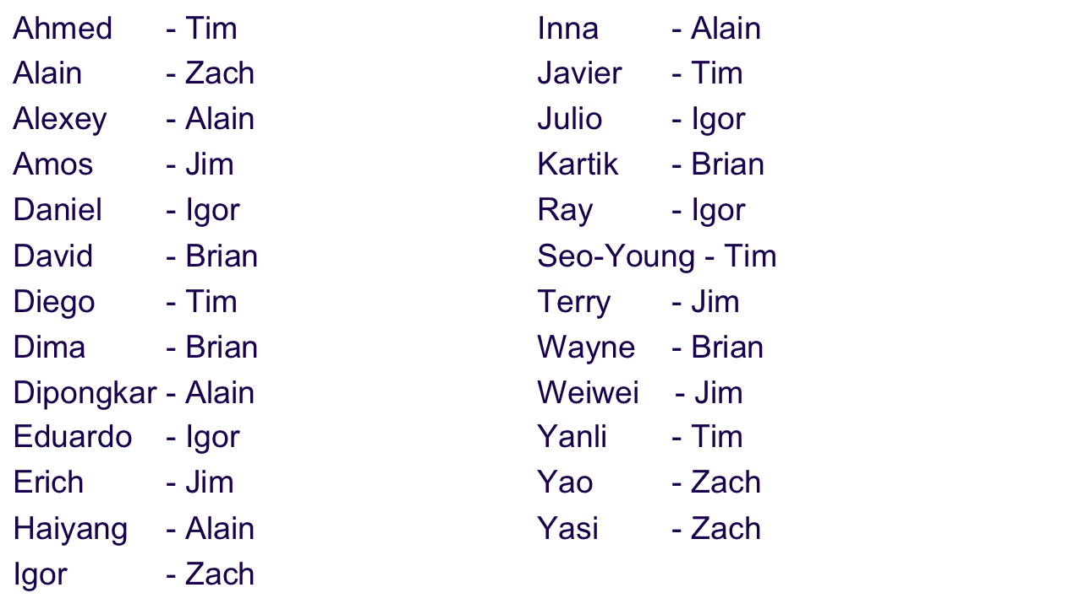
Mentor Assignments
Also in Student List: https://twiki.grid.iu.edu/bin/view/Education/OSGSS2011Students

Slide 16
We hope you enjoyed the learning!
Please continue to work with us
  Do and/or support research
  Use our software
  Use our resources
  Contribute to our collaboration and team
We look forward to supplying new solutions based on your needs

Slide 17
Questions?
Questions? Comments?
  My contact info:
  Jim, jweichel@fnal.gov, jdweichel on AIM, jweichel on Skype

