Slide 1
Welcome & Performance Primer
August 9th 2011, OSG Site Admin Workshop
Jason Zurawski – Internet2 Research Liaison

Slide 2

Who are we, Who are you?
<number> – 11/08/26, © 2011 Internet2

Slide 3
Agenda
Welcome and Thanks
  http://www.internet2.edu/workshops/npw/roster/neren.cfm
Tutorial Agenda:
  Network Performance Primer - Why Should We Care? (30 Mins)
  Introduction to Measurement Tools (20 Mins)
  Use of NTP for network measurements (15 Mins)
  Use of the BWCTL Server and Client (25 Mins)
  Use of the OWAMP Server and Client (25 Mins)
  Use of the NDT Server and Client (25 Mins)
  perfSONAR Topics (30 Mins)
  Diagnostics vs Regular Monitoring (20 Mins)
  Use Cases (30 Mins)
  Exercises
<number> – 11/08/26, © 2011 Internet2

Slide 4
Your Goals?
What are your goals for this workshop?
  Experiencing performance problems?
  Responsible for the campus/lab network?
  Learning about state of the art, e.g. ‘What is perfSONAR’?
  Developing or researching performance tools?
Is there a Magic Bullet?
  No, but we can give you access to strategies and tools that will help
  Patience and diligence will get you to most goals
This workshop is as much a learning experience for me as it is for you
  What problem/problems need to be solved
  What will make networking a less painful experience
  How can we improve our goods/services
<number> – 11/08/26, © 2011 Internet2

Slide 5
Problem: “The Network Is Broken”
How can your users effectively report problems?
  And how can you learn to take them seriously…
How can users and the local administrators effectively solve multi-domain problems?
  Eliminate the ‘who you know’ network to finding resources
  Automate things when applicable
Components:
  Tools to use
  Questions to ask
  Methodology to follow
  How to ask for (and receive) help
<number> – 11/08/26, © 2011 Internet2

Slide 6
Motivation
Proactive vs Reactive Positions
  Do you want to find problems before the users do?
  Can monitoring tools help in other aspects of operations?
    Capacity Planning
    Scheduling Maintenance
    Traffic Engineering
Automatic user response: “The Network is broken”
  Is this justified behavior?
    In actuality, there is a lot of “network” between the applications
    What about those applications?
    What about the host itself?
Lets try to put this into an example …
<number> – 11/08/26, © 2011 Internet2

Slide 7
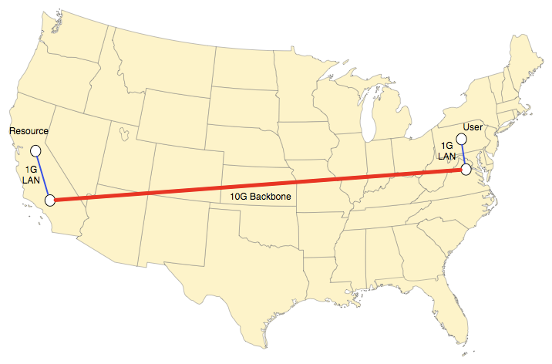
Motivation – A Typical Scenario
User and resource are geographically separated
  Common case: Remote instrument + distributed users
Both have access to high speed communication network
  LAN infrastructure - 1Gbps Ethernet
  WAN infrastructure – 10Gbps Optical Backbone
<number> – 11/08/26, © 2011 Internet2
Notes:
Example is meant to illustrate that there are many things that can (and do) go wrong for a user using the network. Unless the user (and operators) are educated, there will be a lot of tail chasing.

Slide 8
Motivation – A Typical Scenario
User wants to access a file at the resource (e.g. ~600MB)
Plans to use COTS tools (e.g. “scp”, but could easily be something scientific like “GridFTP” or simple like a web browser)
What are the expectations?
  1Gbps network (e.g. bottleneck speed on the LAN)
  600MB * 8 = 4,800 Mb file
  User expects line rate, e.g. 4,800 Mb / 1000 Mbps = 4.8 Seconds
  Audience Poll: Is this expectation too high?
What are the realities?
  Congestion and other network performance factors
  Host performance
  Protocol Performance
  Application performance
<number> – 11/08/26, © 2011 Internet2

Slide 9

Motivation – A Typical Scenario
Real Example (New York USA to Los Angeles USA):
1MB/s (8Mb/s) ??? 10 Minutes to transfer???
Seems unreasonable given the investment in technology
  Backbone network
  High speed LAN
  Capable hosts
Performance realities as network speed decreases:
  100 Mbps Speed – 48 Seconds
  10 Mbps Speed – 8 Minutes
  1 Mbps Speed – 80 Minutes
How could this happen? More importantly, why are there not more complaints?
Audience Poll: Would you complain? If so, to whom?
Brainstorming the above – where should we look to fix this?
<number> – 11/08/26, © 2011 Internet2
Notes:
Brainstorming:
- Host status, is configured properly
- Local network, is it congested? Are the monitoring numbers (if there are monitoring numbers) indicating congestion, loss, asymmetric routing?
- Ditto for the WAN
- After we debug all of the networked components (software and hardware) … what else is there?
APPLICATION!

Slide 10
Motivation – A Typical Scenario
Expectation does not even come close to experience, time to debug. Where to start though?
  Application
    Have other users reported problems? Is this the most up to date version?
  Protocol
    Protocols typically can be tuned on an individual basis, consult your operating system.
  Host
    Are the hardware components (network card, system internals) and software (drivers, operating system) functioning as they should be?
  LAN Networks
    Consult with the local administrators on status and potential choke points
  Backbone Network
    Consult the administrators at remote locations on status and potential choke points (Caveat – do you [should you] know who they are?)
<number> – 11/08/26, © 2011 Internet2
Notes:
List out the possible areas. To examine. There are others, but these are the major ones.

Slide 11
Motivation – A Typical Scenario
Following through on the previous, what normally happens …
  Application
    This step is normally skipped, the application designer will blame the network
  Protocol
    These settings may not be explored. Shouldn’t this be automatic (e.g. autotuning)?
  Host
    Checking and diagnostic steps normally stop after establishing connectivity. E.g. “can I ping the other side”
  LAN Networks
    Will assure “internal” performance, but LAN administrators will ignore most user complaints and shift blame to upstream sources. E.g. “our network is fine, there are no complaints”
  Backbone Network
    Will assure “internal” performance, but Backbone responsibilities normally stop at the demarcation point, blame is shifted to other networks up and down stream
* Denotes Problem Areas from Example
<number> – 11/08/26, © 2011 Internet2
Notes:
Don’t be too hard on the application developers, but this is a common response. Their view is that the network should just ‘work’ even if they are delving into the protocol stack on the host side. Once you start touching the OSI layer, you need to be very careful about the interactions.

Slide 12
Why Worry About Network Performance?
Most network design lends itself to the introduction of flaws:
  Heterogeneous equipment
  Cost factors heavily into design – e.g. Get what you pay for
  Design heavily favors protection and availability over performance
Communication protocols are not advancing as fast as networks
  TCP/IP is the king of the protocol stack
    Guarantees reliable transfers
    Adjusts to failures in the network
    Adjusts speed to be fair for all
User Expectations
  Big Science is prevalent globally
  “The Network is Slow/Broken” – is this the response to almost any problem? Hardware? Software?
  Empower users to be more informed/more helpful
<number> – 11/08/26, © 2011 Internet2

Slide 13
“Big” Science
A Few words on the LHC
  17 Mile Circumference “ring” in Switzerland/France
  Collide opposing beams of particles (3.5 TeV each – 7TeV collision)
  “Detectors” are present to gather data on the collision (ALICE, ATLAS, CMS, LHCb)
  Data is stored at CERN (Tier0), and distributed world wide to other Tiers (1, 2, 3) for processing and analysis
    Different types of data, Raw + several kinds of processed data to find areas of interest.
    N.B. even the raw data doesn’t capture anything – the machine would produce 1PB (!) of data, per second (!!), if it was unfiltered
    Typical processed data set (2011) = 10 – 100 TB.
  Tier1s receive and distribute data to Tier2s, Tier2s do the same for Tier3s
  Each Tier contains storage and processing software/hardware.
    Goal is to get the data to the lowest tier within 4 hours (!)
<number> – 11/08/26, © 2011 Internet2

Slide 14
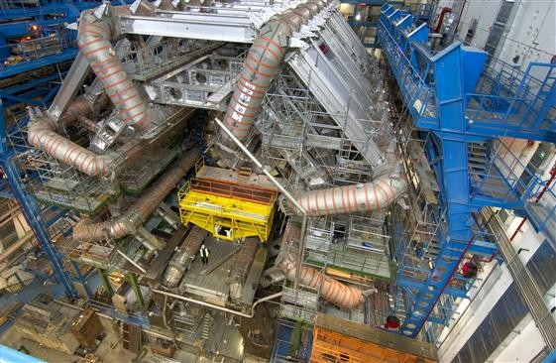
“Big” Science – ATLAS Detector
<number> – 11/08/26, © 2011 Internet2

Slide 15
Why is Science Data Movement Different?
Different Requirements
  Campus network is not designed for large flows
    Enterprise requirements
    100s of Mbits is common, any more is rare (or viewed as strange)
    Firewalls
    Network is designed to mitigate the risks since the common hardware (e.g. Desktops and Laptops) are un-trusted
  Science is different
    Network needs to be robust and stable (e.g. predictable performance)
    10s of Gbits of traffic (N.B. that its probably not sustained – but could be)
    Sensitive to enterprise protections (e.g. firewalls, LAN design)
Fixing is not easy
  Design the base network for science, attach the enterprise on the side (expensive, time consuming, and good luck convincing your campus this is necessary…)
  Mitigate the problems by moving your science equipment to the edge
    Try to bypass that firewall at all costs
    Get as close to the WAN connection as you can
<number> – 11/08/26, © 2011 Internet2

Slide 16
Identifying Common Network Problems
The above examples paint a broad picture: there is a problem, somewhere, that needs to be fixed
What could be out there?
  Architecture
  Common Problems, e.g. “Soft Failures”
Myths and Pitfalls
  Getting trapped is easy
  Following a bad lead is easy too
<number> – 11/08/26, © 2011 Internet2

Slide 17
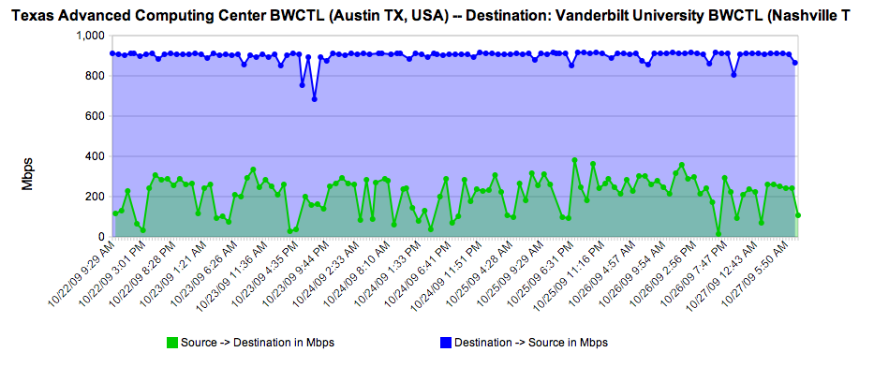
Identifying Common Network Problems
Audience Question: Would you complain if you knew what you were getting was not correct?
N.B. Actual performance between Vanderbilt University and TACC – Should be about 1Gbps in both directions.
<number> – 11/08/26, © 2011 Internet2

Slide 18
Identifying Common Network Problems
Internet2/ESnet engineers will help members and customers debug problems if they are escalated to us
  Goal is to solve the entire problem – end to end
  Involves many parties (typical: End users as well as Campus, Regional, Backbone staff)
  Slow process of locating and testing each segment in the path
  Have tools to make our job easier (more on this later)
Common themes and patterns for almost every debugging exercise emerge
  Architecture (e.g. LAN design, Equipment Choice, Firewalls)
  Configuration
  “Soft Failures”, e.g. something that doesn’t severe connectivity, but makes the experience unpleasant
<number> – 11/08/26, © 2011 Internet2

Slide 19
Architectural Considerations
LAN vs WAN Design
  Multiple Gbit flows [to the outside] should be close to the WAN connection
  Eliminate the number of hops/devices/physical wires that may slow you down
  Great performance on the LAN != Great performance on the WAN
You Get What you Pay For
  Cheap equipment will let you down
  Network
    Small Buffers, questionable performance (e.g. internal switching fabric can’t keep up w/ LAN demand let alone WAN)
    Lack of diagnostic tools (SNMP, etc.)
  Storage
    Disk throughput needs to be high enough to get everything on to the network
    Plunking a load of disk into an incapable server is not great either
      Bus performance
      Network Card(s)
<number> – 11/08/26, © 2011 Internet2

Slide 20
Architectural Considerations – cont.
Firewalls
  Designed to stop traffic
    read this slowly a couple of times…
  Small buffers
    Concerned with protecting the network, not impacting your performance
  Will be a lot slower than the original wire speed
  A “10G Firewall” may handle 1 flow close to 10G, doubtful that it can handle a couple.
  If firewall-like functionality is a must – consider using router filters instead
<number> – 11/08/26, © 2011 Internet2

Slide 21
Configuration
Host Configuration
  Tune your hosts (especially compute/storage!)
  Changes to several parameters can yield 4 – 10X improvement
  Takes minutes to implement/test
  Instructions: http://fasterdata.es.net/tuning.html
Network Switch/Router Configuration
  Out of the box configuration may include small buffers
  Competing Goals: Video/Audio etc. needs small buffers to remain responsive. Science flows need large buffers to push more data into the network.
  Read your manuals and test LAN host to a WAN host to verify (not LAN to LAN).
<number> – 11/08/26, © 2011 Internet2

Slide 22
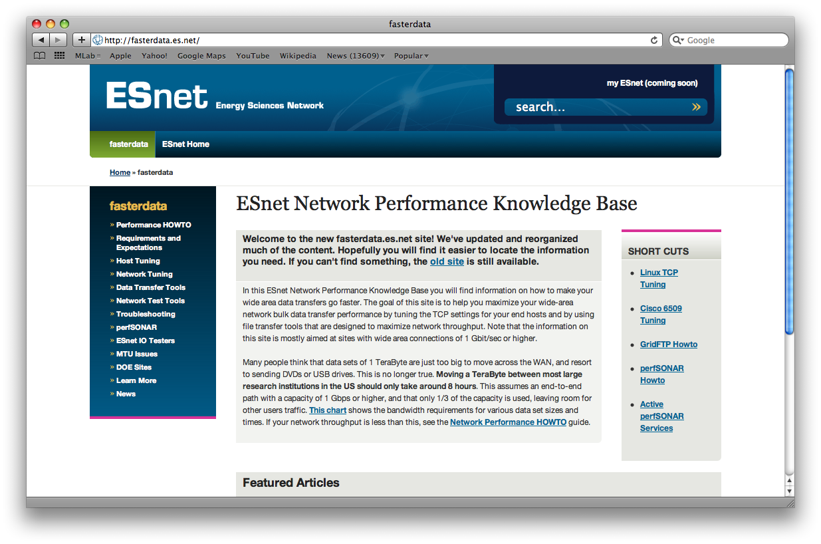
Host Configuration
<number> – 11/08/26, © 2011 Internet2

Slide 23
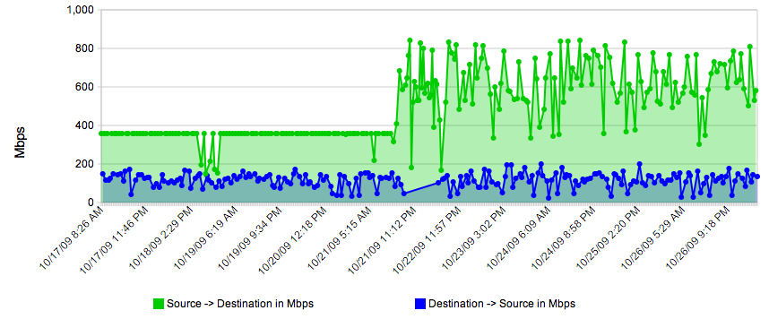
Configuration – cont.
Host Configuration – spot when the settings were tweaked…
N.B. Example Taken from REDDnet (UMich to TACC), using BWCTL measurement)
<number> – 11/08/26, © 2011 Internet2

Slide 24
Soft Failures
Soft Failures are any network problem that does not result in a loss of connectivity
  Slows down a connection
  Hard to diagnose and find
  May go unnoticed by LAN users in some cases, but remote users may be the ones complaining
    Caveat – How much time/energy do you put into listing to complaints of remote users?
Common:
  Dirty or Crimped Cables
  Failing Optics/Interfaces
  [Router] Process Switching, aka “Punting”
  Router Configuration (Buffers/Queues)
<number> – 11/08/26, © 2011 Internet2

Slide 25
Soft Failures – cont.
Dirty or Crimped Cables and Failing Optics/Interfaces
  Throw off very low levels of loss – may not notice on a LAN, will notice on the WAN
  Will be detected with passive tools (e.g. SNMP monitoring)
  Question: Would you fix it if you knew it was broken?
[Router] Process Switching
  “Punt” traffic to a slow path
  Duplicate traffic onto multiple paths
Router Configuration (Buffers/Queues)
  Need to be large enough to handle science flows
  Routing table overflow (e.g. system crawls to a halt when memory is exhausted)
<number> – 11/08/26, © 2011 Internet2

Slide 26
Myths and Pitfalls
“My LAN performance is great, WAN is probably the same”
  TCP recovers from loss/congestion quickly on the LAN (low RTT)
  TCP will cut speed in half for every loss/discard on the WAN – will take a long time to recover for a large RTT/
  Small levels of loss on the LAN (ex. 1/1000 packets) will go unnoticed, will be very noticeable on the WAN.
“Ping is not showing loss/latency differences”
  ICMP May be blocked/ignored by some sites
  Routers process ICMP differently than other packets (e.g. may show phantom delay)
  ICMP may hide some (not all) loss.
  Will not show asymmetric routing delays (e.g. taking a different path on send vs receive)
Our goal is to dispel these and others by educating the proper way to verify a network – we have lots of tools at our disposal but using these in the appropriate order is necessary too
<number> – 11/08/26, © 2011 Internet2

Slide 27
Topics of Discussion in this Workshop
Diagnosis Methodology
Partial Path Decomposition
Systematic Troubleshooting
On Demand vs Regular Testing
<number> – 11/08/26, © 2011 Internet2

Slide 28
Topics of Discussion
Diagnosis Methodology
  Find a measurement server “near me”
    Why is this important?
    How hard is this to do?
  Encourage user to participate in diagnosis procedures
  Detect and report common faults in a manner that can be shared with admins/NOC
    ‘Proof’ goes a long way
  Provide a mechanism for admins to review test results
  Provide feedback to user to ensure problems are resolved
<number> – 11/08/26, © 2011 Internet2

Slide 29
Topics of Discussion – cont.
Partial Path Decomposition
  Networking is increasingly:
    Cross domain
    Large scale
    Data intensive
  Identification of the end-to-end path is key (must solve the problem end to end…)
  Discover measurement nodes that are “near” this path
  Provide proper authentication or receive limited authority to run tests
    No more conference calls between 5 networks, in the middle of the night
  Initiate tests between various nodes
  Retrieve and store test data for further analysis
<number> – 11/08/26, © 2011 Internet2

Slide 30
Topics of Discussion – cont.
Systematic Troubleshooting
  Having tools deployed (along the entire path) to enable adequate troubleshooting
  Getting end-users involved in the testing
  Combining output from multiple tools to understand problem
    Correlating diverse data sets – only way to understand complex problems.
  Ensuring that results are adequately documented for later review
On Demand vs Regular Testing
  On-Demand testing can help solve existing problems once they occur
  Regular performance monitoring can quickly identify and locate problems before users complain
    Alarms
    Anomaly detection
  Testing and measuring performance increases the value of the network to all participants
<number> – 11/08/26, © 2011 Internet2

Slide 31
Our Goals
To spread the word that today’s networks really can, do, and will support demanding applications
  Science
    Physics
      LHC, LIGO
    Astronomy
      LSST, SDSS, eVLBI
    Biology and Climate
      Genome Sequencing, Weather simulations, remote senors
  Arts and Humanities
    Distance learning, synchronized performance
  Computational and Network Research
    DYNES, GENI, MeasurementLab, etc.
To increase the number of test points
  Instrumenting the end to end path is key
  Spread the knowledge and encourage adoption
<number> – 11/08/26, © 2011 Internet2

Slide 32
Final Thoughts
See a talk from the recent Joint Techs Conference:
  http://www.internet2.edu/presentations/jt2010july/20100714-metzger-whatnext.pdf
Take home points:
  Close to $1 Billion USD spent on networking at all levels (Campus, Regional, Backbone) in the next 2 years due to ARRA Funding
  Unprecedented access and capacity for many people
  Ideal View:
    Changes will be seamless
    Completed on time
    Bandwidth will solve all performance problems
  Realistic View:
    Network ‘breaks’ when it is touched (e.g. new equipment, configs)
    Optimization will not be done in a global fashion (e.g. backbone fixes performance, but what about regional and campus?)
    Bandwidth means nothing when you have a serious performance problem
<number> – 11/08/26, © 2011 Internet2

Slide 33
Welcome & Performance Primer
August 9th 2011, OSG Site Admin Workshop
Jason Zurawski – Internet2 Research Liaison
For more information, visit http://www.internet2.edu/workshops/npw
<number> – 11/08/26, © 2011 Internet2

