Slide 1
OSG
Area Coordinator’s Report:
Workload Management
June 3rd, 2010
Maxim Potekhin
BNL
631-344-3621
potekhin@bnl.gov

Slide 2
Workload Management: Overview
Areas of Activity: ITB, Engagement , upgrade of Panda monitoring
Current Initiatives
  Panda/ITB:
    Continued use of “ITB robot” to run test suite via Panda
    Code is being tested for glexec integration at FNAL (Jose)
    Plans to have a web service for data archiving and plotting (Jose, Suchandra)
  Engagement:
    South American Initiative: plans for a workshop (Jose)
    DUSEL Long Base Neutrino Experiment (LBNE), and Daya Bay: set up Condor-C pilot submission to Panda, testing
      They don’t have resources to set up a gatekeeper for Condor-G
      Condor-C is a special case and requires extra setup.
    CHARMM: expansion of job submission to more sites
      26 more sites are being set up (Jose, Tim, Alden)
    SBGRID – performed Panda setup (Maxim, Alden)
      SBGRID decided to stay with the more familiar Condor submission, in the form of glideinWMS

Slide 3
Workload Management: Overview
Areas of Activity: ITB, Engagement , upgrade of Panda monitoring
Current Initiatives
  Upgrade of Panda monitoring system (Maxim)
    Item 2.2.4 of the OSG WBS
    Need to upgrade realized in Atlas and OSG a while ago, in discussion and presentations at BNL and CERN
    Equally important to improve usability for non-Atlas VOs
    Finalized technology choice as Django server back-end, JSON data container and AJAX/jQuery front-end
    Created a prototype of “Production Monitor Tool” which is a satellite system for Panda (now in further development at CERN)
    Started migration of Panda monitoring system to the new platform (created a Django/AJAX/jQuery prototype)
    Presented at Atlas Monitoring Meetings
    Plans for integration with CERN Analysis Dashboard (jobs need to be instrumented with messaging agent)
  Mics:
    Panda section of the “OSG Job Submission Document” completed (Dan, Maxim, Brian)

Slide 4
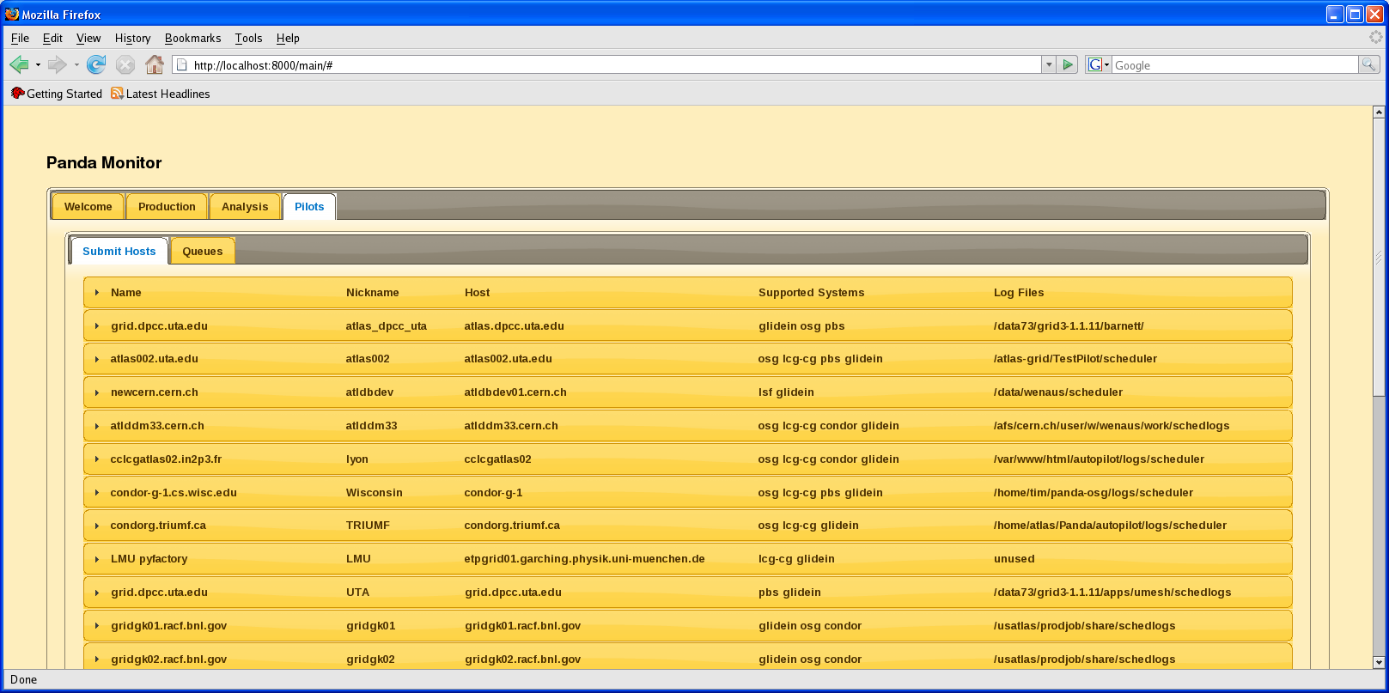
Panda Monitoring Development (AJAX/jQuery UI)

Slide 5
Overview
Workload Management
Issues / Concerns
  Panda monitoring upgrade is a key element of improving usability of Panda for both Atlas and other organizations, and is a priority
  First deliverable expected in July
  WBS item 2.2.3.2: Panda data movement - is stalled (manpower)

