Slide 1
Data Considerations
Thursday AM, Lecture 2
Lauren Michael
CHTC, UW-Madison

Slide 2
Overview – Data Handling
Review of HTCondor Data Handling
Data Management Tips
What is ‘Large’ Data?
Dealing with Large Data
  Next talks: local and OSG-wide methods for large-data handling

Slide 3
Overview – Data Handling
Review of HTCondor Data Handling
Data Management Tips
What is ‘Large’ Data?
Dealing with Large Data
  Next talks: local and OSG-wide methods for large-data handling

Slide 4
Review: HTCondor Data Handling
exec server
exec server
exec server
submit server
HTCondor
exec server
submit file
executable
dir/ input
output
(exec dir)/
executable
input
output

Slide 5
Network bottleneck: the submit server
exec server
exec server
exec server
submit server
HTCondor
exec server
submit file
executable
dir/ input
output
(exec dir)/
executable
input
output

Slide 6
Overview – Data Handling
Review of HTCondor Data Handling
Data Management Tips
What is ‘Large’ Data?
Dealing with Large Data
  Next talks: local and OSG-wide methods for large-data handling

Slide 7
Data Management Tips
Determine your job needs
Determine your batch needs
Leverage HTCondor data handling features!
Reduce per-job data needs

Slide 8
Determining In-Job Needs
“Input” includes any files transferred by HTCondor
  executable
  transfer_input_files
  data and software
“Output” includes any files copied back by HTCondor
  output, error

Slide 9
Data Management Tips
Determine your job needs
Determine your batch needs
Leverage HTCondor data handling features!
Reduce per-job data needs

Slide 10
First! Try to reduce your data
split large input for better throughput
eliminate unnecessary data
file compression and consolidation
  job input: prior to job submission
  job output: prior to end of job
  moving data between your laptop and the submit server

Slide 11
Overview – Data Handling
Review of HTCondor Data Handling
Data Management Tips
What is ‘Large’ Data?
Dealing with Large Data
  Next talks: local and OSG-wide methods for large-data handling

Slide 12
What is big large data?
For researchers “big data” is relative
  What is ‘big’ for you? Why?

Slide 13
What is big large data?
For researchers “big data” is relative
  What is ‘big’ for you? Why?
Volume, velocity, variety!
  think: a million 1-KB files, versus one 1-GB file

Slide 14
Network bottleneck: the submit server
exec server
exec server
exec server
submit server
HTCondor
exec server
submit file
executable
dir/ input
output
(exec dir)/
executable
input
output

Slide 15
‘Large’ input data:
The collaborator analogy
What method would you use to send data to a collaborator?
amount | method of delivery
words | email body
tiny – 10MB | email attachment (managed transfer)
10MB – GBs | download from Google Drive, Drop/Box, other web-accessible server
TBs | ship an external drive (local copy needed)

Slide 16
Large input in HTC and OSG
What methods should you use for HTC and OSG?
amount | method of delivery
words | within executable or arguments?
tiny – 10MB per file | HTCondor file transfer (up to 1GB total)
10MB – 1GB, shared | download from web proxy (network-accessible server)
1GB - 10GB, unique or shared | StashCache (regional replication)
10 GB - TBs | shared file system (local copy, local execute servers)

Slide 17
Large input in HTC and OSG
What methods should you use for HTC and OSG?
amount | method of delivery
words | within executable or arguments?
tiny – 10MB per file | HTCondor file transfer (up to 1GB total)
10MB – 1GB, shared | download from web proxy (network-accessible server)
1GB - 10GB, unique or shared | StashCache (regional replication)
10 GB - TBs | shared file system (local copy, local execute servers)

Slide 18
Network bottleneck: the submit server
Input transfers for many jobs will coincide
exec server
exec server
exec server
submit server
HTCondor
exec server
submit file
executable
dir/ input
output
(exec dir)/
executable
input
output

Slide 19
Network bottleneck: the submit server
Input transfers for many jobs will coincide
exec server
exec server
exec server
submit server
HTCondor
exec server
submit file
executable
dir/ input
output
(exec dir)/
executable
input
output
Output transfers are staggered

Slide 20
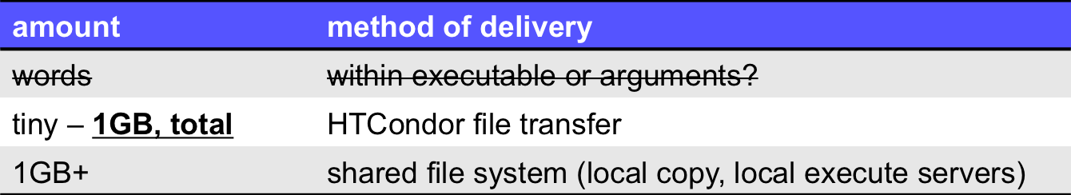
Output for HTC and OSG

Slide 21
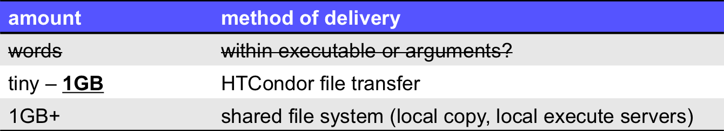
Output for HTC and OSG
Why are there fewer options?

Slide 22
Exercises
2.1 Understanding a job’s data needs
2.2 Using data compression with HTCondor file transfer
2.3 Splitting input (prep for large run in 3.1)

Slide 23
Questions?
Feel free to contact me:
  lmichael@wisc.edu
Next: Exercises 2.1-2.3
Later: Handling large input data

Slide 24
blah
Activate modules:
. /cvmfs/oasis.opensciencegrid.org/osg/modules/lmod/current/init/bash
Load a software module:
module load modulename
List loaded modules:
module list
Unload a module (to prepare for another)
module unload modulename

Slide 25
Example: Check Python from login.osgconnect.net
$ module load python/2.7
$ module list
Currently Loaded Modules:
1) python/2.7
$ which python
/cvmfs/oasis.opensciencegrid.org/osg/modules/python-2.7.7/bin/python

Slide 26
Example: Python Wrapper Script
#!/bin/bash
# activate modules and load python2.7:
. /cvmfs/oasis.opensciencegrid.org/osg/modules/lmod/current/init/bash
module load python/2.7
# run my python script:
python myscript.py
# END

