Slide 1
Executive Director Report
Executive Board 4/26/07
Things under control
Things out of control

Slide 2
Under Control
OSG is operating. We are solving problems. Usage is increasing overall.
Our main stakeholders are getting the throughput they need.
We are meeting some of our major milestones.
We are getting a small but steady stream of new contributors.
We have an active technical team both in the project and the consortium.

Slide 3
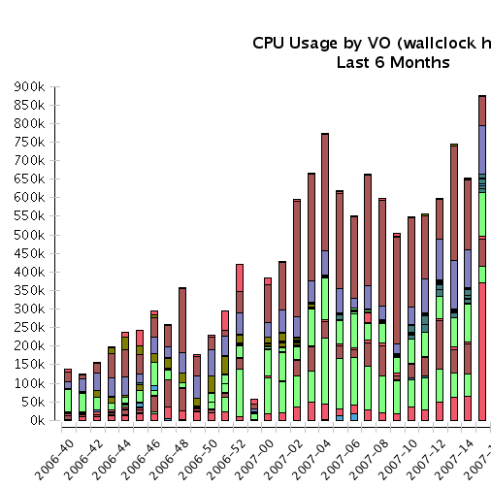
Throughput
Gratia reporting steadily increasing.. Due to more coverage or more throughput?
Not all of them are OSG jobs.. Need better matching to CEs and filters.
Daily/Weekly reports
help - but not sufficient.
(Look at Gratia daily report.)
s
CPU Wallclock hous/week, last 6 months

Slide 4
The Sites (84 including 8 SEs)
AGLT2 | GRASE-NYU-BENCH | NERSC-PDSF | UARK_ACE
ASGC_OSG | GRASE-RIT-GCLUSTER | NWICG-NotreDame | UC_ATLAS_MWT2
BNL_ATLAS_1 | GRASE-SB-SBNYSGRID | OSG_INSTALL_TEST_2 | UC_Teraport
BNL_ATLAS_2 | GRASE-SU-CLUSTER04 | OSG_LIGO_PSU | UCR-HEP
BU_ATLAS_Tier2 | GRASE-UR-NEBULA | OU_OCHEP_SWT2 | UCSandiegoOSG-Prod-SE
CIT_CMS_T2 | GROW-PROD | OU_OSCER_OSG | UCSDT2
CIT_CMS_T2:srm_v1 | GROW-UNI-P | OUHEP_OSG | UF-HPC
DARTMOUTH | HAMPTONU | PROD_SLAC | UFlorida-IHEPA
FIU-PG | HEPGRID_UERJ | Purdue-Lear | UFlorida-PG
FNAL_FERMIGRID | isuhep | Purdue-Physics | UIC_PHYSICS
FNAL_GPFARM | IU_ATLAS_Tier2 | Purdue-RCAC | UNM_HPC
FSU-HEP | Lehigh_coral | Rice | USATLAS_dCache_at_BNL
gpnjayhawk | LTU_CCT | SMU_PHY | USCMS-FNAL-WC1-CE
GRASE-ALBANY-NYS | LTU_OSG | SPRACE | USCMS-FNAL-WC1-SE
GRASE-BINGHAMTON | MCGILL_HEP | SPRACE-SE | UTA-DPCC
GRASE-CCR-U2 | MIT_CMS | STAR-Bham | UVA-HEP
GRASE-CORNELL-CTCNYSGRID | MIT_CMS:srm_v1 | STAR-BNL | UVA-sunfire
GRASE-GENESEO-OSG | MWT2_IU | STAR-SAO_PAULO | UWMadisonCMS
GRASE-GENESEO-ROCKS | MWT2_UC | STAR-WSU | UWMadisonCMS-SE
GRASE-MARIST-nysgrid11 | Nebraska | T2_Nebraska_Storage | UWMilwaukee
GRASE-NU-CARTMAN | NERSC-Davinci | TTU-ANTAEUS | Vanderbilt

Slide 5
Daily Success/Failure reports
Summary of the job exit status (midnight to midnight central time) for 2007-04-22. For Condor the value used is taken from 'ExitCode' and NOT from 'Exit Status’.
Includes EGEE VOs running on CMS Tier-1 site (shared with OSG) - clearly a (one of many) problem.

Slide 6
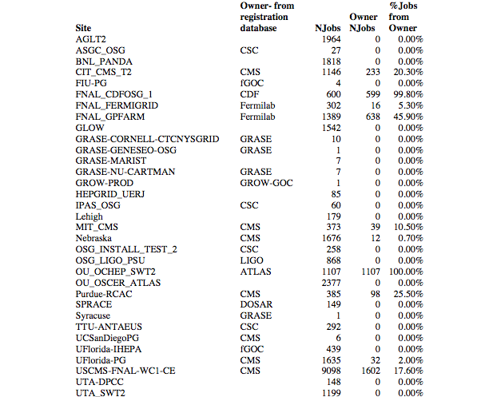
Usage by owners - daily report - need to make this correct.

Slide 7
Milestones from Feb 2007 at JOT, updated for Apr EB
WBS | Name | Date
1.1.1.2 | Define Operational Metrics for Year 1 | 1/1/07
1.1.3.1.1 | Release Security Plan | 1/1/07
1.1.5.2.3 | Release OSG 0.6.0 | 2/27/07
1.1.6.2.4 | Production use of OSG by one additional science community | 3/31/07
1.1.5.3.2 | OSG-TeraGrid software using common Globus and Condor releases. | 4/2/07
1.3.2.2.4 | Complete deployment and registration of 15 Storage Resources using srm/dCache from VDT. | 6/10/07
1.1.5.2.4 | Release OSG 0.8.0 | 8/15/07
1.1.1.5 | Report on Operational Metrics for Year 1 | 9/1/07
1.1.6.2.5 | Production use of OSG by a 2nd additional science community | 9/28/07
1) Still in draft.
Draft under review
√
Provisioning and final testing in progress
2)Not yet met?
3)Is this true?
√
ITB starting tests now SRM V1.1
*
4)How do we meet this?

Slide 8
Upcoming Science Milestones: the metrics we are working on.
LIGO: Binary Inspiral Analysis runs on OSG | Warren Anderson | 6/15/07
ATLAS: Validation of OSG infrastructure and extensions in full-chain production challenge. | Jim Shank | 6/15/07
CMS: Full support for opportunistic use of OSG resources for MC production and data processing. | Lothar Bauerdick | 6/15/07
STAR: Migration of >80% of simulation to OSG | Jerome Lauret | 6/15/07
CDF: Full use of OSG for MC | Ashutosh Kotwal | 6/15/07
D0: Full use of OSG sites for D0 reprocessing in 2007 (in progress) | Brad Abbott | 6/15/07
SDSS: Fit all spectra beyond data release 5, QSO fitting project (+now DES simulations/data transfer) | Chris Stoughton | 6/15/07
Support for CMS Job Throughput 50Kjobs/day | Würthwein | 4/1/07
Support for CMS Job Throughput 75Kjobs/day | Würthwein | 5/1/07
Support for CMS Job Throughput 100K jobs/day | Würthwein | 6/1/07
CMS site validations using the SAM infrastructure | Würthwein | 6/1/07
Support for ATLAS Throughput of 20-30K | Jim Shank | 7/3/07

Slide 9
LIGO: Binary Inspiral Analysis runs on OSG
1st 2 milestones already met.
What needs to happen to meet this?
Does this include the analysis being accepted by LIGO Science Collaboration ?

Slide 10
Ready to be asked about success?
ATLAS: Validation of OSG infrastructure and extensions in full-chain production challenge.
CMS: Full support for opportunistic use of OSG resources for MC production and data processing.
CDF: Full use of OSG for MC
SDSS: Fit all spectra beyond data release 5, QSO fitting project (+now DES simulations/data transfer)

Slide 11
STAR: Migration of >80% of simulation to OSG
Troubleshooting and STAR have put a lot of effort into solving the end to end data problems between LBNL and BNL.
STAR SRM End-point within BNL firewall causing problems that are not getting solved. Can STAR piggyback on ATLAS SRM end-points outside the firewall?
Activity to get STAR applications running on non-DRM SEs successful with quite some effort on FermiGrid. Will write this up.
Phone meeting last week with Jerome laid out plan for STAR to integrate their grid scheduler with simulation application by mid-May.

Slide 12
D0: Full use of OSG sites for D0 reprocessing in 2007
With continued focus D0 estimate they will finish reprocessing at the end of May.
While they are getting much better than expected throughput from OSG Sites the D0 end-to-end infrastructure is still not able to get full efficiency;
Analysis of faillures and effort to mitigate them is lacking.

Slide 13
Getting VOs to be able to rely on successfully running on Sites that Inform the VO is supported.
Engage: This is a perfect example for how "disconnected" our infrastructure is when getting a VO and site connected takes "high powers" to be involved ... Miron
  We must make this a priority now and assign an “owner” of the problem whose only job is to solve it.
  Who and what are we going to drop?

Slide 14
The Sites (84 including 8 SEs)
AGLT2 | GRASE-NYU-BENCH | NERSC-PDSF | UARK_ACE
ASGC_OSG | GRASE-RIT-GCLUSTER | NWICG-NotreDame | UC_ATLAS_MWT2
BNL_ATLAS_1 | GRASE-SB-SBNYSGRID | OSG_INSTALL_TEST_2 | UC_Teraport
BNL_ATLAS_2 | GRASE-SU-CLUSTER04 | OSG_LIGO_PSU | UCR-HEP
BU_ATLAS_Tier2 | GRASE-UR-NEBULA | OU_OCHEP_SWT2 | UCSandiegoOSG-Prod-SE
CIT_CMS_T2 | GROW-PROD | OU_OSCER_OSG | UCSDT2
CIT_CMS_T2:srm_v1 | GROW-UNI-P | OUHEP_OSG | UF-HPC
DARTMOUTH | HAMPTONU | PROD_SLAC | UFlorida-IHEPA
FIU-PG | HEPGRID_UERJ | Purdue-Lear | UFlorida-PG
FNAL_FERMIGRID | isuhep | Purdue-Physics | UIC_PHYSICS
FNAL_GPFARM | IU_ATLAS_Tier2 | Purdue-RCAC | UNM_HPC
FSU-HEP | Lehigh_coral | Rice | USATLAS_dCache_at_BNL
gpnjayhawk | LTU_CCT | SMU_PHY | USCMS-FNAL-WC1-CE
GRASE-ALBANY-NYS | LTU_OSG | SPRACE | USCMS-FNAL-WC1-SE
GRASE-BINGHAMTON | MCGILL_HEP | SPRACE-SE | UTA-DPCC
GRASE-CCR-U2 | MIT_CMS | STAR-Bham | UVA-HEP
GRASE-CORNELL-CTCNYSGRID | MIT_CMS:srm_v1 | STAR-BNL | UVA-sunfire
GRASE-GENESEO-OSG | MWT2_IU | STAR-SAO_PAULO | UWMadisonCMS
GRASE-GENESEO-ROCKS | MWT2_UC | STAR-WSU | UWMadisonCMS-SE
GRASE-MARIST-nysgrid11 | Nebraska | T2_Nebraska_Storage | UWMilwaukee
GRASE-NU-CARTMAN | NERSC-Davinci | TTU-ANTAEUS | Vanderbilt

Slide 15
Accuracy and correctness of accounting information
Why can’t we fix:
  the “unknowns”,
  Errors in VO names: “uscms-cms”, “engagement-engage” “LIGO-ligo”
Need follow up to daily and weekly reports and more easy access to longer term throughput reports.
Do we need a full day and sub-group review to focus on the Gratia information and deliverables ?
Do we need Philippe to report to the ET meetings weekly?

Slide 16
Sum of requests, OSGs actual capacity & planning to meet the demands.
D0 | Continue to need ~1500 CPUs til end of may. | Just need to keep them stable.
Engage | 500 CPUhours a day or 500 Job Slots continuously when needed. | See next slide
CompBioGrid | From Ops meeting minutes:13 sites that they can access with jobmanager Fork. 300 batch slots for peak is their goal. They will send the GOC a list of sites where they can run successfully currently. It will be two to three months time before they get up to a production level and start dealing with issues.
CMS | Ramping up production now. Focussed peak use planned for July and August. Will include opportunistic use of non-CMS sites. What are the actual needs? How will this affect use of CMS sites by other VOs?
ATLAS | Jim Shank says all ATLAS sites will be fully occupied by ATLAS for the forseeable future.
CHARMM | Need to track expected vs delivered throughput; it can’t be unbounded.
Need to keep this table up to date.
Need to make expectations and constraints clear to the VO.
Need to review at ET meetings and have more quantitative information.
Will I do this ?

Slide 17
Knowing and dealing with Policies
Starting to gather policies from sites for D0 now.
Plan is small steps. Does this give it enough bandwidth and priority?

Slide 18
Other things?

