Slide 1





Grid Compute Resources and Job Management

Slide 2
Job and compute resource management
This module is about running jobs on remote compute resources

Slide 3
Job and resource management
Compute resources have a local resource manager
  This controls who is allowed to run jobs and how they run, on a resource
GRAM
  Helps us run a job on a remote resource
Condor
  Manages jobs

Slide 4
Local Resource Managers
Local Resource Managers (LRMs) – software on a compute resource such a multi-node cluster.
Control which jobs run, when they run and on which processor they run
Example policies:
  Each cluster node can run one job. If there are more jobs, then the other jobs must wait in a queue
  Reservations – maybe some nodes in cluster reserved for a specific person
eg. PBS, LSF, Condor

Slide 5
Job Management on a Grid
GRAM
Condor
LSF
User
Site A
Site C
PBS
fork
Site B
Site D
The Grid

Slide 6
GRAM
Globus Resource Allocation Manager
Provides a standardised interface to submit jobs to different types of LRM
Clients submit a job request to GRAM
GRAM translates into something the LRM can understand
Same job request can be used for many different kinds of LRM

Slide 7
GRAM
Given a job specification:
  Create an environment for a job
  Stage files to and from the environment
  Submit a job to a local resource manager
  Monitor a job
  Send notifications of the job state change
  Stream a job’s stdout/err during execution

Slide 8
Two versions of GRAM
There are two versions of GRAM
  GRAM2
    Own protocols
    Older
    More widely used
    No longer actively developed
  GRAM4
    Web services
    Newer
    New features go into GRAM4
In this module, will be using GRAM2

Slide 9
GRAM components
Clients – eg. Globus-job-submit, globusrun
Gatekeeper
  Server
  Accepts job submissions
  Handles security
Jobmanager
  Knows how to send a job into the local resource manager
  Different job managers for different LRMs

Slide 10
GRAM components
Gatekeeper
Internet
globus
job
run
Jobmanager
Jobmanager
LRM eg Condor, PBS, LSF
Submitting machine
eg. User's workstation
Worker nodes / CPUs
Worker node / CPU
Worker node / CPU
Worker node / CPU
Worker node / CPU
Worker node / CPU

Slide 11
Submitting a job with GRAM
Globus-job-run command
globus-job-run rookery.uchicago.edu /bin/hostname
rook11
Run '/bin/hostname' on the resource rookery.uchicago.edu
We don't care what LRM is used on 'rookery'. This command works with any LRM.

Slide 12
The client can describe the job with GRAM’s Resource Specification Language (RSL)
Example:
  &(executable = a.out)
  (directory = /home/nobody )
  (arguments = arg1 "arg 2")
Submit with:
globusrun -f spec.rsl -r rookery.uchicago.edu

Slide 13
Use other programs to generate RSL
RSL job descriptions can become very complicated
We can use other programs to generate RSL for us
Example: Condor-G – next section

Slide 14
Condor
Globus-job-run submits jobs, but...
  No job tracking: what happens when something goes wrong?
Condor:
  Many features, but in this module:
  Condor-G for reliable job management

Slide 15
Condor can manage a large number of jobs
Managing a large number of jobs
  You specify the jobs in a file and submit them to Condor, which runs them all and keeps you notified on their progress
  Mechanisms to help you manage huge numbers of jobs (1000’s), all the data, etc.
  Condor can handle inter-job dependencies (DAGMan)
  Condor users can set job priorities
  Condor administrators can set user priorities
Can do this as:
  a local resource manager on a compute resource
  a grid client submitting to GRAM (Condor-G)

Slide 16
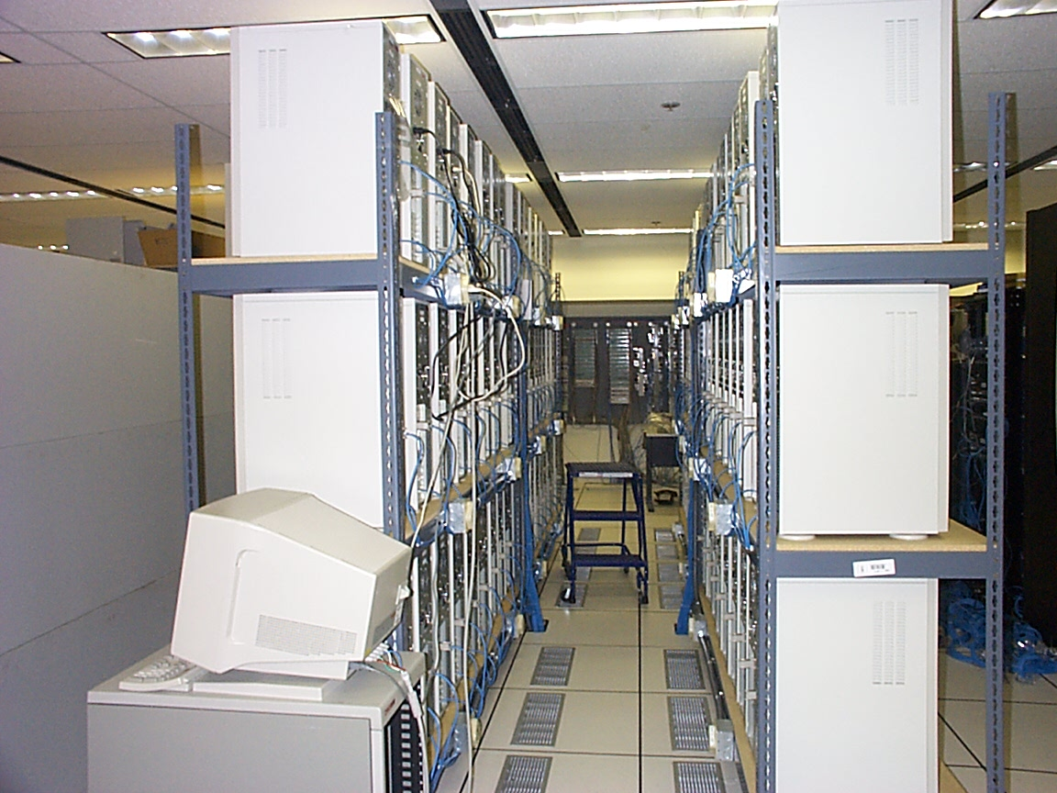
Condor can manage compute resource
Dedicated Resources
  Compute Clusters
Non-dedicated Resources
  Desktop workstations in offices and labs
    Often idle 70% of time
Condor acts as a Local Resource Manager

Slide 17
… and Condor Can Manage Grid jobs
Condor-G is a specialization of Condor. It is also known as the “Grid universe”.
Condor-G can submit jobs to Globus resources, just like globus-job-run.
Condor-G benefits from Condor features, like a job queue.

Slide 18
Some Grid Challenges
Condor-G does whatever it takes to run your jobs, even if …
  The gatekeeper is temporarily unavailable
  The job manager crashes
  Your local machine crashes
  The network goes down

Slide 19


Remote Resource Access: Globus
Globus
JobManager
Globus GRAM Protocol
“globusrun
myjob …”
fork()
Organization A
Organization B

Slide 20
Remote Resource Access: Condor-G + Globus + Condor
Globus GRAM Protocol
Globus
GRAM
Condor-G
myjob1
myjob2
myjob3
myjob4
myjob5
…
Submit to LRM
Organization A
Organization B

Slide 21
Example Application …
Simulate the behavior of F(x,y,z) for 20 values of x, 10 values of y and 3 values of z (20*10*3 = 600 combinations)
  F takes on the average 3 hours to compute on a “typical” workstation (total = 1800 hours)
  F requires a “moderate” (128MB) amount of memory
  F performs “moderate” I/O - (x,y,z) is 5 MB and F(x,y,z) is 50 MB
  600 jobs

Slide 22
Creating a Submit Description File
A plain ASCII text file
Tells Condor about your job:
  Which executable, universe, input, output and error files to use, command-line arguments, environment variables, any special requirements or preferences (more on this later)
Can describe many jobs at once (a “cluster”) each with different input, arguments, output, etc.

Slide 23
Simple Submit Description File
# Simple condor_submit input file
# (Lines beginning with # are comments)
# NOTE: the words on the left side are not
# case sensitive, but filenames are!
Universe = vanilla
Executable = my_job
Queue
$ condor_submit myjob.sub

Slide 24
Other Condor commands
condor_q – show status of job queue
condor_status – show status of compute nodes
condor_rm – remove a job
condor_hold – hold a job temporarily
condor_release – release a job from hold

Slide 25


Condor-G: Access non-Condor Grid resources
Globus
middleware deployed across entire Grid
remote access to computational resources
dependable, robust data transfer
Condor
job scheduling across multiple resources
strong fault tolerance with checkpointing and migration
layered over Globus as “personal batch system” for the Grid

Slide 26
Condor-G
Job Description (Job ClassAd)
Condor-G
GT2 [.1|2|4]
Condor
PBS/LSF
NorduGrid
GT4
Unicore
HTTPS
WSRF

Slide 27
Submitting a GRAM Job
In submit description file, specify:
  Universe = grid
  Grid_Resource = gt2 <gatekeeper host>
    ‘gt2’ means GRAM2
  Optional: Location of file containing your X509 proxy
  universe = grid
  grid_resource = gt2 beak.cs.wisc.edu/jobmanager-pbs
  executable = progname
  queue

Slide 28
How It Works
Personal Condor
Globus Resource
GRAM
Schedd
LSF

Slide 29
How It Works
600 Globus
jobs
Personal Condor
Globus Resource
GRAM
Schedd
LSF

Slide 30
How It Works
600 Globus
jobs
Personal Condor
Globus Resource
GRAM
Schedd
LSF
GridManager

Slide 31
How It Works
600 Globus
jobs
Personal Condor
Globus Resource
GRAM
Schedd
LSF
GridManager

Slide 32
How It Works
600 Globus
jobs
Personal Condor
Globus Resource
GRAM
Schedd
LSF
GridManager
User Job

Slide 33
Grid Universe Concerns
What about Fault Tolerance?
  Local Crashes
    What if the submit machine goes down?
  Network Outages
    What if the connection to the remote Globus jobmanager is lost?
  Remote Crashes
    What if the remote Globus jobmanager crashes?
    What if the remote machine goes down?
Condor-G’s persistent job queue lets it recover from all of these failures
If a JobManager fails to respond…

Slide 34
Globus Universe Fault-Tolerance:
Lost Contact with Remote Jobmanager
Can we contact gatekeeper?
Yes - jobmanager crashed
No – retry until we can talk to gatekeeper again…
Can we reconnect to jobmanager?
No – machine crashed or job completed
Yes – network was down
Restart jobmanager
Has job completed?
No – is job still running?
Yes – update queue

Slide 35
Back to our submit file…
Many options can go into the submit description file.
  universe = grid
  grid_resource = gt2 beak.cs.wisc.edu/jobmanager-pbs
  executable = progname
  log = some-file-name.txt
  queue

Slide 36
A Job’s story: The “User Log” file
A UserLog must be specified in your submit file:
  Log = filename
You get a log entry for everything that happens to your job:
  When it was submitted to Condor-G, when it was submitted to the remote Globus jobmanager, when it starts executing, completes, if there are any problems, etc.
Very useful! Highly recommended!

Slide 37
Sample Condor User Log
000 (8135.000.000) 05/25 19:10:03 Job submitted from host: <128.105.146.14:1816>
...
001 (8135.000.000) 05/25 19:12:17 Job executing on host: <128.105.165.131:1026>
...
005 (8135.000.000) 05/25 19:13:06 Job terminated.
(1) Normal termination (return value 0)
Usr 0 00:00:37, Sys 0 00:00:00 - Run Remote Usage
Usr 0 00:00:00, Sys 0 00:00:05 - Run Local Usage
Usr 0 00:00:37, Sys 0 00:00:00 - Total Remote Usage
Usr 0 00:00:00, Sys 0 00:00:05 - Total Local Usage
9624 - Run Bytes Sent By Job
7146159 - Run Bytes Received By Job
9624 - Total Bytes Sent By Job
7146159 - Total Bytes Received By Job
...

Slide 38
Uses for the User Log
Easily read by human or machine
  C++ library and Perl Module for parsing UserLogs is available
Event triggers for meta-schedulers
  Like DAGMan…
Visualizations of job progress
  Condor-G JobMonitor Viewer

Slide 39
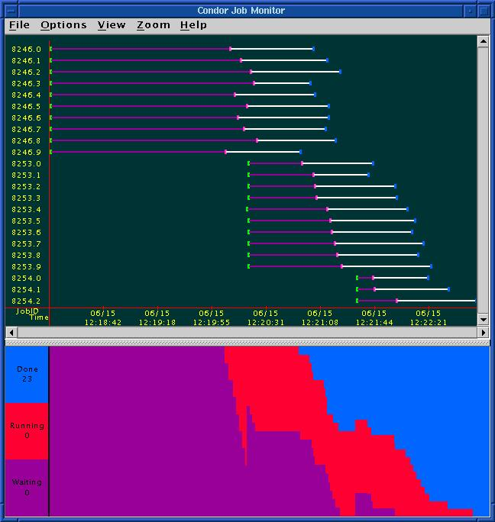
Condor-G JobMonitor
Screenshot

Slide 40
Want other Scheduling possibilities?
Use the Scheduler Universe
In addition to Globus, another job universe is the Scheduler Universe.
Scheduler Universe jobs run on the submitting machine.
Can serve as a meta-scheduler.
DAGMan meta-scheduler included

Slide 41
DAGMan
Directed Acyclic Graph Manager
DAGMan allows you to specify the dependencies between your Condor-G jobs, so it can manage them automatically for you.
(e.g., “Don’t run job “B” until job “A” has completed successfully.”)
Notes:
In the simplest case…

Slide 42
What is a DAG?
A DAG is the data structure used by DAGMan to represent these dependencies.
Each job is a “node” in the DAG.
Each node can have any number of “parent” or “children” nodes – as long as there are no loops!
Job A
Job B
Job C
Job D
Notes:
a DAG is the best data structure to represent a workflow of jobs with dependencies
children may not run until their parents have finished – this is why the graph is a directed graph … there’s a direction to the flow of work
In this example, called a “diamond” dag, job A must run first; when it finishes, jobs B and C can run together; when they are both finished, D can run; when D is finished the DAG is finished
Loops, where two jobs are both descended from one another, are prohibited because they would lead to deadlock – in a loop, neither node could run until the other finished, and so neither would start – this restriction is what makes the graph acyclic

Slide 43
Defining a DAG
A DAG is defined by a .dag file, listing each of its nodes and their dependencies:
  # diamond.dag
  Job A a.sub
  Job B b.sub
  Job C c.sub
  Job D d.sub
  Parent A Child B C
  Parent B C Child D
each node will run the Condor-G job specified by its accompanying Condor submit file
Job A
Job B
Job C
Job D
Notes:
This is all it takes to specify the example “diamond” dag

Slide 44
Submitting a DAG
To start your DAG, just run condor_submit_dag with your .dag file, and Condor will start a personal DAGMan daemon which to begin running your jobs:
  % condor_submit_dag diamond.dag
condor_submit_dag submits a Scheduler Universe Job with DAGMan as the executable.
Thus the DAGMan daemon itself runs as a Condor-G scheduler universe job, so you don’t have to baby-sit it.
Notes:
Just like any other Condor job, you get fault tolerance in case the machine crashes or reboots, or if there’s a network outage
And you’re notified when it’s done, and whether it succeeded or failed
% condor_q
-- Submitter: foo.bar.edu : <128.105.175.133:1027> : foo.bar.edu
ID OWNER SUBMITTED RUN_TIME ST PRI SIZE CMD
2456.0 user 3/8 19:22 0+00:00:02 R 0 3.2 condor_dagman -f -

Slide 45
Running a DAG
DAGMan acts as a “meta-scheduler”, managing the submission of your jobs to Condor-G based on the DAG dependencies.
DAGMan
A
Condor-G
Job
Queue
.dag
File
A
B
C
D
Notes:
First, job A will be submitted alone…

Slide 46
Running a DAG (cont’d)
DAGMan holds & submits jobs to the Condor-G queue at the appropriate times.
DAGMan
A
Condor-G
Job
Queue
B
B
C
C
D
Notes:
Once job A completes successfully, jobs B and C will be submitted at the same time…

Slide 47
Running a DAG (cont’d)
In case of a job failure, DAGMan continues until it can no longer make progress, and then creates a “rescue” file with the current state of the DAG.
DAGMan
A
Condor-G
Job
Queue
Rescue
File
B
X
D
Notes:
If job C fails, DAGMan will wait until job B completes, and then will exit, creating a rescue file. Job D will not run.
In its log, DAGMan will provide additional details of which node failed and why.

Slide 48
Recovering a DAG
Once the failed job is ready to be re-run, the rescue file can be used to restore the prior state of the DAG.
DAGMan
A
Condor-G
Job
Queue
Rescue
File
B
C
C
D
Notes:
Since jobs A and B have already completed, DAGMan will start by re-submitting job C

Slide 49
Recovering a DAG (cont’d)
Once that job completes, DAGMan will continue the DAG as if the failure never happened.
DAGMan
A
Condor-G
Job
Queue
B
C
D
D

Slide 50
Finishing a DAG
Once the DAG is complete, the DAGMan job itself is finished, and exits.
DAGMan
A
Condor-G
Job
Queue
B
C
D
Notes:
If job C fails, DAGMan will wait until job B completes, and then will exit, creating a rescue file.

Slide 51
Additional DAGMan Features
Provides other handy features for job management…
  nodes can have PRE & POST scripts
  failed nodes can be automatically re-tried a configurable number of times
  job submission can be “throttled”
  reliable data placement

Slide 52

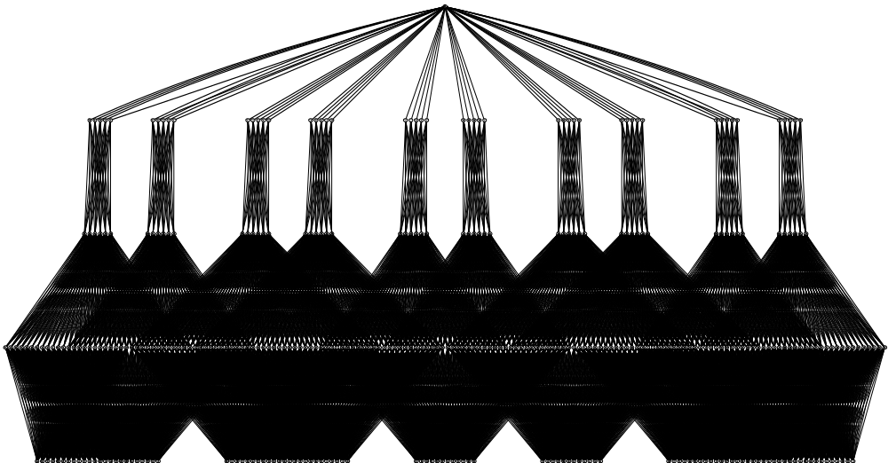
Here is a real-world workflow:
744 Files, 387 Nodes
50
60
168
108
Argonne National Laboratory

Slide 53
This presentation based on:
Grid Resources and Job Management
Jaime Frey
Condor Project,
University of Wisconsin-Madison
jfrey@cs.wisc.edu
Grid Summer Workshop
June 26-30, 2006

