Slide 1
Intermediate HTCondor: Workflows
Monday pm
Greg Thain
Center For High Throughput Computing
University of Wisconsin-Madison

Slide 2

Before we begin…
Any questions up to now?

Slide 3
Quick Review: 1
Executable = runme.sh
Output = out
Error = err
Log = log
Request_Memory = 1024
…
queue
1 Job

Slide 4
Quick Review: 2
Executable = runme.sh
Output = out.$(PROCESS)
Error = err.$(PROCESS)
Log = log.$(PROCESS)
Request_Memory = 1024
Queue 10000
Many Jobs

Slide 5
What could go wrong at scale?
Machine has bad disk
Machine has wrong OS version
Machine has missing dependencies

Slide 6
Life cycle of HTCondor Job
Held
Idle
Running
Complete
Submit
file
Suspend
Suspend
Suspend
History file

Slide 7
Life cycle of HTCondor Job
Held
Idle
Running
Complete
Submit
file
Suspend
Suspend
Suspend
History file
HTCondor handles this

Slide 8
Life cycle of HTCondor Job
When Job exits
OF OWN ACCORD!
Held
Idle
Running
Complete
Submit
file
Suspend
Suspend
Suspend
History file

Slide 9
Life cycle of HTCondor Job
Held
Sometimes we need this
Idle
Running
Complete
Submit
file
Suspend
Suspend
Suspend
History file

Slide 10
ON_EXIT_REMOVE
Executable = runme.sh
Output = out
Error = err
Log = log
Request_Memory = 1024
ON_EXIT_REMOVE = true
queue
Default: true
Means always remove

Slide 11
ON_EXIT_REMOVE
Executable = runme.sh
Output = out
Error = err
Log = log
Request_Memory = 1024
ON_EXIT_REMOVE = false
queue
False
Means never remove
(Don’t ever do this)

Slide 12
ON_EXIT_REMOVE
Executable = runme.sh
Output = out
Error = err
Log = log
Request_Memory = 1024
ON_EXIT_REMOVE = (ExitCode =?= 0) &&
(ExitBySignal =?= false)
queue

Slide 13
Life cycle of HTCondor Job
Sometimes we need to decide this needs to happen
Held
Idle
Running
Complete
Submit
file
Suspend
Suspend
Suspend
History file

Slide 14
PERIODIC_HOLD
Executable = runme.sh
Output = out
Error = err
Log = log
Request_Memory = 1024
PERIODIC_HOLD = (JobStatus == 2) &&
((CurrentTime - EnteredCurrentStatus) > (60 * 60 * 2))
queue

Slide 15
PERIODIC_HOLD
Executable = runme.sh
Output = out
Error = err
Log = log
Request_Memory = 1024
PERIODIC_HOLD = (JobStatus == 2) &&
((CurrentTime - EnteredCurrentStatus) > (60 * 60 * 2))
queue
Job is Running
For > 2 hours

Slide 16
Life cycle of HTCondor Job
Held
Idle
Running
Complete
Submit
file
Suspend
Suspend
Suspend
History file

Slide 17
Life cycle of HTCondor Job
Or this…
Held
Idle
Running
Complete
Submit
file
Suspend
Suspend
Suspend
History file

Slide 18
PERIODIC_RELEASE
Executable = runme.sh
Output = out
Error = err
Log = log
Request_Memory = 1024
periodic_release = (JobStatus == 5) &&
(HoldReason == 3) && (NumJobStarts < 5)
queue
Job is Held
Magic Hold code

Slide 19
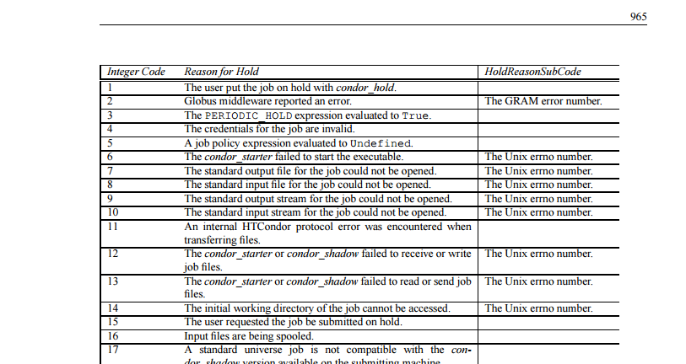
Manual has hold codes

Slide 20
PERIODIC_REMOVE
Executable = runme.sh
Output = out
Error = err
Log = log
Request_Memory = 1024
Periodic_remove = (NumJobStarts > 5)
queue

Slide 21
We apologize for this slide…
Executable = runme.sh
…
request_memory = ifthenelse(MemoryUsage =!= undefined,(MemoryUsage * 3/2), 2048)
periodic_hold = (MemoryUsage >= ((RequestMemory) * 5/4 )) && (JobStatus == 2)
periodic_release = (JobStatus == 5) &&
((CurrentTime - EnteredCurrentStatus) > 180) && (NumJobStarts < 5) && (HoldReasonCode =!= 13) && (HoldReasonCode =!= 34)
queue

Slide 22
Workflows
Often, you don’t have independent tasks!
Common example:
  You want to analyze a set of images
    You need to generate N images (once)
    You need to analyze all N images
      One job per image
    You need to summarize all results (once)

Slide 23
Do you want to do this manually?
Generate
Analyze
Analyze
Analyze
Analyze
Summarize

Slide 24
Workflows: The HTC definition
Workflow:
A graph of jobs to run: one or more jobs must succeed before one or more others can start running

Slide 25


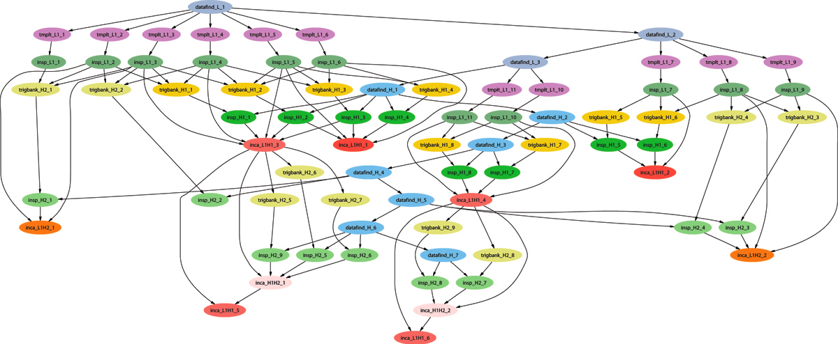
Example of a LIGO Inspiral DAG

Slide 26
DAGMan
DAGMan: HTCondor’s workflow manager
  Directed Acyclic Graph (DAG)
  Manager (Man)
Allows you to specify the dependencies between your HTCondor jobs
Manages the jobs and their dependencies
That is, it manages a workflow of HTCondor jobs
Notes:
In the simplest case…

Slide 27
What is a DAG?
A DAG is the structure used by DAGMan to represent these dependencies.
Each job is in a node in the DAG.
Each node can have any number of “parent” or “children” nodes – as long as there are no loops!
A
OK:
B
C
D
Not OK:
A
B
C
Notes:
a DAG is the best data structure to represent a workflow of jobs with dependencies
children may not run until their parents have finished – this is why the graph is a directed graph … there’s a direction to the flow of work
In this example, called a “diamond” dag, job A must run first; when it finishes, jobs B and C can run together; when they are both finished, D can run; when D is finished the DAG is finished
Loops, where two jobs are both descended from one another, are prohibited because they would lead to deadlock – in a loop, neither node could run until the other finished, and so neither would start – this restriction is what makes the graph acyclic

Slide 28
So, what’s in a node?
(optional pre-script)
Job
(optional post-script)
A
B
C
D

Slide 29
Defining a DAG
A DAG is defined by a .dag file, listing each of its nodes and their dependencies. For example:
  # Comments are good
  Job A a.sub
  Job B b.sub
  Job C c.sub
  Job D d.sub
  Parent A Child B C
  Parent B C Child D
Job A
Job B
Job C
Job D
Notes:
This is all it takes to specify the example “diamond” dag

Slide 30
DAG Files….
This complete DAG has five htcondor files
One DAG File:
Four Submit Files:
  Job A a.sub
  Job B b.sub
  Job C c.sub
  Job D d.sub
  Parent A Child B C
  Parent B C Child D
Universe = Vanilla
Executable = analysis…
Universe = …

Slide 31
Submitting a DAG
To start your DAG, just run condor_submit_dag with your .dag file, and HTCondor will start a DAGMan process to manage your jobs:
  % condor_submit_dag diamond.dag
condor_submit_dag submits a Scheduler Universe job with DAGMan as the executable
Thus the DAGMan daemon itself runs as an HTCondor job, so you don’t have to baby-sit it
Notes:
Just like any other Condor job, you get fault tolerance in case the machine crashes or reboots, or if there’s a network outage
And you’re notified when it’s done, and whether it succeeded or failed
% condor_q
-- Submitter: foo.bar.edu : <128.105.175.133:1027> : foo.bar.edu
ID OWNER SUBMITTED RUN_TIME ST PRI SIZE CMD
2456.0 user 3/8 19:22 0+00:00:02 R 0 3.2 condor_dagman -f -

Slide 32
DAGMan is a HTCondor job
DAGMan itself is a condor job with a job id, so
  % condor_rm job_id_of_dagman
  % condor_hold job_id_of_dagman
  % condor_q –dag # is magic
DAGMan submits jobs, one cluster per node
Don’t confuse dagman as job with jobs of dagman
Notes:
Just like any other Condor job, you get fault tolerance in case the machine crashes or reboots, or if there’s a network outage
And you’re notified when it’s done, and whether it succeeded or failed
% condor_q
-- Submitter: foo.bar.edu : <128.105.175.133:1027> : foo.bar.edu
ID OWNER SUBMITTED RUN_TIME ST PRI SIZE CMD
2456.0 user 3/8 19:22 0+00:00:02 R 0 3.2 condor_dagman -f -

Slide 33
Some examples:
$ condor_submit_dag test.dag
File for submitting this DAG to HTCondor: test.dag.condor.sub
Log of DAGMan debugging messages: test.dag.dagman.out
Log of HTCondor library output : test.dag.lib.out
Log of HTCondor library error messages: test.dag.lib.err
Log of the life of condor_dagman itself: test.dag.dagman.log
Submitting job(s).
1 job(s) submitted to cluster 64.

Slide 34
Some examples:
$ condor_q
-- Schedd: learn.chtc.wisc.edu : <128.104.100.43:9618?...
ID OWNER SUBMITTED RUN_TIME ST PRI SIZE CMD
64.0 gthain 7/19 11:03 0+00:00:03 R 0 0.3 condor_dagman -p 0 -f -l . -Lockfile test.dag.lock -AutoRe
1 jobs; 0 completed, 0 removed, 0 idle, 1 running, 0 held, 0 suspended

Slide 35
Some examples:
$ condor_q -dag
-- Schedd: learn.chtc.wisc.edu : <128.104.100.43:9618?...
ID OWNER/NODENAME SUBMITTED RUN_TIME ST PRI SIZE 64.0 gthain 7/19 11:03 0+00:00:07 R 0 0.3 condor_dagman -p 0 -f -l . -Lockfile test.dag.lock -Aut
65.0 |-A 7/19 11:04 0+00:00:00 I 0 0.0
2 jobs; 0 completed, 0 removed, 1 idle, 1 running, 0 held, 0 suspended

Slide 36
Some examples:
$ condor_submit_dag test.dag
ERROR: "test.dag.condor.sub" already exists.
ERROR: "test.dag.lib.out" already exists.
ERROR: "test.dag.lib.err" already exists.
ERROR: "test.dag.dagman.log" already exists.
Some file(s) needed by condor_dagman already exist. Either rename them,
use the "-f" option to force them to be overwritten, or use
the "-update_submit" option to update the submit file and continue.

Slide 37
Running a DAG
DAGMan acts as a job scheduler, managing the submission of your jobs to HTCondor based on the DAG dependencies
A
HTCondor
Job
Queue
.dag
File
A
B
C
DAGMan
D
Notes:
First, job A will be submitted alone…

Slide 38
Running a DAG (cont’d)
DAGMan submits jobs to HTCondor at the appropriate times
For example, after A finishes, it submits B & C
A
HTCondor
Job
Queue
B
B
C
C
DAGMan
D
Notes:
Once job A completes successfully, jobs B and C will be submitted at the same time…

Slide 39
Finishing a DAG
Once the DAG is complete, the DAGMan job itself is finished, and exits
A
HTCondor
Job
Queue
B
C
DAGMan
D
Notes:
If job C fails, DAGMan will wait until job B completes, and then will exit, creating a rescue file.

Slide 40
What if a job fails?
A job fails if it exits with a non-zero exit code
In case of a job failure, DAGMan runs other jobs until it can no longer make progress, and then creates a “rescue” file with the current state of the DAG
A
HTCondor
Job
Queue
Rescue
File
B
X
DAGMan
D
Notes:
If job C fails, DAGMan will wait until job B completes, and then will exit, creating a rescue file. Job D will not run.
In its log, DAGMan will provide additional details of which node failed and why.

Slide 41
Recovering a DAG
Once the failed job is ready to be re-run, the rescue file can be used to restore the prior state of the DAG
  Another example of reliability for HTC!
A
HTCondor
Job
Queue
Rescue
File
B
C
C
DAGMan
D
Notes:
Since jobs A and B have already completed, DAGMan will start by re-submitting job C

Slide 42
Recovering a DAG (cont’d)
Once that job completes, DAGMan will continue the DAG as if the failure never happened
A
HTCondor
Job
Queue
B
C
D
DAGMan
D

Slide 43
DAGMan & Fancy Features
DAGMan doesn’t have a lot of “fancy features”
  No loops
  No help to make very large DAGs
Focus is on solid core
  Add the features people need in order to run large DAGs well
  People build systems on top of DAGMan

Slide 44
Related Software
Pegasus: http://pegasus.isi.edu/
  Writes DAGs based on abstract description
  Runs DAG on appropriate resource (HTCondor, OSG, EC2…)
  Locates data, coordinates execution
  Uses DAGMan, works with large workflows
Makeflow: http://nd.edu/~ccl/software/makeflow/
  User writes make file, not DAG
  Handles data transfers to remote systems

Slide 45
DAGMan: Reliability
For each job, HTCondor generates a log file
DAGMan reads this log to see what has happened
If DAGMan dies (crash, power failure, etc…)
  HTCondor will restart DAGMan
  DAGMan re-reads log file
  DAGMan knows everything it needs to know
  Principle: DAGMan can recover state from files and without relying on a service (HTCondor queue, database…)
Recall: HTC requires reliability!

Slide 46

Let’s try it out!
Exercises with DAGMan.

Slide 47
Questions?
Questions? Comments?
Feel free to ask me questions later:

Slide 48

Bonus Material…

Slide 49
Use of HTCondor by the LIGO Scientific Collaboration
HTCondor handles 10’s of millions of jobs per year running on the LDG, and up to 500k jobs per DAG.
HTCondor standard universe check pointing widely used, saving us from having to manage this.
At Caltech, 30 million jobs processed using 22.8 million CPU hrs. on 1324 CPUs in last 30 months.
For example, to search 1 yr. of data for GWs from the inspiral of binary neutron star and black hole systems takes ~2 million jobs, and months to run on several thousand ~2.6 GHz nodes.
(Statement from 2010—”last 30 months” isn’t from now. Also, I think they do up to 1 million jobs per DAG now.)

Slide 50
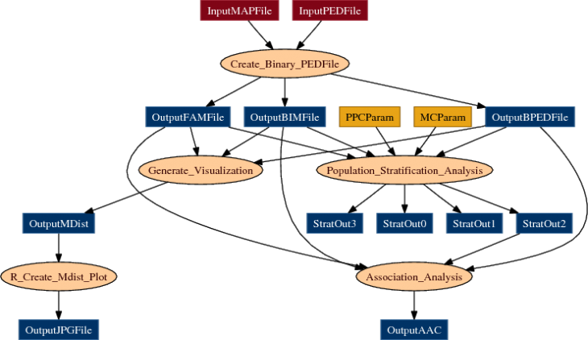
Example workflow: Bioinformatics
From Mason, Sanders, State (Yale)
http://pegasus.isi.edu/applications/association_test

Slide 51
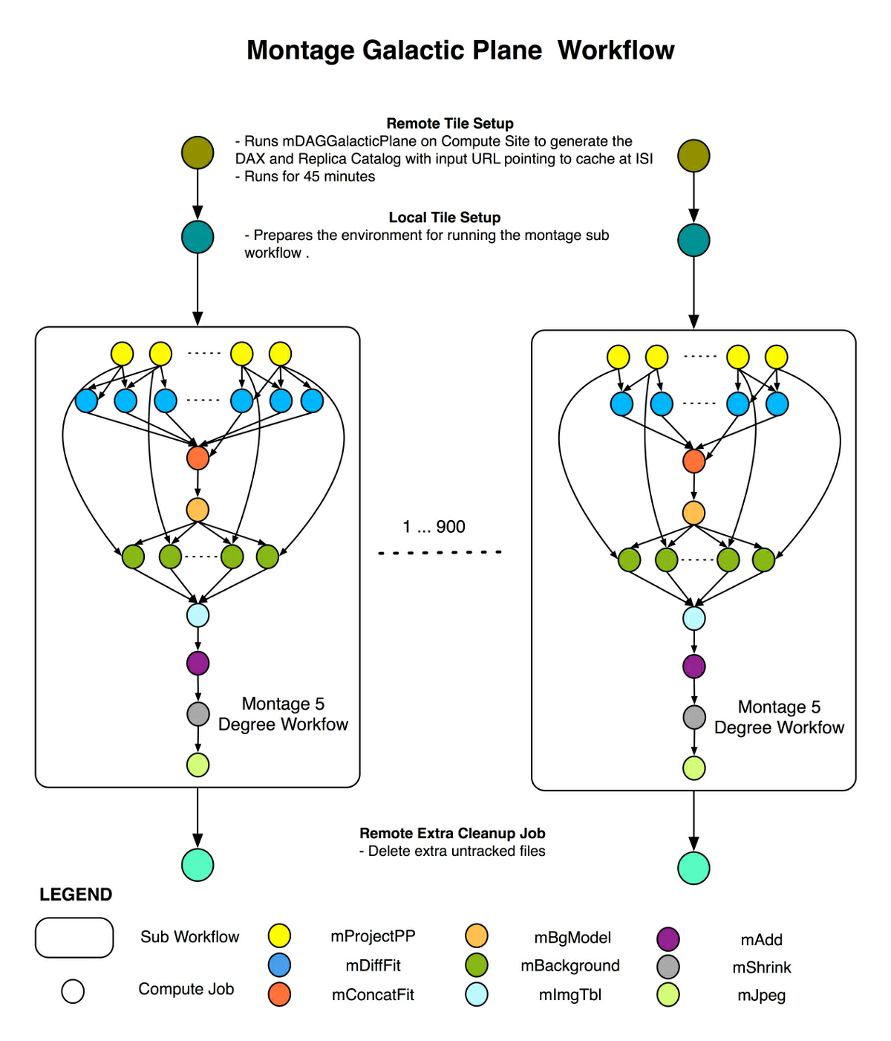
Example workflow: Astronomy
From Berriman & Good (JPAC)
http://pegasus.isi.edu/applications/galactic-plane

