Slide 1
LSST Simulations on OSG
Overview
OSG Engagement of LSST
LSST Simulation Workflow Requirements
System Architecture
Resource Utilization
Operational Experience
Results Validation
Sep 21, 2010
Gabriele Garzoglio for the OSG Task Force on LSST
Computing Division, Fermilab

Slide 2
Introduction
LSST at Purdue (Ian Shipsey) and OSG are collaborating to explore the use of the OSG to run LSST computations
We have integrated the LSST “current” version of the image simulation with OSG
In Sep, Bo Xin (LSST Purdue) has…
  produced 400 / 529 image pairs (some jobs may still require recovery)
  validated the OSG production against one official reference (PT1) image

Slide 3
OSG “engagement” of LSST
Goal of OSG is to empower LSST to use OSG resources independently
OSG is currently “engaging” LSST i.e. it provides experts for a limited time to help with
  commissioning a submission system (software & resources) to run LSST workflows on OSG resources
  supporting the integration of LSST applications with OSG
  supporting the initial LSST operations

Slide 4
History
Feb 2010 – Proof of principle of 1 LSST image simulated on OSG
Jun 2010 – OSG EB forms an OSG task force for LSST
  Goal of the project is to simulate one night of image taking (500 image pairs)
Jul 2010 – Commissioning of the LSST submission system on OSG
  Using an old application release (svn-11853), 1 person produced 183 times the same image in 1 day
Aug 2010 – Integrated “current” LSST release (svn-16264) with the system
Sep 2010 – LSST operator (Bo Xin) ran operations to produce 529 pairs.

Slide 5
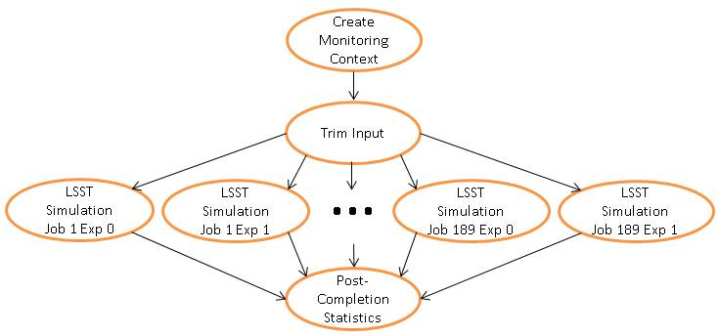
Workflow Requirements
LSST simulation of 1 image: 189 trivially parallel jobs for the 189 chips
Input to the workflow:
  SED catalog and focal plane conf. files: 15 GB uncompr., pre-installed at all sites
  Instance Catalog (SED files + wind speed, etc.): 500 MB compr. per image pair
Workflow:
  Trim catalog file into 189 chip-specific files
  Submit 2 x 189 jobs:
  1 image pair (same
  image w/ 2 exposures)
Output: 2 x 189
FITS files, 25 MB
each compr.

Slide 6
Production by Numbers
Goal: simulate 1 night of LSST data collection: 500 pairs
200k simulation jobs (1 chip at a time) + 500 trim jobs
Assume 4 hours / job for trim and simulation (over-est.)
→ 800,000 CPU hours
Assume 2000 jobs DC → ~50,000 CPU hours / day
17 days to complete (w/o counting failures)
12,000 jobs / day i.e. 31 image pairs / day
50 GB / day of input files moved (different for every job)
300 GB / day of output
Total number of files = 400,000 (50% input - 50% output)
Total output compressed = 5.0 TB (25 MB per job) _x0013_

Slide 7
Architecture
2
Glidein
VO Frontend
Submit
Monitor
5
Submitter
3
Condor
Collector
User
Interface
DAG
OSG Glidein Factory
Create
1
Submit
3
1
Glidein
WN Info
Local Disk
Condor
Scheduler
CE
Grid Site
Hadoop
Job &
Data
4
Binaries and SED files
pre-installed via OSG MM

Slide 8
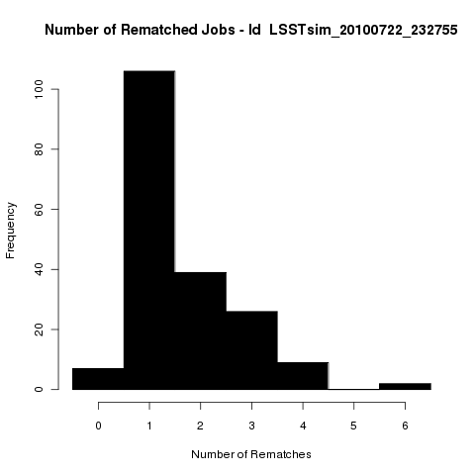
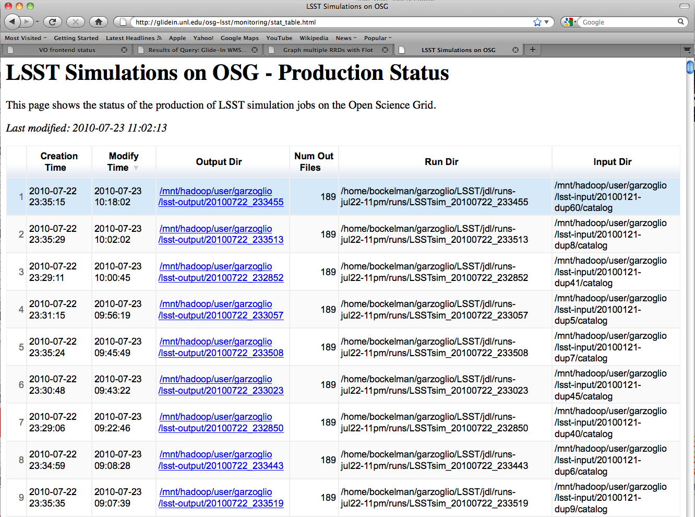
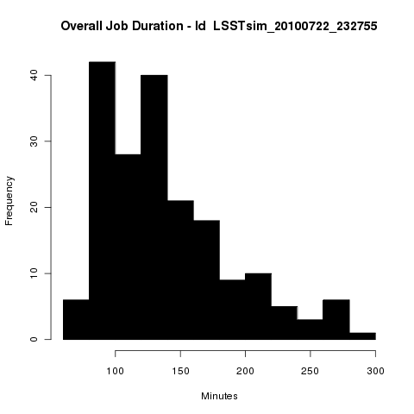
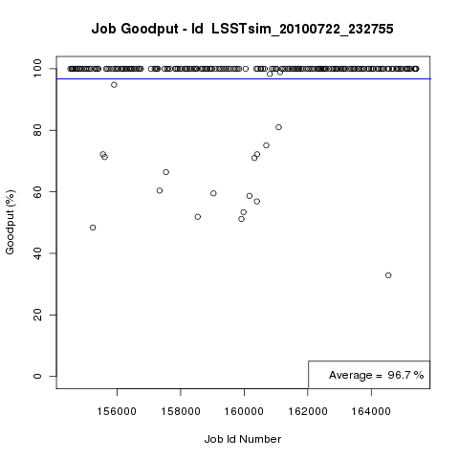
Monitoring Operations
If job exits due to system failure → automatically resubmit indefinitely
If job exits due to app. failure → resubmit 5 times
Periodically look at the output dir
…

Slide 9
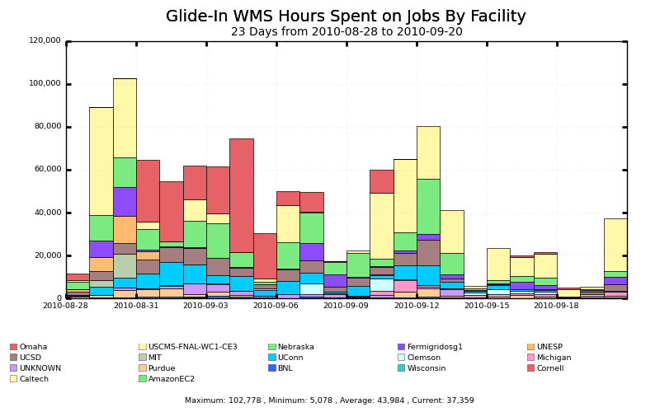
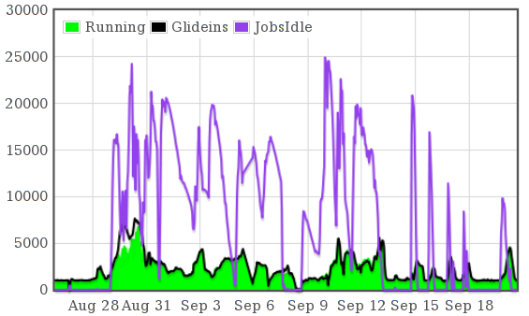
Resource Utilization
By Sep 3, produced 150 pairs in 5 days using 13 sites.
Now 400 / 529 pairs are produced (some chips job may require recovery)
150 pairs
produced
Gratia Resource Utilization plots
Frontend Status: Jobs & Glideins

Slide 10
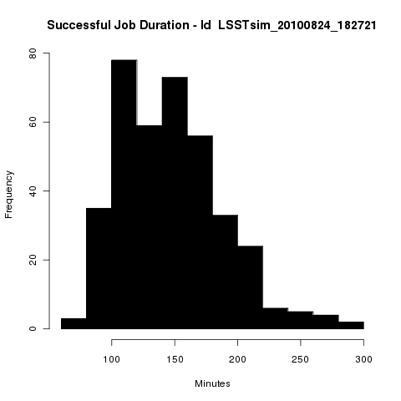
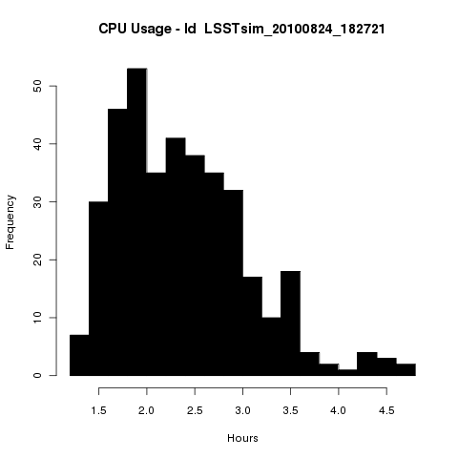
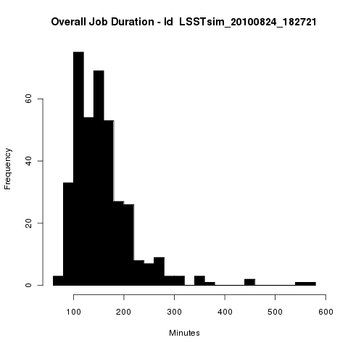
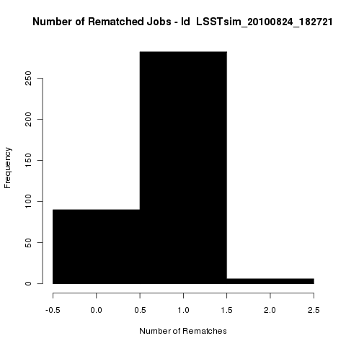
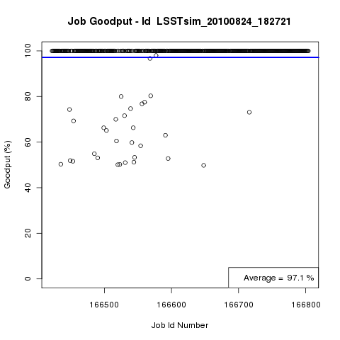
Typical Workflow Statistics

Slide 11
Operational Challenges
LSST binaries were not Grid-ready
  Application assumed writable software distribution
  Application assumed path-lengths too short for the Grid
  Orchestration script did not exit with failure upon error (required manual recovery until fixed)
Typical failures at sites:
  Job required more memory than the batch system allotted
  Storage unavailable due to maintenance at some of the most productive sites
Limited disk quota on the submission machine
After the production of 150 pairs, the operator was mostly traveling and had limited time to dedicate to the operations

Slide 12
Validation: reproducibility on OSG
An image is validated by subtracting it pixel by pixel from a reference.
We produced 2 different images twice on OSG, each on a different mix of resources.
In both cases, the pixel-subtraction is consistently 0.

Slide 13
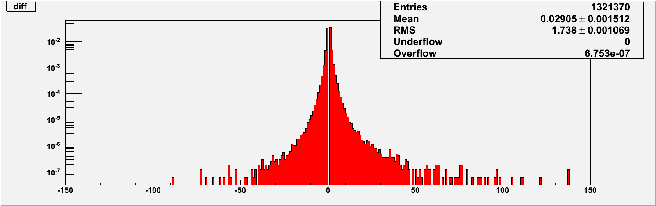
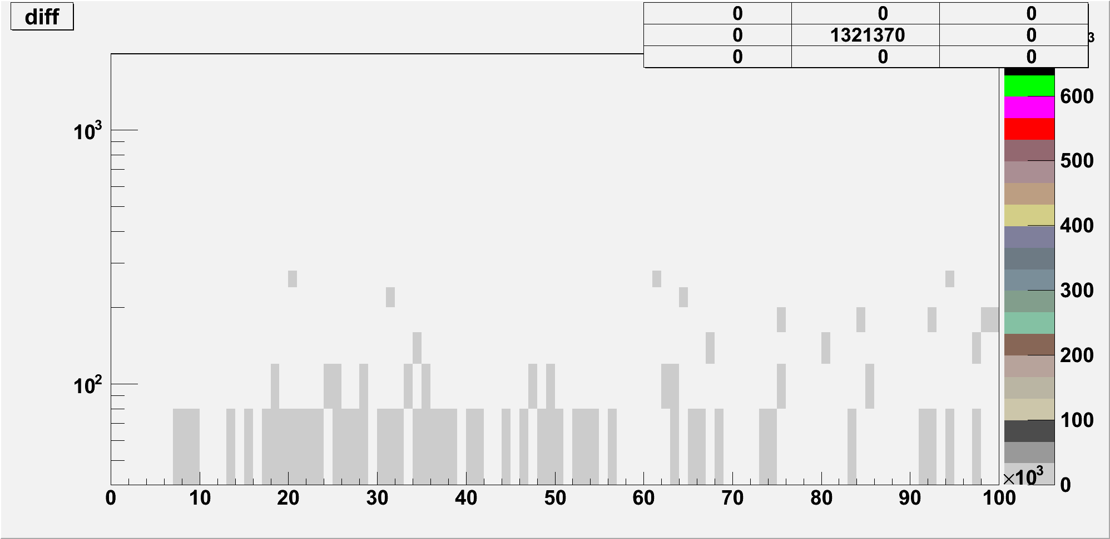
Validation: comparison with PT1
We compared 1 image pair (378 chips) with an “official” reference (PT1).
For 374 chips the pixel-subtraction is consistently 0.
For 4 chips it is negligible*.
More investigations are under way. Study done by Bo Xin.

Slide 14
Conclusions
This project has demonstrated that OSG is a valuable platform to simulate LSST images
1 LSST person, Bo Xin, with expert support has produced 150 image pairs in 5 days, using in average 50,000 CPU h / day.
Bo is currently finishing the production of 529 pairs (400 done with possible needs for recovery)
We see image simulation only as the first application integrated with OSG. We are interested in the integration of data-intensive applications as well.
We are interested in discussing the creation of LSST as an independent Virtual Organization in OSG
Thank you to the OSG Task Force
  Especially to Brian Bockelman, Parag Mhashilkar, and Derek Weitzel

