Slide 1

The GriPhyN
Virtual Data System
Summer Grid Workshop
Michael Wilde
wilde@mcs.anl.gov
Argonne National Laboratory
14 July 2005

Slide 2


Acknowledgements
…many thanks to the entire Trillium / OSG Collaboration, iVDGL and OSG Team, Virtual Data Toolkit Team, and all of our application science partners in ATLAS, CMS, LIGO, SDSS, Dartmouth DBIC and fMRIDC, SCEC, and Argonne’s Computational Biology and Climate Science Groups of the Mathematics and Computer Science Division.
The Virtual Data System group is:
  ISI/USC: Ewa Deelman, Carl Kesselman, Gaurang Mehta, Gurmeet Singh, Mei-Hui Su, Karan Vahi
  U of Chicago: Catalin Dumitrescu, Ian Foster, Luiz Meyer (UFRJ, Brazil), Doug Scheftner, Jens Voeckler, Mike Wilde, Yong Zhao
  www.griphyn.org/vds
GriPhyN and iVDGL are supported by the National Science Foundation
Many of the research efforts involved in this work are supported by the US Department of Energy, office of Science.

Slide 3
The GriPhyN Project
Enhance scientific productivity through…
Discovery, application and management of data and processes at petabyte scale
Using a worldwide data grid as a scientific workstation
The key to this approach is Virtual Data – creating and managing datasets through workflow “recipes” and provenance recording.

Slide 4

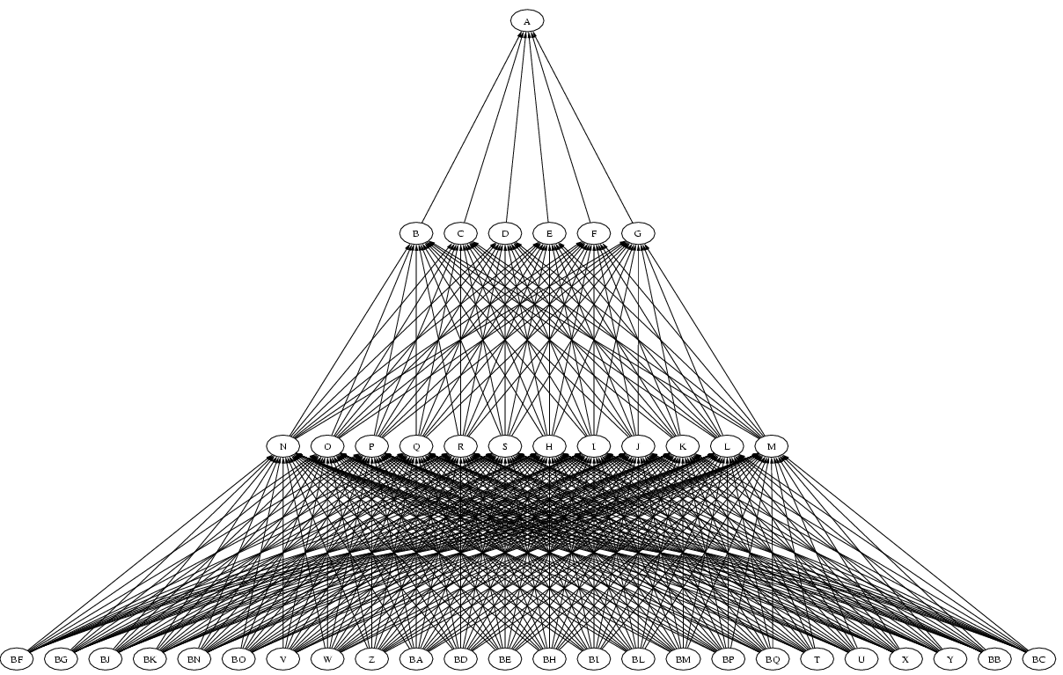
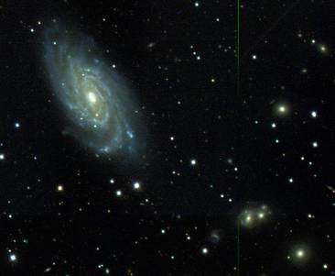
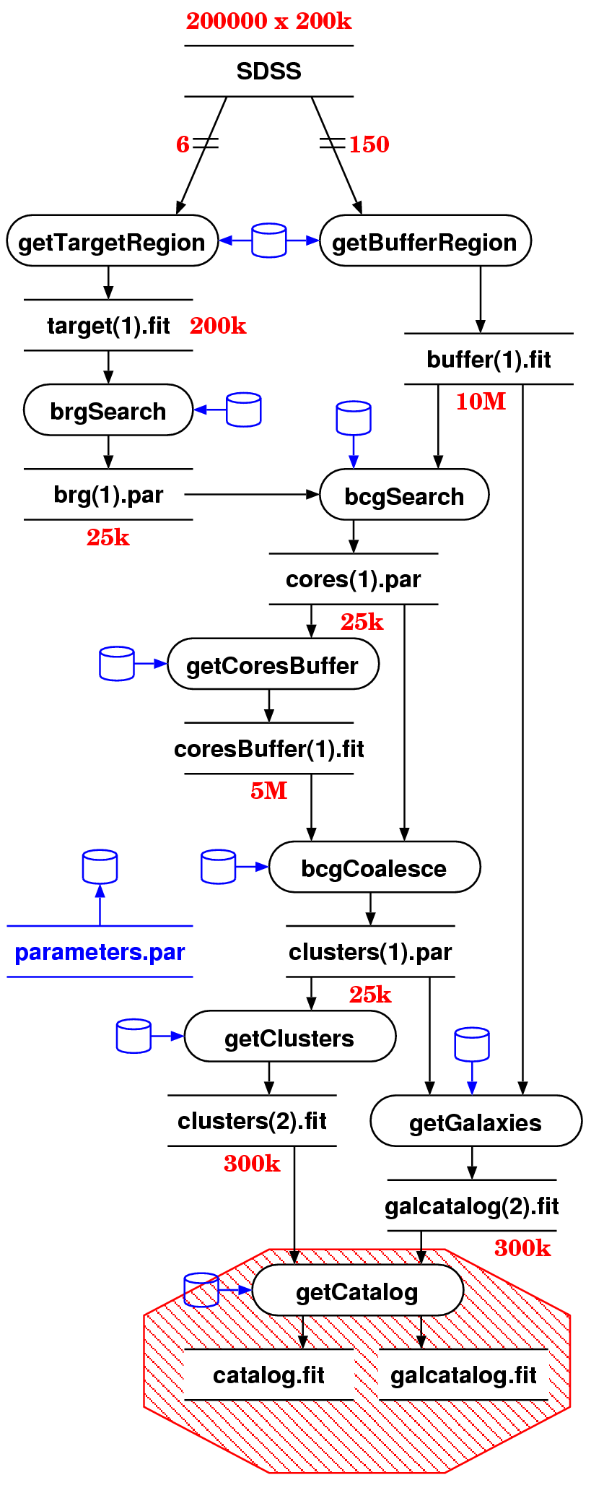
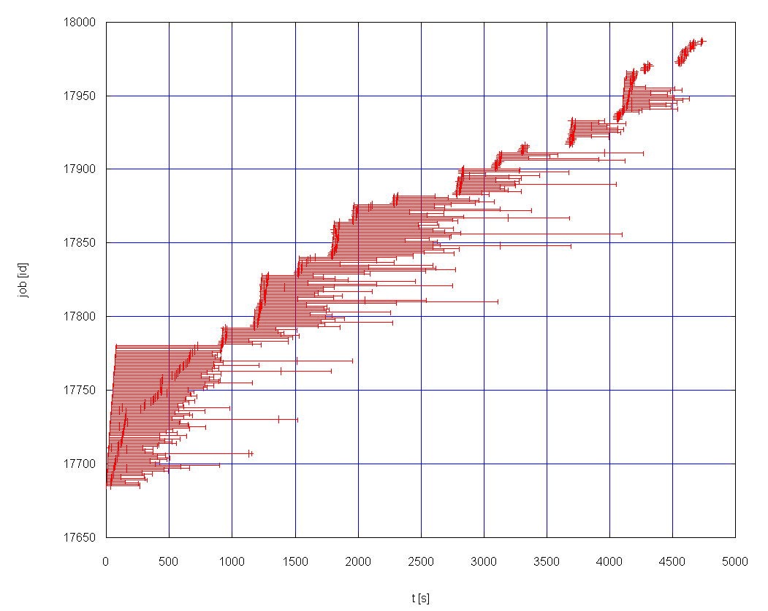
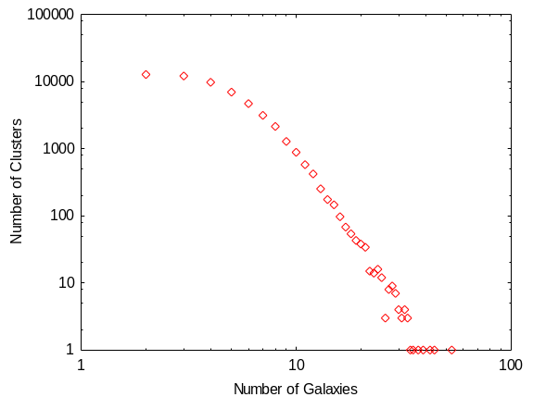
Virtual Data Example:
Galaxy Cluster Search
DAG
Sloan Data
Galaxy cluster
size distribution
Jim Annis, Steve Kent, Vijay Sehkri, Fermilab, Michael Milligan, Yong Zhao, University of Chicago

Slide 5
A virtual data glossary
virtual data
  defining data by the logical workflow needed to create it virtualizes it with respect to location, existence, failure, and representation
VDS – Virtual Data System
  The tools to define, store, manipulate and execute virtual data workflows
VDT – Virtual Data Toolkit
  A larger set of tools, based on NMI, VDT provides the Grid environment in which VDL workflows run
VDL – Virtual Data Language
  A language (text and XML) that defines the functions and function calls of a virtual data workflow
VDC – Virtual Data Catalog
  The database and schema that store VDL definitions

Slide 6
What must we “virtualize” to compute on the Grid?
Location-independent computing: represent all workflow in abstract terms
Declarations not tied to specific entities:
  sites
  file systems
  schedulers
Failures – automated retry for data server and execution site un-availability

Slide 7
Expressing Workflow in VDL
file1
TR grep (in a1, out a2) {
argument stdin = ${a1};
argument stdout = ${a2}; }
TR sort (in a1, out a2) {
argument stdin = ${a1};
argument stdout = ${a2}; }
DV grep (a1=@{in:file1}, a2=@{out:file2});
DV sort (a1=@{in:file2}, a2=@{out:file3});
grep
file2
sort
file3
Notes:
Explicit dependencies.

Slide 8
Expressing Workflow in VDL
Define a “function” wrapper for an application
file1
TR grep (in a1, out a2) {
argument stdin = ${a1};
argument stdout = ${a2}; }
TR sort (in a1, out a2) {
argument stdin = ${a1};
argument stdout = ${a2}; }
DV grep (a1=@{in:file1}, a2=@{out:file2});
DV sort (a1=@{in:file2}, a2=@{out:file3});
grep
Define “formal arguments” for the application
Connect applications via output-to-input dependencies
file2
sort
file3
Define a “call” to invoke application
Provide “actual” argument values for the invocation
Notes:
Explicit dependencies.

Slide 9
Essence of VDL
Elevates specification of computation to a logical, location-independent level
Acts as an “interface definition language” at the shell/application level
Can express composition of functions
Codable in textual and XML form
Often machine-generated to provide ease of use and higher-level features
Preprocessor provides iteration and variables

Slide 10
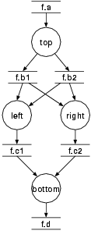
Compound Workflow
Complex structure
  Fan-in
  Fan-out
  "left" and "right" can run in parallel
Uses input file
  Register with RC
Supports complex file dependencies
  Glues workflow
preprocess
findrange
findrange
analyze
Notes:
We deal with "regular diamonds" (as in the big dag), and "black diamonds". Regular diamonds use a generating top node, and don't have cross-dependencies.
The processes are neither "findrange" nor "right". "findrange" is the TR name, "right" the DV name. The application (and thus process) is most likely "keg".

Slide 11
Compound Transformations for nesting Workflows
Compound TR encapsulates an entire sub-graph:
  TR rangeAnalysis (in fa, p1, p2,
  out fd, io fc1,
  io fc2, io fb1, io fb2, )
  {
  call preprocess( a=${fa}, b=[ ${out:fb1}, ${out:fb2} ] );
  call findrange( a1=${in:fb1}, a2=${in:fb2}, name="LEFT", p=${p1}, b=${out:fc1} );
  call findrange( a1=${in:fb1}, a2=${in:fb2}, name="RIGHT", p=${p2}, b=${out:fc2} );
  call analyze( a=[ ${in:fc1}, ${in:fc2} ], b=${fd} );
  }
Notes:
The declaration uses abbreviations, nothing for "none", "in" for "input" etc.
Until transient filenames are implemented, it is required to declare the glue filenames as IO formal argument.
IO arguments must declare their direction either as in or out when being used (referenced).

Slide 12
Compound Transformations (cont)
Multiple DVs allow easy generator scripts:
  DV d1-> rangeAnalysis ( fd=@{out:"f.00005"}, fc1=@{io:"f.00004"}, fc2=@{io:"f.00003"},
  fb1=@{io:"f.00002"}, fb2=@{io:"f.00001"},
  fa=@{io:"f.00000"}, p2="100", p1="0" );
  DV d2-> rangeAnalysis ( fd=@{out:"f.0000B"}, fc1=@{io:"f.0000A"}, fc2=@{io:"f.00009"},
  fb1=@{io:"f.00008"}, fb2=@{io:"f.00007"},
  fa=@{io:"f.00006"}, p2="141.42135623731", p1="0" );
  ...
  DV d70-> rangeAnalysis ( fd=@{out:"f.001A3"}, fc1=@{io:"f.001A2"}, fc2=@{io:"f.001A1"},
  fb1=@{io:"f.001A0"}, fb2=@{io:"f.0019F"},
  fa=@{io:"f.0019E"}, p2="800", p1="18" );

Slide 13
Using VDL
Generated directly for low-volume usage
Generated by scripts for production use
Generated by application tool builders as wrappers around scripts provided for community use
Generated transparently in an application-specific portal (e.g. quarknet.fnal.gov/grid)
Generated by drag-and-drop workflow design tools such as Triana

Slide 14
Basic VDL Toolkit
Convert between text and XML representation
Insert, update, remove definitions from a virtual data catalog
Attach metadata annotations to defintions
Search for definitions
Generate an abstract workflow for a data derivation request
Multiple interface levels provided:
  Java API, command line, web service

Slide 15
Representing Workflow
Specifies a set of activities and control flow
Sequences information transfer between activities
VDS uses XML-based notation called
“DAG in XML” (DAX) format
VDC Represents a wide range of workflow possibilities
DAX document represents steps to create a specific data product

Slide 16
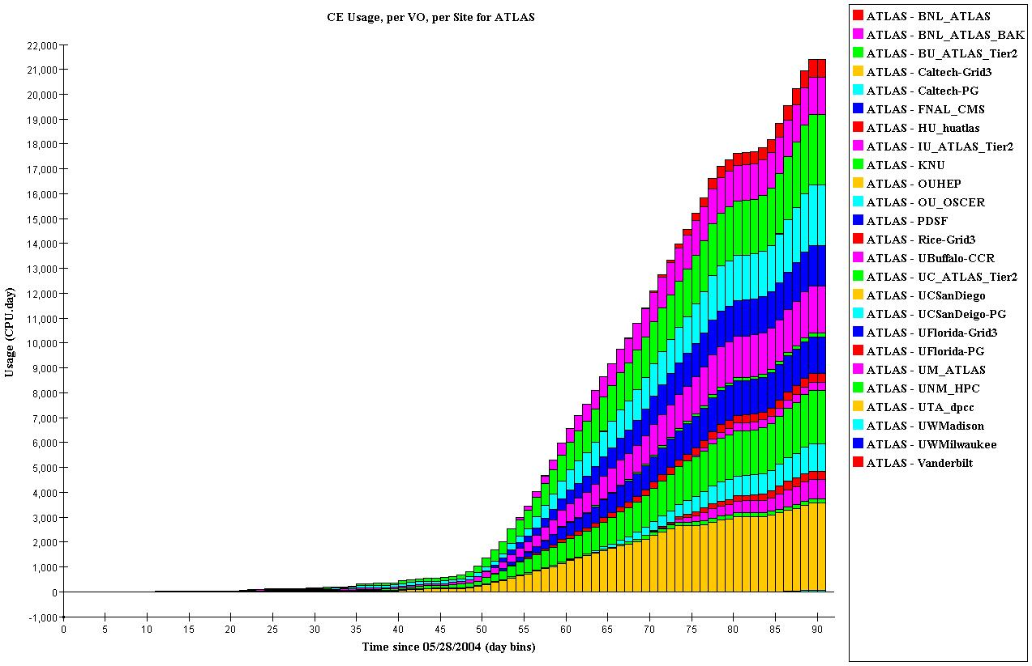
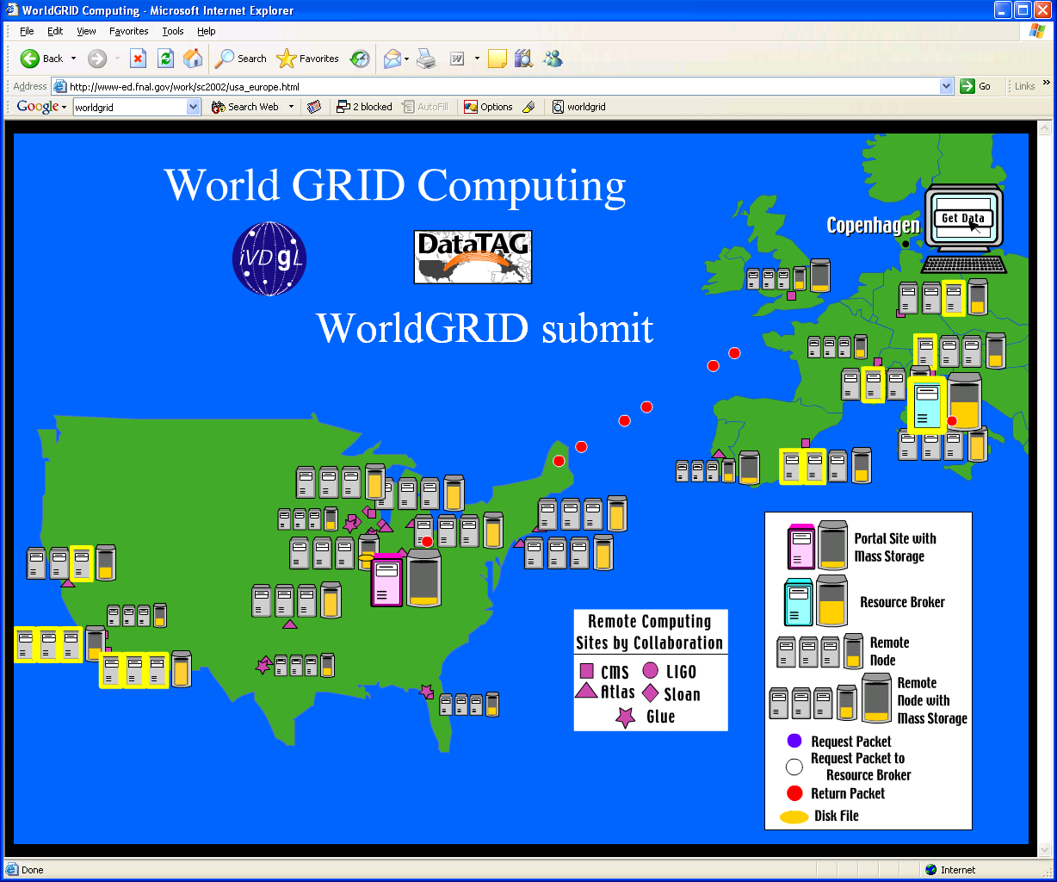
Executing VDL Workflows
Workflow spec
Create Execution Plan
Grid Workflow Execution
VDL
Program
Statically
Partitioned
DAG
DAGman
DAG
Virtual Data
catalog
DAGman &
Condor-G
Dynamically
Planned
DAG
Virtual Data
Workflow
Generator
Job
Planner
Job
Cleanup
Local planner
Abstract
workflow
Notes:
VDLt: textual version of the virtual data language
VDLx: XML version of the virtual data language
DAX: abstract directed acyclic graph description
VDLt is slightly less expressive than VDLx, thus the initial back-and-forth conversion between the formats might lose some non-essential information. Any further round will yield equivalent results.

Slide 17

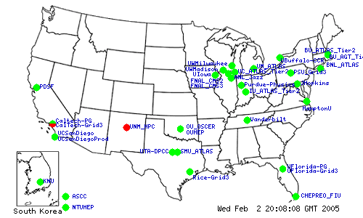











OSG:The “target chip” for VDS Workflows
Supported by the National Science Foundation and the Department of Energy.

Slide 18
VDS Supported Via
Virtual Data Toolkit
NMI
VDT
Sources
(CVS)
Build
Test
Binaries
Build & Test
Condor pool
22+ Op. Systems
Pacman cache
Package
Patching
RPMs
Build
Binaries
GPT src
bundles
Build
Binaries
Test
Many Contributors
A unique laboratory for testing, supporting, deploying, packaging, upgrading, & troubleshooting complex sets of software!
Slide courtesy of Paul Avery, UFL

Slide 19
Collaborative Relationships
Partner science projects
Partner networking projects
Partner outreach projects
Requirements
Prototyping
& experiments
Production
Deployment
Other linkages
Work force
CS researchers
Industry
Computer
Science
Research
Virtual
Data
Toolkit
Larger
Science
Community
Techniques
& software
Tech
Transfer
U.S.Grids
Globus, Condor, NMI, iVDGL, PPDG
EU DataGrid, LHC Experiments,
QuarkNet, CHEPREO, Dig. Divide
Int’l
Outreach
Slide courtesy of Paul Avery, UFL

Slide 20
VDS Applications
Application | Jobs / workflow | Levels | Status
ATLAS HEP Event Simulation | 500K | 1 | In Use
LIGO Inspiral/Pulsar | ~700 | 2-5 | Inspiral In Use
NVO/NASA Montage/Morphology | 1000s | 7 | Both In Use
GADU Genomics: BLAST,… | 40K | 1 | In Use
fMRI DBIC AIRSN Image Proc | 100s | 12 | In Devel
QuarkNet CosmicRay science | <10 | 3-6 | In Use
SDSS Coadd; Cluster Search | 40K 500K | 2 8 | In Devel / CS Research
FOAM Ocean/Atmos Model | 2000 (core app runs 250 8-CPU jobs) | 3 | In use
GTOMO Image proc | 1000s | 1 | In Devel
SCEC Earthquake sim | 1000s |  | In use

Slide 21
A Case Study – Functional MRI
Problem: “spatial normalization” of a images to prepare data from fMRI studies for analysis
Target community is approximately 60 users at Dartmouth Brain Imaging Center
Wish to share data and methods across country with researchers at Berkeley
Process data from arbitrary user and archival directories in the center’s AFS space; bring data back to same directories
Grid needs to be transparent to the users: Literally, “Grid as a Workstation”

Slide 22
A Case Study – Functional MRI (2)
Based workflow on shell script that performs 12-stage process on a local workstation
Adopted replica naming convention for moving user’s data to Grid sites
Creates VDL pre-processor to iterate transformations over datasets
Utilizing resources across two distinct grids – Grid3 and Dartmouth Green Grid

Slide 23
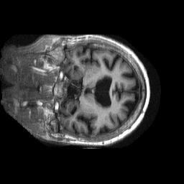
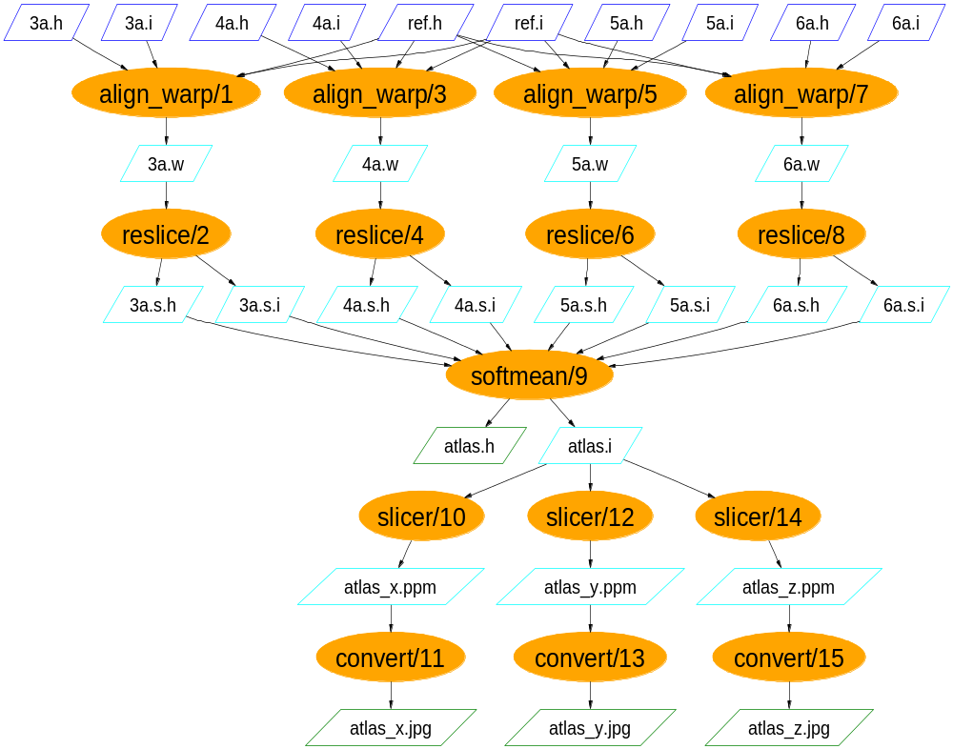
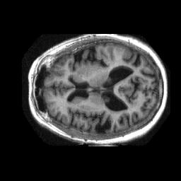
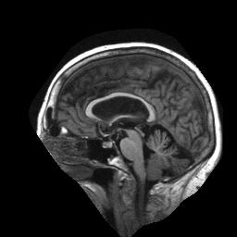
Functional MRI Analysis
Workflow courtesy James Dobson, Dartmouth Brain Imaging Center

Slide 24
fMRI Dataset processing
FOREACH BOLDSEQ
DV reorient (# Process Blood O2 Level Dependent Sequence
input = [ @{in: "$BOLDSEQ.img"},
@{in: "$BOLDSEQ.hdr"} ],
output = [@{out: "$CWD/FUNCTIONAL/r$BOLDSEQ.img"}
@{out: "$CWD/FUNCTIONAL/r$BOLDSEQ.hdr"}],
direction = "y", );
END
DV softmean (
input = [ FOREACH BOLDSEQ
@{in:"$CWD/FUNCTIONAL/har$BOLDSEQ.img"}
END ],
mean = [ @{out:"$CWD/FUNCTIONAL/mean"} ]
);

Slide 25
fMRI Virtual Data Queries
Which transformations can process a “subject image”?
Q: xsearchvdc -q tr_meta dataType
subject_image input
A: fMRIDC.AIR::align_warp
List anonymized subject-images for young subjects:
Q: xsearchvdc -q lfn_meta dataType subject_image
privacy anonymized subjectType young
A: 3472-4_anonymized.img
Show files that were derived from patient image 3472-3:
Q: xsearchvdc -q lfn_tree 3472-3_anonymized.img
A: 3472-3_anonymized.img
3472-3_anonymized.sliced.hdr
atlas.hdr
atlas.img
…
atlas_z.jpg
3472-3_anonymized.sliced.img

Slide 26

US-ATLAS
Data Challenge 2
CPU-day
Mid July
Event generation using Virtual Data
Sep 10

Slide 27
Provenance for DC2
How much compute time was delivered?
| years| mon | year |
+------+------+------+
| .45 | 6 | 2004 |
| 20 | 7 | 2004 |
| 34 | 8 | 2004 |
| 40 | 9 | 2004 |
| 15 | 10 | 2004 |
| 15 | 11 | 2004 |
| 8.9 | 12 | 2004 |
+------+------+------+
Selected statistics for one of these jobs:
start: 2004-09-30 18:33:56
duration: 76103.33
pid: 6123
exitcode: 0
args: 8.0.5 JobTransforms-08-00-05-09/share/dc2.g4sim.filter.trf CPE_6785_556
... -6 6 2000 4000 8923 dc2_B4_filter_frag.txt
utime: 75335.86
stime: 28.88
minflt: 862341
majflt: 96386
Which Linux kernel releases were used ?
How many jobs were run on a Linux 2.4.28 Kernel?

Slide 28
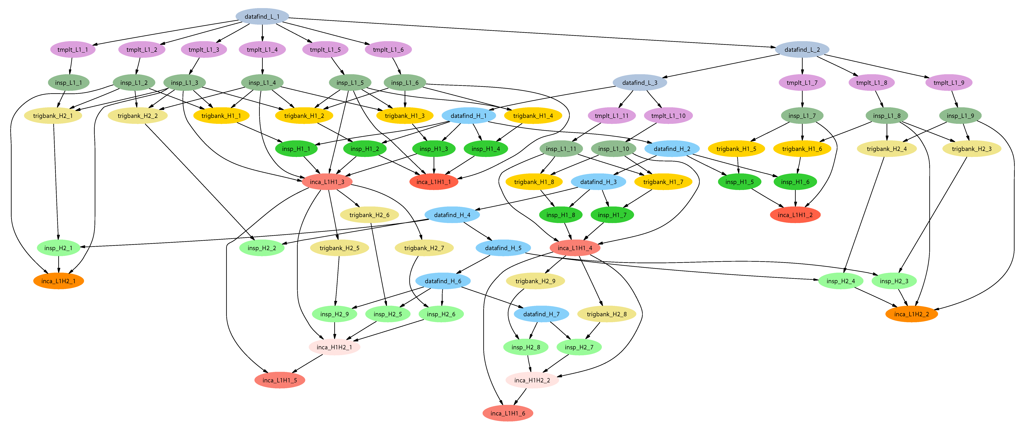
LIGO Inspiral Search Application
Describe…
Inspiral workflow application is the work of Duncan Brown, Caltech,
Scott Koranda, UW Milwaukee, and the LSC Inspiral group

Slide 29
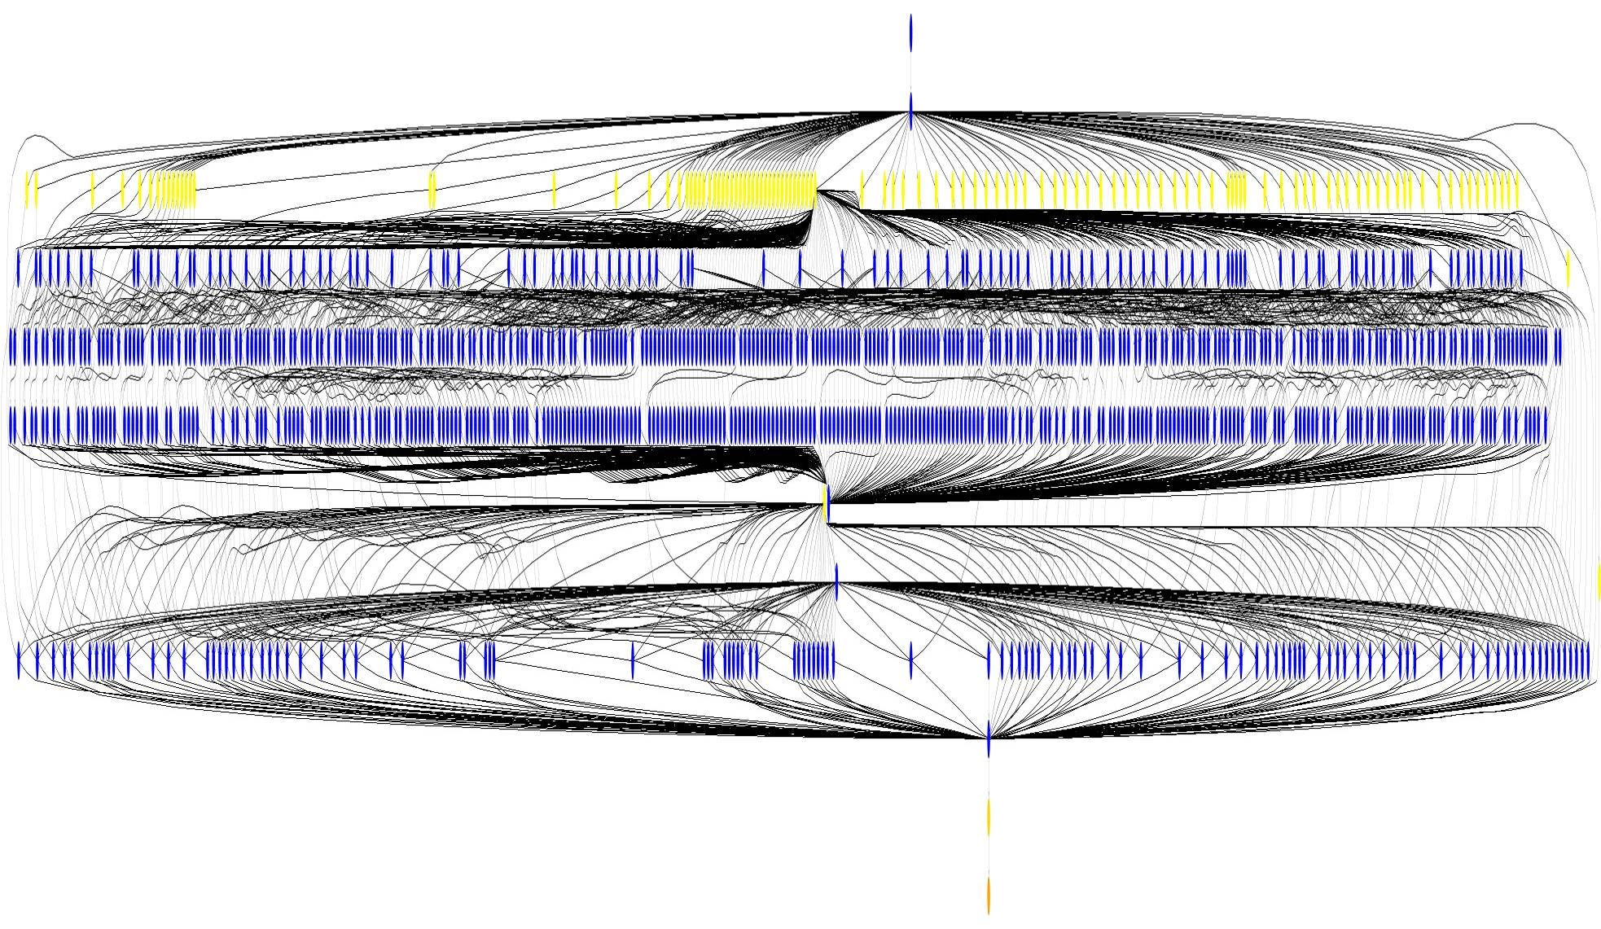
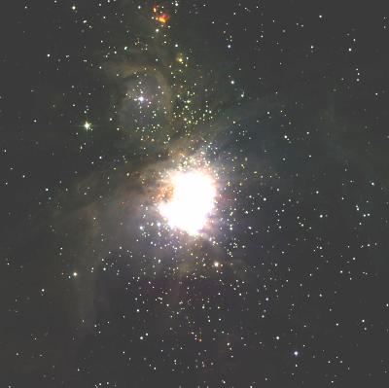
Small Montage Workflow
~1200 node workflow, 7 levels
Mosaic of M42 created on
the Teragrid using Pegasus

Slide 30
FOAM:
Fast Ocean/Atmosphere Model
250-Member Ensemble
Run on TeraGrid under VDS
Remote Directory Creation for Ensemble Member 1
Remote Directory Creation for Ensemble Member 2
Remote Directory Creation for Ensemble Member N
FOAM run for Ensemble Member 1
FOAM run for Ensemble Member 2
FOAM run for Ensemble Member N
Atmos Postprocessing
Atmos Postprocessing for Ensemble Member 2
Ocean Postprocessing for Ensemble Member 2
Coupl Postprocessing for Ensemble Member 2
Coupl Postprocessing for Ensemble Member 2
Results transferred to archival storage
Work of: Rob Jacob (FOAM), Veronica Nefedova (Workflow design and execution)

Slide 31
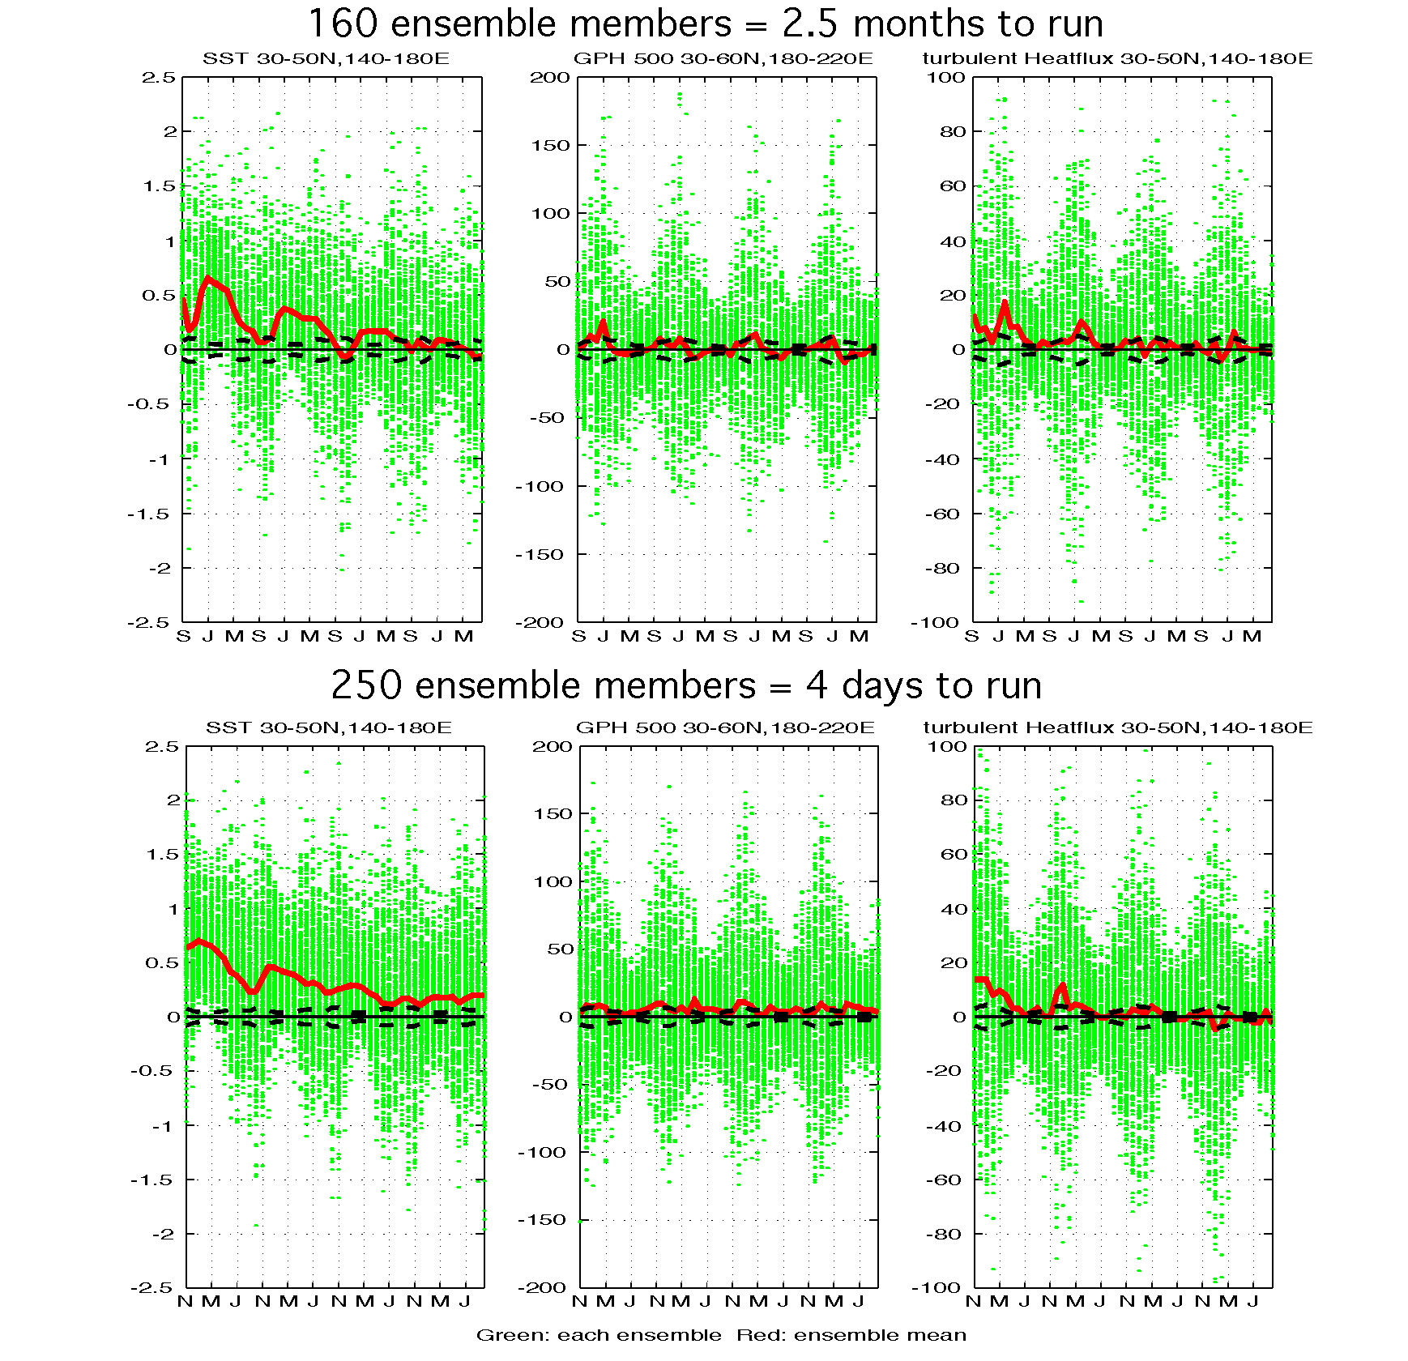
FOAM: TeraGrid/VDSBenefits
Climate Supercomputer
TeraGrid with NMI and VDS
Visualization courtesy Pat Behling and Yun Liu, UW Madison

Slide 32
NMI Tools Experience
GRAM & Grid Information System
  Tools needed to facilitate app deployment, debugging, and maintenance across sets of sites: “gstar” prototype at osg.ivdgl.org/twiki/bin/view/GriphynMainTWiki/GstarToolkit (work of Jed Dobson and Jens Voeckler)
Condor-G/DAGman
  Efforts under way to provide means to dynamically extend a running DAG; also research exploring the influence of scheduling parameters on DAG throughput and responsiveness
Site Selection
  Automated, opportunistic approaches being designed and evaluated
  Policy based approaches are a research topic (Dumitrescu, others)
RLS Namespace
  Needed to extend data archives to Grid and provide app transparency – some efforts underway to prototype this
Job Execution Records (accounting)
  Several different efforts – desire to unify in OSG

Slide 33
Conclusion
Using VDL to express location-independent computing is proving effective: science users save time by using it over ad-hoc methods
  VDL automates many complex and tedious aspects of distributed computing
Proving capable of expressing workflows across numerous sciences and diverse data models: HEP, Genomics, Astronomy, Biomedical
Makes possible new capabilities and methods for data-intensive science based on its uniform provenance model
Provides an abstract front-end for Condor workflow, automating DAG creation

Slide 34
Next Steps
Unified representation of data-sets, metadata, provenance and mappings to physical storage
Improved queries to discover existing products and to perform incremental work (versioning)
Improved error handling and diagnosis: VDS is like a compiler whose target chip architecture is the Grid – this is a tall order, and much work remains.
Leverage XQuery to formulate new workflows from those in a VO’s catalogs

Slide 35
Tutorial: Introduction to the Virtual Data Language
Summer Grid 2004
UT Brownsville South Padre Island Center
24 June 2004
Presented by: Mike Wilde
Argonne National Laboratory
Mathematics and Computer Science Division
Developed by: Jens Voeckler
The University of Chicago
Department of Computer Science

Slide 36
Acknowledgements:
Virtual Data is a Large Team Effort
The Chimera Virtual Data System
is the work of Ian Foster, Jens Voeckler, Mike Wilde and Yong Zhao
The Pegasus Planner is the work of Ewa Deelman, Gaurang Mehta, and Karan Vahi
Applications described are the work of many people, including: James Annis, Rick Cavanaugh, Dan Engh, Rob Gardner, Albert Lazzarini, Natalia Maltsev, Marge Bardeen, and their wonderful teams

Slide 37
Acknowledgements
GriPhyN, iVDGL, and QuarkNet
(in part) are supported by the National Science Foundation
The Globus Alliance, PPDG, and QuarkNet are supported in part by the US Department of Energy, Office of Science; by the NASA Information Power Grid program; and by IBM

Slide 38
Outline
Install the Virtual Data System
Simple workflows:
Get (some) user apps to run with shplan
Euryale – yet another concrete planner
Pegasus = Planning and Execution in grids
Notes:
Install= run test-version script.

Slide 39
Components of GVDS
The Chimera system for managing virtual data products
  Virtual data: materialize data on-demand
  Virtual data language, catalog and interpreter
The Pegasus system for planning and execution in grids
  Pegasus is a configurable system that can map and execute complex workflows on grid resources
Contributed packages:
  Visualizers, shell planner, Euryale

Slide 40
Prepare GVDS Installation
Log onto your Linux system.
Ensure Java version 1.4.*
  Type "$JAVA_HOME/bin/java –version"
  If necessary, download from
  http://java.sun.com/j2se/1.4/
Set JAVA_HOME environment variable
  Points to Java installation directory
  Example: setenv JAVA_HOME /usr/lib/java
Notes:
Some developers are able to use cygwin runtime environment. There are issues with the path setup that are not easily portable between Unix, cygwin and Windows. You have been warned.

Slide 41
Installation
Download the latest tar-ball
http://www.griphyn.org/workspace/VDS/snapshots.php
  The binary release is smaller
  The source release allows patching
  Let's try the source release for now…
Unpack
  gtar xvzf vds-source-1.2.5.tar.gz
cd vds-1.2.5
  Use the latest version.
Notes:
Also comes as part of VDT 1.1.14.

Slide 42
Starting
Source necessary shell script (all releases)
  Explicit setting of VDS_HOME=`/bin/pwd` before sourcing required
  Bourne: . set-user-env.sh
  C-Shell: source set-user-env.csh
Run test-version program to check
  Script is a small sanity test
  If it fails, Chimera will not run!
    Developer mode will fail to find gvds.jar – no worry.
Notes:
Developers should instead source the appropriate set-devel-env.sh or set-devel-env.csh scripts.
If you are changing between user mode and developer mode, unset the CLASSPATH variable before sourcing the correct shell script.
The difference between user mode and developer mode is that the user mode includes chimera.jar into the CLASSPATH variable, whereas in developer mode, the CLASSPATH points to the start of the source hierarchy instead. All scripts append the PATH with $VDS_HOME/bin and MANPATH.
In order to run Chimera in developer mode, one must compile all classes successfully, e.g. use "ant jar" without error.

Slide 43
Sample test-version Script Output
# checking for JAVA_HOME
# checking for CLASSPATH
# checking for VDS_HOME
# starting java
# Using recommended version of Java, OK
# looking for Xerces
# found /home/voeckler/vds/lib/xercesImpl.jar, OK for now
# found /home/voeckler/vds/lib/xmlParserAPIs.jar, OK for now
# looking for antlr
# found /home/voeckler/vds/lib/antlrall.jar, OK for now
# looking for GNU getopt
# found /home/voeckler/vds/lib/java-getopt-1.0.9.jar, OK for now
# looking for JDBC driver
# found /home/voeckler/vds/lib/pg73jdbc3.jar, OK for now
# found /home/voeckler/vds/lib/mysql-connector-java-…
# looking for my replica catalogs
# found /home/voeckler/vds/lib/rls.jar, OK for now
# looking for myself
# in developer mode, ignore not finding gvds.jar
# found /home/voeckler/vds/lib/gvds.jar, OK for now
Notes:
In developer mode, the last step may fail, as there is no chimera.jar in the CLASSPATH. That is o.k.

Slide 44
For Support and Problems
Mailing lists
  chimera-announce@griphyn.org
    Few emails; announcements only [closed list]
  chimera-support@griphyn.org
    Errors reports [open list]
  chimera-discuss@griphyn.org
    Features, futures, discussion, thoughts [open list]
Bugzilla website
  http://bugzilla.globus.org/chimera/
Notes:
It's not always Chimera's fault!

Slide 45
Working with Virtual Data
VDLx
vdlt2vdlx
VDLt
VDLx
vdlx2vdlt
search
ins/upd
DAX
gendax
VDC
Only the abstract planning process is shown
Notes:
VDLt: textual version of the virtual data language
VDLx: XML version of the virtual data language
DAX: abstract directed acyclic graph description
VDLt is slightly less expressive than VDLx, thus the initial back-and-forth conversion between the formats might lose some non-essential information. Any further round will yield equivalent results.

Slide 46
The Virtual Data Languages
VDLt is textual
Concise
For human consumption
Usually for (TR) transformation
Process by converting to VDLx
VDLx uses XML
Uses XML-Schema
For generation from scripts
Usually for (DV)
derivations
Storage representation of current VDDB
Notes:
The database format will improve over the current textual file version.

Slide 47
VDL: Virtual Data Language
Describes Data Transformations
Transformation
  Abstract template of program invocation
  Similar to "function definition"
Derivation
  “Function call” to a Transformation
  Store past and future:
    A record of how data products were generated
    A recipe of how data products can be generated
Invocation
  Record of a Derivation execution
TR
DV
PTR
Notes:
Derivations are "named calls". Future versions may use more unnamed calls, and have naming an option, not a mandate.

Slide 48
Example Transformation
TR tut::t1( out a2, in a1,
none pa = "500",
none env = "100000" ) {
argument = "-p "${pa};
argument = "-f "${a1};
argument = "-x –y";
argument stdout = ${a2};
profile env.MAXMEM = ${env};
}
$a1
tut::t1
$a2

Slide 49
Example Derivations
DV tut::d1->tut::t1 (
env="20000", pa="600",
a2=@{out:"run1.exp15.T1932.summary"},
a1=@{in:"run1.exp15.T1932.raw"},
);
DV tut::d2->tut::t1 (
a1=@{in:"run1.exp16.T1918.raw"},
a2=@{out:"run1.exp16.T1918.summary"}
);

Slide 50
Hello World
Exercise 1:
  Wrap echo 'Hello world!' into VDL
Start with the transformation
  TR tut::hw( output file )
  {argument = "Hello world!";
  argument stdout = ${file}; }
Then "call" the transformation
  DV tut::hello->tut::hw(
  file=@{output:"out.txt"} );
Save into a file hw.vdl
Notes:
"world" is the name of the transformation. This is a logical name.
"hello" is the name of the derivation (left of arrow), which calls "hello" (right of arrow).
Parameter matching is done on name (like Python), but expected to take position into account in future versions.
Every argument may be named. Only the special names "stdin", "stdout" and "stderr" refer to the streams to capture from or into a file.
All file names are logical.
Where now does the echo application come into the game?
And what about the logical file out.txt ?

Slide 51
What to do with it?
All VDLt must be converted into VDLx before it becomes "usable" to the VDS.
  vdlt2vdlx hw.vdl hw.xml
All VDLx must be stored into your VDDB, before the system can work with it
  insertvdc hw.xml
or
  updatevdc hw.xml
But where did it go?
Notes:
Insert will add to the database, but does not overwrite existing definitions
Update will add to the database, adding new items if necessary, or updating existing items. Updates work by removing possibly existing definitions, and adding them again. Thus, insertion is faster, and should be preferred, if possible.
Tip: Build VDL-generators to generate VDLx to save the conversion step.

Slide 52
Properties I
The GVDS is configured by properties
Prefix "vds."
Best documentation in
$VDS_HOME/etc/sample.properties
Global properties in
$VDS_HOME/etc/properties
User-local properties (overwrites) in
$HOME/.chimerarc
Command-line properties highest prio
-Dvds.some.key=value
Notes:
Settings in the local user properties can overwrite setting in the global properties. Command-line properties take precedence over both.
If command-line properties are specified, they must be the first argument(s).

Slide 53
VDC storage options
Support for flat files…
  For simple, out-of-the-box test use
  Default, suggested maximum 1000
    vds.db.vdc.schema = SingleFileSchema
    vds.db.vdc.schema.file.store = <flatfile xml>
    #vds.db.vdc.schema.xml.url = <VDLx xsd>
Notes:
Could/should be turned into a web service.

Slide 54
VDC storage options II
… and relational database systems
  For production systems
  PostGreSQL 7.3.* (and 7.4.*)
    vds.db.*.driver = Postgres
  MySQL 4.1.*
    vds.db.*.driver = MySQL
  Permits spreading of unrelated catalogs across DBs
    vds.db.<schema1>.driver = Postres
    vds.db.<schema2>.driver = MySQL
Notes:
Could/should be turned into a web service.
Toying with Oracle support.
The * is a stand-in to mean "all schemas" that are not handled explicitely.

Slide 55
VDC storage options III
rDBMS requires schema setup
  $VDS_HOME/sql contains schema files.
  $VDS_HOME/doc user guide for setup.
and properties per rDBMS
  The usual suspects include
    vds.db.<schema>.driver.url = jdbc:…
    vds.db.<schema>.driver.user = ${user.name}
    vds.db.<schema>.driver.password = ${user.name}
Notes:
Could/should be turned into a web service.

Slide 56
VDC schema flavors
either/or
AnnotationSchema
  Based on chunk schema
  Permits annotations
  Future default
ChunkSchema
  Simple, fast
  Current default
InvocationSchema
  Currently optional
  Future required
  Tracks provenance
Notes:
You must chose either chunk or anno schema. Both will work with the InvocationSchema.

Slide 57
VDC schema storage options
Schemas also require properties
  Simple chunk schema
    vds.db.vdc.schema = ChunkSchema
  Annotated schema
    vds.db.vdc.schema = Annotationchema
  Provenance Tracking Catalog (PTC)
    vds.db.ptc.schema = InvocationSchema
Notes:
Could/should be turned into a web service.

Slide 58
So, Where did it go?
You can check with your VDDB
  searchvdc –n tut
    2004.05.14 … [app] searching the database
    tut::hw
    tut::hello->tut::hw
Output and search options
  List view, VDLt view, VDLx results
  Search by namespace, definition type, LFN
  Etc.
Notes:
Try "searchvdc –h" (future: --help) for quick help on search options. Or refer to the manpage.

Slide 59
From VDC to DAX
Deriving the provenance of a logical file or derivation is the abstract planning process.
Abstract DAG in XML = DAX
All files and transformations are logical!
  The complete provenance will be unrolled
  No external catalogs (TC,RC) are queried
Notes:
The label "-l" is used later to identify the master instance (DAG file, master shell script, etc.) to invoke later. You should always use a label. Otherwise, it defaults to "test".

Slide 60
From VDC to DAX
Ask the catalog for the produced file
  gendax –l hw –o hw1.dax –f out.txt
Or ask for the derivation
  gendax –l hw –o hw2.dax –n tut –i hello or
  gendax –l hw –o hw3.dax –D tut::hello
Notes:
The label "-l" is used later to identify the master instance (DAG file, master shell script, etc.) to invoke later. You should always use a label. Otherwise, it defaults to "test".

Slide 61
The DAX file
Result of the Chimera abstract planner.
Richer than Condor DAGMan format.
Expressed in terms of logical entities.
Contains complete (build) lineage.
Consists of three major parts
  All logical files necessary for the DAG.
  All jobs necessary to produce all files.
  The dependencies between the jobs.
Notes:
DAX format is projected to change. The sections order may change next.

Slide 62
Output hw1.dax
<?xml version="1.0" encoding="UTF-8"?>
<!-- generated: 2004-05-14T15:21:38-05:00 -->
<!-- generated by: voeckler [??] -->
<adag xmlns="http://www.griphyn.org/chimera/DAX" xmlns:xsi="http://www.w3.org/2001/XMLSchema-instance" xsi:schemaLocation="http://www.griphyn.org/chimera/DAX http://www.griphyn.org/chimera/dax-1.8.xsd"
version="1.8" count="1" index="0" name="hw">
<!-- part 1: list of all files used (may be empty) -->
<filename file="out.txt" link="output"/>
<!-- part 2: definition of all jobs (at least one) -->
<job id="ID000001" namespace="tut" name="hw" level="1"
dv-namespace="tut" dv-name="hello">
<argument>Hello World! </argument>
<stdout file="out.txt" link="output" varname="file"/>
<uses file="out.txt" link="output" dontRegister="false" dontTransfer="false"/>
</job>
<!-- part 3: list of control-flow dependencies (empty for single jobs) -->
</adag>

Slide 63
Making a DAX Runnable
Map logical entities to physical entities.
Require external services for mapping:
  Replica Catalog (RC)
    Maps LFN to PFN
    and thus TFN, SFN
  Resource (pool) Catalog (PC)
    Contains site-specific configurations
  Transformation Catalog (TC)
    Maps transformation to application

Slide 64
The Transformation Catalog
Translates logical transformation into an application specific for a certain pool
Default: Simple, text based file
  3+ columns
  Blank lines and comments are ignored
Standard location
  $VDS_HOME/var/tc.data
  adjustable with property vds.tc.file
New: Pegasus will use an rDBMS
  available soon
Notes:
$VDS_HOME/etc/properties contains all user properties for VDS. Please refer to the user guide for details on available properties and their effects.

Slide 65
Transformation Catalog Columns
1st column is the pool handle
  Shell planner only uses the "local" handle
  Other handles for concrete planners
2nd column is the logical transformation
  Format: <ns>_ _ <name>_<version>
  Name-only names are just <name>
3rd column is the path to the executable
4th column for environment variables
  Use "null" if unused
  Format: key=value;key=value
Notes:
Quirk: If you use ns or vs, you must specify both – for Pegasus.
Support for the fully-qualified transformation name may be lacking in some concrete planners.
Examples are strewn over many directories.

Slide 66
The Shplan Replica Catalog
A replica catalog translates a logical filename into a set of physical filenames
This RC is for the shell planner only
Production-strength RC is RLS-based.
Simple textual file
  Three columns
  Blank lines and comments are ignored
Standard location
  $VDS_HOME/var/rc.data
  Adjustable with property vds.db.rc
Notes:
$VDS_HOME/etc/properties contains all user properties for VDS. Please refer to the user guide for details on available properties and their effects.

Slide 67
Shell planner RC Columns
1st column is the pool handle
  Shell planner only uses the "local" handle
  Other handles for concrete planner
2nd column is the logical filename
  A LFN may contain slash etc.
3rd column is the path to the file
Are multiples allowed?
  No, only the last (first?) match is taken

Slide 68
TC and RC Short-cuts
Application locations can come from VDL
  hints.pfnHint takes precedence over TC
    pfnHint is a deprecated feature!
  Shell planner may run w/o any TC
Files need not be registered with RC
  Existence checks are done in file system
  RC updates can be optional
  Shell planner may run w/o any RC
➔ After all, we run locally with the shell planner!
Notes:
Using application locations in VDL is not recommended, as the specific location of an application may change from pool to pool.

Slide 69
Preparing to Run The Shell Planner
Make sure that your TC contains a translation for logical transformation "hw"
  local tut__hw /bin/echo null
Make sure that there is a RC without weird content:
  cp /dev/null $VDS_HOME/var/rc.data
Notes:
The distributed rc.data may contain some weird content, sorry!

Slide 70
Running The Shell Planner
Run the shell planner
  shplanner –o hw hw1.dax
Check directory "hw"
  Master script: <DAX-label>.sh
  Job scripts: <TR>_<DAX-JobID>.sh
  Helper files: <TR>_<DAX-JobID>.lst
Notes:
Ignore the slightly verbose output for now

Slide 71
Running The Shell-Plan
Shell planner generates a master plan
  This is a tool-kit → no auto-run feature
Run the master plan
  ( cd hw && ./hw.sh )
Can check log file for status etc.
  Standard name: <DAX-label>.log
Master script will exit with 0 on success
  Exit 1, if any sub-script fails.

Slide 72
Convert A Unix Pipeline
Example 2: Full name from a username
  grep ^user /etc/passwd | awk –F: '{ print $5 }'
Create abstract transformations
Create concrete derivations to call them
Convert into VDLx
Add to VDDB
Run abstract planner
Run shell planner
Run master script

Slide 73
Workflow from File Dependencies
file1
TR tut::tr1(in a1, out a2) {
argument stdin = ${a1};
argument stdout = ${a2}; }
TR tut::tr2(in a1, out a2) {
argument stdin = ${a1};
argument stdout = ${a2}; }
DV tut::x1->tut::tr1(a1=@{in:file1}, a2=@{out:file2});
DV tut::x2->tut::tr2(a1=@{in:file2}, a2=@{out:file3});
tut::x1
file2
tut::x2
file3
Notes:
Explicit dependencies.

Slide 74
Abstract Transformations
Grep for an arbitrary user name
  TR tut::grep( none name, output of )
  { argument = "^"${name}" /etc/passwd";
  argument stdout = ${of}; }
Extract a full name from a line
  TR tut::awk( input line, output full )
  { argument stdin = ${line};
  argument stdout = ${full};
  argument = "-F: '{ print $5 }' "; }
Notes:
DO NOT call your files any of the reserved words none, in, input, inout, io, out, or output. Currently, the standard vdlt2vdlx also does not allow these reserved words as prefix to any name, but we intend to fix that.
Some tricks here. The /etc/passwd, albeit a file, is handled like a constant. Thus, it will be untracked. For most Unix systems, this is ok.
The script to awk is presented on the commandline to awk. Thus, its quotes must be quoted for correct usage. Please note that the first example might run into troubles, too, if certain things are used w/o quoting.

Slide 75
Concrete Derivations
Run with a concrete username…
  DV tut::d2->tut::grep( name="voeckler", of=@{output:"grepout.txt"} );
… and post-process the results
  DV tut:: d3-> tut:: awk( line=@{in:"grepout.txt"}, full=@{out:"awkout.txt"} );
The two derivations are linked by a LFN
  "grepout.txt" is produced by "d2"
  "grepout.txt" is consumed by "d3"

Slide 76
Convert, Insert and Plan
Convert into VDLx
  vdlt2vdlx ex2.vdl ex2.xml
Insert into your VDDB
  insertvdc ex2.xml
Run abstract planner
  gendax –l ex2 –o ex2.dax –f awkout.txt

Slide 77
Run Shell Planner
Prepare transformation catalog
  local tut__grep /usr/bin/egrep null
  local tut__awk /opt/gnu/bin/gawk null
Run shell planner
  shplanner –o ex2 ex2.dax
Run master plan
  ( cd ex2 && ./ex2.sh )

Slide 78
Kanonical Executable for Grids
Simple application
  Copies all input with indentation to all output files
  Adds additional data about itself
Allows tracking
  What ran where, when, which architecture, and how long
To be used as stand-in for real applications
  Allows to check the DAG stages
Notes:
Run "keg –o /dev/fd/1"

Slide 79
The "black diamond" WF
Complex structure
  Fan-in
  Fan-out
  "left" and "right" can run in parallel
Uses input file
  Register with RC
Complex file dependencies
  Glues workflow
preprocess
findrange
findrange
analyze
Notes:
We deal with "regular diamonds" (as in the big dag), and "black diamonds". Regular diamonds use a generating top node, and don't have cross-dependencies.
The processes are neither "findrange" nor "right". "findrange" is the TR name, "right" the DV name. The application (and thus process) is most likely "keg".

Slide 80
Workflow step "preprocess"
TR preprocess turns f.a into f.b1 and f.b2
  TR tut::preprocess( output b[], input a ) {
  argument = "-a top";
  argument = " –i "${input:a};
  argument = " –o " ${output:b};
  }
Makes use of the "list" feature of VDL
  Generates 0..N output files.
  Number file files depend on the caller.

Slide 81
Workflow step "findrange"
Turns two inputs into one output
  TR tut::findrange( output b, input a1,
  input a2, none name="findrange",
  none p="0.0" ) {
  argument = "-a "${name};
  argument = " –i " ${a1} " " ${a2};
  argument = " –o " ${b};
  argument = " –p " ${p};
  }
Uses the default argument feature

Slide 82
Can also use list[] parameters
  TR tut::findrange( output b, input a[],
  none name="findrange", none p="0.0" ) {
  argument = "-a "${name};
  argument = " –i " ${" "|a};
  argument = " –o " ${b};
  argument = " –p " ${p};
  }

Slide 83
Workflow step "analyze"
Combines intermediary results
  TR tut::analyze( output b, input a[] ) {
  argument = "-a bottom";
  argument = " –i " ${a};
  argument = " –o " ${b};
  }

Slide 84
Complete VDL workflow
Generate appropriate derivations
  DV tut::top->tut::preprocess( b=[ @{out:"f.b1"},
  @{out:"f.b2"} ], a=@{in:"f.a"} );
  DV tut::left->tut::findrange( b=@{out:"f.c1"}, a2=@{in:"f.b2"}, a1=@{in:"f.b1"}, name="left", p="0.5" );
  DV tut::right->tut::findrange( b=@{out:"f.c2"}, a2=@{in:"f.b2"}, a1=@{in:"f.b1"}, name="right" );
  DV tut::bottom->tut::analyze( b=@{out:"f.d"}, a=[ @{in:"f.c1"}, @{in:"f.c2"} );
Notes:
Filenames provide the glue.
findrange is called multiple times.

Slide 85
The Diamond DAG II
The "black diamond" takes one input file
  echo –e "local\tf.a\t${HOME}/f.a"
  » $VDS_HOME/var/rc.data
  date > ${HOME}/f.a
It uses three different transformations
  echo –e "local\ttut__preprocess\t$VDS_HOME/bin/keg\tnull" » $VDS_HOME/var/tc.data
  echo –e "local\ttut__findrange\t$VDS_HOME/bin/keg\tnull"
  » $VDS_HOME/var/tc.data
  echo –e "local\ttut__analyze\t$VDS_HOME/bin/keg\tnull"
  » $VDS_HOME/var/tc.data

Slide 86
Interlude: LFN
Historically in two flavors:
  Staged and tracked (regular) files
    @{dir:"lfn"}
  Unstaged and untracked (temporary) files
    @{dir:"lfn":"tmp"}
Now with option flags for finer control:
    @{dir:"lfn" [:"tmp"] [|flags]}
  @{dir:"lfn"|rt}
  @{dir:"lfn":"tmp"|}

Slide 87
Immediate Future LFNs
Optional file transfers
  Don't fail a transfer is a file is missing.
  Prototypical new transfer tool working.
  VDLt: Since 1.22: @{lfn|T} flag
Optional files
  Don't fail abstract job, if a file is missing.
  VDLt: Since 1.23: @{lfn|o} flag

Slide 88
A Big Example
Overall tree structure
  70 "regular" diamond DAGs on top
  10 collecting nodes
  1 final collector
  291 jobs to run
All files are generated, no RC preloading
Add "multi" TR to last example
  echo –e "local\ttut__multi\t$VDS_HOME/bin/keg\tnull" » $VDS_HOME/var/tc.data

Slide 89
Compound Transformations
Using compound TR
  Composition of complex TRs from basic ones
  Calls are independent
    unless linked through LFN
  A Call is effectively an anonymous derivation
    Late instantiation at workflow generation time
  Permits bundling of repetitive workflows
  Model: Function calls nested within a function definition
  Permits temporary filenames

Slide 90
Compound Transformations
TR diamond1 bundles black-diamonds
  TR tut::diamond1( out fd, io fc1, io fc2, io fb1, io fb2,
  in fa, p1, p2 ) {
  call tut::preprocess( a=${fa}, b=[ ${out:fb1}, ${out:fb2} ] );
  call tut::findrange( a1=${in:fb1}, a2=${in:fb2}, name="LEFT", p=${p1}, b=${out:fc1} );
  call tut::findrange( a1=${in:fb1}, a2=${in:fb2}, name="RIGHT", p=${p2}, b=${out:fc2} );
  call tut::analyze( a=[ ${in:fc1}, ${in:fc2} ], b=${fd} );
  }
Notes:
The declaration uses abbreviations, nothing for "none", "in" for "input" etc.
Until transient filenames are implemented, it is required to declare the glue filenames as IO formal argument.
IO arguments must declare their direction either as in or out when being used (referenced).

Slide 91
Compound Transformations (cont)
Multiple DVs allow easy generator scripts:
  DV tut::d1->tut::diamond1( fd=@{out:"f.00005"}, fc1=@{io:"f.00004"|}, fc2=@{io:"f.00003"|},
  fb1=@{io:"f.00002"|}, fb2=@{io:"f.00001"|},
  fa=@{io:"f.00000"}, p2="100", p1="0" );
  DV tut::d2->tut::diamond1( fd=@{out:"f.0000B"}, fc1=@{io:"f.0000A"|}, fc2=@{io:"f.00009"|},
  fb1=@{io:"f.00008"|}, fb2=@{io:"f.00007|"},
  fa=@{io:"f.00006"}, p2="141.42135623731", p1="0" );
  ...
  DV tut::d70->tut::diamond1( fd=@{out:"f.001A3"}, fc1=@{io:"f.001A2"|}, fc2=@{io:"f.001A1"|},
  fb1=@{io:"f.001A0"|}, fb2=@{io:"f.0019F"|},
  fa=@{io:"f.0019E"}, p2="800", p1="18" );
Notes:
Very verbose to link workflows together with inout files. All these files are tracked, transferred and registered, even though they may not serve any purpose beyond gluing a workflow together.

Slide 92
New Compound Transformations
TR diamond2 bundles black-diamonds better:
  TR tut::diamond2( out fd, in fa, p1, p2 ) {
  inout fb1 = @{inout:"f.b1":"f.b1.XXXXXX"};
  inout fb2 = @{inout:"f.b2":"f.b2.XXXXXX"};
  inout fc1 = @{inout:"f.c1":"f.c1.XXXXXX"};
  inout fc2 = @{inout:"f.c2":"f.c2.XXXXXX"};
  call tut::preprocess( a=${fa}, b=[ ${out:fb1}, ${out:fb2} ] );
  call tut::findrange( a1=${in:fb1}, a2=${in:fb2}, name="LEFT", p=${p1}, b=${out:fc1} );
  call tut::findrange( a1=${in:fb1}, a2=${in:fb2}, name="RIGHT", p=${p2}, b=${out:fc2} );
  call tut::analyze( a=[ ${in:fc1}, ${in:fc2} ], b=${fd} );
  }
Notes:
The formal argument declaration uses abbreviations, nothing for "none", "in" for "input" etc.
The temporary filenames which glue the graph are declared first. A new set of LFNs is instantiated for each instantiation of the compound.
If the glue filenames provide valuable information, render them trackable: Declare those glue filenames as IO formal argument.
IO filenames must declare their direction either as in or out when being used (referenced).
Using a temporary pattern implies dontRegister (no "r") and dontTransfer (no "t") option for LFNs.

Slide 93
New Compound Transformations
Easier generator scripts, less clutter:
  DV tut::d1->tut::diamond( fd=@{out:"f.00002"}, fa=@{io:"f.00001"}, p2="100", p1="0" );
  DV tut::d2->tut::diamond( fd=@{out:"f.00004"}, fa=@{io:"f.00003"}, p2="141.42135623731", p1="0" );
  ...
  DV tut::d70->tut::diamond( fd=@{out:"f.00140"}, fa=@{io:"f.00139"}, p2="800", p1="18" );
Notes:
Less files to transfer or clutter RLS.

Slide 94
Acknowledgements
…many thanks to the entire Trillium / OSG Collaboration, iVDGL and OSG Team, Virtual Data Toolkit Team, and all of our application science partners in ATLAS, CMS, LIGO, SDSS, Dartmouth DBIC and fMRIDC, SCEC, and Argonne’s Computational Biology and Climate Science Groups of the Mathematics and Computer Science Division.
The Virtual Data System group is:
  ISI/USC: Ewa Deelman, Carl Kesselman, Gaurang Mehta, Gurmeet Singh, Mei-Hui Su, Karan Vahi
  U of Chicago: Catalin Dumitrescu, Ian Foster, Luiz Meyer (UFRJ, Brazil), Doug Scheftner, Jens Voeckler, Mike Wilde, Yong Zhao
  www.griphyn.org/vds
GriPhyN and iVDGL are supported by the National Science Foundation
Many of the research efforts involved in this work are supported by the US Department of Energy, office of Science.

