Slide 1
OSG
Area Coordinator’s Report:
Workload Management
March 25th, 2010
Maxim Potekhin
BNL
631-344-3621
potekhin@bnl.gov

Slide 2
Workload Management: Overview
Areas of Activity: ITB, Engagement , upgrade of Panda monitoring
Current Initiatives
  Panda/ITB:
    expanded ITB job submission to as many sites as we could (see next slide for status)
    Atlas: ran new release of Atlas software on ITB platform for validation
  Engagement:
    DUSEL Long Base Neutrino Experiment (LBNE), and Daya Bay: Working out file system access on RACF (they work on the RHIC side of BNL cluster)
    Ongoing support of CHARMM and expansion of job submission to more sites, new project starting
    SBGRID – performed initial Panda setup, starting testing
    UW Milwaukee – project didn’t get funding, canceled effort
  Upgrade of Panda monitoring system
    Renewed focus in ATLAS, weekly meetings
    VOs expressed interest in a simpler, leaner monitoring interface, we need to accommodate this
  Mics:
    Panda section of the “OSG Job Submission Document” in preparation

Slide 3
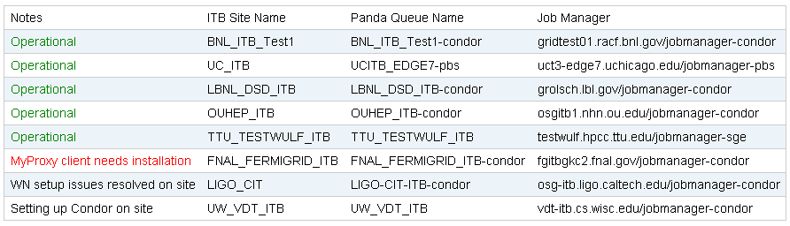
Workload Management: Panda/ITB
Panda ITB Status:
  Standing by for set up at 3 sites, 5 operational
  Allows for convenient monitoring of ITB jobs execution from one central Web location
  Access to logs and output files stored in Panda Monitor makes the process self-documenting
  Better overall organization

Slide 4
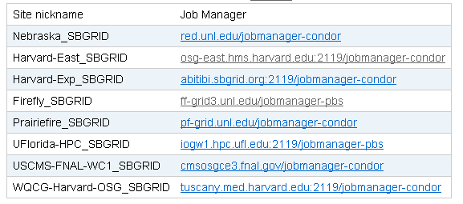
Workload Management: Engagement
Setting up Panda for feasibility tests by SBGRID
  Currently this is a test on a limited number of priority sites
  Does not require significant diversion of effort on either SBGRID or OSG side
  Useful discussions at All-Hands Meeting at FNAL
  Initial Panda setup done since then (table below)
  Testing to commence within days
CHARMM
  Currently ramping up production levels
  Need 250k CPU-hours for the current run
Daya Bay/LBNE (2 groups at BNL)
  Resolving site, pilot generator and file system set up issues (slightly different mechanism required in Panda)

Slide 5
Workload Management: Panda Monitoring upgrade
Cooperation with CERN:
  Personnel changes and a renewed focus on the design of the Dashboard, and Panda data feed into it
  Weekly meetings held
  Previous effort in investigating Google Web Toolkit indicates that a different platform needs to be chosen (too much overhead and learning curve)
  Our approach has always been that any development effort we undertake in monitoring area, will serve the needs of not only Atlas but other VOs using Panda
  Based on our previous design work, we continue with AJAX/JSON approach for the API, and view Panda monitoring as a Web service delivering data to multiple other clients and services on demand
  In a nutshell, our preferred solution is Django serving JSON

Slide 6
Overview
Workload Management
Accomplishments since last report:
  Completion of Panda/ITB setup (the so-called Panda Robot) and readiness to quickly expand to more sites as they become available
  Support of the new CHARMM production run
  Started working with SBGRID. Panda setup done for main SBGRID sites, testing commencing
  Panda section of the “OSG Job Submission Document” close to final (effort led by D.Fraser)
  Better documentation of Panda usage for non-Atlas VOs
    http://www.usatlas.bnl.gov/twiki/bin/view/AtlasSoftware/PandaExtensions#Current_activities
Issues / Concerns
  Carryover from previous report: Panda monitoring upgrade likely to have a scope that would require more manpower to get it right, and such upgrade does remain a priority according to feedback we get
  Need for specialized setup for Daya Bay/LBNE

