Slide 1
OSG RA, DOEGrids CA features
Doug Olson, LBNL
August 2006

Slide 2
Contents
RA, agent, sponsor layout & OU=People use case
Sample web form
Agent Role
GridAdmin Role
Questions
Schedule

Slide 3



Grid Classic PKI
People Certificate Workflow
Registration Manager (RM)
PKI1.DOEGrids.Org
4
CA
Sponsor
1
2
2
4
3
Project
DBMS
8
5
Registration Authority (RA) Agent
9
Subscriber
6
7
Subscriber requests Certificate
RM posts signing request notice
The RA for the Subscriber retrieves request
The RA agent reviews request with Grid project
The agent updates/approves/rejects request
Approved Certificate Request is sent to CM
Certificate Manager (CM)
(Certificate Signing Engine)
CM issues certificate
RM sends Email notice to Subscriber
Subscriber picks up new certificate

Slide 4
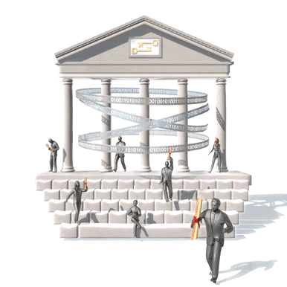


OSG RA Layout
10. download
Certificate
Subscriber
6.
Registration
Manager
Registered
Support
Centers
1. submit
2,8. notify
7.
request
DOEGrids CA 1
2. notify
2,8. notify
CDF
CMS
DES
DOSAR
DZero
Fermilab
fMRI
GADU
geant4
GLOW
GRASE
GridChem
GridEx
GROW
i2u2
iVDGL
LIGO
mariachi
MIS
nanoHUB
SDSS
STAR
USATLAS
CSC
DOSAR
DZero
Fermilab
fGOC
GADU
GRASE
GROW-GOC
LIGO
mariach-support
OSG-GOC
PROD_SLAC
SDSS
STAR
TACC
UC CI
USATLAS
USCMS
VDT
4.c verify
4.d reply
Publish
certificates
3. retrieve
request
Sponsor
4.b authenticate
LDAP
Cert.
directory
4.e. confirm or deny
VO
sponsor
DB
4.a check authorized
sponsors
5. approve
or reject
9. Record RA actions
Agents within each
support center know
which VOs and sites
they support
RA Log
Registered
VOs
Subscriber chooses
one of the existing
OSG registered VOs
Typical use case for
personal certificate.
Draft 19 Apr 2006

Slide 5
Things on the horizon
ESnet has a new version of the CA software in and house under investigation
  RedHat Certificate System
  http://www.redhat.com/solutions/rhcs/
  evolution of same code base of iPlanet/SUN CMS
OSG RA setting up Roundup Issue Tracking to track request processing with more flexibility than the CA Agent interface.
  Will form basis of RA performance metrics.
Implementing https based sponsor confirmation as alternative to digitally signed email
DOEGrids/ESnet looking at setting up CA tied to other user account database via Radius, such as LDAP, …

Slide 6
Interfaces we can affect
Cert Request form (somewhat)
Cert management scripts
Email request notices to agents (somewhat)
Consider separate OSG Registration Manager to isolate OSG from other RA requests
Ldap directory of published certificates

