Slide 1
Gluex VO Status Report
Richard Jones, University of Connecticut
OSG Council Meeting, September 11, 2012

Slide 2
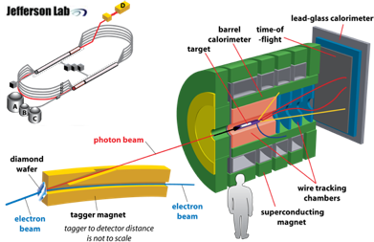
Gluex VO – the science
Goal: discover the spectrum of exotic mesons in the mass range
1.5 – 2.5 GeV (exotic resonance region predicted by LQCD)

Slide 3
Gluex VO – the collaboration
15 institutions + Jlab
~60 members
Collab. Board (6)
Executive Committee
Current spokesperson
Curtis Meyer, CMU
Arizona State University
Carnegie Mellon University
Catholic University of America
Christopher Newport University
University of Connecticut
Florida International University
Florida State University
University of Glasgow
Indiana University
Jefferson Lab
U. of Massachusetts
M.I.T.
North Carolina A&T State
University of North Carolina
Santa Maria University
University of Regina
University of Athens
Schedule:
Sept. 2008: CD3 start of construction
May 2012: end of 6 GeV Ops.
2015: CD4 start of operations

Slide 4
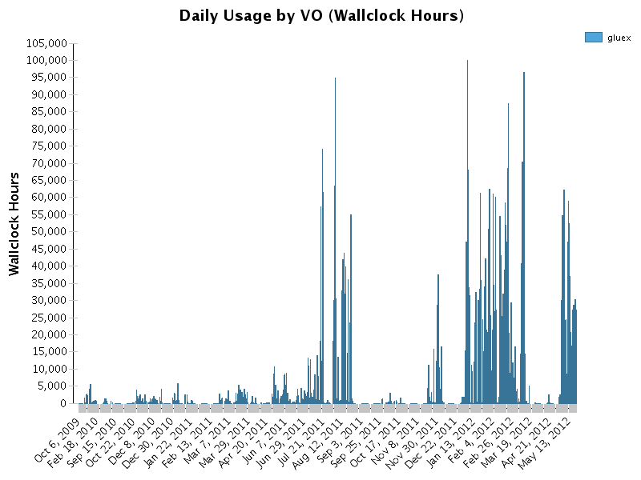
OSG Usage History by GlueX
Date range: 2009-9-1 - 2012-05-21

Slide 5
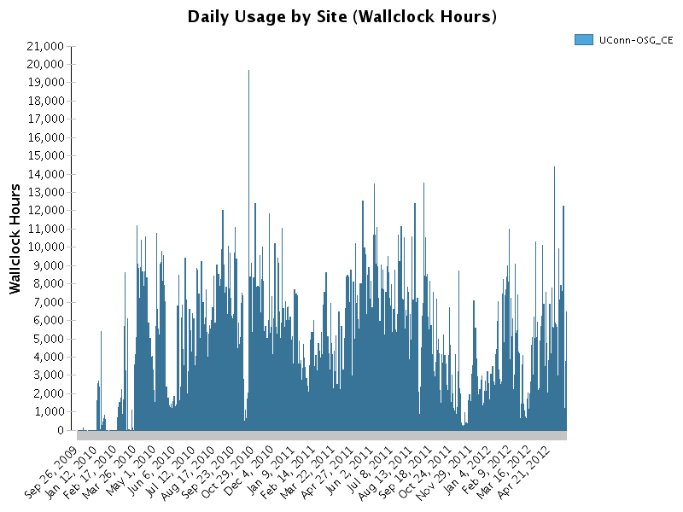
UConn Site Usage History by OSG
Date range: 2009-9-1 - 2012-05-21

Slide 6
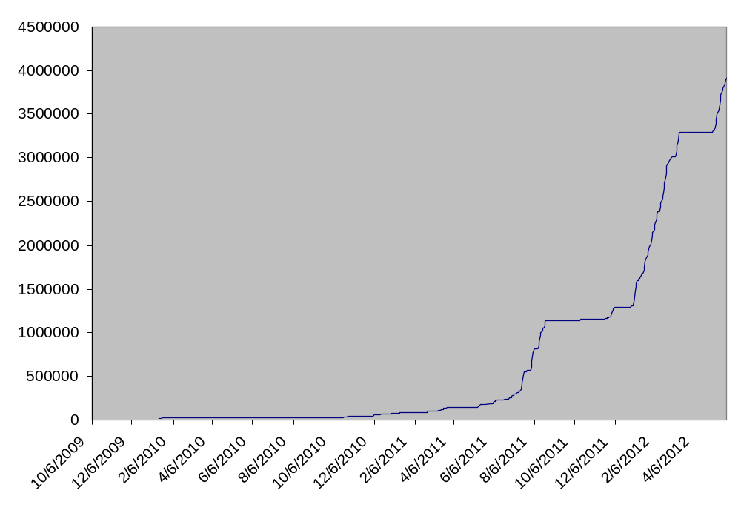
OSG Usage History by Gluex
Date range: 2009-9-1 - 2012-05-21
wallclock hours

Slide 7
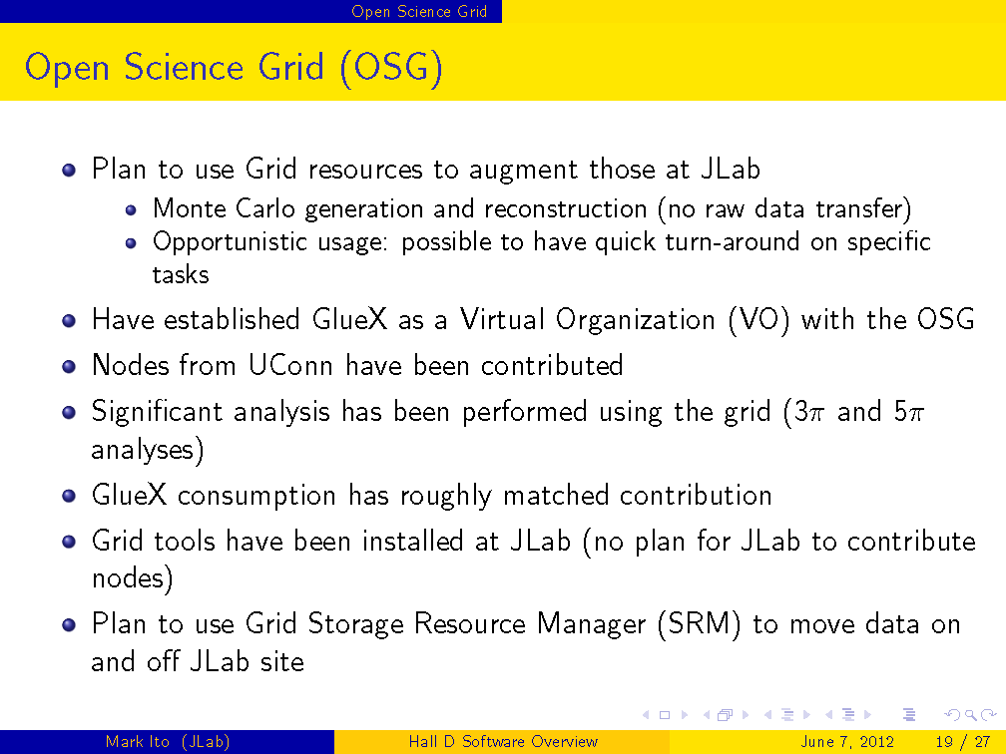
GlueX offline computing plan, M. Ito, Software Readiness Review, June 7, 2012

Slide 8
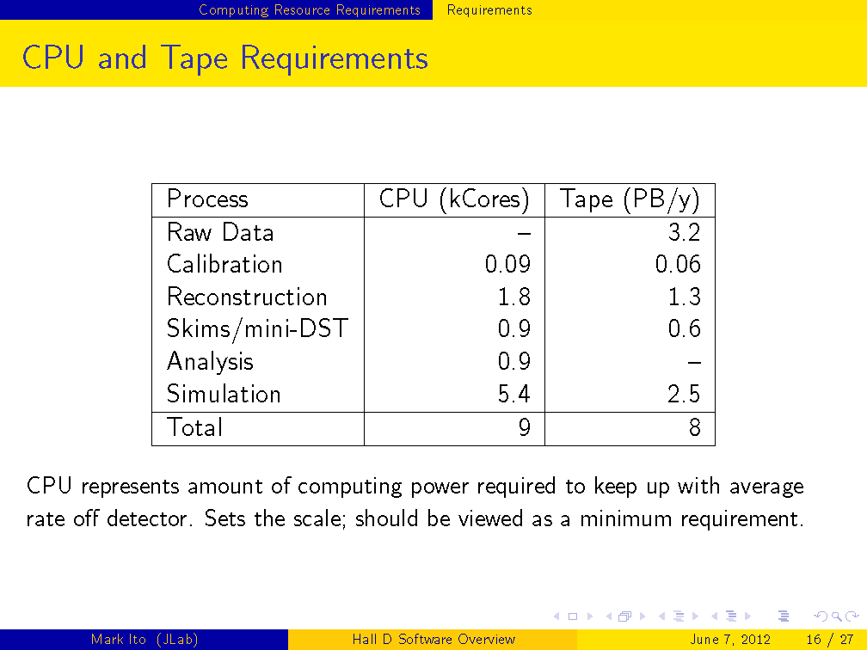
GlueX offline computing plan, M. Ito, Software Readiness Review, June 7, 2012
Series of process/data challenges are planned to ramp up toward this level

Slide 9
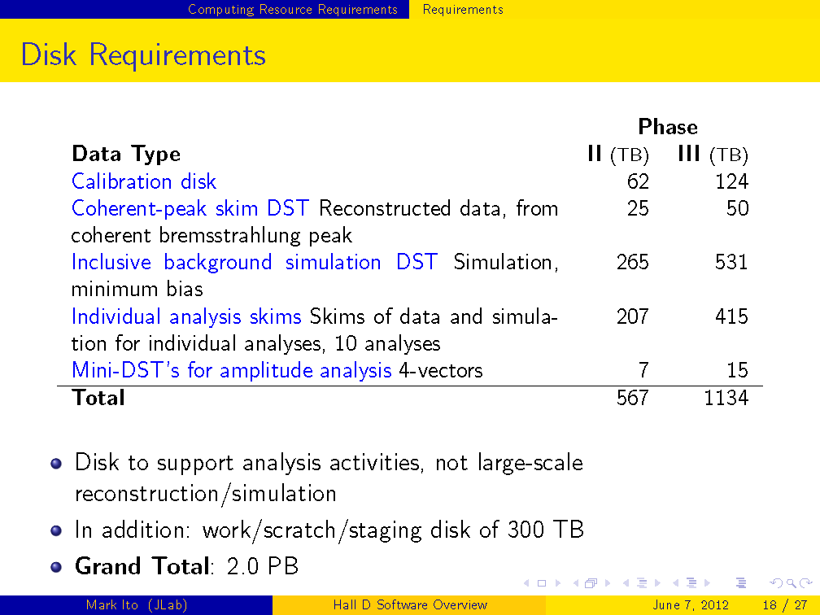
GlueX offline computing plan, M. Ito, Software Readiness Review, June 7, 2012

Slide 10
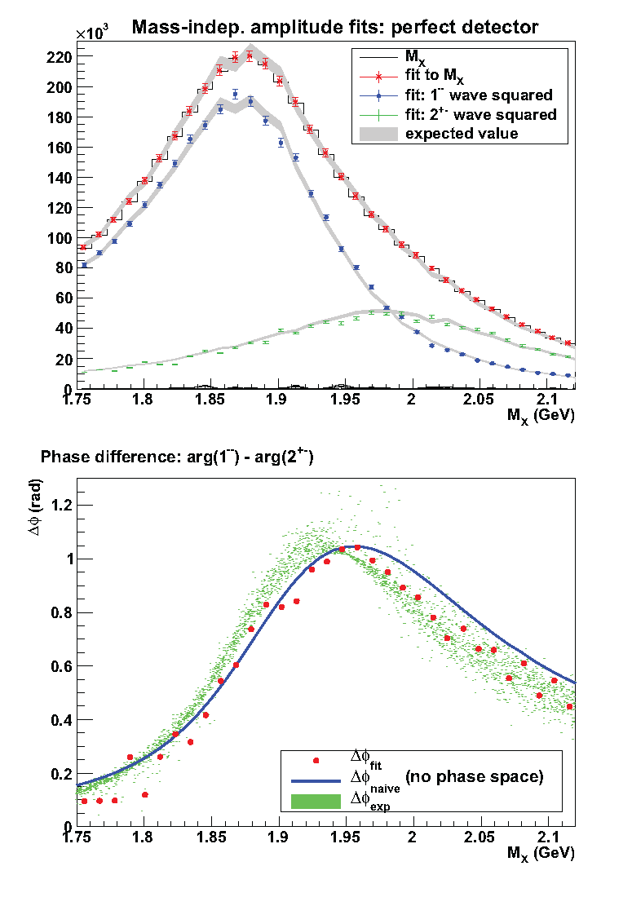
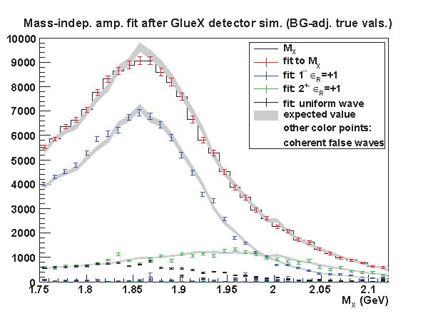
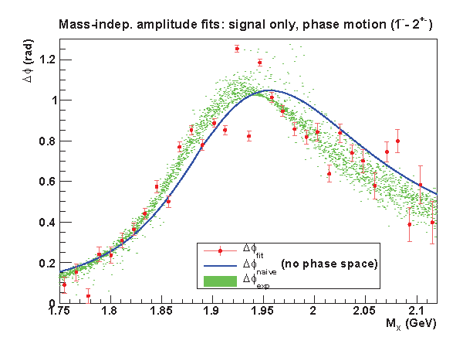
Recent results obtained using OSG
from Ph.D thesis of Igor Senderovich, August 31, 2012

Slide 11
backup slides

Slide 12
OSG Usage by Gluex VO
Gluex VO created 9/2009
Experiment is in construction phase until 2014
Usage increasing with demand for Monte Carlo
Growth has slowed as work increases to digest the results
Task: simulation of background QCD photoproduction (Pythia)
Purpose: develop cuts to suppress background, measure leakage from minimum-bias events into signal sample after cuts, requires very large statistics MC samples, shared between analysis tasks.
Plans: saturate at the level 5-10M cpu.hr/yr until physics data collection begins ca. 2015.
Strategy: glideinWMS – support from OSG admins outstanding !
run period usage
9/2009 – 9/2010 26.4 khr
9/2010 – 9/2011 1.1 Mhr
9/2011 – present 2.1 Mhr

