Slide 1
NEES, NEES2, and OSG
Thomas Hacker
Purdue University

Slide 2
Importance of OSG
Production quality cyberinfrastructure
Allows users and resource providers to reliably use and share resources for HPC/HTC applications
Many applications can effectively use the loosely coupled distributed architecture provided by OSG
E.g. OpenSees
Very efficient use of limited HPC resources across member institutions
Tremendously successful grass-roots program
Originating from the Physics community
Use spreading into other disciplines

Slide 3
NEES and OSG
NEES provides access to OSG resources through the NEEShub
OpenSees
NEES has an OSG allocation through XSEDE
Plan to continue to request XSEDE OSG allocation every year
Continue to work with the OSG community to facilitate use of the of the OSG by the NEES community
OSG evangelization/ambassador efforts
Ruth Pordes chairing the NEES Cyberinfrastructure Subcommittee (CIS)
NEES “Bridge to the Future” project
Working OSG to allow NEES users to run computation on the OSG, transfer output back to NEES CI, and then to upload results into the NEES Project Warehouse as a type of NEES project
Working with Andre Barbosa (Oregon State University) and Gabriele Garzoglio to create this facility
NEES IT staff working to link NEEShub with OSG resources and data
Brian Rohler, Gemez Marshall (Senior Software Engineering), Anup Mohan (NEES GSRA)

Slide 4
NEES2 and OSG
We are preparing a proposal for the NEES2 recompetition
$62M over five years
NSF is reducing the number of NEES sites from 14 to “four to six experimental facilities”
Need to reuse data will increase over time
Tremendous growth in the number of project files and directories in the NEES Project Warehouse over the past two years
Feb 2013: 1,571,777 Files 336,321 Directories
From the NEES2 RFP:
“To support these users, the awardee must operate community-driven, production-quality cyberinfrastructure with near 100% uptime that provides the following baseline resources:... Facilitated access to and use of campus and/or national high-performance computing resources.”

Slide 5
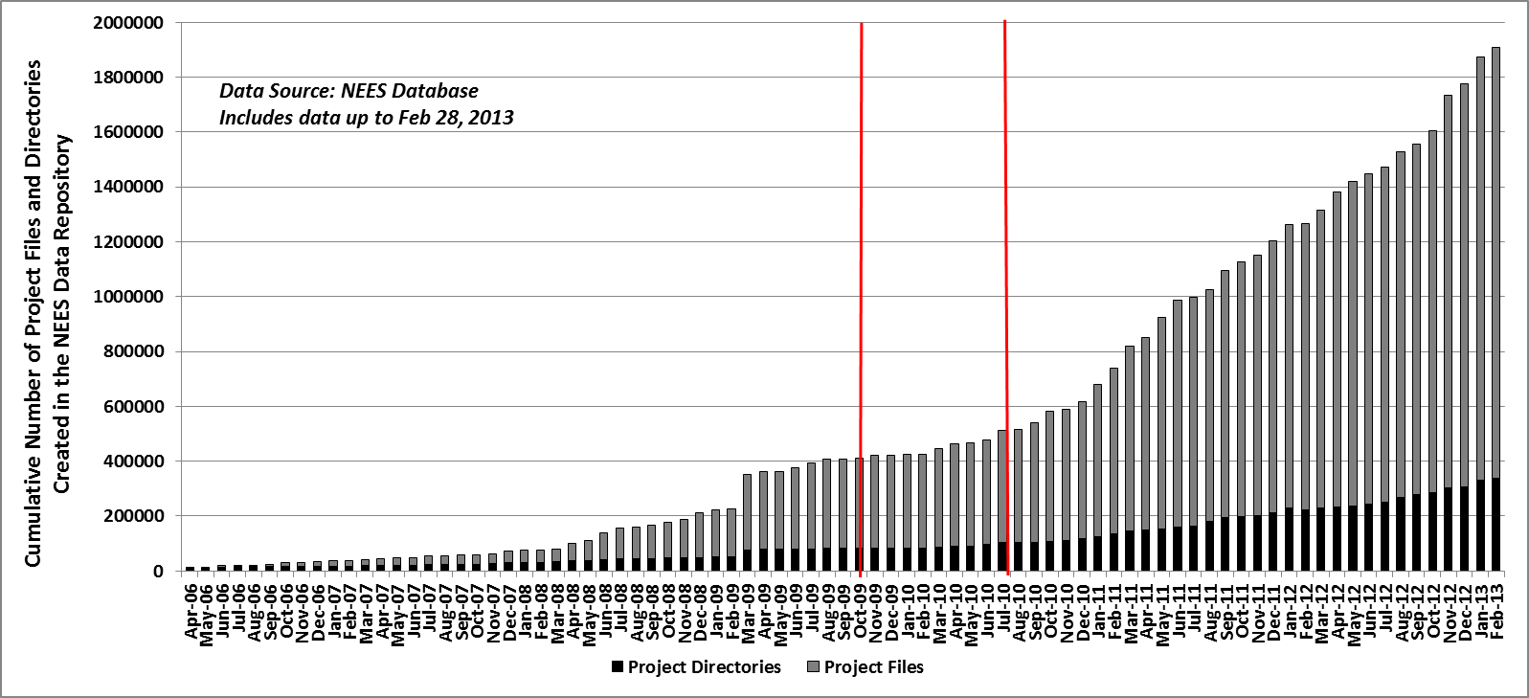
NEES Project Warehouse Project Files and Directories

Slide 6
Data, Simulation, and Analysis
Growing need to more closely couple NEES Project Warehouse Data with simulation and analysis
From NEES2 RFP - new types of data from NIST:
“Additionally, by the end of year two, the data management infrastructure must provide full capability for long-term digital preservation of all experimental data generated by all earthquake engineering research awards supported by NSF, all data generated using PERRR facility resources, all data collected under NSF-supported post-earthquake investigation awards, legacy data sets identified as high priority data by the earthquake engineering community, and experimental data from global partners in support of such partnerships. NIST is currently developing a "Disaster and Failure Events Data Repository" to serve as a national archival data base of significant hazard events, such as earthquakes, tsunamis, hurricanes, tornadoes, and windstorms. The NEES2 data repository should be designed to interoperate with NIST's data repository.”
In the event of a natural disaster that involves the PERRR site, NEES2 community will need
Quick access to HPC simulation and analysis
Ability to stage raw data quickly to a large data cyberinfrastructure
More closely couple data with simulation and data analysis

Slide 7
PERRR
Post-earthquake, rapid response research (PERRR) facility
From the NEES2 RFP
“The goal of the PERRR facility is to provide the leadership, infrastructure, data management, operations, and maintenance to deploy resources for post-earthquake investigations nationally and internationally. The PERRR facility must be designed to meet the requirements listed above for a NEES2 experimental facility and work closely with the cyberinfrastructure to develop the associated data management infrastructure. Recent workshops and reports have identified the need for community resources to gather perishable data immediately following an earthquake event, share the data, and archive the data for longer-term research use…”
The trend is a greater need for HPC/HTC resources that is closely coupled with large data storage systems

