Slide 1
Campus Grids Report
OSG Area Coordinator’s Meeting
Dec 15, 2010
Dan Fraser
(Derek Weitzel, Brian Bockelman)

Slide 2
Mini Campus Grid History
Lots of interest in Campus Grids
  Workshops, meetings, a few campus engagements over past few years
  Not much traction (Clemson, …)
    Some sites are building Campus Grids, but the effort is often unrelated to OSG activity.
Early 2010 -- A new approach (Dan, Miron)
  Can we offer campuses more than a plan ?
  Can we package up a technology set to help new campuses build a Campus grid ?
  Started piecing together a technology package
    Draft architecture document
    Blueprint meeting in June (led to a refined whiteboard architecture)
    Derek agreed to work on this for his Masters Thesis

Slide 3
Campus Grid Concepts
Integrate different batch systems together
  PBS, LSF, Condor, …
  Users should not need to know details of each
Use the Glide-in model
  Proving to be a huge success on the broader OSG
  Nebraska already using this for their Campus submissions
  Easy for users to use more resources such as the OSG
Don’t require Grid Certificates
  Except possibly when using external campus resources
  “When you are already in the house, you don’t need a passport to go to the bathroom” - M. Livny

Slide 4
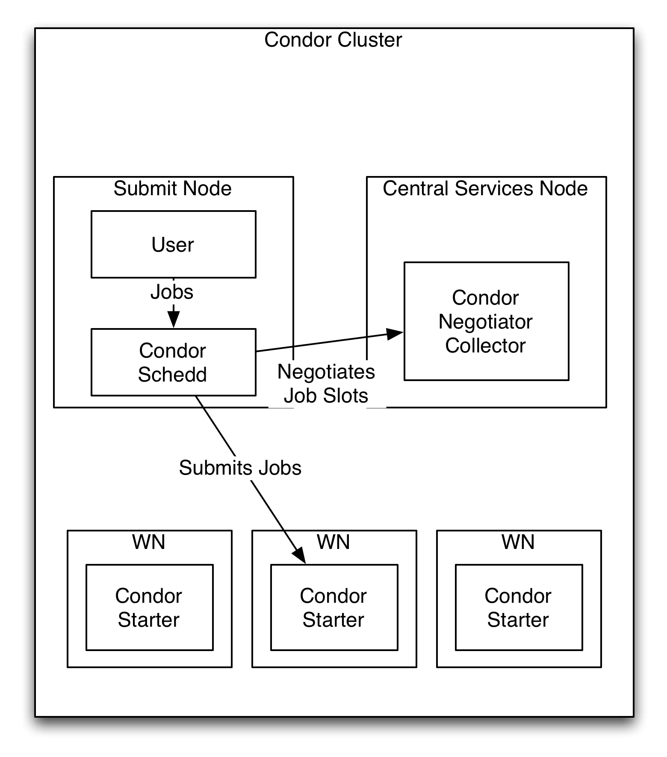
Implementation
Consider a typical Condor cluster.
  User submits to a scheduler (schedd)
  Schedd negotiates slots from the negotiator.
  Schedd contacts WN and runs job

Slide 5
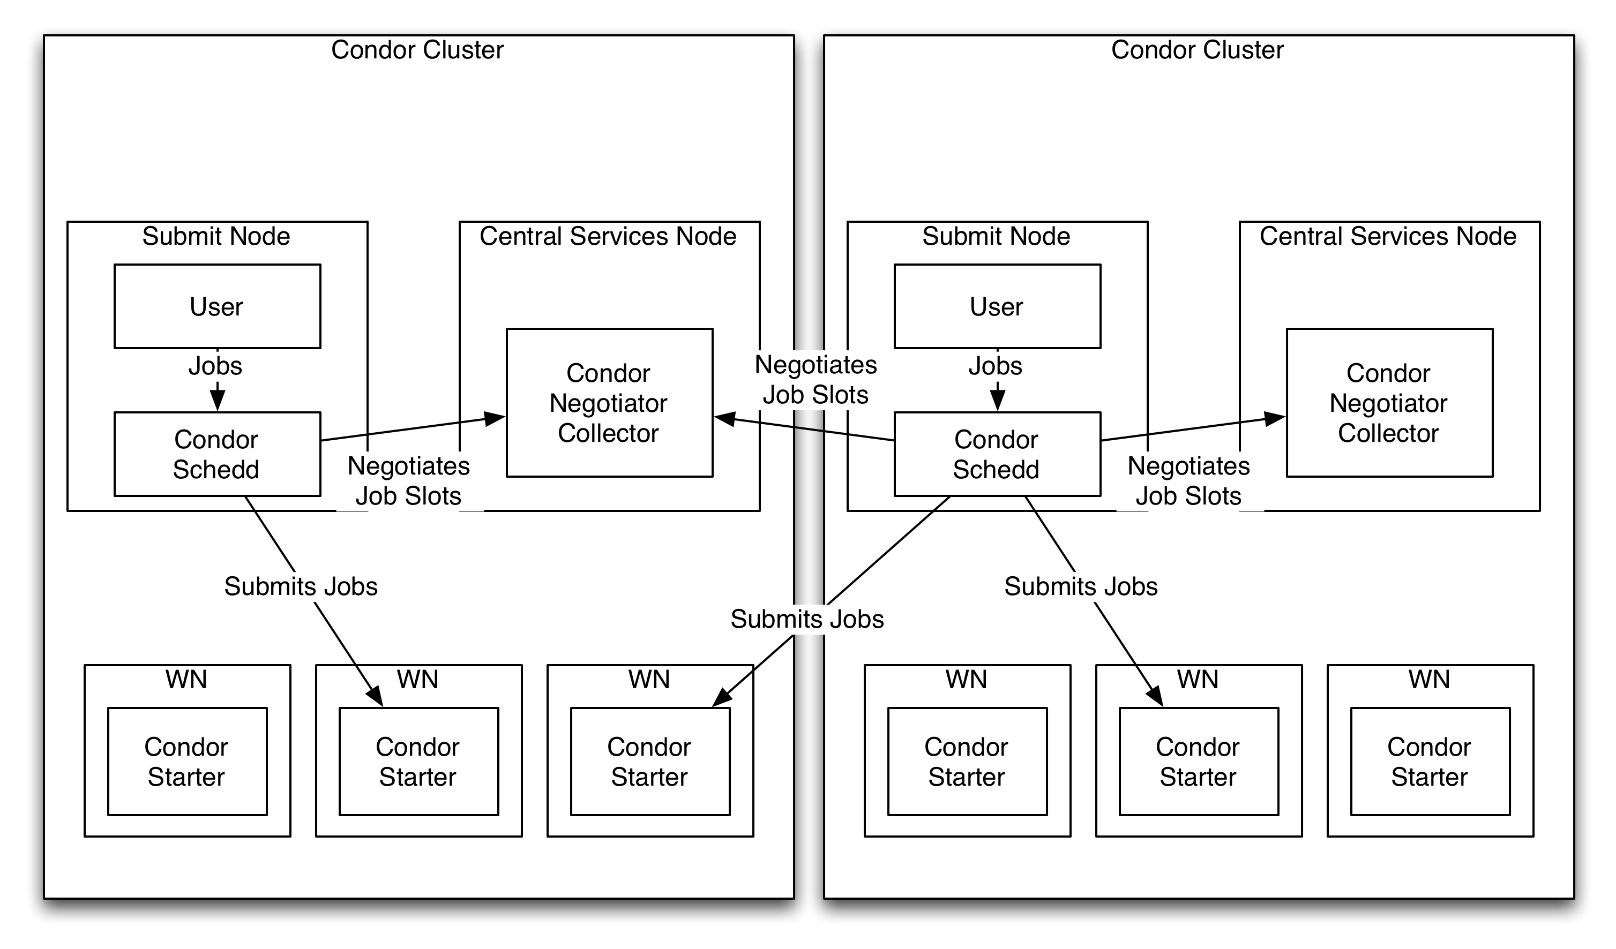
Implementation
Next, flock between Condor clusters.
My scheduler contacts other negotiators for slots

Slide 6
Condor Glidein
From the grid world, Condor has developed glidein’s – the ability to configure and start a condor_startd through one script.
  Meant to be executed as the payload job inside other batch systems – a pilot native to Condor.

Slide 7
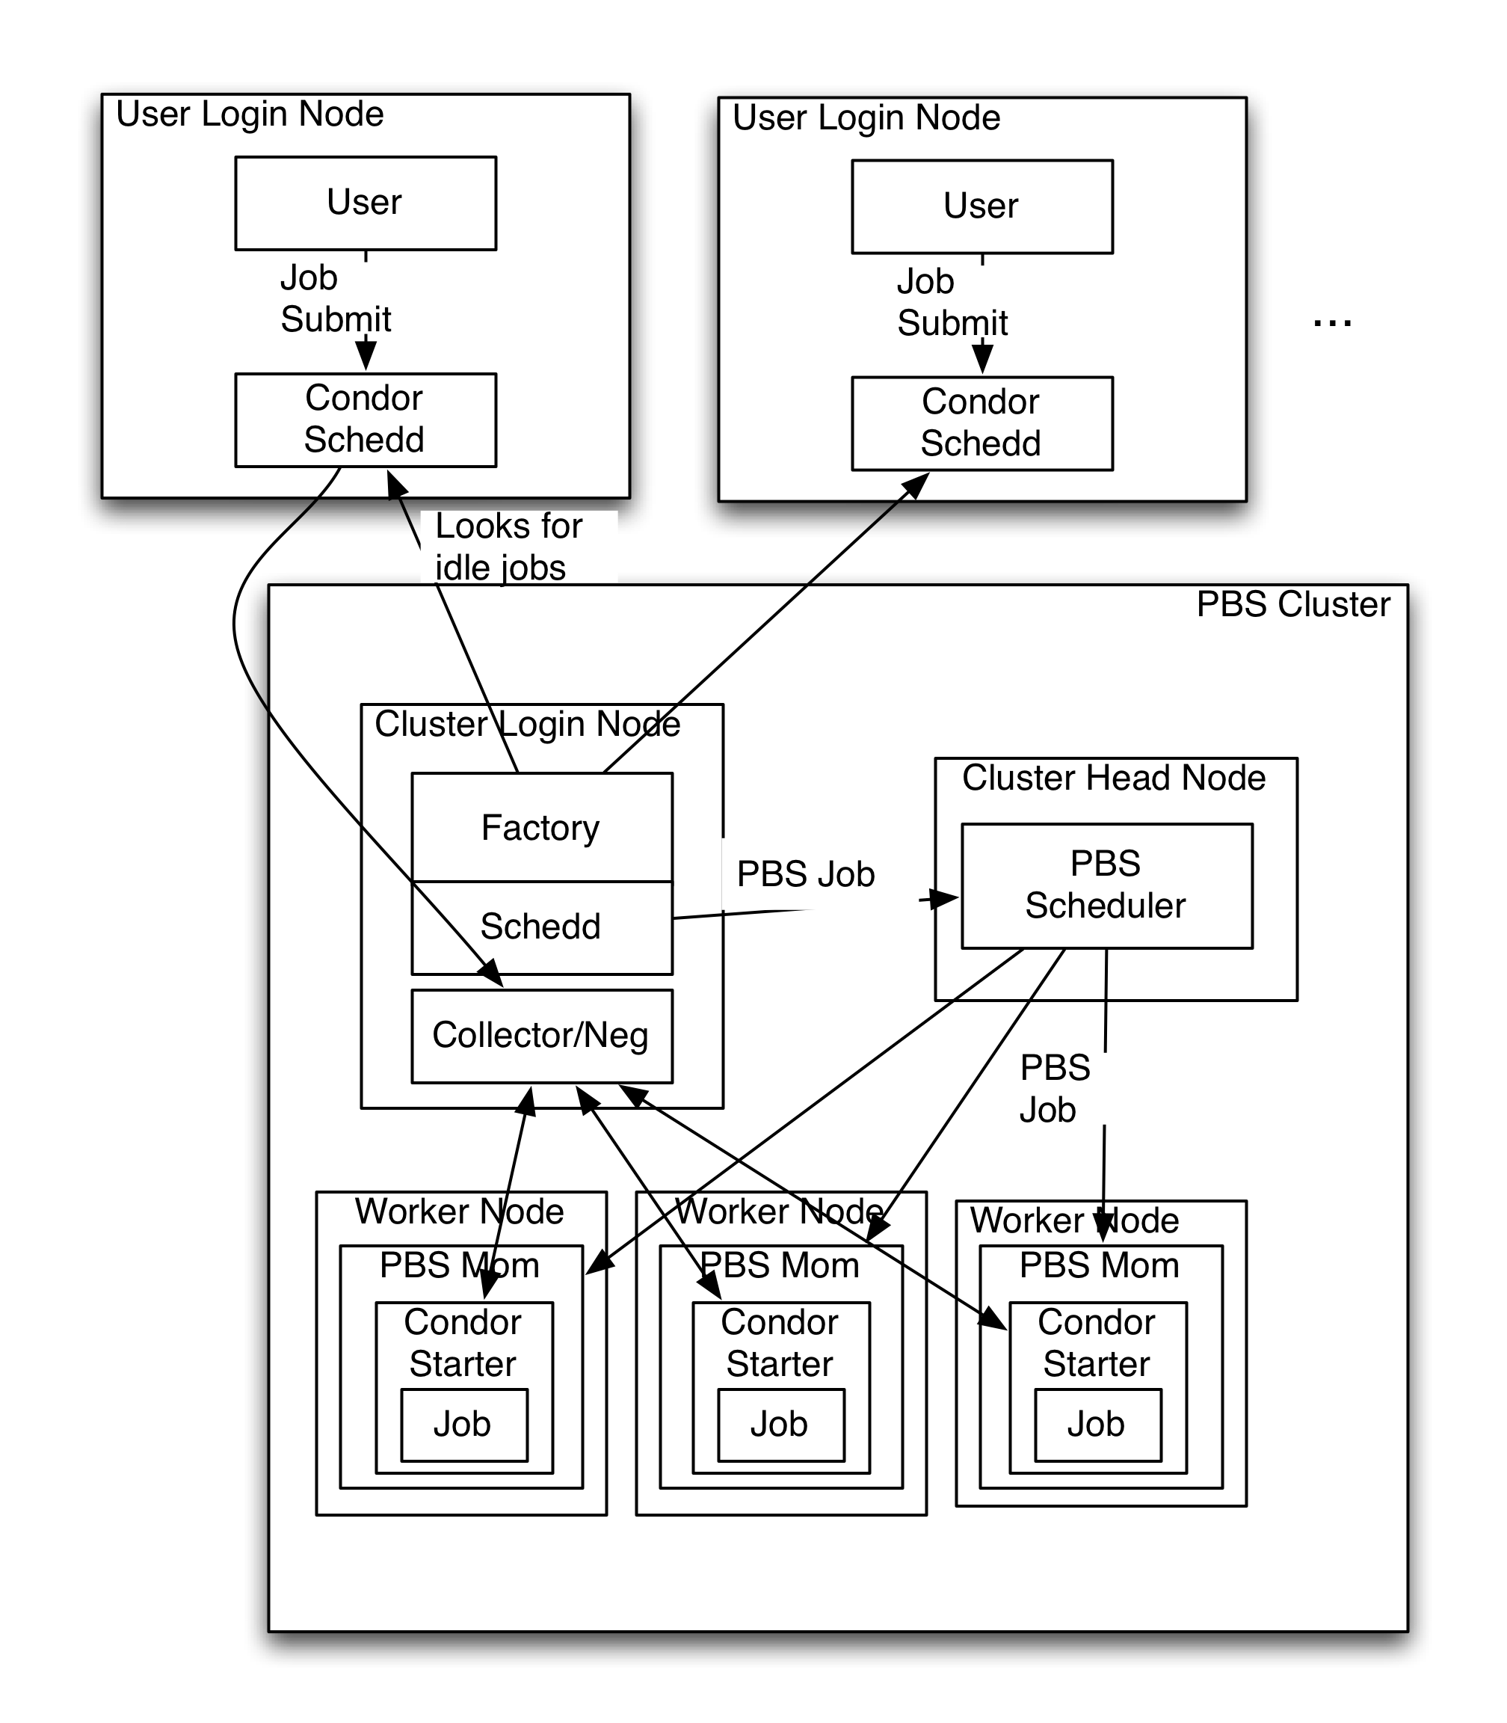
Include non-Condor sites
Derek created the Factory code
Factory process runs on cluster login node.
Queries known schedd’s to see if there are idle jobs.
If so, creates an Condor-G job (universe=PBS) and submits the job directly to the local PBS scheduler via BLAHp.
The condor_starters join the virtual Condor pool local to PBS cluster.
Then jobs flock from the submit node to the PBS cluster.

Slide 8
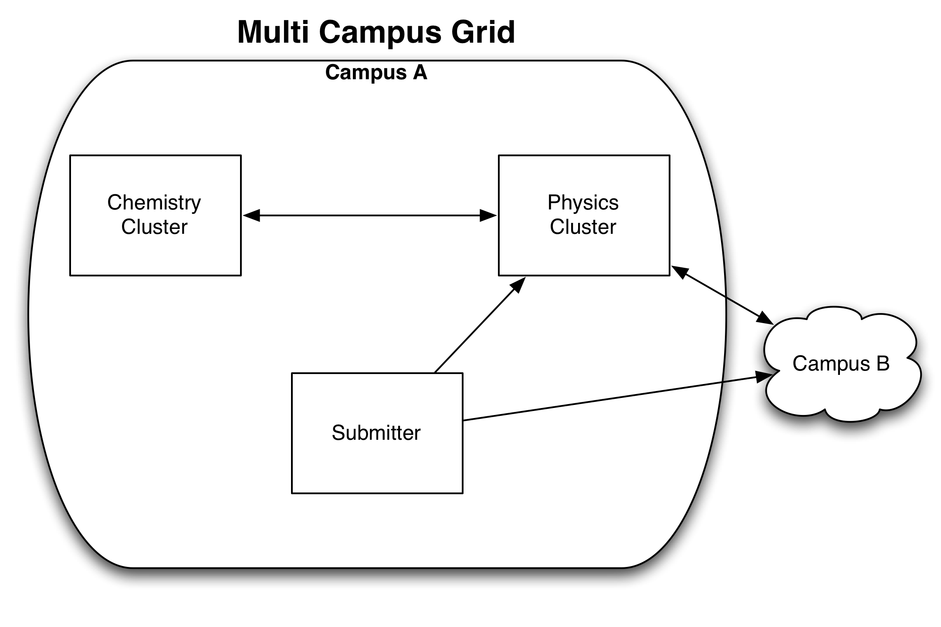
Inter-Campus Grids
Flocking doesn’t need to respect the campus boundary
Condor NAT transversal helps here (CCB)
Nebraska flocks to Purdue currently

Slide 9
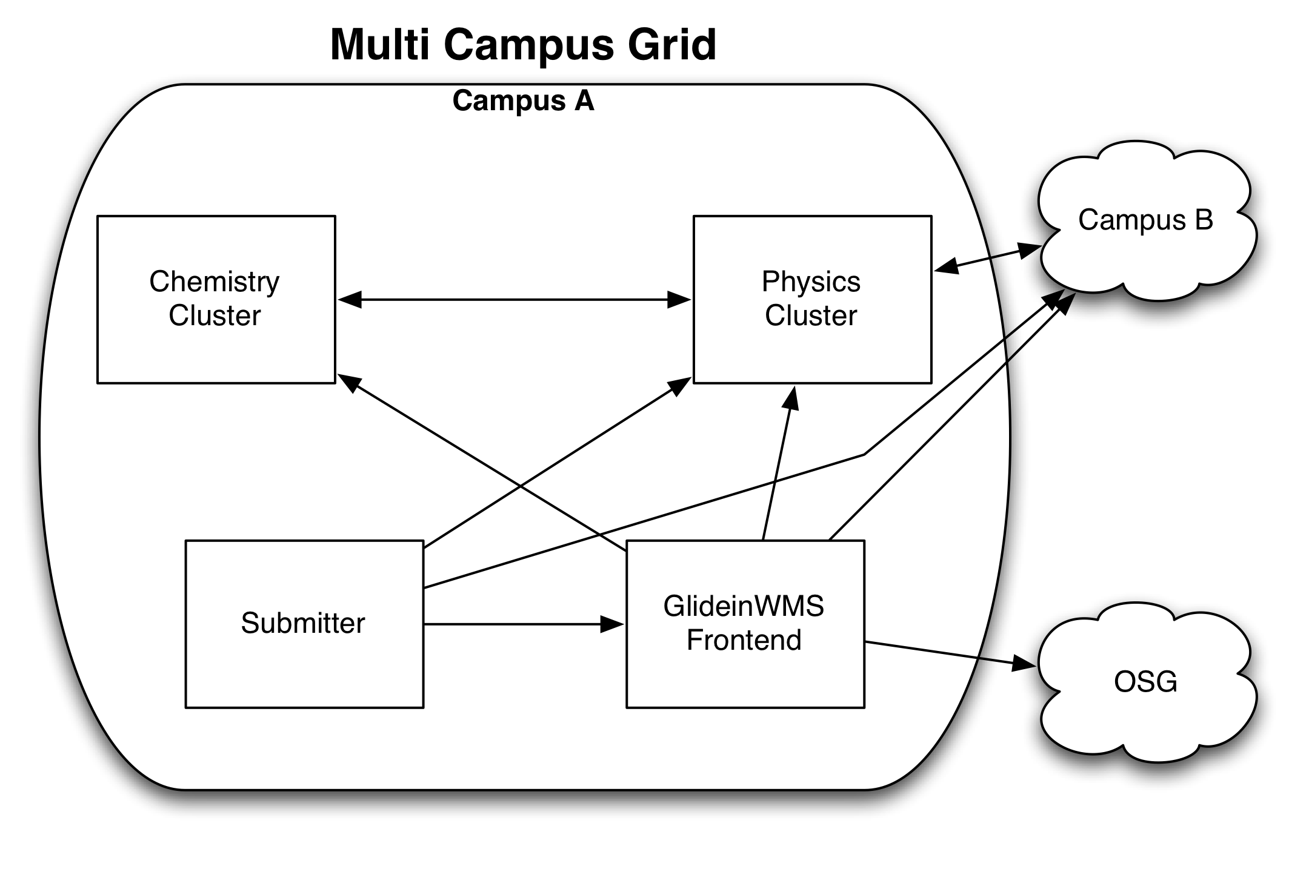
Expand to use the OSG
Further expand with GlideinWMS
Current grid at Nebraska

Slide 10
Security
GSI/X509 works great for offsite computing as a way to do identity management.
Use campus based security inside the campus.
  I.e., Physics sysadmins trust the math sysadmins.
Between campuses, Condor daemons can negotiate the security protocol in order to make both sides happy.
  This happens automatically
  Sites can enforce local auth{z,n} policies at the daemon level.

Slide 11
Issues to overcome
Data
Accounting
…

Slide 12
More reading & Downloads
Campus grid weekly meetings
  https://twiki.grid.iu.edu/bin/view/CampusGrids/CampusGridMeetings
Release downloads, documentation, & install guide
  http://sourceforge.net/apps/trac/campusfactory
Info on Offline Class Ads
  https://twiki.grid.iu.edu/bin/viewauth/CampusGrids/OfflineClassAdFactory

Slide 13
Looking for Interested Campuses
If you know of a Campus that may be interested in building a campus grid, please contact us:
  fraser@anl.gov
  dweitzel@cse.unl.edu
  bbockelm@math.unl.edu

