Slide 1
OSG Area Report
Production – Operations – Campus Grids
June 19, 2012
Dan Fraser
Rob Quick

Slide 2
Current Production Focus
Transition to RPMs
  31 sites using RPM based installs
  70 sites still using Pacman install
  All the main RPMs have been released
    Incl. Gums and Gratia
  Still working on a few issues / bugs
  ABCD gradually winding down
  Main RPM packages have been released
  Documentation for RPMs is usable
    https://twiki.grid.iu.edu/bin/view/Documentation/Release3/WebHome
    Doc Fest Mon-Tues this week

Slide 3
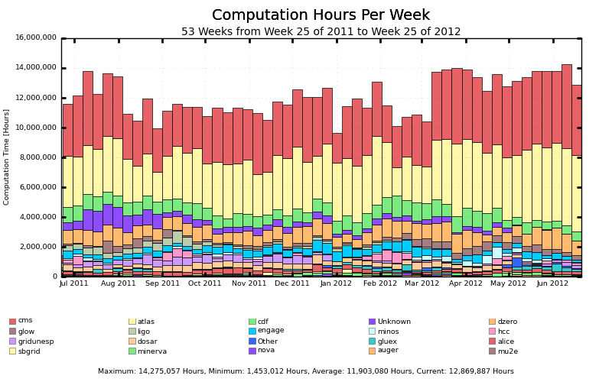
Overall Production

Slide 4
Some Production Issues…
Effort from the entire team
  Recent compromise of hypernews and webserver security breech
  Transition to BDII v5 – basically abandoned
  Adding lots of new services to GOC …
  SE-only publishing issue
  Ongoing GRAM-5 production issues (memory leaks, scaling, etc.)
  CA updates no longer automated by OSG (RPM)
  GUMS-Voms compatibility with CERN (progress ongoing)
  …

Slide 5
Campus Grid Status
Campus grid working in production:
  Glow, Diagrid (All Condor campus grids)
  Nebraska
  University of Florida (not used much)
Pre-Production/testing:
  RENCI
  Virginia Tech (Bio-tech)
    http://gratiaweb.grid.iu.edu/gratia/xml/glidein_hours_bar_smry?probe=condor:dhcpseven237.bioinformatics.vt.edu
  Virginia Tech (Belle, DayaBay)
  FIU

Slide 6
Campus Grid Direction
Make the factory easier to install / maintain
  Current factory = flocking + glide-in + BLAH
  Fewer “assumptions” about the existing environment
Parallel path of using SSH + BLAH
  Have been working with Condor & CG team
  BOSCO (Blah over SSH Condor Overlay)
  http://www.boscoworld.com/ ☺
New Documentation
  Focus on end user
  Manage multiple sites from one submit host (SSH)
The hard part is not “technology” but finding / keeping users

Slide 7
Campus Grids Project Plan
    https://twiki.grid.iu.edu/bin/view/CampusGrids/CampusInfrastructureProjectPlan
Release of BOSCO V0
  Completed on time in March.
  Included Documentation and usability testing.
  New checkbox for Campus Grids
  Procedure is to file a ticket, we add them
    https://ticket.grid.iu.edu/goc/submit
    Still working on Gratia accounting

Slide 8
Campus Grids Project Plan
Release of BOSCO V1 Q2
  Slipped to July primarily due to Condor File Transfer component.
  Includes Centralized Campus Factory
    Still has dependency on same OS between submit host and cluster.
  To include “traceroute” functionality
Upgrade existing CG sites Q3
Working on next gen WBS
  Including an “engage with researchers” plan

