Slide 1
OSG Logging Architecture Update
Brian L. Tierney: LBNL
Center for Enabling Distributed Petascale Science
http://www.cedps-scidac.org

Slide 2
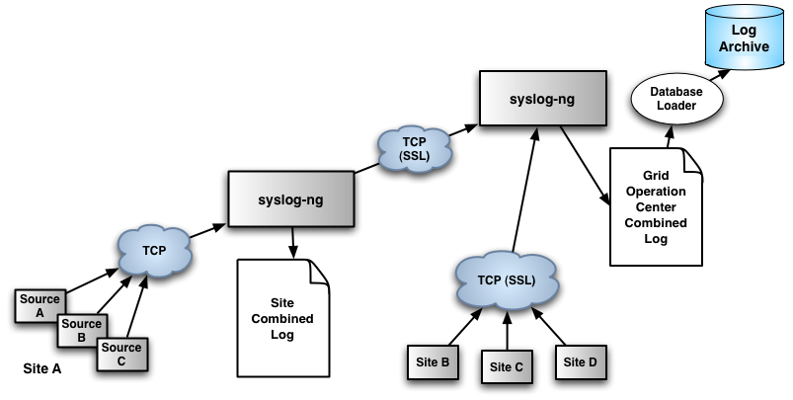
Previously suggested architecture

Slide 3
Problems with this approach
Main idea of old architecture:
  all grid logs are sent to a central collector
After talking to several sites, the following has become clear:
  some sites are quite worried about sensitive data in the log files
  some sites want to be able to control exactly who gets access to what log data
Solution:
  most logs stay local to the site, only a minimal subset is sent to the central collector
  sites deploy a new service that provides X.509-authenticated access to logs

Slide 4
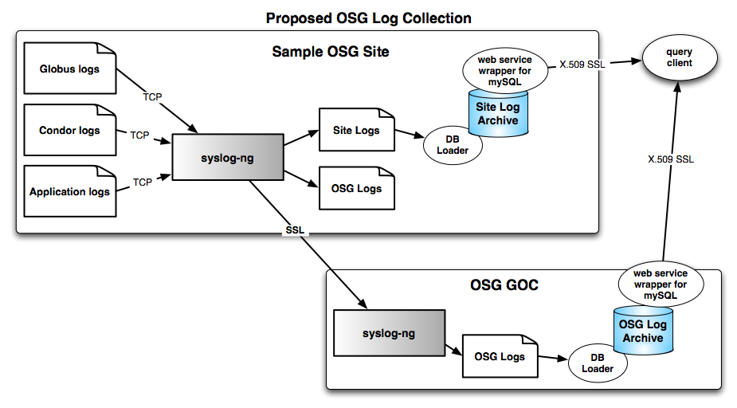
Updated Architecture

Slide 5
New Ideas
Key Points:
  Minimal logging sent to central collector by default
    eg: resource name, job ID, start time, end_time, DN, VO
      enough information to locate log files of interest
    basically the same info currently collected by Gratia
    site can send more if they choose to
  Site admins have control over access to log database
    hopefully sites will allow users to see their own logs
  Site admins see exactly what data is being sent to the central collector
    data is sent to the central collector using ssl

Slide 6
New Functionality
Deployment of site log archives will provide OSG with the following new functionality
  OSG security staff can easily query site archives to see what DNs have been used
  Users can query site archives for their own logs
  GOC stuff can query site archives for to aid troubleshooting

Slide 7
Components Needed
syslog-ng configuration
stunnel configuration
ability to parse key log files and load them into mysql database
X.509-based client to mySQL
  OGSA-DAI provides this
    http://www.ogsadai.org.uk/
VDT packages for all of the above

Slide 8
Current Status
syslog-ng configuration
  need to update VDT package to send logs to site archive instead of central archive
stunnel configuration
  need to integrate with syslog-ng package
ability to parse key log files and load them into mysql database
  prototype almost complete
X.509 interface to mySQL
  currently testing OSGA-DAI
VDT packages for all of the above

Slide 9
Questions/Issues
Can/should Gratia be used/extended for the central database
  Central database has a lot in common with Gratia
  should only need user DN, site name, and timestamp to locate site log services
  would also need data services in Gratia
    GridFTP, SRM, etc.

