Slide 1
Grid Information Systems

Slide 2
Two grid information problems
Two problems
  Monitoring
  Discovery
We can use similar techniques for both
Notes:
MDS addresses two problems: monitoring and discovery. These are two distinct problems but similar techniques can be used to address both.

Slide 3
Monitoring grid resources
Status of resource on grid
Up/down?
How much load?

Slide 4
Discovery
Start with a task to perform on the grid
For example, want to perform run a simulation
How do we find resources to use?
How do we choose which resource to use?
Notes:
Resource Discovery
“Which resources are relevant to my task?”
Resource Status Inquiry
“Which resource is best to use (now)?”
Resource Control
Use the resource
submitting a job
Not part of MDS!
Sequence of questions we must ask in choosing a resource.
(give examples using compute nodes)
DISCOVERY: “What IRIX boxes with more than 8 processors exist in VO?”
STATUS INQ: “What is the CPU and disk utilisation at the moment?”

Slide 5




Discovering a grid resource
user
storage
Compute system
other
Notes:
Here is the grid – a lot of resources of various kinds: compute resources, storage resources and other kinds that we do not necessarily need to know about.
In the middle of it all, we have a user.
The user doesn’t necessarily know which resources are available.
MDS makes this information available, so that we can perform the first step in discovery…

Slide 6
1. Which resources are relevant?
Notes:
The first step is to select the resources which are relevant. In our example, the user selects the compute resources, discarding the other types. So now the user has a list of (4) compute systems.
But the user doesn’t know which to choose…

Slide 7
2. Which resources are best for task?
128 slow
CPUs
Low load
2 CPUs
100Gb disk
Medium load
16 fast CPUs
500Gb disk
High load
Notes:
The next stage is for MDS to provide information about each of the relevant resources, so that we can pick which one is best.
Note that there is not an overall ‘best’ that fits every situation. For example, in the case of computation, we might have code that is very parallelised, in which case we can make use of a large number of CPUs; or it might be more single threaded, in which case a small number of CPUs is appropriate.

Slide 8
3. Choose a resource
128 slow
CPUs
Low load
Notes:
So having got information about each relevant resource, the user can pick the best resource for the task at hand…

Slide 9
4. Attempt to use resource
Use the resource – job submission, file transfer
Notes:
And having chosen the resource, can try to use it (for example, by submitting a job through the GRAM component of GT)

Slide 10
What makes this difficult on the grid?
Distributed users and resources
  Sometimes unreliable network
Variable resource status
  Resources come up and go down without any centralised co-ordination
Variable grouping
  Different people belong to different groups (Virtual Organisations)
  The grid is not cleanly partitioned

Slide 11
Resource Discovery/Monitoring
R
R
?
R
R
R
?
R
R
R
R
network
dispersed users
R
?
?
R
R
R
R
R
R
R
R
R
R
Pink VO
Green VO
Distributed users and resources
Variable resource status
Variable grouping
Green VO has become partitioned because of network failure!
Notes:
This is an example of a grid environment
Two groups of people and resources: “purple” and “green” – these are Virtual Organisations.
Distributed between locations
Some things are in both groups.
There are failures – individual resources fail; connectivity between resources fail
Eg. The green VO is partitioned into two pieces.
When stuff fails, we want what is left to still work

Slide 12
Examples of Useful Information
Characteristics of a compute resource
  Software available, networks connected to, load, type of CPU, disk space
Characteristics of the Globus infrastructure
  Hosts, resource managers, service availability
Policies
  Difficult…
Notes:
Policy is ‘?’ because no one seems to have worked out how to express it well even though people do want to express it

Slide 13
Key Concepts
Virtual Organizations (VOs)
  Group together resources and users in related communities
  Support community-specific discovery
  Specialized views
  Scalability
Notes:
Probably seen VOs talked about in various other talks.

Slide 14
Virtual Organizations
Collaborating individuals and institutions
  Enable sharing of resources
  Non-locality of participants
Dynamic in nature
  VOs come and go
  Resources join and leave VOs
  Resources change status and fail
Community-wide goals
Must not interfere with each other
Notes:
Shared goals – for example working on the same research project
Sharing of resources – towards those same shared goals
Non-locality of participants – affiliated to different real-world organisations (for example universities) on different networks
For example, we might form a VO of people with the community goal of analysing a specific set of this week’s results from an experiment. This is quite dynamic – the VO might not exist for more than a week or so.
Some participants will provide resources (compute systems, storage, datasets) to the VO.

Slide 15
Pink VO
R
R
?
R
R
R
R
R
?
R
R
R
R
Pink VO
Notes:
Here is a VO, in a pink bubble. Call it the pink VO.
Users at two locations
Resources at four locations – two failed resources
A network connects the resources and users together.

Slide 16
Green VO
R
R
R
?
R
R
network
?
R
R
R
R
Green VO
Notes:
Here is another VO, this one in a green bubble… call it the Green VO
Similar to the Pink VO.
But network has a failure! so the VO has been partitioned into two sections that cannot communicate with each other.
Users in each section to be able to use the resources in their section.

Slide 17
The Grid
R
R
?
R
R
R
?
R
R
R
R
network
dispersed users
R
?
?
R
R
R
R
R
R
R
R
R
R
Pink VO
Green VO
Some resources are in both VOs
Some resources are in neither VO
  But are in other VOs
Notes:
On the Grid there are lots of VOs.
Some of them overlap – here some resources are in both the Pink and Green VO.
Things happening in the green VO should not affect the pink VO, and vice-versa, even though there are shared resources.

Slide 18
Grid Information: Facts of Life
Information is always old
  Time of flight; changing system state
Distributed snapshot of state hard to obtain
Components will fail
Scalability and overhead
Many different usage scenarios
Notes:
Time of flight – takes some time for information to be delivered from its source to its destinations
Changing system state means that by the time you get information, it is ‘wrong’. For example, say we take several seconds to propagate memory usage information from a resource, and memory usage changes on the resource host, then the information is wrong.
The above means its difficult to say ‘this is what the grid looks like *NOW*’. Instead we can mark data with aging information to let you determine when it was valid. To illustrate, it is useful to know that a disk had a gigabyte free on it 60 seconds ago, even though it now has only 0.9 gigabytes free.
Components will fail. Of course they will.
Discussed scalability on a previous slide
Het.policy: different organisations (virtual and non-virtual) have different policies on what their resources can be used for.
Eg of rapidly changing info: cpu load, free disk space.
But even if logged into console and type ‘uptime’, that data is out of date within 5 seconds.
We believe this is enough.
Qualitydata==timestamping of validity – later on in schema examples, we’ll see what this looks like
applications need to be aware that the data maybe slightly out of date.
We’re trying to provide general purpose information as part of toolkit. Other more specialised stuff can be added.

Slide 19
Age of information
MORE
Older
more
A
~10m
A
A
~5m
Fresher
less
R
R
R
R
R
R
~30s
As information flows upwards
  There is information about more resources
  The information is generally older
FRESH
Notes:
Can query high up to get lots of information (about many resources); this information will be older.
Can query lower down to get fresher information about fewer resources.
At the extreme, can talk to the resource itself – we get the latest information (often only seconds old) – but:
i) the information is just about that resource
ii) we need to know the resource exists and how to communicate with it – we can get this information from a higher index

Slide 20
Information models
Each information sources publishes information in XML according to some schema.
Some times the author of the information source or the grid resource defines that schema.
Some collaborative efforts to define common schemas– for example GLUE for compute information
Schema typically written in XSD, but not required

Slide 21
GLUE schema
Grid Laboratory Uniform Environment
Schema developed by DataTAG for EU/USA interoperability.
Modelled in UML
Implementations
  XML, LDAP, SQL

Slide 22
GLUE schema example
<ce:Cluster ce:Name="stomoxys.isi.edu" ce:UniqueID="stomoxys.isi.edu“
ogsi:availableUntil="2003-12-01T23:00:25.690Z“ ogsi:goodFrom="2003-12-01T22:59:54.690Z“ ogsi:goodUntil="2003-12-01T23:00:24.690Z">
<ce:SubCluster ce:Name="stomoxys.isi.edu“ ce:UniqueID="stomoxys.isi.edu">
<ce:Host ce:Name="stomoxys.isi.edu“ ce:UniqueID="stomoxys.isi.edu">
<ce:OperatingSystem ce:Name="Linux“ ce:Release="2.4.18-14" />
<ce:ProcessorLoad ce:Last15Min="074" ce:Last1Min="095" ce:Last5Min="078" />
…
</ce:Cluster>
Notes:
This is a rather cut down fragment of a piece of GLUE schema service data. We’ll go through the interesting components one by one.

Slide 23
User interfaces
General purpose UIs
  Web browser based interfaces
  Command line tools
Specialized clients
  Brokers
  Site selectors

Slide 24
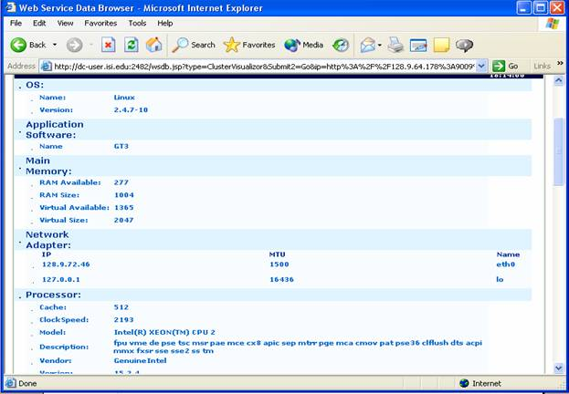
WebMDS
Web-based interface to display monitoring information
Easily extensible for new data using XSLT

Slide 25
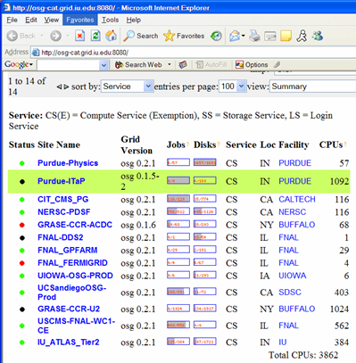
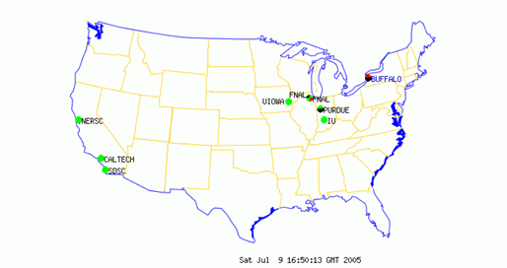

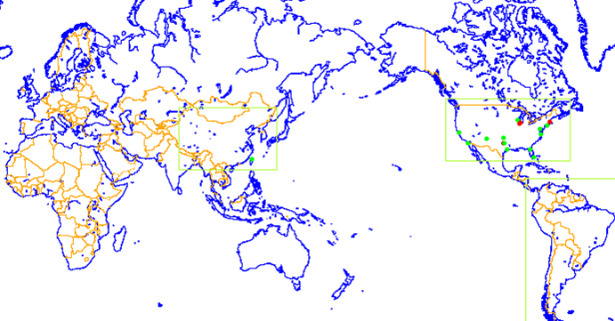

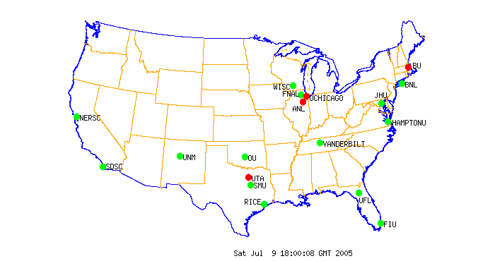
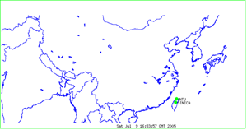
GridCat
http://osg-cat.grid.iu.edu
http://www.ivdgl.org/grid3/gridcat
http://www.ivdgl.org/gridcat/home/

Slide 26
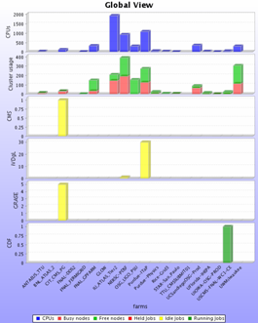
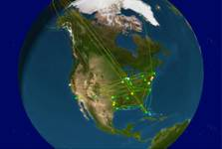
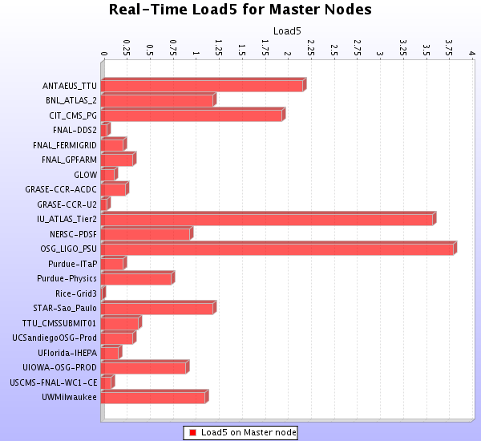
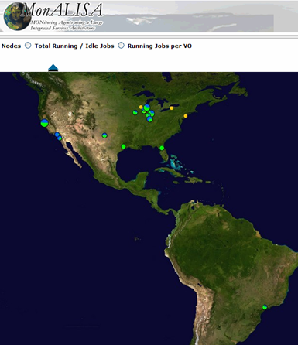
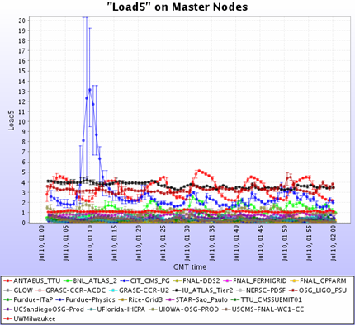
MonALISA
http://monalisa.caltech.edu/

Slide 27
Based on:
Globus Monitoring and Discovery
Ben Clifford
USC/ISI & Globus
Copyright (c) 2002-5 University of Chicago and The University of Southern California. All Rights Reserved. This presentation is licensed for use under the terms of the Globus Toolkit Public License.
See http://www.globus.org/toolkit/download/license.html for the full text of this license.

