Slide 1

Diagnostics vs Regular Monitoring
August 10th 2010, OSG Site Admin Workshop - Network Performance
Jason Zurawski, Internet2

Slide 2


Agenda
Tutorial Agenda:
  Network Performance Primer - Why Should We Care? (15 Mins)
  Getting the Tools (10 Mins)
  Use of the BWCTL Server and Client (30 Mins)
  Use of the OWAMP Server and Client (30 Mins)
  Use of the NDT Server and Client (30 Mins)
  BREAK (15 mins)
  Diagnostics vs Regular Monitoring (30 Mins)
  Network Performance Exercises (1 hr 30 Mins)
<number> – 11/07/26, © 2010 Internet2

Slide 3
Performance Monitoring Motivation
Finding a solution to network performance problems can be broken into two distinct steps:
  Use of Diagnostic Tools to locate problems
    Tools that actively measure performance (e.g. Latency, Available Bandwidth)
    Tools that passively observe performance (e.g. error counters)
  Regular Monitoring to establish performance baselines and alert when expectation drops.
    Using diagnostic tools in a structured manner
    Visualizations and alarms to analyze the collected data
Incorporation of either of these techniques must be:
  ubiquitous, e.g. the solution works best when it is available everywhere
  seamless (e.g. federated) in presenting information from different resources and domains
<number> – 11/07/26, © 2010 Internet2
Notes:
More examples of metrics of interest are around, these are the most popular.

Slide 4
On Demand vs Scheduled Testing
On-Demand testing can help solve existing problems once they occur
Regular performance monitoring can quickly identify and locate problems before users complain
  Alarms
  Anomaly detection
Testing and measuring performance increases the value of the network to all participants
<number> – 11/07/26, © 2010 Internet2

Slide 5
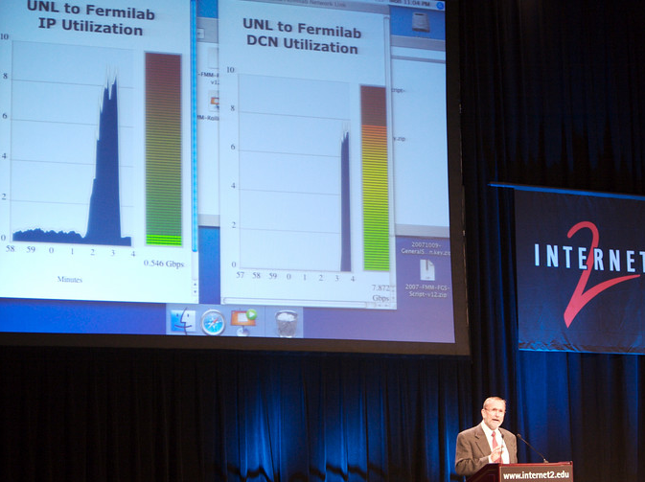
<number> – 11/07/26, © 2009 Internet2

Slide 6
What is perfSONAR?
Most organizations perform monitoring and diagnostics of their own network
  SNMP Monitoring via common tools (e.g. MRTG, Cacti)
  Enterprise monitoring (e.g. Nagios)
Networking is increasingly a cross-domain effort
  International collaborations in many spaces (e.g. science, the arts and humanities) are common
  Interest in development and use of R&E networks at an all time high
Monitoring and diagnostics must become a cross-domain effort
  Complete view of all paths
  Eliminate “who to contact” and “what to ask for” - 24/7 availability of diagnostic observations
<number> – 11/07/26, © 2010 Internet2

Slide 7
What is perfSONAR?
A collaboration
  Production network operators focused on designing and building tools that they will deploy and use on their networks to provide monitoring and diagnostic capabilities to themselves and their user communities.
An architecture & set of communication protocols
  Web Services (WS) Architecture
  Protocols established in the Open Grid Forum
    Network Measurement Working Group (NM-WG)
    Network Measurement Control Working Group (NMC-WG)
    Network Markup Language Working Group (NML-WG)
Several interoperable software implementations
  perfSONAR-MDM
  perfSONAR-PS
A Deployed Measurement infrastructure
<number> – 11/07/26, © 2010 Internet2

Slide 8
perfSONAR Architecture Overview
Interoperable network measurement middleware designed as a Service Oriented Architecture (SOA):
  Each component is modular
  All are Web Services (WS) based
  The global perfSONAR framework as well as individual deployments are decentralized
  All perfSONAR tools are Locally controlled
  All perfSONAR tools are capable of federating locally and globally
perfSONAR Integrates:
  Network measurement tools and archives (e.g. stored measurement results)
  Data manipulation
  Information Services
    Discovery
    Topology
  Authentication and authorization
<number> – 11/07/26, © 2010 Internet2

Slide 9
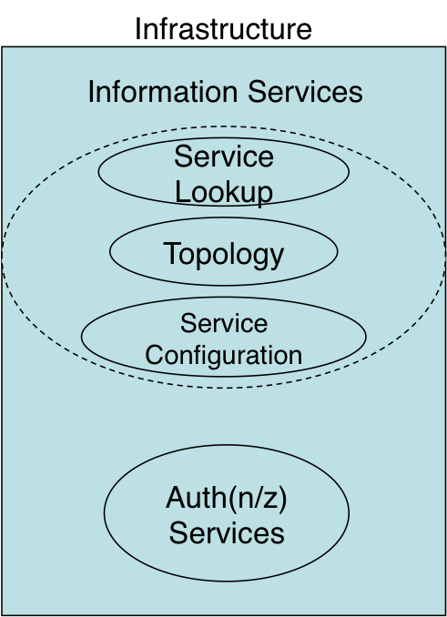
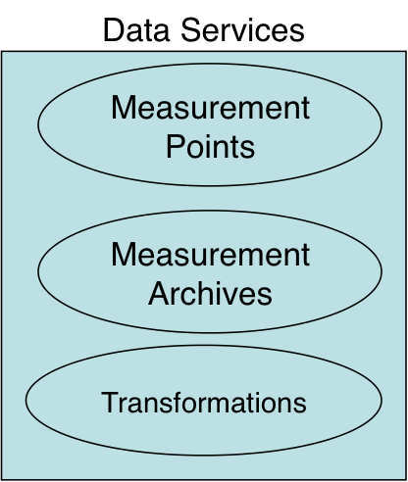
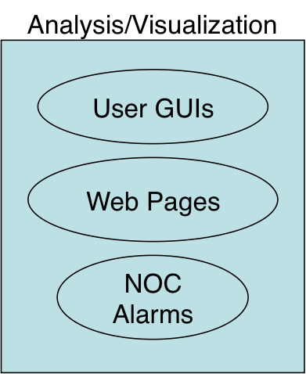
perfSONAR Architecture Overview
<number> – 11/07/26, © 2010 Internet2

Slide 10
perfSONAR Architecture Overview
A perfSONAR deployment can be any combination of services
  An instance of the Lookup Service is required to share information
  Any combination of data services and analysis and visualization tools is possible
perfSONAR services have the ability to federate globally
  The Lookup Service communicates with a confederated group of directory services (e.g. the Global Lookup Service)
  Global discovery is possible through APIs
perfSONAR is most effective when all paths are monitored
  Debugging network performance must be done end-to-end
  Lack of information for specific domains can delay or hinder the debug process
<number> – 11/07/26, © 2010 Internet2

Slide 11
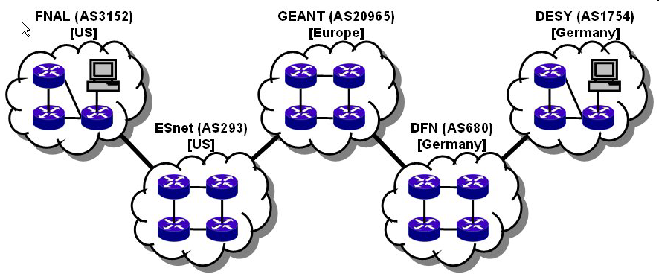

Many collaborations are inherently multi-domain, so for an end-to-end monitoring tool to work everyone must participate in the monitoring infrastructure
user
performance GUI
measurement archive
measurement archive
Analysis tool
measurement archive
measurement archive
m1
m1
m4
m1
m4
m4
measurement archive
m3
m3
m3
GEANT (AS20965)
[Europe]
m1
m4
DESY (AS1754)
[Germany]
FNAL (AS3152)
[US]
m1
m4
m3
ESnet (AS293)
[US]
DFN (AS680)
[Germany]
m3
<number> – 11/07/26, © 2010 Internet2

Slide 12
Who is perfSONAR?
The perfSONAR Consortium is a joint collaboration between
  ESnet
  Géant
  Internet2
  Rede Nacional de Ensino e Pesquisa (RNP)
Decisions regarding protocol development, software branding, and interoperability are handled at this organization level
There are at least two independent efforts to develop software frameworks that are perfSONAR compatible.
  perfSONAR-MDM
  perfSONAR-PS
  Others? The beauty of open source software is we will never know the full extent!
Each project works on an individual development roadmap and works with the consortium to further protocol development and insure compatibility
<number> – 11/07/26, © 2010 Internet2

Slide 13
Who is perfSONAR-PS?
perfSONAR-PS is comprised of several members:
  ESnet
  Fermilab
  Georgia Tech
  Indiana University
  Internet2
  SLAC
  The University of Delaware
perfSONAR-PS products are written in the perl programming language and are available for installation via source or RPM (Red Hat Compatible) packages
perfSONAR-PS is also a major component of the pS Performance Toolkit – A bootable Linux CD containing measurement tools.
<number> – 11/07/26, © 2010 Internet2

Slide 14
perfSONAR-PS Availability
perfSONAR-PS is an implementation of the perfSONAR measurement infrastructure and protocols written in the perl programming language
All products are available as platform and architecture independent source code.
All products are available as RPMs (e.g. RPM Package Manager). The perfSONAR-PS consortium directly supports the following operating systems:
  CentOS (version 5)
RPMs are compiled for the x86 (should work w/ x86 64 bit) architecture.
Functionality on other platforms and architectures is possible, but not supported. Attempts are done at the user’s own risk.
  Should work:
    Scientific Linux (versions 4 and 5)
    Red Hat Enterprise Linux (versions 4 and 5)
  Harder, but possible:
    Fedora Linux (any recent version)
    SuSE (any recent version)
    Debian Variants (…)
<number> – 11/07/26, © 2010 Internet2

Slide 15
perfSONAR-PS Availability
The pS Performance Toolkit (pSPT) is a Linux ISO image (e.g. a LiveCD) packed by Internet2 for both easy of installation and configuration of performance tools
  Prior:
    Based on Knoppix Linux
  Current:
    Based on CentOS (version 5) Linux
  Designed for x86 architecture
  No explicit support for x86 64 bit but compatibility is expected
Product also contains other relevant measurement tools and perfSONAR-PS dependencies.
Support structure is limited to the following goals:
  Updated versions of all software (operating system and performance) with each release
  Monitoring and alerts regarding critical security vulnerabilities for all software. Critical patches and releases available for severe cases
  Semi annual (4 times per year) minor releases
<number> – 11/07/26, © 2010 Internet2

Slide 16
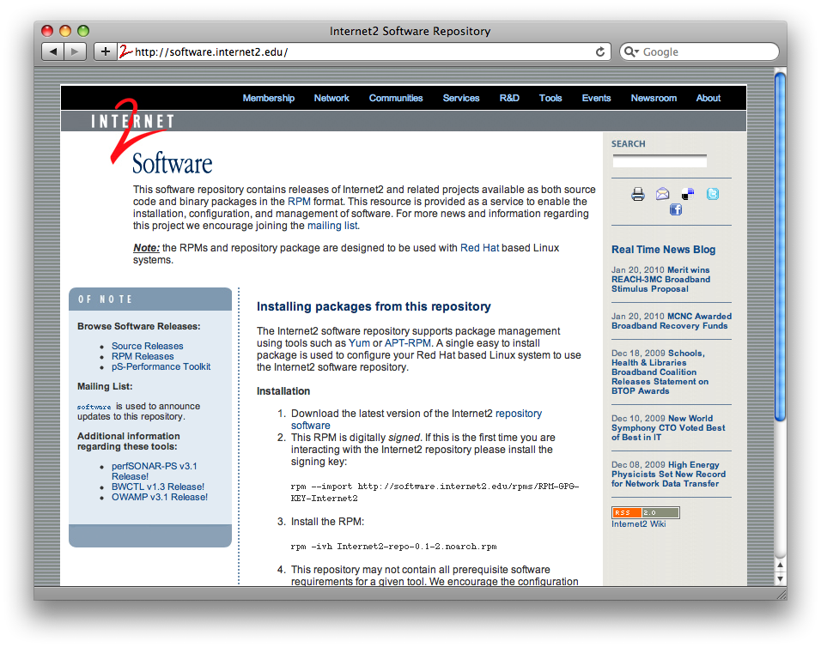
perfSONAR-PS Availability
perfSONAR-PS and the pSPT are available from http://software.internet2.edu
<number> – 11/07/26, © 2010 Internet2

Slide 17
perfSONAR-PS Availability
To facilitate installation and updates on the supported platforms, installation is available through several package managers:
  YUM
  Up2date
  APT-RPM
Instructions to enable are available on http://software.internet2.edu
Installing software becomes a simple one step operation
  Dependencies are managed by the operating system
  Software is identified by name, and can be searched for
<number> – 11/07/26, © 2010 Internet2

Slide 18
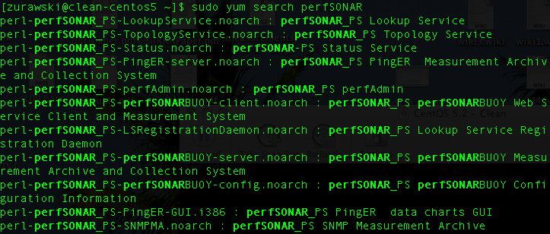
perfSONAR-PS Availability
Using YUM to search for packages:
<number> – 11/07/26, © 2010 Internet2

Slide 19
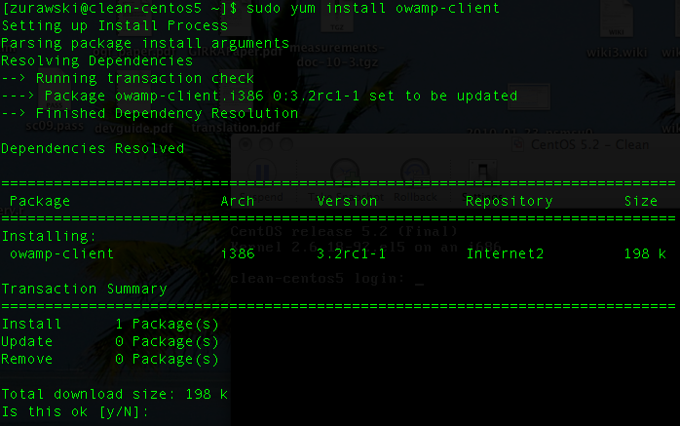
perfSONAR-PS Availability
Using YUM to install packages:
<number> – 11/07/26, © 2010 Internet2

Slide 20
perfSONAR-PS Availability
perfSONAR-PS is working to build a strong user community to support the use and development of the software.
perfSONAR-PS Mailing Lists
  Users List: https://mail.internet2.edu/wws/subrequest/perfsonar-ps-users
  Announcement List: https://mail.internet2.edu/wws/subrequest/perfsonar-ps-announce
pSPT Mailing Lists
  Users List: https://mail.internet2.edu/wws/subrequest/performance-node-users
  Announcement List: https://mail.internet2.edu/wws/subrequest/performance-node-announce
<number> – 11/07/26, © 2010 Internet2

Slide 21
perfSONAR Adoption
perfSONAR is gaining traction as an interoperable and extensible monitoring solution
Adoption has progressed in the following areas:
  R&E networks including backbone, regional, and exchange points
  Universities on a national and international basis
  Federal labs and agencies in the United States (e.g. JET nets)
  Scientific Virtual Organizations, notably the LHC project
Recent interest has also accrued from:
  International R&E network partners and exchange points
  Commercial Providers in the United States
  Hardware manufactures
<number> – 11/07/26, © 2010 Internet2

Slide 22
Regular Monitoring Motivation
Now that we have seen the purpose and makeup of the perfSONAR infrastructure, it’s time to see what it can do in the real world
perfSONAR is used by network engineers to identify many types of performance problem
  A Divide and Conquer strategy is necessary to isolate problems
  A structured methodology helps to eliminate duplicate or useless steps
  perfSONAR works best when everyone participates, holes in deployment lead to holes in the problem solving phase
The following sections will outline the proper deployment strategy and describe some real work use cases
<number> – 11/07/26, © 2010 Internet2

Slide 23
How it Should Work
To accurately and swiftly address network performance problems the following steps should be undertaken
  Identify the problem: if there a user in one location is complaining about performance to another, get as much information as possible
    Is the problem un-directional? Bi-directional?
    Does the problem occur all the time, frequently, or rarely?
    Does the problem occur for only a specific application, many applications, or only some applications?
    Is the problem reproducible on other machines?
  Gather information about the environment
    Hosts
    Network Path
    Configuration (where applicable)
    Resources available
<number> – 11/07/26, © 2010 Internet2

Slide 24
How it Should Work
Cont.
  Methodically approach the problem
    Test using the same tool everywhere, gather results
    Before moving on to the next tool, did you gather everything of value?
    Are the results consistent?
  After proceeding through all tools and approaches, form theories
    Can the problem be isolated to a specific resource or component?
    Can testing be performed to eliminate dead ends?
Consider the following example:
  International path
  Problems noted
  We know the path
  We have tools available
<number> – 11/07/26, © 2010 Internet2

Slide 25

Scenario: Multi-domain International Path
<number> – 11/07/26, © 2010 Internet2

Slide 26
Desirable Case: Expected Performance
<number> – 11/07/26, © 2010 Internet2

Slide 27
Typical: Poor Performance … Somewhere
<number> – 11/07/26, © 2010 Internet2

Slide 28
Typical: Poor Performance … Somewhere
But where?
<number> – 11/07/26, © 2010 Internet2

Slide 29
Solution: Test Points + Regular Monitoring
<number> – 11/07/26, © 2010 Internet2

Slide 30

perfSONAR: Backbone and Exchanges
<number> – 11/07/26, © 2010 Internet2

Slide 31
perfSONAR: Regional Networks
<number> – 11/07/26, © 2010 Internet2

Slide 32
perfSONAR: Campus
<number> – 11/07/26, © 2010 Internet2

Slide 33
Path Decomposition – Isolate the Problem
Step by step: test
between points
<number> – 11/07/26, © 2010 Internet2

Slide 34
Path Decomposition – Isolate the Problem
1st Segment - no
problems found
<number> – 11/07/26, © 2010 Internet2

Slide 35
Path Decomposition – Isolate the Problem
2nd Segment – Problem
Identified …
<number> – 11/07/26, © 2010 Internet2

Slide 36
Path Decomposition – Isolate the Problem
2nd Segment – Problem
Identified … and fixed!
<number> – 11/07/26, © 2010 Internet2

Slide 37
Path Decomposition – Isolate the Problem
But end to end
performance still
poor
<number> – 11/07/26, © 2010 Internet2

Slide 38
Path Decomposition – Isolate the Problem
3rd Segment – No
problems
<number> – 11/07/26, © 2010 Internet2

Slide 39
Path Decomposition – Isolate the Problem
4th Segment – No
problems
<number> – 11/07/26, © 2010 Internet2

Slide 40
Path Decomposition – Isolate the Problem
5th Segment – Last
problem found …
<number> – 11/07/26, © 2010 Internet2

Slide 41
Path Decomposition – Isolate the Problem
5th Segment – Last
problem found …
and fixed!
<number> – 11/07/26, © 2010 Internet2

Slide 42
Lessons Learned
Problem resolution requires proper tools
  Specialized to given task (e.g. Bandwidth, Latency)
  Widely available where the problems will be
Isolating a problem is a well defined, multi-step process
  Rigid set of steps – systematic approach to prevent causing new problems
Diagnostics, as well as regular monitoring, can reveal true network performance
<number> – 11/07/26, © 2010 Internet2

Slide 43
How it Probably Works
If the suggested steps aren’t taken (or followed in an ad-hoc manner), results will vary.
  Skipping steps leads to missing clues
Deployment and participation may vary, this leads to some gaps in the debugging process
Consider the following example:
  International path
  Problems noted
  We know the path
  We have tools available - almost everywhere
<number> – 11/07/26, © 2010 Internet2

Slide 44
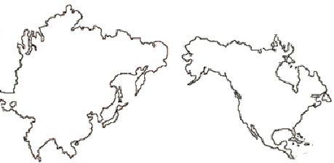
Scenario: Multi-domain International Path
<number> – 11/07/26, © 2010 Internet2

Slide 45
Desirable Case: Expected Performance
<number> – 11/07/26, © 2010 Internet2

Slide 46
Typical: Poor Performance … Somewhere
<number> – 11/07/26, © 2010 Internet2

Slide 47
Typical: Poor Performance … Somewhere
But where?
<number> – 11/07/26, © 2010 Internet2

Slide 48
Solution: Test Points + Regular Monitoring
<number> – 11/07/26, © 2010 Internet2

Slide 49
Solution: Test Points + Regular Monitoring
Key Point: End to end monitoring
Requires participation from all
domains
<number> – 11/07/26, © 2010 Internet2

Slide 50
Typical: Poor Performance … Somewhere
Internet2 – Available on
the backbone
<number> – 11/07/26, © 2010 Internet2

Slide 51
Typical: Poor Performance … Somewhere
The Campus is
participating too
<number> – 11/07/26, © 2010 Internet2

Slide 52
Typical: Poor Performance … Somewhere
The exchange point
makes statistics available
<number> – 11/07/26, © 2010 Internet2

Slide 53
Typical: Poor Performance … Somewhere
A regional network may
not participate…
<number> – 11/07/26, © 2010 Internet2

Slide 54
Typical: Poor Performance … Somewhere
Complete end to end
Monitoring is not
possible.
<number> – 11/07/26, © 2010 Internet2

Slide 55
Lessons Learned
Missing part of the path leaves us with a huge disadvantage
May discover some problems through isolation on the path we know, could miss something
  Most network problems occur on the demarcation between networks
  Testing around the problem won’t work (we still have to transit this network)
<number> – 11/07/26, © 2010 Internet2

Slide 56
Why is Science Data Movement Different?
Different Requirements
  Campus network is not designed for large flows
    Enterprise requirements
    100s of Mbits is common, any more is rare (or viewed as strange)
    Firewalls
    Network is designed to mitigate the risks since the common hardware (e.g. Desktops and Laptops) are un-trusted
  Science is different
    Network needs to be robust and stable (e.g. predictable performance)
    10s of Gbits of traffic (N.B. that its probably not sustained – but could be)
    Sensitive to enterprise protections (e.g. firewalls, LAN design)
Fixing is not easy
  Design the base network for science, attach the enterprise on the side (expensive, time consuming, and good luck convincing your campus this is necessary…)
  Mitigate the problems by moving your science equipment to the edge
    Try to bypass that firewall at all costs
    Get as close to the WAN connection as you can
<number> – 11/07/26, © 2010 Internet2

Slide 57
Identifying Common Network Problems
The above examples paint a broad picture: there is a problem, somewhere, that needs to be fixed
What could be out there?
  Architecture
  Common Problems, e.g. “Soft Failures”
Myths and Pitfalls
  Getting trapped is easy
  Following a bad lead is easy too
<number> – 11/07/26, © 2010 Internet2

Slide 58
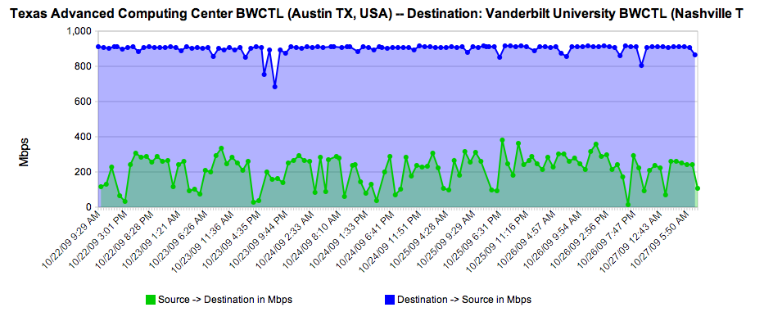
Identifying Common Network Problems
Audience Question: Would you complain if you knew what you were getting was not correct?
N.B. Actual performance between Vanderbilt University and TACC – Should be about 1Gbps in both directions.
<number> – 11/07/26, © 2010 Internet2

Slide 59
Identifying Common Network Problems
Internet2/ESnet engineers will help members and customers debug problems if they are escalated to us
  Goal is to solve the entire problem – end to end
  Involves many parties (typical: End users as well as Campus, Regional, Backbone staff)
  Slow process of locating and testing each segment in the path
  Have tools to make our job easier (more on this later)
Common themes and patterns for almost every debugging exercise emerge
  Architecture (e.g. LAN design, Equipment Choice, Firewalls)
  Configuration
  “Soft Failures”, e.g. something that doesn’t severe connectivity, but makes the experience unpleasant
<number> – 11/07/26, © 2010 Internet2

Slide 60
Architectural Considerations
LAN vs WAN Design
  Multiple Gbit flows [to the outside] should be close to the WAN connection
  Eliminate the number of hops/devices/physical wires that may slow you down
  Great performance on the LAN != Great performance on the WAN
You Get What you Pay For
  Cheap equipment will let you down
  Network
    Small Buffers, questionable performance (e.g. internal switching fabric can’t keep up w/ LAN demand let alone WAN)
    Lack of diagnostic tools (SNMP, etc.)
  Storage
    Disk throughput needs to be high enough to get everything on to the network
    Plunking a load of disk into an incapable server is not great either
      Bus performance
      Network Card(s)
<number> – 11/07/26, © 2010 Internet2

Slide 61
Architectural Considerations – cont.
Firewalls
  Designed to stop traffic
    read this slowly a couple of times…
  Small buffers
    Concerned with protecting the network, not impacting your performance
  Will be a lot slower than the original wire speed
  A “10G Firewall” may handle 1 flow close to 10G, doubtful that it can handle a couple.
  If firewall-like functionality is a must – consider using router filters instead
<number> – 11/07/26, © 2010 Internet2

Slide 62
Configuration
Host Configuration
  Tune your hosts (especially compute/storage!)
  Changes to several parameters can yield 4 – 10X improvement
  Takes minutes to implement/test
  Instructions: http://fasterdata.es.net/tuning.html
Network Switch/Router Configuration
  Out of the box configuration may include small buffers
  Competing Goals: Video/Audio etc. needs small buffers to remain responsive. Science flows need large buffers to push more data into the network.
  Read your manuals and test LAN host to a WAN host to verify (not LAN to LAN).
<number> – 11/07/26, © 2010 Internet2

Slide 63
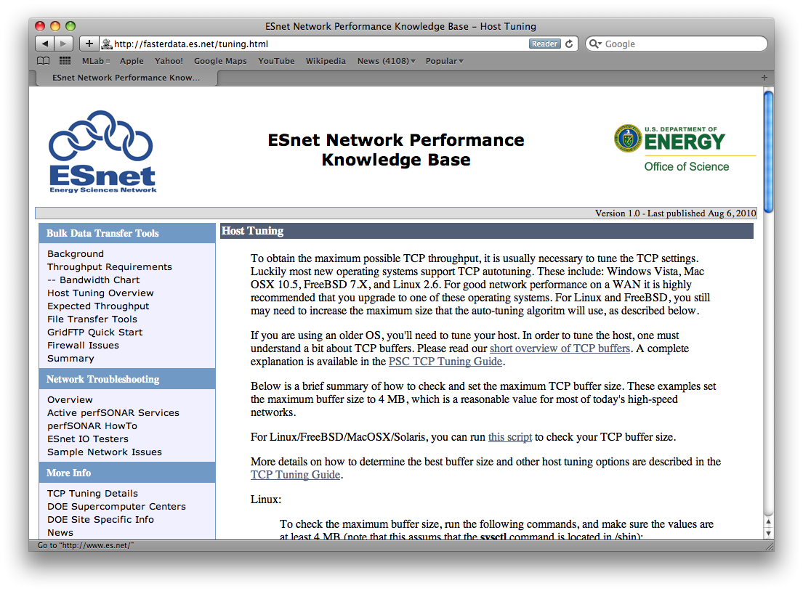
Host Configuration
<number> – 11/07/26, © 2010 Internet2

Slide 64
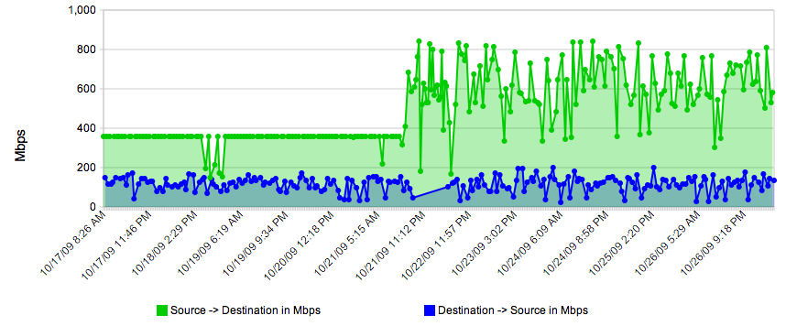
Configuration – cont.
Host Configuration – spot when the settings were tweaked…
N.B. Example Taken from REDDnet (UMich to TACC), using BWCTL measurement)
<number> – 11/07/26, © 2010 Internet2

Slide 65
Soft Failures
Soft Failures are any network problem that does not result in a loss of connectivity
  Slows down a connection
  Hard to diagnose and find
  May go unnoticed by LAN users in some cases, but remote users may be the ones complaining
    Caveat – How much time/energy do you put into listing to complaints of remote users?
Common:
  Dirty or Crimped Cables
  Failing Optics/Interfaces
  [Router] Process Switching, aka “Punting”
  Router Configuration (Buffers/Queues)
<number> – 11/07/26, © 2010 Internet2

Slide 66
Soft Failures – cont.
Dirty or Crimped Cables and Failing Optics/Interfaces
  Throw off very low levels of loss – may not notice on a LAN, will notice on the WAN
  Will be detected with passive tools (e.g. SNMP monitoring)
  Question: Would you fix it if you knew it was broken?
[Router] Process Switching
  “Punt” traffic to a slow path
Router Configuration (Buffers/Queues)
  Need to be large enough to handle science flows
  Routing table overflow (e.g. system crawls to a halt when memory is exhausted)
<number> – 11/07/26, © 2010 Internet2

Slide 67
Soft Failures – cont.
Identifying and Fixing should be done through the use of monitoring and diagnostic tools
  Establish testing points on the network
    On the edge and in the center
  Test to WAN points to find hidden/hard to diagnose problems
    Where to Place and how to find?
      Have collaborators co-allocate a testing machine
      Use discovery tools to find them (e.g. perfSONAR)
  Use an array of tools for different characteristics
    Latency (One wan and Round Trip)
    Bandwidth
    Interface Utilization/Discards/Errors
    Active vs Passive Testing
<number> – 11/07/26, © 2010 Internet2

Slide 68
Myths and Pitfalls
“My LAN performance is great, WAN is probably the same”
  TCP recovers from loss/congestion quickly on the LAN (low RTT)
  TCP will cut speed in half for every loss/discard on the WAN – will take a long time to recover for a large RTT/
  Small levels of loss on the LAN (ex. 1/1000 packets) will go unnoticed, will be very noticeable on the WAN.
“Ping is not showing loss/latency differences”
  ICMP May be blocked/ignored by some sites
  Routers process ICMP differently than other packets (e.g. may show phantom delay)
  ICMP may hide some (not all) loss.
  Will not show asymmetric routing delays (e.g. taking a different path on send vs receive)
Our goal is to dispel these and others by educating the proper way to verify a network – we have lots of tools at our disposal but using these in the appropriate order is necessary too
<number> – 11/07/26, © 2010 Internet2

Slide 69
For more information
General and MDM implementation: http://www.perfsonar.net
The PS implementation: http://psps.perfsonar.net
perfSONAR-PS tools and software: http://software.internet2.edu
A hook to the global lookup service:
http://www.perfsonar.net/activeServices/IS/
More human-readable list of services:
http://www.perfsonar.net/activeServices/
<number> – 11/07/26, © 2010 Internet2

Slide 70
Mailing Lists
Development (by approval of the project)
  https://lists.internet2.edu/sympa/subscribe/perfsonar-dev
User Support
  https://lists.internet2.edu/sympa/subscribe/perfsonar-ps-users
  https://lists.internet2.edu/sympa/subscribe/performance-node-users
Announcements
  https://lists.internet2.edu/sympa/subscribe/perfsonar-ps-announce
  https://lists.internet2.edu/sympa/subscribe/performance-node-announce
Working Groups
  https://lists.internet2.edu/sympa/subscribe/performance-wg
  https://lists.internet2.edu/sympa/subscribe/is-wg
  http://www.ogf.org/mailman/listinfo/nm-wg
  http://www.ogf.org/mailman/listinfo/nmc-wg
  http://www.ogf.org/mailman/listinfo/nml-wg
<number> – 11/07/26, © 2010 Internet2

Slide 71
Diagnostics vs Regular Monitoring
August 10th 2010, OSG Site Admin Workshop – Network Performance
Jason Zurawski – Internet2
For more information, visit http://www.internet2.edu/workshops/npw
<number> – 11/07/26, © 2010 Internet2

