Slide 1
Reorganization of the OSG Project
The existing project organization chart was put in place at the beginning of 2006.
It has worked very well. However, the needs are changing and the project is evolving.
The Executive Team is asking for Council endorsement of the proposed reorganization of the OSG project.
1

Slide 2
Reasons for Reorganization:
Ensure clear identification of ”key-3” stakeholders to all in the project- ATLAS, CMS, LIGO –particularly with the start of LHC data taking.
Augment and strengthen technical software effort and coordination across the program.
Strengthen support for the VOs & Community Grids as part of and integrated with the distributed facility.
Improve interaction across the project.

Slide 3
Note:
NO CHANGE IN GOALS & SCOPE -
Changes in Organization to improve effectiveness.

Slide 4
Key changes in response
Identified “major account managers” within project leadership. Each of Miron, Chander and I will be assigned to one. (strawman proposal is Ruth – ATLAS, Miron - CMS, Chander - LIGO,)
Technical Director (Miron) to lead the technical evolution of all aspects of the program – increasingly important as we have a well-operating infrastructure and move towards the future.
Include focus on Services as well as having the Facility.
Add Users/VO Group and Training/Education to the Facility to provide more effective use and coordination of efforts and activities.
Merge the currently small Troubleshooting activities into other areas.
Better identify roles and transitions between Engagement and Users group.
Resources Manager in Executive Board rather than in the ET – view to rationalize meetings.
Still likely to be an identified need for additional Production Services management/ high level effort. How to address this is TBD.

Slide 5
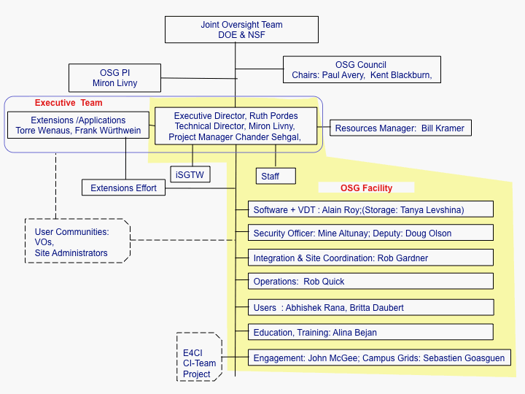
New Project Organization Chart

Slide 6
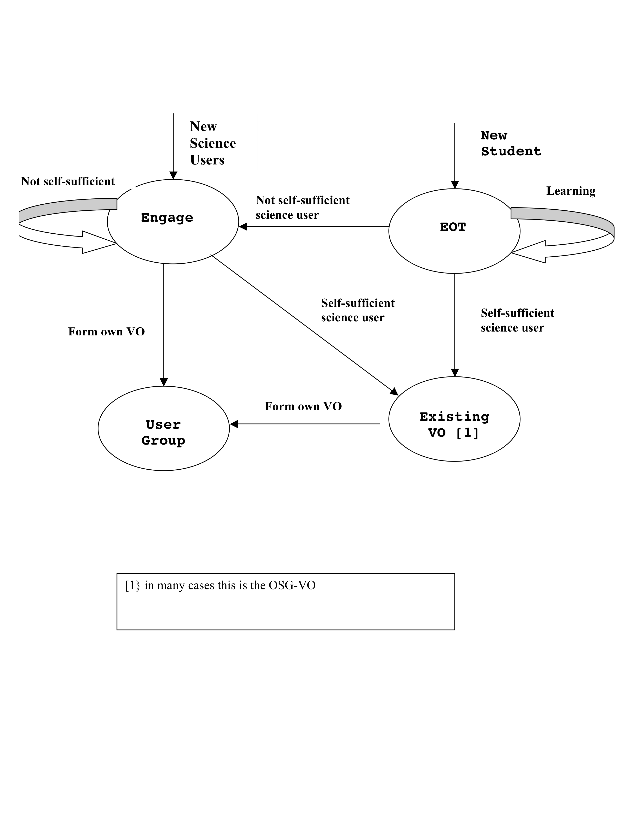
New Entrant VO Flow

Slide 7
Regular Meetings for Running the Project
Production (weekly) covers Operations, Security and Support, includes explicit representation from US ATLAS, US CMS, LIGO, with the rest of the VOs represented by the Users Group. Replaces the current Facility Meeting.
Software (every 2 weeks) or New Capabilities.
Engagement, EOT, Users/VO Group (monthly).
Continued weekly for the core-ET and biweekly meeting for ET.
Continued 6-8 times a year for the EB.

Slide 8
The Facility
The work, goals and efforts of the OSG Facility remains.
The Facility Coordination Team is expanded by the addition of the Education and Users/VO areas and reduced by the contraction of the Troubleshooting into other areas.

Slide 9
OSG Software Tools
Increase attention to and need for OSG software tools.
Software coordinator (Alain) to lead software tools activities across the project – with some effort migrating from other areas.

Slide 10
Authorization & Document Changes
Endorsement from the Council
Need to get agreement from the JOT - current structure is in the Cooperative Agreement.
Will need to change management and project execution plans.

