Slide 1


OSG Area Coordinators
Campus Infrastructures Update
Dan Fraser
Miha Ahronovitz, Jaime Frey, Rob Gardner, Brooklin Gore, Marco Mambelli, Todd Tannenbaum, Derek Weitzel
March 27, 2013

Slide 2
OSG Campus Program
Focus on the Researcher (…or Artist)
  What can we do to increase the throughput of your computing?
Bosco (http://bosco.opensciencegrid.org )
  Help ease the motivated researcher into a distributed environment
    Make Bosco bullet proof
    Broadening the user base
    http://display.opensciencegrid.org
Campus Infrastructure Community
  Community building focal point
    Rob Gardner

Slide 3
Campus Infrastructure Community
Center where researchers can learn about and adopt campus technologies.
  Led by Rob Gardner
First meeting held in November
  UC Santa Cruz
Second meeting at the OSG AHM (Mar)
Monthly “Interactive Forum” meetings now moving to bi-weekly
  Attendance has been good (~15-20)

Slide 4
Bosco Plan (release ~quarterly)
Current Version v1.1.2
  Invitation sent out to Condor users mailing list
  Previous Campus grids have been upgraded to Bosco
    Nebraska, Virginia Tech
  View on OSG Display
    (http://display.opensciencegrid.org)
Working on v1.2 (April, 2013)
  Focus on reliability, reducing annoyances
  Scaling to 1000 submissions
Start on v1.3 (July)
  Gratia Accounting (integrated probe)
  SLURM support
  Additional features TBD

Slide 5
New Bosco Developments
Bosco invite sent to Condor list
New Bosco downloads site:
  https://twiki.grid.iu.edu/bin/view/CampusGrids/BoscoAnalytics
New use cases:
  CMS submission without a gatekeeper.
  Pegasus HTPC workflow to XSEDE resources
Exploring an HTC scientific/artistic competition

Slide 6
Campus Grid Issues
Emerging concern is that Bosco, while making it easier to submit HTC jobs, does not yet meet the needs of the end users.
  May require integration with an infrastructure
    Currently exploring “R”
  This conclusion is in part due to Miha’s efforts so far in user interviews.

Slide 7
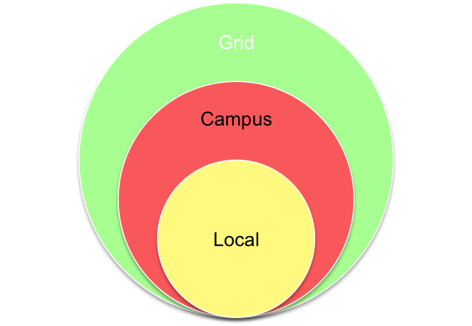
Campus HTC Infrastructure Direction
Help the researcher use local HTC resources
  Run on a local campus cluster
  Run on several local clusters
    Use local authentication credentials
Use/share resources with a
collaborator on another campus
Access to the national cyberinfrastructure
  OSG (and also XSEDE) resources
Submit Locally, Run Globally

