Slide 1
Network Monitoring for OSG
Shawn McKee/University of Michigan
OSG Staff Planning Retreat
July 10th, 2012

Slide 2
Outline
Motivation for Network Monitoring
Status and Related Work
perfSONAR-PS
Modular Dashboard
Goals
Draft Work Plan

Slide 3
Motivations for OSG Network Monitoring
Distributed collaborations rely upon the network as a critical part of their infrastructure, yet finding and debugging network problems can be difficult and, in some cases, take months.
There is typically no differentiation of how the network is used amongst the OSG users. (Quantity may vary)
We need a standardized way to monitor the network and locate problems quickly if they arise
We don’t want to have a network monitoring system per VO!

Slide 4
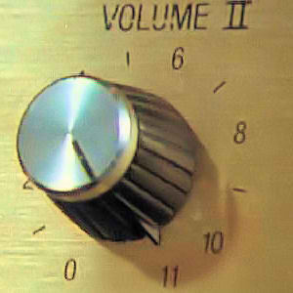
Data Movement for Science
This should not be news to anyone here …
Flows getting larger (e.g. Science datasets in the R&E world)
Special requirements (e.g. Streaming media is sensitive to jitter, bulk data transfer is sensitive to loss)
Number of users/devices is increasing
Locations are spread out
Everything is cross domain
Slide from Jason Zurawski

Slide 5
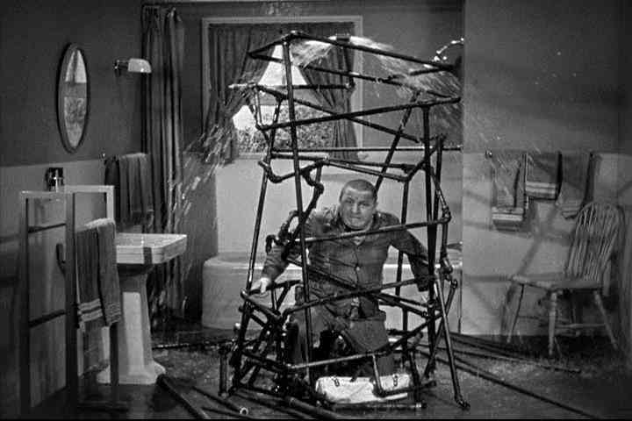
Network Realities
Where are the problems?
Network Core? Everything is well connected, well provisioned, and flawlessly configured, RIGHT?
End Systems? Properly tuned for optimal TCP performance (no matter the operating system), proper drivers installed and functioning optimally, RIGHT?
LAN? Regional Net?
Better to ask “Where aren’t there problems?”
Slide from Jason Zurawski

Slide 6
Need for a “Finger Pointing” Tool
As you can imagine (or have experienced), network problems can be hard to identify and/or isolate.
To first order most users identify any problem where the WAN is involved as being a “network problem” (sometimes they are right)
How can we quickly identify when problems are network problems and help isolate their locations?
The perfSONAR project was designed to help do this

Slide 7
History of perfSONAR
perfSONAR: a joint effort of ESnet, Internet2, GEANT and RNP to standardize network monitoring protocols, schema and tools
USATLAS adopted perfSONAR-PS toolkit starting in 2007. All Tier-2s and the Tier-1 instrumented + full mesh tests by 2010.
Modular dashboard developed by Tom Wlodek/BNL based upon USATLAS requirements to better understand deployed infrastructure (working well for USATLAS).
LHCOPN choose to adopt in June 2011…mostly deployed within 3 months (by September 2011).

Slide 8
OSG perfSONAR-PS Deployment
We want a set of tools that:
Are easy to install
Measure the “network” behavior
Provide a baseline of network performance between end-sites
Are standardized and broadly deployed
Details of how LHCONE sites setup the perfSONAR-PS installations is documented on the Twiki at: https://twiki.cern.ch/twiki/bin/view/LHCONE/SiteList
An example OSG could follow (with minor changes)
In the next few slides I will highlight some of the relevant details

Slide 9
OSG Network Monitoring Goals
We want OSG sites to have the ability to easily monitor their network status
Sites should be able to determine if network problems are occurring
Sites should have a reasonable “baseline” measurement of usable bandwidth between themselves and selected peers
Sites should have standardized diagnostic tools available to identify, isolate and aid in the repair of network-related issues
We want OSG VOs to have the ability to easily monitor the set of network paths used by their sites
VOs should be able to identify problematic sites regarding their network
VOs should be able to track network performance and alert-on network problems between VO sites

Slide 10
How To Achieve These Goals?
OSG should plan to leverage the existing and ongoing efforts in LHC regarding network monitoring
The perfSONAR-PS toolkit is a actively developed set of network monitoring tools following the perfSONAR standards
There is an existing modular dashboard which is currently undergoing a redesign. OSG should not only use this but provide input about design features needed to enable its effective use for OSG
Some effort is underway to enable alerting for network problems. I have an undergraduate working on an example system.
Details of how best to integrate within OSG planning and existing and future infrastructure are why we are here
Later we can discuss a draft workplan.

Slide 11
perfSONAR-PS Deployment Considerations
We want to measure (to the extent possible) the entire network path between OSG resources. This means:
We want to locate perfSONAR-PS instances as close as possible to the storage/compute resources associated with a site. The goal is to ensure we are measuring the same network path to/from the relevant site resources.
There are two separate instances that should be deployed: latency & bandwidth (Two instances to prevent interference)
The latency instance measures one-way delay by using an NTP synchronized clock and send 10 packets per second to target destinations (Important metric is packet-loss!)
The bandwidth instance measures achievable bandwidth via a short test (20-60 seconds) per src-dst pair every 4 (or ‘n’) hour period

Slide 12
perfSONAR-PS Deployment Considerations
Each “site” should have perfSONAR-PS instances in place.
If an OSG site has more than one “network” location, each should be instrumented and made part of scheduled testing.
Standardized hardware and software is a good idea
Measurements should represent what the network is doing and not differences in hardware/firmware/software.
USATLAS has identified and tested systems from Dell for perfSONAR-PS hardware. Two variants: R310 and R610.
R310 cheaper (<$900), can host 10G (Intel X520 NIC) but not supported by Dell (Most US ATLAS sites choose this)
R610 officially supports X520 NIC (Canadian sites choose this)
Orderable off the Dell LHC portal for LHC sites
VOs should try to upgrade perfSONAR-PS toolkit versions together

Slide 13
Network Impact of perfSONAR-PS
To provide an idea of the network impact of a typical deployment here are some numbers as configured in USATLAS
Latency tests send 10Hz of small packets (20 bytes) for each testing location. USATLAS Tier-2’s test to ~9 locations. Since headers account for 54 bytes each packet is 74 bytes or the rate for testing to 9 sites is 6.7 kbytes/sec.
Bandwidth tests try to maximize the throughput. A 20 second test is run from each site in each direction once per 4 hour window. Each site runs tests in both directions. Typically the best result is around 925 Mbps on a 1Gbps link for a 20 second test. That means we send 4x925 Mbps*20 sec every 4 hours per testing pair (src-dst) or about 46.25 Mbps average for testing with 9 other sites.
Tests are configurable but the above settings are working fine.

Slide 14
Modular Dashboard
While the perfSONAR-PS toolkit is very nice, it was designed to be a distributed, federated installation.
Not easy to get an “overview” of a set of sites or their status
USATLAS needed some “summary interface”
Thanks to Tom Wlodek’s work on developing a “modular dashboard” we have a very nice way to summarize the extensive information being collected for the near-term network characterization.
The dashboard provides a highly configurable interface to monitor a set of perfSONAR-PS instances via simple plug-in test modules. Users can be authorized based upon their grid credentials. Sites, clouds, services, tests, alarms and hosts can be quickly added and controlled.

Slide 15
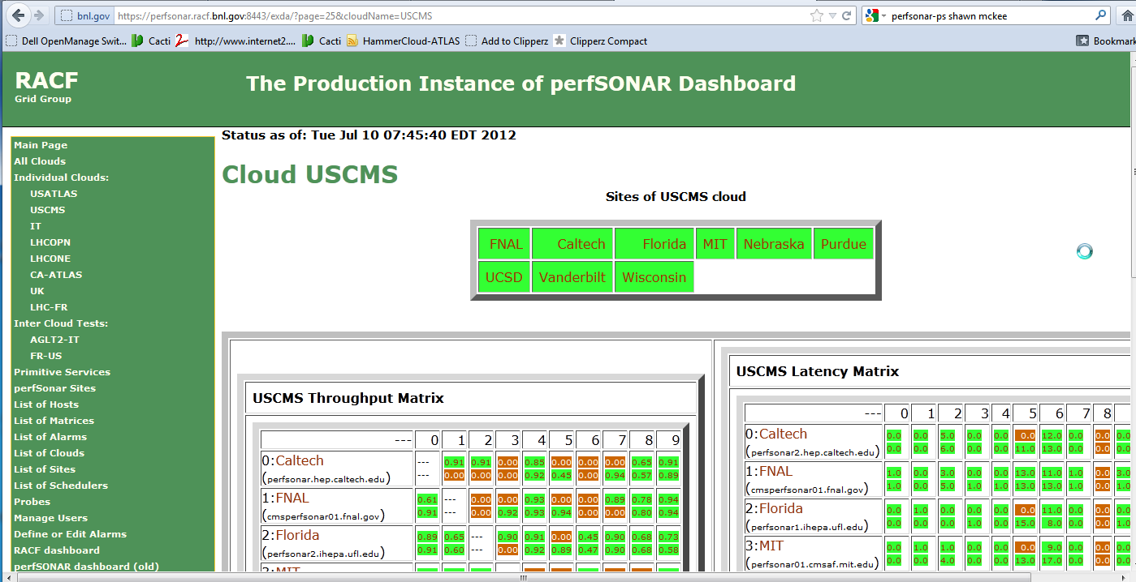

Example of Dashboard for US CMS
“Primitive” service status
Other Dashboards
See http://perfsonar.racf.bnl.gov:8080/exda/?page=25&cloudName=USCMS

Slide 16
VO Site Configuration Considerations
Determine what VO wants for scheduled tests
Recommendation for tests:
Latency tests (for the packet loss info). Use default settings
Throughput. How often and how long (USATLAS one per 4 hrs, 20 second duration; 10GE may need longer test)
Traceroute: Sites should setup a traceroute test to each other VO site
Use a “community” to self-identify VO sites of interest. I recommend the VO name. This will allow VO sites to pick that community and see everyone “advertising” that attribute. Allows adding sites to tests with a “click”
Get VO sites at the same (current) version
Make sure firewalls are not blocking either VO sites nor the collector at BNL (or OSG?): rnagios01.usatlas.bnl.gov
Copy/rewrite the LHCONE info on the Twiki for VO use

Slide 17
Targets for OSG
Two “clients” for OSG Network Monitoring: sites and VOs
How to support both most effectively?
Sites need:
Details of options for required hardware
Software (perfSONAR-PS) and detailed installation instructions
Configuration options documented with suggested best-practices
Notification when problems are identified
VOs need:
Site details (perfSONAR-PS instances at each VO site)
Software (modular dashboard host by OSG?) and detailed configuration options.
Dashboard configuration details: How to add my VO sites for monitoring?
Centralized test/scheduling management (“pull” model seems best)

Slide 18
Draft Work Plan for OSG
Develop OSG site install procedures for perfSONAR-PS
Use existing infrastructure for software download or provide OSG distribution?
Provide site recommendations and best practices guide
Provide VO-level recommendations and best practices doc
OSG should host a set of services providing a modular dashboard for VOs. Need to determine details
Should OSG provide packaged “modular dashboard” components to allow sites/VOs to deploy their own instance?
OSG should allow VOs or sites to request “alerting” when monitoring identifies network problems. Need to create and deploy such a capability

Slide 19
Challenges Ahead
Getting hardware/software platform installed at OSG sites
Dashboard development: Currently USATLAS/BNL and soon OSG, Canada (ATLAS, HEPnet) and USCMS. OSG input?
Managing site and test configurations
Determining the right level of scheduled tests for a site, e.g., which other OSG or VO sites?
Improving the management of the configurations for VOs/Clouds
Tools to support “central” configuration (Internet2 working on this)
Alerting: A high-priority need but complicated:
Alert who? Network issues could arise in any part of end-to-end path
Alert when? Defining criteria for alert threshold. Primitive services are easier. Network test results more complicated to decide
Integration with existing VO and OSG infrastructures.

Slide 20
Discussion/Questions
Questions or Comments?

Slide 21
References
perfSONAR-PS site http://psps.perfsonar.net/
Install/configuration guide: http://code.google.com/p/perfsonar-ps/wiki/pSPerformanceToolkit32
Modular Dashboard: https://perfsonar.racf.bnl.gov:8443/exda/ or http://perfsonar.racf.bnl.gov:8080/exda/
Tools, tips and maintenance: http://www.usatlas.bnl.gov/twiki/bin/view/Projects/LHCperfSONAR
LHCONE perfSONAR: https://twiki.cern.ch/twiki/bin/view/LHCONE/SiteList
LHCOPN perfSONAR: https://twiki.cern.ch/twiki/bin/view/LHCOPN/PerfsonarPS
CHEP 2012 presentation on USATLAS perfSONAR-PS experience: https://indico.cern.ch/contributionDisplay.py?sessionId=5&contribId=442&confId=149557

Slide 22
Modular Dashboard Development
The dashboard that currently exists has some shortcomings which are being addressed by a new development effort
There is a mailing list tracking the effort at: https://lists.bnl.gov/mailman/listinfo/ps-dashboard-devel-l
We (OSG) need to ensure the product will meet our needs. If there is input appropriate for the development effort we need to make sure it gets into the development process. Coding is just starting now…

Slide 23
Old dashboard - overview
user
dashboard
database
Collector API
PS Host
Collector
PS Host

Slide 24
Proposed structure of new dashboard framework
Display GUI
Object config GUI
Alarms
Authentication
Collector
Other?
Data Access API
Data Store
Data Persistence Layer
Database

Slide 25
Modular Dashboard Schedule
Current modular dashboard development schedule from Tom Wlodek/BNL and Andy Lake/ESnet
July 1st: We will have official version 1.0 of the design document ready and we can start coding. We can add changes to the document later but it will be a stating point for development. See https://docs.google.com/document/d/1NnVNF6TKnTIZkL9BQNyRlqX9dNXH1K-62Ax9rFnZvKE/edit?pli=1
August 1st: We will have first version of dashboard deployed. It shall consist of collector (Andy), data store and data access API (myself) and some rudimentary text gui. We may reuse Andy's gui if possible, Andy is going to look into that. Not included will be: Configuration gui, persistence and probe history.
Sep 1st: We will have full dashboard including history, configuration gui and persistence. I am not sure if we will fit the alarms by then.
.

