Slide 1
Introduction to Grids
Tutorial
SuperComputing ’07
Notes:
People:
Ben Clifford – developer with the University of Chicago Computation Institute – works on grid workflow development (which you'll see at the very end of this talk) and on the Open Science Grid education programme (which is what this tutorial is heavily based on).
Alina Bejan – the OSG Education Coordinator (EOT) who works at the CI;
Mike Wilde -- also works on the Education program OSG EOT, on Swift and on many other projects

Slide 2
Roadmap
Motivation
What is the grid?
How do we work with a grid?
What’s next?

Slide 3
Motivation
Example

Slide 4
Scaling up Science: Citation Network Analysis in Sociology
Work of James Evans, University of Chicago, Department of Sociology
Notes:
Our example problem is the Citation Analysis
Citation Analysis is the most common method of bibliometrics. Citation analysis uses citations in scholarly works to establish links to other works or other researchers. Co-citation coupling and bibliographic coupling are specific kinds of citation analysis.
Citation analysis is the examination of the frequency and pattern of citations in articles and books.
Due to unprecedented growth of electronic resource (e-resource) availability, one of the questions currently being explored is, "how often are e-resources being cited in my field?”
the graph that represents the ‘reference’ relationships is not easy to compute
Picture: citation network analysis for the case of plant biotechnology; the relationships among scientists and the public, private, and nonprofit organizations involved in research on the genetic model organism Arabidopsis thaliana are represented

Slide 5
Scaling up the analysis
Query and analysis of 25+ million citations
Work started on desktop workstations
Queries grew to month-long duration
With data distributed across
U of Chicago TeraPort cluster
  Advantages:
    50 (faster) CPUs gave 100 X speedup
    Many more methods and hypotheses can be tested!
Higher throughput and capacity enables deeper analysis and broader community access.
Notes:
This project started running on a desktop workstation, as most projects do – you write the code on your PC and it works.
But as you start feeding in more data, it starts taking longer and longer to process – it started off taking a few minutes to run with a small number of citations but as his citation database got bigger the program slowed down.
Eventually he had over 25 million citations and the program was taking a month to run on his PC – every time he made a change and wanted to try it out, it took a month to process everything.
So one thing we did was to move the problem onto UC's grid site, the Teraport – using 50 CPUs instead of his one PC, and faster CPUs at that, he got 100x speedup – go from a month back down to running his jobs in hours.
This way, he can get his results faster and he can do much deeper analysis than he could with one PC.
It is possible to expand further, using even more available computing and storage capacity for this application.

Slide 6
A desktop workstation is yours to do what you like.
~2 GHz CPU
~500 GB
~30 Gigaflops
Notes:
Here is the scaling up problem again:
We start with a PC – CPU around 2Ghz, storage of maybe half a terabyte.
You own it yourself – yours to use and abuse.

Slide 7
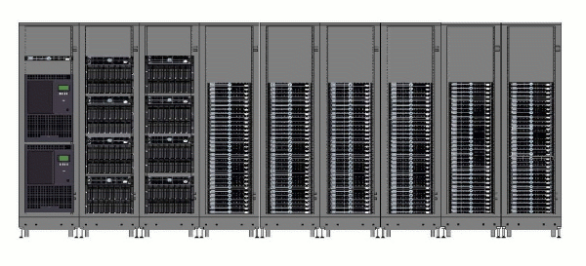
A Cluster is a shared resource.
Cluster Management
“frontend”
I/O Servers typically RAID fileserver
A few Headnodes, gatekeepers and other service nodes
Disk Arrays
Lots of Worker Nodes
Tape Backup robots
Notes:
Your department might purchase and manage a cluster– illustrated above.
A cluster has many “compute nodes”, (plenty of) storage, and network connectivity. (like putting multiple computers to work together)
Basically it provides a shared computing resource for tasks that are too demanding for your PC, where you can't afford to have your own dedicated big computer.
A regular user (you) will probably use it only part of the time, so it makes sense to share it.
It is possible that everyone in your department gets access to this cluster.

Slide 8

Grids represent a different approach
The OSG
  Build bigger supercomputers by joining smaller ones together in a grid
Origins:
  National Grid (iVDGL, GriPhyN, PPDG) and LHC Software & Computing Projects
Current Compute Resources:
  61 Open Science Grid sites
  Connected via Inet2, NLR.... from 10 Gbps – 622 Mbps
  Compute & Storage Elements
  All are Linux clusters
  Most are shared
    Campus grids
    Local non-grid users
  More than 10,000 CPUs
    A lot of opportunistic usage
    Total computing capacity difficult to estimate
    Same with Storage
Notes:
We are now ready to introduce the notion of a grid, and grid computing.
There exists a different approach to the cluster we just saw, which is the grid approach.
instead of building a bigger and bigger single cluster, you federate together a lot of smaller ones.
For example, the OSG has 60 sites used by many thousands of users spread mostly around the United States but also in other countries.

Slide 9
PC vs Cluster vs Grid
PC:
  Owner has total control
  Limited capabilities
Cluster:
  Used by a small number of people using (e.g., department, institution)
  – Preserves some locality
Grid:
  Thousands of users - large scale
  From many different places - highly distributed
  Increased problems (due to distributivity aspect)
Notes:
As we transition from PC up to a grid, though, many things change.

Slide 10
What is a grid?
Grid is a system that:
  coordinates resources that are not subject to centralized control,
  using standard, open, general-purpose protocols and interfaces,
  to deliver nontrivial qualities of service
  (based on Ian Foster’s definition in http://www.gridtoday.com/02/0722/100136.html)
Notes:
Different definitions.
Let’s consider Ian Foster's three point checklist – a grid is an infrastructure that brings resources together without imposing central control. Computers, storage space, network connections, databases are examples of resources.
Why are open protocols important? So that you can use different software – you don't have to buy special programs to use it and be bound by certain licensing limitations. Offers freedom and flexibility in working on your own terms, allowing you (the grid user) to make decisions about your local infrastructure.
A major advantage is that a grid is capable of delivering non-trivial qualities of service – basically it means that it doesn't just break at the first opportunity. Reliability is important especially for large scale problems as those that are usually scheduled on grids.

Slide 11
How do we access the grid ?
  Command line with tools that you'll use
  Specialised applications
    Ex: Write a program to process images that sends data to run on the grid as an inbuilt feature.
  Web portals
    I2U2
    SIDGrid‏

Slide 12
Grid Middleware glues the grid together
A short, intuitive definition:
the software that glues together different clusters into a grid, taking into consideration the socio-political side of things (such as common policies on who can use what, how much, and what for)

Slide 13
GM services couple users with remote resources through resource brokers.
  Offers services that couple users with remote resources through resource brokers
    Forrest: can you make a picture that represents above phrase ?
Remote process management
Co-allocation of resources
Storage access
Information
Security
QoS

Slide 14
Globus Toolkit is the de facto standard for grid middleware.
Developed at ANL & Uchicago (Globus Alliance)
Open source
Adopted by different scientific communities and industries
Conceived as an open set of architectures, services and software libraries that support grids and grid applications
Provides services in major areas of distributed systems:
  Core services
  Data management
  Security
Notes:
Note: Our very own Ben has worked on and with Globus for more than 5 years.

Slide 15
Globus core services are the basic infra-structure needed to create grid services.
Authorization
Message level security
System level services (e.g., monitoring)
Associated data management provides file services
  GridFTP
  RFT (Reliable File Transfer)
  RLS (Replica Location Service)
Globus uses GT4
  Promotes open high-performance computing (HPC)
Notes:
GridFTP: a high performance, secure, and reliable data transfer protocol based on the standard FTP. GridFTP enhances FTP with GSI security, multiple data channels for parallel transfers, third party transfers, and authenticated reusable channels.
RFT: protocol that provides reliability and fault tolerance for file transfers.
RLS: a component of the data grid architecture. It provides access to mapping information from logical names to physical names of items. It’s goal is to reduce access latency, improve data locality, improve robustness, scalability and performance for distributed applications
RLS produces replica catalogs (LRCs), which represent mappings between logical and physical files scattered across the storage system. For better performance, the LRC can be indexed..

Slide 16
Roadmap for this tutorial
Execution: running programs with GRAM and Condor
  GRAM is a Globus Toolkit component
Data management: moves data with the grid
Information systems: give users info about the grid to:
  Decide where to run jobs
  Find out job, network status, etc
Security: authentication, authorization & accounting
National Grids: Open Science Grid (OSG) and TeraGrid
Workflow
Notes:
Data movement:
input data: move to execution node
output data: move from execution node locally (laptop)
GridFTP
Security is general (not related to a specific component, but integrated within the entire grid)
it isn't really a separate software component like the software talked about in the previous sections are. instead, its pervasive throughout all the software. There are three broad topics here: authentication (who are you), authorization (what are you allowed to do?) and accounting (what have you done?). All of this needs to be done in a decentralised grid setting, which can make it difficult.
The lab exercises will use both grids, OSG and TG.

Slide 17
Job and resource management
Compute resources have a local resource manager (LRM) that controls:
  Who is allowed to run jobs
  How jobs run on a specific resource
GRAM
  Helps running a job on a remote resource
Condor
  Manages jobs
Notes:
This component deals with job submission.
Naturally, users want to be able to runs their programs – for example, data processing, simulation. This section provides you with the answer on how this task can be accomplished on grids.
We can run our jobs on other computers on the grid to make use of those resources.
The challenging part is that sites on the grid have different platforms, therefore a uniform way of accessing the grid must be deployed. This is exactly the purpose of the grid software stack - it tries to deal with some of those differences.

Slide 18
Local Resource Managers control which, when and where jobs run.
LRM is software on a compute resource
Controls on which jobs can run on which processors, and when
Example policy:
  Each cluster node can run one job.
  If there are more jobs, then they must wait in a queue
LRMs allow nodes in a cluster can be reserved for a specific person
Examples: PBS, LSF, Condor
Notes:
So on a particular site, we have a few components involved in job submission.
Closest to the hardware, we have a piece of software called a Local Resource Manager. This is a piece of software which manages the local resource, by specifying the order and location of jobs. In its simplest form, it makes sure only one user is using each compute node at once, and has some kind of queue.
More advanced LRMs can deal with reservations, prioritising between different users and various other parameters. LRMs are not grid specific – an LRM manages jobs on a particular cluster. It is important to realize that an LRM doesn't deal with jobs coming in from elsewhere. You need to, for example, log in directly to the cluster to submit your jobs.

Slide 19
Job Management on a Grid
GRAM
Condor
LSF
User
Site A
Site C
PBS
fork
Site B
Site D
The Grid
Notes:
Each cluster has a local resource manager on it. Each site can have a different local resource manager, chosen by the site administration. What we need to do now is to be able to access these resources in a homogeneous way -- this can be done my placing a new layer between the user (submission node) and each cluster. In the globus world, this is accomplished by piece of the globus toolkit called GRAM – the Grid Resource Allocation Manager.
GRAM provides a common network interface to various LRMs – so users can go to any site on your grid and make a job submission without really needing to know which LRM is being used. But GRAM doesn't manage the execution – its up the the LRM to do that. Make sure you understand the distinction between the resource allocation manager (GRAM) and the LRM (for example Condor).
GRAM and the LRM work together – GRAM gets the job to a cluster in a standard way for execution, and the LRM then executes it.
http://www.globus.org/toolkit/docs/4.0/execution/

Slide 20
GRAM provides a standardised interface to submit jobs to LRMs.
GRAM = Globus Resource Allocation Manager
Clients submit a job request to GRAM
GRAM translates into something a(ny) LRM can understand
Same job request can be used for many different kinds of LRM

Slide 21
GRAM’s abilities
Given a job specification:
  Create an environment for a job
  Stage files to and from the environment
  Submit a job to a local resource manager
  Monitor a job
  Send notifications of the job state change
  Stream a job’s stdout/err during execution

Slide 22
GRAM components
Gatekeeper
Internet
globus
job
run
Jobmanager
Jobmanager
LRM eg Condor, PBS, LSF
Submitting machine
(e.g. User's workstation)
Worker nodes / CPUs
Worker node / CPU
Worker node / CPU
Worker node / CPU
Worker node / CPU
Worker node / CPU

Slide 23
Condor is a software system that creates an HTC environment.
Created at UW-Madison
Detects machine availability
Harnesses available resources
Uses remote system calls to send R/W operations over the network
Requires no account login (?) on remote machines
Provides powerful resource management by matching resource owners with consumers (broker)
Notes:
Condor is a specialized workload management system for compute-intensive jobs.
Like other full-featured batch systems, Condor provides a job queueing mechanism, scheduling policy, priority scheme, resource monitoring, and resource management. Users submit their serial or parallel jobs to Condor, Condor places them into a queue, chooses when and where to run the jobs based upon a policy, carefully monitors their progress, and ultimately informs the user upon completion.

Slide 24
Condor - features
Checkpoint & migration
  Why is it important?
Remote system calls
  Able to transfer data files and executables across machines
Job ordering
Job requirements and preferences can be specified via powerful expressions

Slide 25
Condor lets you manage a large number of jobs.
Specify the jobs in a file and submit them to Condor
Condor runs them and keeps you notified on their progress
  Mechanisms to help you manage huge numbers of jobs (1000’s), all the data, etc.
  Handles inter-job dependencies (DAGMan)‏
Users can set Condor's job priorities
Condor administrators can set user priorities
Can do this as:
  Local resource manager (LRM) on a compute resource
  Grid client submitting to GRAM (as Condor-G)‏
Notes:
Commonly when you submit a job to the grid, you do it as a large number of separate job submissions – for example if you want to use 100 CPUs – you might make a few hundred job submissions then, each one intended to use its own CPU. This can get a bit hard to manage, so you can use a piece of software called Condor – this can (amongst many other things) manage large numbers of jobs for you.
It can track their progress, restart them if they fail, handle dependencies between different jobs so that you can say that some jobs must not start till some other job has finished.

Slide 26
Condor-G is the job management part of Condor.
Hint: Install Condor-G to submit to resources accessible through a Globus interface.
Condor-G does not create a grid service.
It only deals with using remote grid services.

Slide 27
Condor-G does whatever it takes to run your jobs, even if …
The gatekeeper is temporarily unavailable
  Gatekeeper =
The job manager crashes
Your local machine crashes
The network goes down

Slide 28
Remote Resource Access: Globus
Globus
JobManager
Globus GRAM Protocol
“globusrun
myjob …”
fork()‏
Organization A
Organization B

Slide 29
Remote Resource Access:
Condor-G + Globus + Condor
Globus GRAM Protocol
Globus
GRAM
Condor-G
myjob1
myjob2
myjob3
myjob4
myjob5
…
Submit to LRM
Organization A
Organization B

Slide 30
Data Management
Want to move data around:
  Store it long term in appropriate places (e.g., tape silos)‏
  Move input to where your job is running
  Move output data from where your job ran to where you need it (eg. your workstation, long term storage)‏
Exercises will introduce Globus Toolkit component called GridFTP
Notes:
What we have covered so far relates to jobs and execution.
One of the other very big areas in using the grid is dealing with large amounts of data.
We need to deal with things such as moving data around, storing it somewhere long term, keeping track of where we've stored it, for large amounts (terabytes, and heading towards petabytes) and large numbers of files.
So, like the GRAM case, we have some grid software to do this for us. For data movement, pretty much the standard that everyone uses is GridFTP.
There are various other pieces of software to deal with storing data within a site (like an LRM but for data) such as dCache; and for keeping track of where you've put data (such as the Globus Replica Location Service).

Slide 31
High-performance tools needed to solve several data problems.
The huge raw volume of data:
  Storing it
  Moving it
  Measured in terabytes, petabytes, and ???
The huge number of filenames:
  10¹² filenames is expected soon
  Collection of 10¹² of anything is a lot to handle efficiently
How to find the data

Slide 32
A file transfer with GridFTP
Control channel can go either way
  Depends on which end is client, which end is server
Data channel is still in same direction
Control channel
Site B
Site A
Server
Data channel
Notes:
We have a file on site A, and we want to move it to site B.
Let’s assume there is a GridFTP server on site B, and we are running at site A.
We can use a GridFTP client on site A (such as the globus-url-copy command) to copy from A to B.
What actually happens when we run a globus-url-copy command?
First the client establishes what is called a 'control channel'. This is a connection that will be used to co-ordinate data transfers.
Then we open a 'data channel' from the client to the server. The control channel is used to co-ordinate this between the client and the server.
And then, when the data channel is open, we send the contents of our data file through this channel, and the data arrives at the server, where it is written to disk. These operations constitute a single data transfer.

Slide 33
Third party transfer
Controller can be separate from src/dest
Useful for moving data from storage to compute
Client
Control channels
Server
Site B
Site A
Server
Data channel
Notes:
Third party transfer is a file is transferred from one server to another server without flowing through the client.
This is very useful when there is a very good connection between the two servers, and not such a good connection from those servers to you.
One way of transferring files would be to copy them from site A to your computer; and then from your computer to site B. But it would often be better to transfer directly from site A to site B.
Third party transfer does this. The scenario follows these steps: our client opens two control channels – one to each of the servers; then using those control channels it can get the two servers to establish a data channel between them and move the data across.

Slide 34
Going fast – parallel streams
Use several data channels
Control channel
Server
Site B
Site A
Data channels
Notes:
GridFTP has various other modes for increasing speeds.
For example, it can do 'parallel streams'. With parallel streams, we establish several data channels, and send the file in pieces across all of the connections. There are a few advantages here. The underlying network protocol, TCP, that most data transfers on the internet use, tries to share bandwidth equally between each stream. By using more streams, we can get more shares.
Some people think this is cheating, though and some people will get upset about it as a form of network abuse.
Another advantage is that if one or more of the channels do not run at full speed (for example, a single lost packet can cause massive slow down), this slowdown is ameliorated.

Slide 35
To make GridFTP go really fast:
Use fast disks/filesystems
  Filesystem should read/write > 30 MB/second
Configure TCP for performance
  See the TCP Tuning Guide at
  http://www-didc.lbl.gov/TCP-tuning/
Patch your Linux kernel with web100 patch
  Important work-around for Linux TCP “feature”
  See http://www.web100.org
Understand your network path
Notes:
So here are some hints for experts from the experts.
To make GridFTP go fast, you have to tune it.
You need to have some fast disks and filesystems at both ends of your connection.
You need to tune your TCP connections – TCP has many settings that can be diddled which affect performance. This is something of a black art.
There are some linux kernel patches called the web100 patches, which give more control and information about network connections on your servers.
And its important to understand what the network path between your two servers are – a big part of tuning your connections relies on knowing what the network looks like.

Slide 36
Reliable file transfer
Client
RFT
Server
Site B
Site A
Server
Control channels
Data channel
Notes:
Just as in the job submission section, we mentioned a facility, GRAM, for submitting jobs , and then another program, Condor, sitting on top of that that provides things like reliability. A similar situation in the data transfer context.
We have a component called RFT, the Reliable File Transfer service, which comes as part of the Globus Toolkit.
http://www.globus.org/toolkit/docs/4.0/data/rft/
RFT acts as a client to GridFTP, providing management of a large number of transfer jobs – RFT can keep track of the state of each job, run several transfers at once, deal with connection failure, network failure, failure of any of the servers involved.

Slide 37
RFT
WS-RF compliant High Performance data transfer service
  Soft state
  Notifications/Query
Reliability on top of high performance provided by GridFTP
  Fire and Forget
  Integrated Automatic Failure Recovery
    Network level failures
    System level failures, etc.

Slide 38
Globus Replica Location Service maps logical filenames to physical filenames.
Logical Filenames
  Names a file with interesting data in it
  Doesn’t refer to location (which host, or where in a host)‏
Physical Filenames
  Refers to a file on some filesystem somewhere
  Often use gsiftp:// URLs to specify
Two RLS catalogs: Local Replica Catalog and Replica Location Index

Slide 39
Local Replica Catalog (LRC)‏ stores mappings from LFNs to PFNs.
Interaction:
  Q: Where can I get filename ‘experiment_result_1’?
  A: You can get it from gsiftp://gridlab1/home/benc/r.txt
Undesirable to have one of these for whole grid
  Lots of data
  Single point of failure

Slide 40
Replica Location Index (RLI)‏ stores mappings from LFNs to LRCs.
Interaction:
  Q: Who can tell me about filename ‘experiment_result_1’.
  A: You can get more info from the LRC at gridlab1
  (Then go to ask that LRC for more info)‏
Failure of one RLI or LRC doesn’t break everything
RLI stores reduced set of information, so can cope with many more mappings

Slide 41
Grid Information Systems
Why do we want information?
  Site selection
  manual / automatic
We can obtain such information via:
  VORS in OSG
  MDS in TG
Notes:
The grid is a big place, in terms of whats going on – its hard to keep track of everything.
Often you need to make decisions, such as which site to send your job to, or even which sites are available to send your job to.
To do that, you need information; information about what your applications need, and information about what the grid can provide.
There are more specialised info systems like RLS.

Slide 42
Virtual Organizations (VO)
Virtual Organization (classic definition)
  Geographically distributed organization whose members are connected by common interests, and which communicate and coordinate their work through information services
  Decentralized, non-hierarchical structures
VO in the grid context
  Facilitated by advancements by communication technologies
  Grid computing enables distributed heterogeneous systems to work together as a single virtual system
  OSG VO definition and list of existing VOs
    In the lab, you will become a (temporary) member of the OSGEDU VO

Slide 43
Site Selection - Manually
  VORS = Virtual Organization Resource Selector
Notes:
One of the things that is a fairly obvious thing to do, but that turns out to be quite hard in practise is what is know as 'site selection'.
This is quite a simple idea – you have jobs you want to run on the grid, there are various sites available and you want to choose which site or sites you are going to use. This can be done automatically or it can happen manually.
Manually, you might go to VORS and have a look and choose which sites look right based on your understanding of the sites and what your application needs.
There is a whole area of research into doing site selection automatically. It turns out to be very hard to do in general for a number of reasons.

Slide 44
Site Selection - Automatically
Abstract job description
  Site selection and data source selection done via programs
Let the programs decide:
  Where to run programs
  Where to get data
Swift and Pegasus have 'site selectors'
  Pieces of code written in Java
  Gives abstract description: “I want to run ‘convert’”
  Returns more concrete: “Run convert on site X”
DAGman → Condor matchmaking
Notes:
If your 'building block' task descriptions are sufficiently abstract that you could run on different grid sites, we now have the scope for our workflow system to choose which sites to run on. (we haven’t covered workflows !)
Pegasus and Swift both have the concept of 'site selectors' – these are pieces of code that are written in Java that you give an 'abstract' job description to, and that gives back a more concrete decision about where that job should run.
DAGman uses Condor which has matchmaking.

Slide 45
Good site selection is hard.
Some workflow systems to provide plug in points
Actual useful site selectors are difficult to write – area of research
Easy to come up with simple selectors:
  Constant
  Round robin
  Random
Difficult to write a site selector that does better
Notes:
Workflow systems can do site selection. However, the actual process of deciding which site to run on or to take data from turns out to be very hard.
Workflow systems provide the places for you to specify site selection, but they don't provide decent selection algorithms.
Easy to come up with simple selectors – for example, constant selector that always chooses the same site; round robin that picks sites in its list entirely at random; the random selector that picks sites at random. These are simple and not very good.
Its difficult to write a better one, though.
Next slide discusses that.

Slide 46
Site selection is hard because we can’t predict the future very well.
Various factors
  queue time – in minutes rather than jobs
    better to pick 100th place in a queue of 1 minute jobs than 3rd place in a queue of 24 hour jobs.
    'pick the site with the shortest queue length' doesn't necessarily work
  Network behaviour
    Moving data around is non-trivial
    Attempts to predict network behaviour (e.g., NWS)‏
Lots of more static information
  CPU speed, system RAM
Notes:
Site selection is hard mostly because we can't predict the future very well.
Some of the factors that we can't easily predict:
the queue time for a job – we can see the queue length and so perhaps see that we are 10th in the queue. But that doesn't take into account the time that those jobs will run, or that that there may be higher priority queues. For example, it might be better to take 100th place in a queue with 100 x 1minute jobs compared to taking 3rd place in a queue with 3 x 24 hour jobs. So 'pick the shortest queue' doesn't work.
Network behaviour – grid workflows often involve moving around a lot of data – its difficult to know how the network between various points will behave. There are some tools such as the Network Weather Service (NWS) that try to help there.
Conversely, there's lots of static information that you can predict because its static – eg., CPU speed, RAM.

Slide 47
Grid Security
Identity and Authentication
Message Protection
  Confidentiality
  Integrity
Authorization
Single Sign On
Accounting
Notes:
This section will talk about some of the various topics involved in grid security.
Identity and authentication – asking “who are you?”;
Message protection – that is making sure that either
other people can't read what you are sending over the network, or
other can't tamper with it;
Authorization – asking “what are you allowed to do?”; single sign on – that means you only have to type your password in once and you can use the whole grid without typing it again; and accounting - “what have you done?”

Slide 48
Message Protection

Slide 49
Authentication establishes an entity’s identity.
Each entity should have an identity
Is the entity who he claims he is?
Examples:
  Driving License
  Username/password
Stops masquerading impostors
Notes:
One of the fundamental concepts in grid security is “identity”. This basically means asking the question “Who are you?”.
We give every 'entity' on the grid an identity; we give it a unique name, distinct from any other entity's name; and we give it a way to provide that it really has that name. An entity is a person, or a computer or a service.
Each of these identities gets a name called an X.509 subject name; and it has a credential to prove that it owns that name. That's authentication – proving who you are.

Slide 50
Authorization establishes entities’ rights, what they are permitted to do.
Examples:
  Are you allowed to be on this flight ?
    Passenger ?
    Pilot ?
  Unix read/write/execute permissions
Must authenticate first
VOMS - Virtual Organization Management Service
Notes:
Once you've authenticated yourself to some grid site, you need to be authorized to perform certain actions. What should ad should not you be allowed to do? Example: Should you be allowed to run jobs or transfer data or store files?
This is authorization.
A real life example is, having shown your ID card at an airport to prove your name, are you then allowed to get on any particular flight? That's what your e-ticket is for, not your passport; your passport binds you to your name, and your e-ticket says that the person with your name is allowed to board.
In the grid context, you authenticate to prove your subject name, and then authorization happens (or does not happen). Usually that means looking up in a map file to determine which unix user name you have access to.
In the exercises you'll see that on different machines, you will be mapped to different local unix users – some machines will give you your own account, some you will all share an account.
This is controlled ultimately by the owner of the resource – they say who is allowed to use their resource and who isn't.
(talk about VOMS here and how it allows site owners to delegate mapping responsibility to others in a controlled manner)‏

Slide 51
Single Sign-On (SSO) is a necessary function for complex Grid apps.
Authenticate once rather than for every new access
Enables easy coordination of varied resources
Enables automation of process
Allows remote processes and resources to act on user’s behalf
Authentication and Delegation
Notes:
Single sign on (SSO) is a security concept where you log in once and have access to “everything” — rather than typing in a password every time you want to use a resource, you type it in once and that's good for some period of time (half a day, for example)‏
This is especially important in a grid setting because you're using so many different machines all over the place.

Slide 52

An X.509 certificate binds a public key to a name.
Similar to passport or driver’s license
State of Illinois
Name
Issuer
Public Key
Validity
Signature
John Doe
755 E. Woodlawn
Urbana IL 61801
State of
Illinois
Seal
BD 08-06-65
Male 6’0” 200lbs
GRN Eyes
Valid Till: 01-02-2008

Slide 53
A Certification Authority (CA) exists only to sign user certificates.
The CA signs it’s own certificate which is distributed in a trusted manner
Verify CA certificate, then verify issued certificate
Name: CA
Issuer: CA
CA’s Public Key
Validity
CA’s Signature
Notes:
The CA private key is again a protected key.
But the CA public key is distributed widely.

Slide 54
Globus Security: The Grid Security Infrastructure (GSI)
A set of tools, libraries and protocols used in Globus to allow users and applications to securely access resources.
Based on PKI
Uses SSL for authentication and message protection
  Encryption
  Signature
Adds Proxy Credentials and Delegation, needed for SSO

Slide 55
Each user has a set of GSI credentials to prove their identity on the grid
Consists of a X.509 certificate and private key
Long-term private key is kept encrypted with a passphrase
  Good for security
  Inconvenient for repeated usage

Slide 56
GSI Proxy Credentials provide the same effective ID as your certificate.
Proxy credentials are short-lived credentials created by user
  Proxy signed by certificate private key
Short term binding of user’s identity to alternate private key
SIGN
Notes:
Motivation:
- Encrypted private key requires some warm body,
- long term credential – prevent theft.
Same identity as the certificate proxy is created off
New key pair signed by your certificate
Clock synchronization issues

Slide 57
Proxy credentials are stored unencrypted for easy repeated access.
Chain of trust
  Trust CA → Trust User Certificate → Trust Proxy
Key aspects
  Generate proxies with short lifetime
  Set the appropriate permissions on the proxy file
  Destroy when done
Notes:
Next: Delegation

Slide 58
GSI Delegation enables another entity to run as you.
Provide the other entity with a proxy
Ensure
  Limited lifetime
  Limited capability

Slide 59
Accounting provides statistics regarding jobs that run on a grid.
OSG accounting
  Gratia
Notes:
TeraGrid has more of this than OSG traditionally.

Slide 60

Grid Resources in the US
The TeraGrid
The OSG
Origins:
  National Super Computing Centers, funded by the National Science Foundation
Current Compute Resources:
  9 TeraGrid sites
  Connected via dedicated multi-Gbps links
  Mix of Architectures
    ia64, ia32: LINUX
    Cray XT3
    Alpha: True 64
    SGI SMPs
  Resources are dedicated but
    Grid users share with local and grid users
    1000s of CPUs, > 40 TeraFlops
  100s of TeraBytes
Origins:
  National Grid (iVDGL, GriPhyN, PPDG) and LHC Software & Computing Projects
Current Compute Resources:
  61 Open Science Grid sites
  Connected via Inet2, NLR.... from 10 Gbps – 622 Mbps
  Compute & Storage Elements
  All are Linux clusters
  Most are shared
    Campus grids
    Local non-grid users
  More than 10,000 CPUs
    A lot of opportunistic usage
    Total computing capacity difficult to estimate
    Same with Storage

Slide 61
The Open Science Grid
OSG Resource Providers
User Communities
OSG Operations
UW Campus Grid
Nanotech
nanoHub
UW Campus Grid
Biology
nanoHub
VO support center
VO support center
VO support center A
AstroPhysics
LIGO VO
AstroPhysics
LIGO VO
FNAL
cluster
Astrophysics
LIGO VO
Dep.
cluster
BNL cluster
Dep.
cluster
BNL cluster
Dep.
cluster
RP support center
Dep.
cluster
RP support center
RP support center
RP support center A
AstromomySDSS VO
AstromomySDSS VO
Astronomy SDSS VO
HEP Physics
CMS VO
Tier2 site A
HEP Physics
CMS VO
Tier2 site A
HEP Physics
CMS VO
Tier2 site A
HEP Physics
CMS VO
Tier2 site A
Virtual Organization (VO): Organization composed of institutions, collaborations and individuals, that share a common interest, applications or resources. VOs can be both consumers and providers of grid resources.

Slide 62
Workflow Systems
Motivation
  Grid tools
  Job submission
  Data transfer
But an application requires more …
Notes:
The ultimate goal of using the grid isn't to submit jobs and move data. Those are a means to an end.
The bigger picture is that we would like to be able to build applications that use the grid (by running those tasks your self), instead of manually sending individual jobs to the grid and waiting for results.

Slide 63
Workflow ties pieces of an application together in standard ways.
Better than doing it yourself
Workflow systems handle many of the gritty details
  You could implement them yourself
  You would do it very badly
    Trust me – even better, ask Miron‏
Useful 'additional' functionality beyond basic plumbing such as providing provenance

Slide 64
A very simple example
What we have:
  Two applications
  Some data
Goal: Produce a JPEG of a slice through the supplied brain.
slicer
convert
brain volume
Notes:
We have a data file, a 3D brain scan volume, and two programs – one of them, slicer, makes a 2D slice of a brain scan volume and outputs a .pnm file; the other can convert a PNM file into a JPEG. Conveniently, this is called 'convert'.
Perhaps we have a goal of producing a .jpeg of a brain slice. It should be fairly obvious what you need to do.

Slide 65
A very simple example
We can arrange these to get our result
brain volume
slicer
convert
desired slice JPEG
Notes:
Here we have a (graphical representation of) what we need to do – start with data file, run slicer, run convert, end up with our data file.
A workflow system would allow us to easily express this action plan.
This is a very simple example – real grid workflows are much much more complicated and can handle complex scenarios; their usefulness is then fully justified.

Slide 66
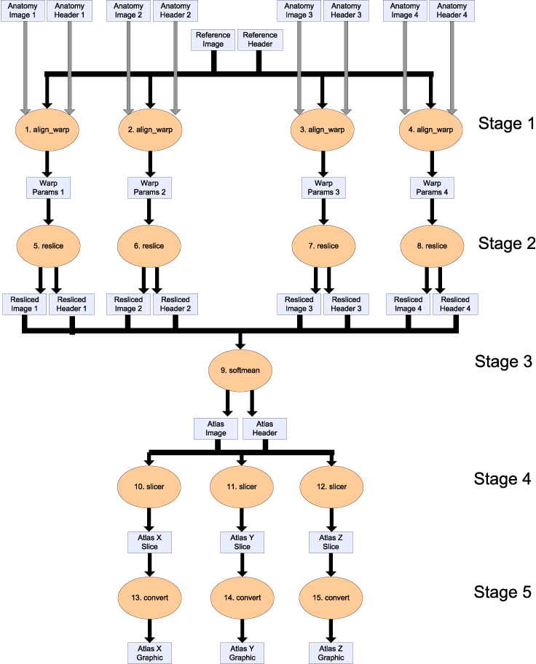
A slightly more complicated example
Notes:
Here we present a slightly more complicated example of of workflow: functional MRI brain processing.
We start with a 3D brain volume and align, average, slice and generate 2D graphics based on the initial 3D model. Follow the arrows to get the plan of actions.

Slide 67
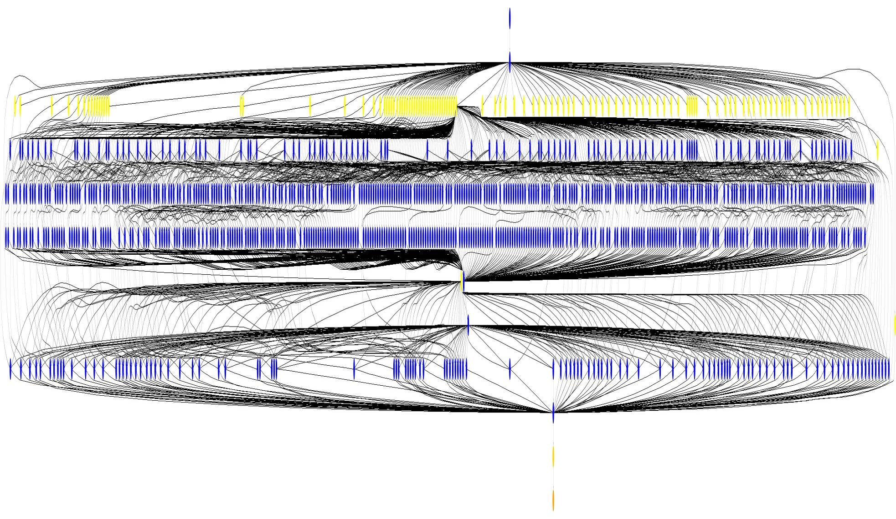
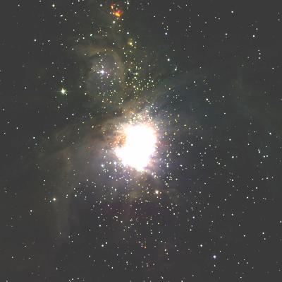
A 1200 node workflow graph
~1200 node workflow, 7 levels
Mosaic of M42 created on
the Teragrid using Pegasus
Montage toolkit
http://montage.ipac.caltech.edu/
Notes:
An even more complicated example: many of nodes, each represents a grid job, and many lines, representing dependencies.

Slide 68

There are many workflow systems.
Askalon
Bigbross Bossa
Bea's WLI
BioPipe
BizTalk
BPWS4J
Breeze
Carnot
Con:cern
DAGMan
DiscoveryNet
Dralasoft
Enhydra Shark
Filenet
Fujitsu's i-Flow
GridAnt
Grid Job Handler
GRMS (GridLab Resource Management System)
GWFE
GWES
IBM's holosofx tool
IT Innovation Enactment Engine
ICENI
Inforsense
Intalio
jBpm
JIGSA
JOpera
Kepler
Karajan
Lombardi
Microsoft WWF
Microsoft WWF
NetWeaver
Oakgrove's reactor
ObjectWeb Bonita
OFBiz
OMII-BPEL
Open Business Engine
Oracle's integration platform
OSWorkflow
OpenWFE
Q-Link
Pegasus
Pipeline Pilot
Platform Process Manager
P-GRADE
PowerFolder
PtolemyII
Savvion
Seebeyond
Sonic's orchestration server
Staffware
ScyFLOW
SDSC Matrix
SHOP2
Swift
Taverna
Triana
Twister
Ultimus
Versata
WebMethod's process modeling
wftk
XFlow
YAWL Engine
WebAndFlo
Wildfire
Werkflow
wfmOpen
WFEE
ZBuilder ……
Notes:
There are a plethora other workflow systems, all different – if you thought there was a lot of middleware like globus, glite &c, workflow is even more so.
None of the workflow systems has established itself as the clear leader. We could point out DAGMan, Pegassus and Swift.

Slide 69
Workflows can be represented as graphs or programs.
As graphs
  DAGman
    Visual representation
    Straightforward visual representation for small workflows
  Visual representation (flowcharts)
As programs: Workflow language
  Programming language specialised for 'scripting the grid'
  Easy to bring in programming language concepts
    variables, loops, subroutines
Notes:
First we'll look at workflows-as-graphs. You've already experienced this twice.
Our simple example was a graph laid out on a 2D plane – this projection screen. The kind of representation shows the tasks to be performed and how they are related.
Secondly, DAGman workflows are represented as a more theoretical form of graph – you specify jobs as the nodes on a graph and dependencies between them as arcs. recall the G is DAGman stands for 'graph’. DAG == Directed Acyclic Graph (a cycle-free graph that specifies dependencies via arrows)
Another way of thinking about workflows is that a workflow is a program.
A workflow system is then a system for “scripting the grid” - so just like other programming languages are specialised for other purposes, like C for systems work, matlab for numerical work, visual basic for desktop office applications, bash shell for running scripts of unix executables.
Then we fairly naturally end up with programming languages constructs – variables, for loops, subroutines.

Slide 70
Swift is a dataflow language that specifies workflow and transformations.
Workflows are specified in terms of data and transformations to be made to that data
  Transform input files to output files using application code (unix executable)‏
Facilitates site selection
Easy to re-run failed jobs (in different place?)‏
Notes:
A third example is Swift. Swift’s 'building block' is data transformation
Swift knows what the input and output files are for each kind of transformation, because you define that as part of the workflow. You also need to tell swift where executables are for your transformations on different sites. Once you've done that, Swift has enough information to run transformations on different grid sites – it knows enough to stage in the data, run the job and stage the results back out; and it knows that because this is a dataflow language that it can try the job again somewhere else.
One of the useful things that you can do with this (that both Swift and Pegasus do) is site selection
Easy to rerun jobs – on same site or different site, because we have captured the effects of the job
Pegasus has similar behaviour (due to shared ancestry with VDS)‏

Slide 71
Provenance tells you where results come from and how they were computed.
Definition …
Know what has been computed already
Various ways to use this information
  Example: In the graph pruning example earlier, we knew that some data had already been computed.
Notes:
Provenance is a term from fine art.

Slide 72
Workflow specifies what to do; Provenance tracks what was done.
Query
What I
Am Doing
Executed
Edit
Executing
What I
Did
What I
Want to Do
…
Executable
Waiting
Execution environment
Schedule

Slide 73
Things we can do with Provenance:
Run the workflow again (maybe on different machines) and see if we get same results
Find out how someone else computed a result
Catalogue which results have been computed already
  Optimise new workflows that are related
  If intermediate results are used already, then we don't need to compute again.
TODO notes: http://twiki.ipaw.info/bin/view/_x000b_Challenge/FirstProvenanceChallenge

Slide 74
Nine Provenance Challenge Queries
Find the process that led to Atlas X Graphic / everything that caused Atlas X Graphic to be as it is. This should tell us the new brain images from which the averaged atlas was generated, the warping performed etc.
Find the process that led to Atlas X Graphic, excluding everything prior to the averaging of images with softmean.
Find the Stage 3, 4 and 5 details of the process that led to Atlas X Graphic.
Find all invocations of procedure align_warp using a twelfth order nonlinear 1365 parameter model (see model menu describing possible values of parameter "-m 12" of align_warp) that ran on a Monday.
Find all Atlas Graphic images outputted from workflows where at least one of the input Anatomy Headers had an entry global maximum=4095. The contents of a header file can be extracted as text using the scanheader AIR utility.

Slide 75
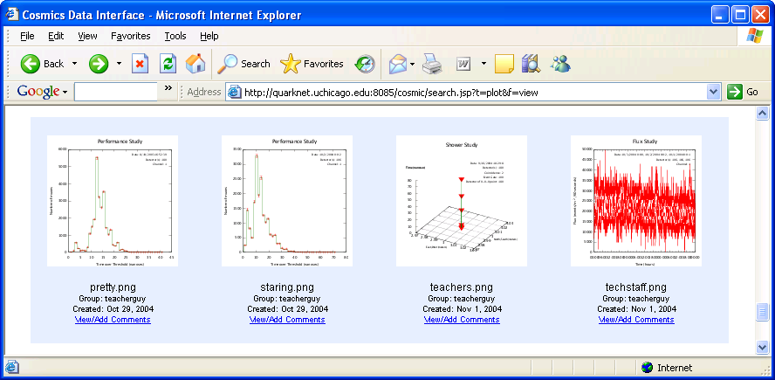
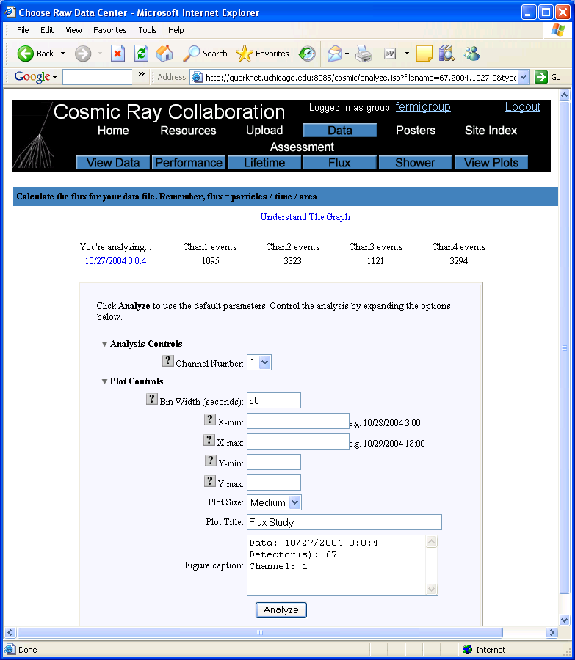
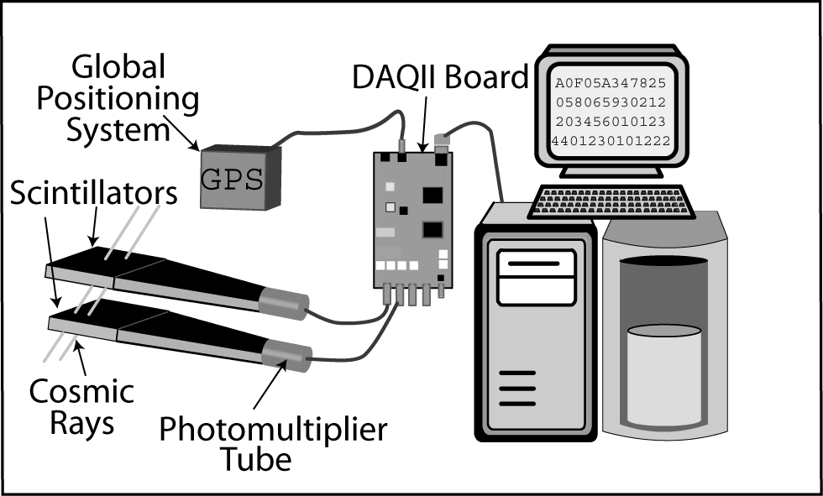
I2U2 - Leveraging Virtual Data for Science Education
Notes:
More information about I2U2 …

Slide 76
Summary

Slide 77
What is a Grid?
A Grid is a system that
  coordinates resources that are not subject to centralized control
  using standard, open, general-purpose protocols and interfaces
  to deliver nontrivial qualities of service
What is the difference between a job scheduler and a job manager ? Give examples of each.
  A job scheduler is a system for submitting, controlling and monitoring the workload of batch jobs in one ore more computer. The jobs are scheduled fore execution at a time decided by the system according to an available policy and on availability of resources. Ex: Condor-G
  A job manager’s function is to provide a single interface for requesting and using remote system resources for the execution of jobs. Ex: GRAM (“remote shell with features”)
Notes:
Now from a different perspective (we have learned so much about grids now), we can asnwer this question …

Slide 78
Discussion session questions

Slide 79
What is the difference between a job scheduler and a job manager?
Give examples of each.
A job scheduler is a system for submitting, controlling and monitoring the workload of batch jobs in one ore more computer. The jobs are scheduled for execution at a time decided by the system according to an available policy and on availability of resources. Ex: Condor-G
A job manager’s function is to provide a single interface for requesting and using remote system resources for the execution of jobs. Ex: GRAM (“remote shell with features”)

Slide 80
Summarize the interaction between job schedulers and other grid middleware.

Slide 81
What are the components of grid middleware?

Slide 82
What is the difference between Condor and Condor-G?
See:
http://www.cs.wisc.edu/condor/condorg/versusG.html
Notes:
Big source of confusion.

Slide 83
HPC vs HTC
HPC = High Performance Computing
Tremendous amount of computing power over a short period of time
Supercomputers - expensive, centralized
HTC = High Throughput
Computing
Large amounts of computing power over a long period of time
Use many, smaller, cheaper PCs

Slide 84
How is data management component implemented in Globus?

Slide 85
How do we choose the right scheduler?

Slide 86
Why do we talk about VOs in grid computing? Why do we need VOs?
Grid computing enables and simplifies collaboration among members of a VO.
Find the list of all OSG VOs
Find the sites that the OSGEDU VO are contributing to the OSG grid.

Slide 87
Why are information systems important in the grid context?

Slide 88
How does the grid determine if you will can submit a certain job to a certain site?
Explain in detail.

Slide 89
Where to get more information
The notes for this talk have URLs throughout.
This course is based on Open Science Grid’s grid schools programme.
  http://www.opensciencegrid.org/workshop for latest
Email us:
  Ben Clifford: benc@ci.uchicago.edu
  Alina Bejan: abejan@ci.uchicago.edu
  Mike Wilde: wilde@mcs.anl.gov

