Slide 1
OSG Area Coordinators
Network Monitoring Update: July 20 2016
Shawn McKee

Slide 2
Overview of Today’s Meeting
As a reference, last time I shared the following Google doc with everyone, outlining OSG network planning an milestones
https://docs.google.com/document/d/1FzmXZinO4Pb8NAfd5SWUzaAFYOL23dt66hQsDmaP-WI/edit?usp=sharing
Today I will go back to the normal format for AC presentations

Slide 3
Review Networking Goals Year 5
Maintain / update the OSG networking services / documentation.
Reach out to non-WLCG OSG sites; Integrate those interested:
Advertise that OSG is ready to help sites with networking issues via:
OSG web pages
Targeted email (Cyberinfrastructure list, perfSONAR user list, etc)
Via interactions with sites at conferences and meetings.
Encourage as many NSF CC*xxx sites as possible to integrate their perfSONAR instances into OSG networking; OSG will provide them a mesh-configuration and gather their data.
Provide Soichi’s standalone mesh-configuration tool for use by campuses and VOs.
OSG will create a network alerting service to find “obvious” network problems
This will involve the creation of a suitable analysis pipeline such that perfSONAR data can be analyzed on a timescale of every 1-2 hours.
Obvious problems include significant decrease in bandwidth between a source and destination or continuing significant packet loss along a path or correlated with a specific site.
Actual alerts will be issued by GOC staff based upon alarms they receive.
Enable automated alerting (email, SMS) on well identified alarms.
This is a “reach” goal for the year but I think it should be feasible
Requires accurate, synchronized mapping of sites to contacts
Tunable pattern of alerts (e.g., 1 alert, wait 1 day and alert if problem continues, then every 3 days until fixed)

Slide 4
Near-term Milestones
Creation of initial OSG web pages informing sites of OSG services in networking --- July 30, 2016
Recruiting of 5 new sites for OSG networking -- August 31, 2016
Need technical design of suitable analysis system based upon existing time-series technologies and proposed data and analysis workflows --- August 31, 2016
Definition of support process for integrating new sites and triaging tickets in OSG production --- September 15, 2016
Initial implementation of analysis running on OSG network data --- September 30, 2016
Initial release of Soichi’s standalone mesh-configuration utility packaged and available --- September 30, 2016

Slide 5
OSG Networking Web Pages
For the closest milestone, I am working on creating a simpler front page for OSG networking assuming the reader be a (non-WLCG) OSG user, site-admin or science domain admin as well as revamping our existing content and putting it someplace more relevant
Kyle Gross will be working with me to implement the new pages
Google doc with draft content aviailable at https://drive.google.com/drive/u/0/folders/0B63jqzjmiVgcOG5aMmg1cFo2SDA
Comments or suggestions very welcome.

Slide 6
Recruiting non-WLCG Sites
The next milestone is to recruit 5 (or more) non-WLCG sites who have perfSONAR instances to “join” OSG
This means they will use the OSG mesh-configuration to define tests
OSG will gather metrics from their instances
Our dashboard and check_mk will display their metrics and monitor their perfSONAR services
I need to work with Rob Quick and Rob Gardner on conducting the initial recruitment campaign (targeting NSF CC* recipients, OSG connect sites, active OSG users, etc) once we have the new OSG web pages in place AND an operational plan for how we engage the new sites once they express interest.

Slide 7
Enabling Alarming
We have a longer term goal of alerting and alarming on network issues.
Milestone coming up: technical design of a suitable analysis system based upon existing time-series technologies
Work with Brian Bockelman to define target technology(ies)
A step in this direction is setting up a network alarm list based upon problems identified via network analytics
Ilija Vukotic / UC has setup an ELK instance and associated Jupyter interface to support analyzing our network metrics.
Jerrod Dixon / Nebraska is working with this data from the CMS perspective (details on backup slides)
Need to define a few specific analyses to identify
All paths with packet-loss > 0.05% (tunable)
All paths with a significant and persistent change in measured bandwidth
We then automate running the analysis and displaying the results…
Marian Babik and I are looking into check_mk rule-based notifications as a future means of implementing the alerting component.

Slide 8
Recent Achievements(1)
We extensively reorganized the OSG/WCLG meshes to
Make the results more relevant for ATLAS, Belle-II, CMS and LHCb
Reduce the load on our perfSONAR instances
Fix tests with > 24-hour cadence
New meshes in place as of end of June
http://psmad.grid.iu.edu/maddash-webui/
Design of new meshes done programatically. See http://etf.cern.ch/perfsonar_meshes.txt
Non-working perfSONAR instances sent to “Global Mesh”
Bandwidth and Latency meshes specific to ATLAS, CMS and LHCb
New meshes now allow bandwidth test within 24-hour time-limit (services restart each 24 hours)
Working well: better coverage and more metrics available

Slide 9
Recent Achievements(2)
We have a beta version of MaDDash 2.0 being tested on our prototype instance at http://maddash.aglt2.org/maddash-webui/
Incorporates MadAlert (developed at UM as part of the OSG networking effort)
Provides analysis of MaDDash results integrated with the MaDDash display
Customizable and supports updating the rules for identifying types of problems

Slide 10
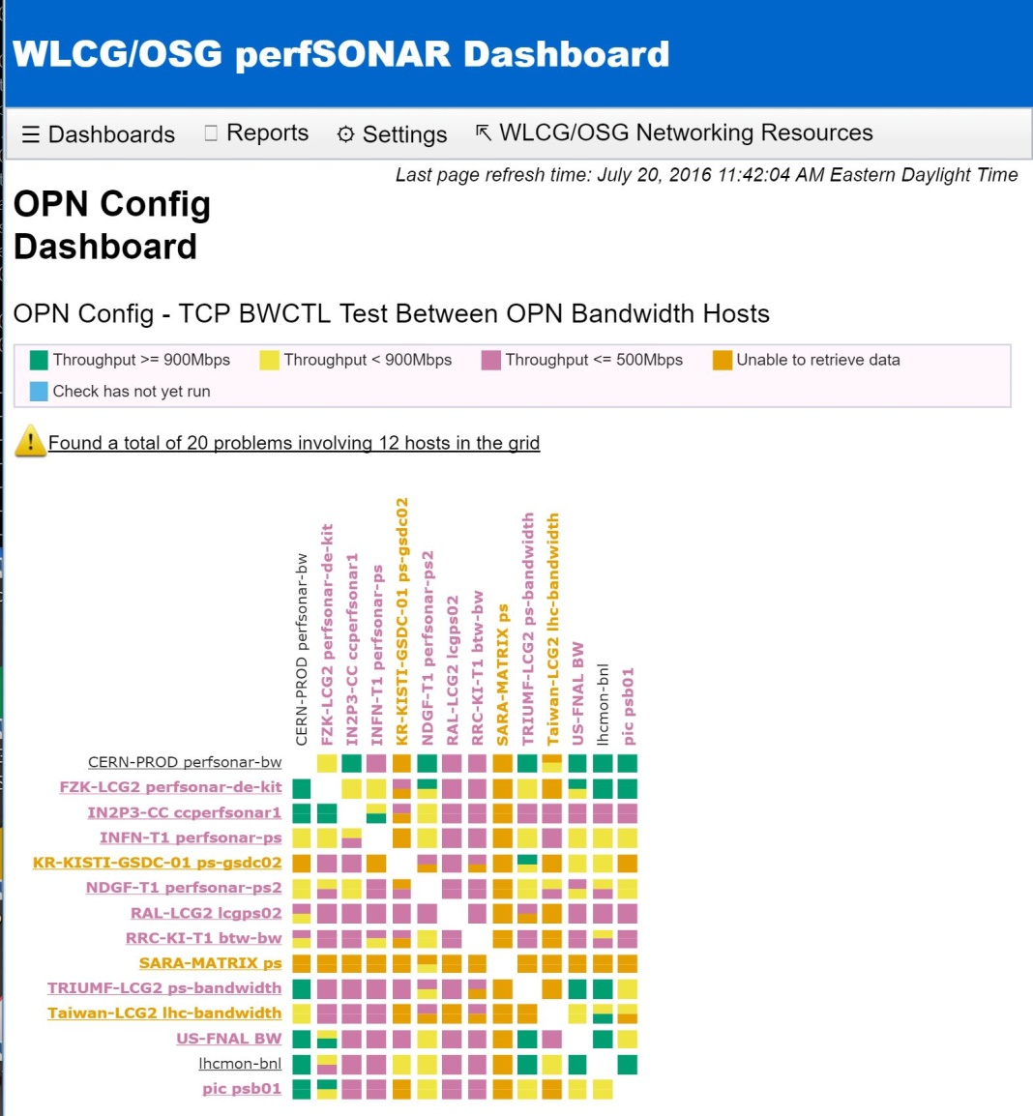

MaDDash v2.0 Beta
Has new color schemes (helpful for color-blind users)
Now has a reports option
Integrates MadAlert analysis

Slide 11
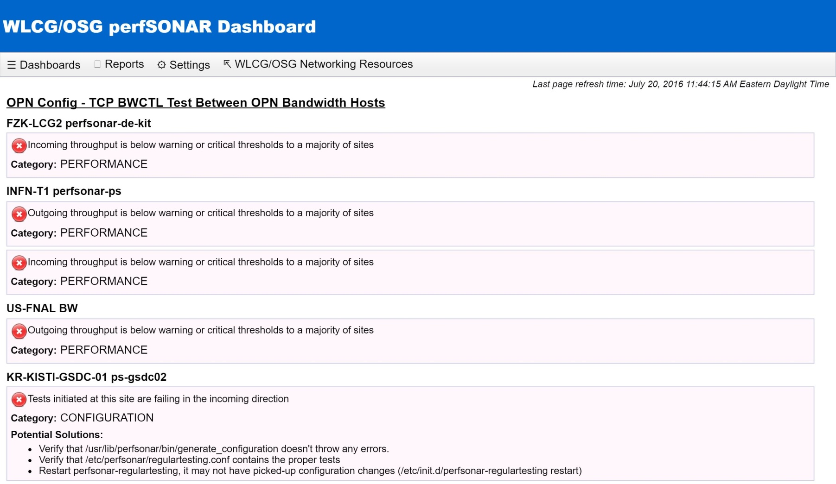
MaDDash v2.0 Report

Slide 12
Concerns
Identifying suitable non-WLCG sites to benefit from OSG networking services
Need targeted outreach
Long-term data lifecycle management
Still nothing from ESnet in this area; need something by EoY
Finalizing support plans to back up the new OSG web pages
Operation of services
Had an unexplained glitch on perfsonar1/2 systems yesterday…fixed by late afternoon
Unknown cause
Services need to be optimized (remove unused)
Must reduce load on ITB instance (use only testbed mesh)
Convergence on “alarming” system.
Examples of most of the needed components are in place. Need to build the chain and enable continuous operation

Slide 13
Near Term Plans
Test Soichi’s standalone mesh-config in ITB
Point ITB MaDDash and RSv-collector to testbed mesh only
Finalize OSG networking web pages in the next week or so and deploy
Update services in ITB and Production
Disable unneeded services
Plan outreach campaign
Identify tech-services needed to alarm

Slide 14
Questions or Comments?
Thanks!

Slide 15
URLs of Relevance
OSG Network Datastore Documents
Operations https://docs.google.com/document/d/1l144BSo-88M0cLMMjKcKMIE-Q5s21X-w3lYl-0Pn_08/edit#
SLA https://twiki.grid.iu.edu/bin/view/Operations/PSServiceLevelAgreement
Current OSG network documentation https://www.opensciencegrid.org/bin/view/Documentation/NetworkingInOSG
Draft OSG web page document https://drive.google.com/drive/u/0/folders/0B63jqzjmiVgcOG5aMmg1cFo2SDA
OSG networking year-5 goals and milestones: https://docs.google.com/document/d/1FzmXZinO4Pb8NAfd5SWUzaAFYOL23dt66hQsDmaP-WI/edit
perfSONAR adoption tracking: http://grid-monitoring.cern.ch/perfsonar_coverage.txt
Deployment documentation for both OSG and WLCG hosted in OSG (migrated from CERN)
https://twiki.opensciencegrid.org/bin/view/Documentation/DeployperfSONAR
ATLAS Analytics: http://cl-analytics.mwt2.org:5601/
Mesh-config in OSG https://oim.grid.iu.edu/oim/meshconfig
Beta Mesh-config: https://ps-test.sca.iu.edu/meshconfig/
MadAlert: http://madalert.aglt2.org/madalert/diff.html
perfSONAR homepage: http://www.perfsonar.net/

Slide 16
Details on Ilija’s / Xinran’s Work
Concerning our own activities, we have been discussing with Shawn the possibility to start running notifications/alarms on some of the measurements, I guess two most obvious cases would be to detect sudden loss of throughput on a link (breaking a trend for N days moving average or similar) as well as detecting consistent packet loss and any changes in packet reordering and jitter (I guess last two are not currently imported in ES). Can the ES service help us compute some of this, so we could just query it and issue an alarm (we can start off with simple avg over all links for a site, but eventually we will probably want to look at each individual link) ?
I have a summer student Xinran Wang that I have tasked to understand the measurements we are collecting and creating an alerting service and you can see his task list here:
https://docs.google.com/document/d/1YPSjPzLn9uw11rl_6_pZmekJ-GK8yLV0tXx-AhTe6QQ/edit?usp=sharing
The other thing we have been discussing was to generate a network map of WLCG and use it to detect when routing changes occur and maybe correlate this with some other measurements - here I’m not sure how ES could help, I have done some prototyping with Neo4J and heard that ES plans to have support for graphs, but not sure about the details. An alternative might be to implement some of this in SPARK graphX, which is what I mentioned at the throughput call some time ago, do you plan to support some streaming analytics platform in the future ?
I was also thinking about adding path data to the ES… I though that it would be the best to:
calculate hashes for paths
once a day report paths and hashes and the rest of the time only hashes.
store paths in a new index, store hashes together with the data on OWD, pocket loss, throughput.
for investigative plotting we could use Jupyter
for some fancy page one could use whatever jqeury + whatever plotting library + ES as a backend.
We will have streaming analytics later but nothing right now.

Slide 17
Details on Jerrod’s Work
The perfSONAR data gathered on the ATLAS-kibana server is currently assisting a project investigating the affects of the grid network on the performance of jobs based on geographic location and the transference of the dataset between storage location and computing location.
Jerrod is using the Jupyter portal at http://uct2-lx2.mwt2.org:9999/ to do this investigation

Slide 18
Previous Slides
For reference…

Slide 19
Operations Area Collaboration
Much of the OSG networking effort is becoming “operational”. We will need to work with Operations in the following areas
A recruitment campaign: We have long planned on actively recruiting sites to participate in OSG networking but have not moved beyond the WLCG sites. We need to work with Operations on actively soliciting new participants outside WLCG (in conjunction with Campus Grids/User Support)
Initial alerting of sites based upon MaDDash and alarming results: Until we have a reliable automated alerting system in place we will need to utilize GOC/Operations personnel to issue alerts based upon easily identified network issues. This will require some additional training and the development of a set of guidelines about when and how to alert.
Creation and maintenance of site/perfSONAR contact emails for alerting purposes: As we move toward alerting on network problems we need to ensure we have the right mapping between perfSONAR instances, sites and contact emails. We need to identify a procedure (with Technology) to produce and maintain a list of contacts that can be used when problems are found.
Testing and operation of automated alerting system: Once Technology/Networking have prototyped an automated alerting system, it needs to be migrated into production. It should replace most of the work previously done manually.
Triage of initial network tickets: We will be advertising that OSG is open to supporting tickets for networking issues. The first point of contact should be a ticket opened in OIM and we need to be ready to handle network related tickets well. This should include:
Training in perfSONAR and OSG network resources to better respond to tickets
Identification of appropriate procedures when network issues are suspected
Support for integrating new OSG sites into the OSG networking infrastructure: As we recruit new (particularly non-WLCG) sites, we have to have a check-list for what is needed to integrate them into OSG networking. This is primarily the following:
Documentation for how to properly install and configure perfSONAR
Enabling the use of the mesh-configuration from OSG
Enabling OSG to have access to the perfSONAR measurement archives at the site
Providing (and updating) relevant contact information

Slide 20
Campus Grids / User Support
As we try to expand OSG networking beyond WLCG sites we will need the involvement of the Campus Grids / User Support area in the following:
Advertising OSG Networking: During year-5 we are targeting the inclusion of 15-30 (or more) new non-WLCG sites to participate in OSG networking. Participate primarily means that perfSONAR instances at those sites take advantage of our OSG mesh-config to define (some of) their tests and that OSG collects and alerts on their networking metrics. To do this, we would like Campus Grids / User Support to inform sites about OSG networking and to actively recruit their participation. This may additionally include pointers to OSG networking documentation in any instructions sent to sites.

Slide 21
Software Area Collaboration
For the software area we will need help in making software identified available to Operations and to end sites as follows:
Packaging and testing of standalone Mesh-Configuration GUI: Soichi has developed a standalone version of the perfSONAR mesh-configuration utility which allows campuses and VOs to organize and manage their perfSONAR instances. This needs packaging and testing such that it can be provided to OSG users.
Software needed for Operations: Not sure if this is required but as we develop, prototype and deploy software for OSG networking we may need some support from the Software area.

