Slide 1
OSG Executive Meeting
Dec 14, 2006

Slide 2
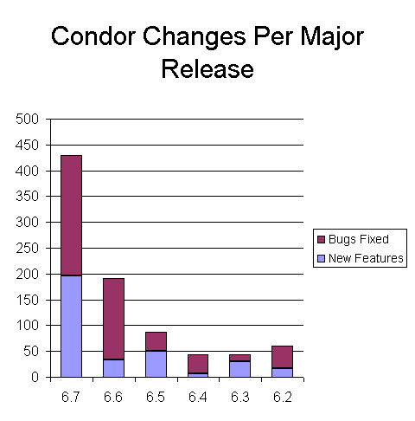
 |  |  |  |  |  | inint

Slide 3
Roadmap
Current stable release is v6.8.2, developer series is v6.9.x.
Recent v6.8 releases address issues w/ security (file creation, buffer overflow), DOS, Quill efficiency
Major v6.9 efforts
  Scalability
  Privilege Separation
  GCB improvements
  Virtual Machine support via Xen
Timeline : next stable release ~ Feb or March?

Slide 4
Scalability
Schedd (submission point) scalability
  Better performance w/ just one schedd
  Testbed: 3 machines for submissions, 400 machines for running jobs.
    Benchmark metric(s) to track improvement
  Current improvement is ~ 5x
  Replacing blocking I/O in key areas w/ non-blocking
  Working towards a load-balancing front end for the schedd
More Throttles
  Investigating server side throttle(s)
Matchmaking (negotiation cycle)

Slide 5
Privilege Separation
Why?
  No more root in the Condor daemons
  GlideIn re-use of resources for different users (aka CDF / CMS glidein scenario)
Instead, a small component will be responsible for privileged operations
  Must be installed locally as setuid root (maybe via sudo?)
  Provided by Condor
Also working with glexec
  Currently working on the execution side
Not required!

Slide 6

Condor with Firewalls and NATS:
GCB in v6.8.0!
GCB
listen
accept
Client app
connect
Server app
GCB layer
translate
GCB layer
TCP/IP
TCP/IP
Relay point
Notes:
Orange: traditional system.
With GCB, who initializes the connection can become arbitrary. No changes needed to the source of the client or server, but this requires significant “translation” so the client and server can retain the same semantics that they had before.

Slide 7
GCB Improvements
Better independence from the GCB proxy server
Better fault tolerance to GCB proxy server failures
  Failover to different GCB server
Better log and error reporting

Slide 8
Virtual Machine Support
“Virtual Machine” job universe
First step: give Condor a disk image, and it returns an image
Limitations and matchmaking can be performed on virtual machine characteristics
Based upon Xen
  Is Xen appropriate for OSG?

Slide 9
Some questions for OSG…
Scaling the OSG front-end
  Support a front-end “cluster” ? With what characteristics?
  Better Condor tuning of parameters ?
  More secure default setup ?
Importance of Condor’s “job router” ? Importance of grid universes beyond gt2?
VM plan?

Slide 10
Thank you!

