Slide 1


Open Science Grid as XSEDE Service Provider December 4, 2011 Chander Sehgal OSG User Support

Slide 2
Overview
OSG will provide computational resources as an XSEDE Service Provider - Target Availability is April 1, 2012
Create presence in XSEDE systems by December 15 to allow requests for OSG resources in the next XRAC cycle
Understand and develop “bridges” between the OSG and XSEDE – there are some important differences
People and roles
Technology
Operational Methods
Establish working interfaces to enable effective environments and support for science users with XSEDE allocations using OSG
OSG is working to quickly learn details of the XSEDE environment but this is new territory; so we plan to be conservative in the initial offering

Slide 3
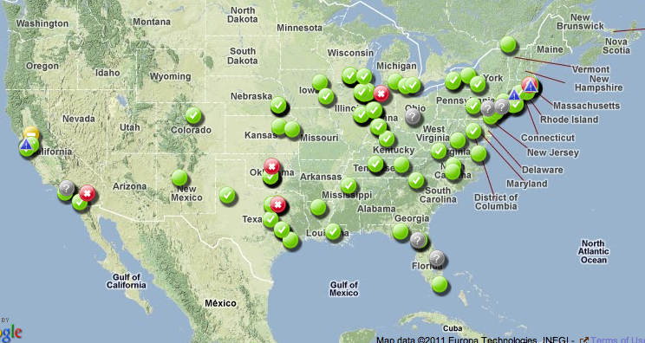
Introduction to OSG
The resources accessible through the OSG are contributed by the community, organized by the OSG, and governed by the OSG Consortium
>30 research communities
>100 sites
>70,000 cores accessible
Users communities (aka VOs) and Campus Grids bring:
1) Users, and/or 2) Resources

Slide 4
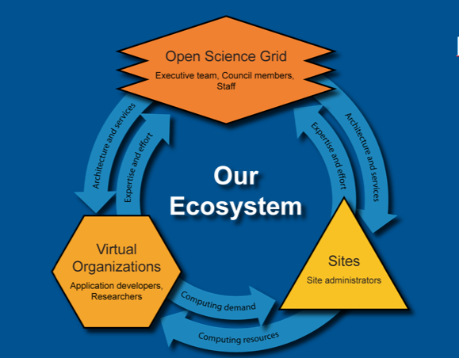
OSG Ecosystem
Consortium
Infrastructures
Project
Satellites
Services:
Consulting
Production
Software

Slide 5
OSG-XSEDE Interface
OSG Virtual Cluster
OSG DHTC Fabric
XSEDE users “login” to the “OSG Virtual Cluster” that provides an abstraction layer to access the distributed OSG fabric. This interface allows XSEDE users to view the OSG as one resource where they submit their jobs, provide the inputs and retrieve the outputs.

Slide 6
POPS & Allocations
For the quarter starting April 1, 2012, OSG will provide an “initial” allocation
Name = Open Science Grid
Nickname = OSG
Quarterly Allocation = 2,000,000 SUs (1 SU = 1 core hour)
Startup Allocation Limit = 100,000 SUs
User guide = In-progress; available Dec 15, 2011 (establishing connections to XSEDE documentation contacts)
Support contact = osg-xsede-support@opensciencegrid.org
We plan to be adapt and evolve this offering as we gain experience with this user community and the types of applications

Slide 7
Some Contacts
OSG Staff | Responsibility
Miron Livny (Wisconsin) | OSG Technical Director and representative at XSEDE SP Forum
Dan Fraser (ANL) | OSG Production and Campus Grids lead; Alternate on XSEDE SP Forum; Campus Champions liaison
Ruth Pordes (Fermilab) | OSG Executive Director
Rob Quick (Indiana) | OSG Operations Lead
Chander Sehgal (Fermilab) | OSG User Support Lead and Project Manager
Mats Rynge (USC-ISI) | OSG User Support for XSEDE ; links to other technical support within OSG; helps adapt applications to run on OSG
OSG Home Page:
http://www.opensciencegrid.org/
Introduction to OSG:
http://osg-docdb.opensciencegrid.org/0008/000839/004/OSG%20Intro%20v23.pdf
General OSG User Documentation:
https://twiki.grid.iu.edu/bin/view/Documentation/WebHome

Slide 8
Wrap-up
OSG offers a rich Distributed High Throughput Computing (DHTC) environment which supports science computation at broad scales in the compute and data dimensions
The “initial” OSG offering to XSEDE is optimized for ease-of-use (and brings some limits in data and storage)
As we learn more about how XSEDE users want to use OSG, we can leverage other OSG methods
As we identify other use cases, we want to work with that science community to enable their computation on OSG

