Slide 1
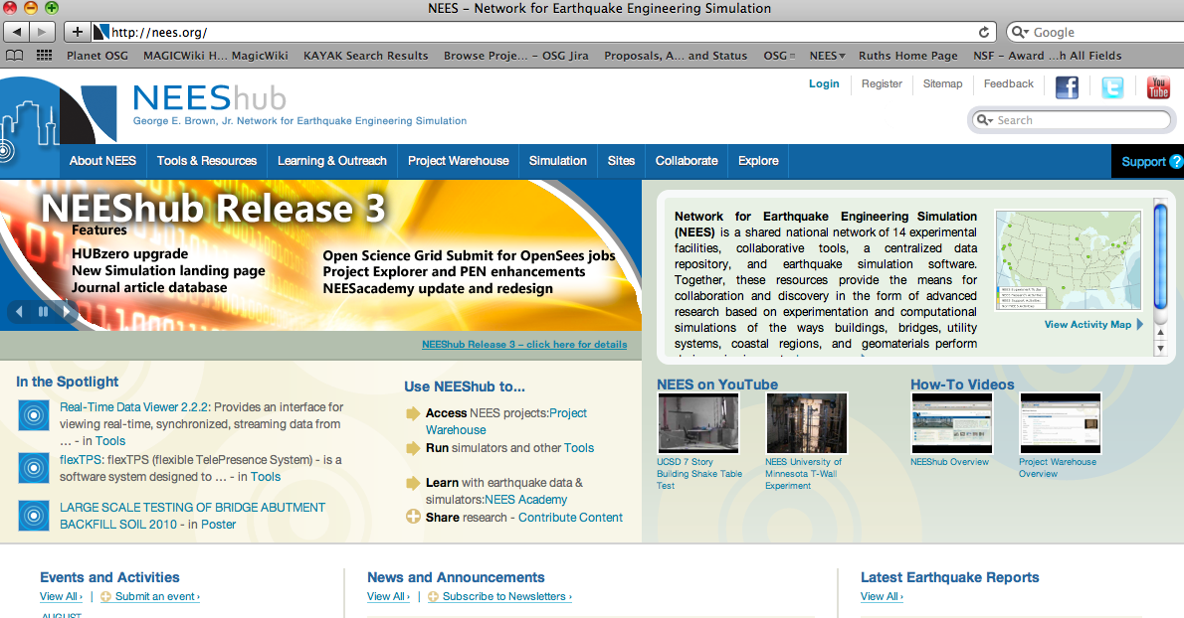

Slide 2
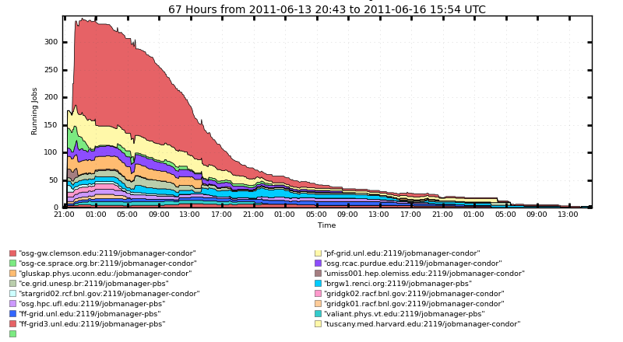
UCSD Submissions under Engage VO Andre Barbosa
Private Video of status (for this audience only)
http://db.tt/uM1htzL

