Slide 1
OSG Area Coordinators Meeting Security Team Report
Mine Altunay
04/02/2014

Slide 2
Key Initiatives
Glow VO submitting certificate-free jobs
Completed the review of Glow VO
Found some issues
Two kinds of submit node: PI-Managed and CHTC-managed
CHTC-managed nodes were straightforward. Single policy and user management process. PI-managed nodes are diverse, dependent on PI’s practices
Made some changes to GLOW submission mechanism. Created two separate job queues. Only CHTC_managed nodes can submit jobs to Fermilab without certificates.
Most users and PIs prefer to use CHTC-managed nodes, so this is not a huge drawback
Moved into production.
Expected to benefit 607 users in Glow.
Very positive feedback from GLOW admins so far.

Slide 3
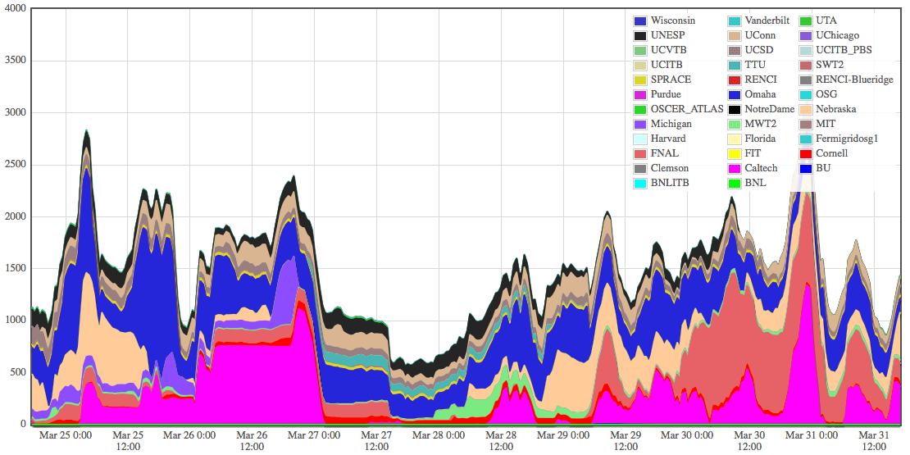
Glow VO Job Stats
Number of Glideins from Glow running on all OSG sites.
The dark salmon color is FNAL, not SWT2.
The number of jobs running on FNAL increasing

Slide 4
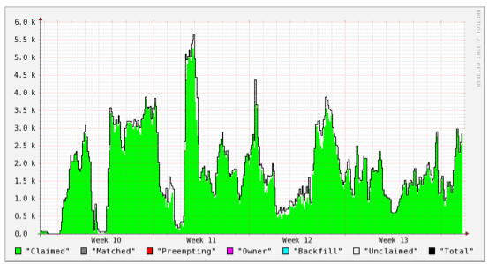
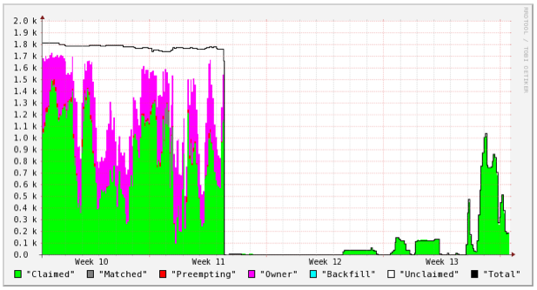
Glow Glideins at all OSG sites
during the last month
Glow Glideins at FNAL during
the last month
Disregard data before week11.
We started on FNAL at week 11
FNAL providing a significant amount of
Glideins for Glow

Slide 5
Key Initiatives
News from CILogon Basic CA
The new IGTF profile IOTA had been approved and included in the new IGTF release.
CILogon Basic CA will complete its accreditation under this profile soon.
What this means is we will soon have CILogon Basic CA as part of our standard IGTF distribution as an accredited CA.
Once the accreditation is complete, we want to push even more users to utilize this CA

Slide 6
IDM Roadmap
OSG IDM Roadmap revisited before DigiCert current contract expiry
First, we will renew our contract with DigiCert for a year or two. So, no worries about sudden changes
Two questions from Lothar triggered our work:
What would happen to OSG stakeholders if we stop to provide certificates?
Can we get certificates somewhere other than DigiCert?
We created a short-term roadmap, OSG-doc-1185, answering these questions in detail. Please read the document for details.

Slide 7
IDM Roadmap
What would happen to OSG Stakeholders if OSG stops to provide certificates?
VO | Impact on User Certs | Impact on Host Certs
LHC (Atlas, CMS, Alice) | None | Yes, need 3500 certs
Fermilab VO | None | Yes, need host certs
OSG VO | Some –10, 15% of users will need certs, but can switch to CILogon CA | Yes, needs 100 certs
DOSAR | Some – only 20 users. Can switch to CILogon CA | Yes, Needs a small amount
GLOW | Some, but can switch to CILogon CA | Yes, needs 100 certs

Slide 8
IDM Roadmap
What would happen to OSG Stakeholders if OSG stops to provide certificates?
User certs has no impact. Few VOs dependent on OSG CA and they do not have any accreditation requirements. So, they can switch to CILogon Basic CA if needed. All other VOs can already get certs form alternative resources, Fermi KCA, CERN CA, etc.
The real issue is the host certs. Everyone is dependent on OSG CA and no VO has an alternative to get certs from.

Slide 9
IDM Roadmap
Can we get certificates somewhere else? Yes:
CILogon Net HSM service
Commercial Retail CAs
InCommon Certificate Service
Operating our own Backend CA
Operating our intermediate CA

Slide 10
Solution | Pros | Cons
CILogon Net HSM | Same functionality as DigiCert. No changes to OIM. Free (for 1.5 years at least). Can start using in 2 months. No changes to OIM or command line clients | Uncertain future funding
Commercial Retail CAs | Per cert cost $10.00. automated process, issues certs in minutes. World-wide trusted CAs. | Requires DNS domain ownership. Hard to prove for our site admins. Sites has to write new tools to manage hundreds of host certs
InCommon Cert Service | Unlimited certs for InCommon members. Getting IGTF accreditation. | Not all OSG sites are members. For FNAL and BNL the membership fee would be 50K/year for 3 year subscription. Changes to command line tools
Our Own BackEnd CA | Same work as Digicert or CILogon NetHSM. No changes to OIM or command line clients | Implementation and Maintenance costs
Our Intermediate CA | Similar to BackEnd CA. No changes to OIM or command line clients | Implementation and Maintenance costs

Slide 11
IDM Roadmap
CILogon Net HSM is the best option. We note the concern about future funding commitments.
Same set of services we get from DigiCert with minimal changes to Frontend
Started a prototype. Instantiating a new HSM service instance for OSG. Will use the same OIM invocation methods. No changes to the command line clients.
If CILogon NET HSM option does not work, then we want to try to set up our own HSM service.
If our own HSM does not work out, we should continue with DigiCert CA.

Slide 12
IDM Roadmap
While completing the Net HSM experiment, our goal is still to eliminate user certs or make them completely hidden from users
1st step is to add an OSG Identity Provider hooked into the OIM.
Soichi already had a prototype IdP working. This will be used for onboarding OSG users into OSGConnect. It will also be used for obtaining CILogon Basic certs when needed.
2nd step is to add a username/passwd access to OIM. So anyone who just needs access to twiki, docdb, OIM, can do so without certs.

Slide 13
IDM Roadmap
3rd step is to access storage elements without user certificates.
Similar to Traceability project, but only for storage elements
We will continue to move VOs to certificate-free submission mode.

Slide 14
Operational Security
Next IGTF release has lots of new things
DOEGrids CA is removed.
New DigiCert trust rots with SHA-2 certs are added
Dropping the old layout– incompatible with sha-2.

