Slide 1

XSEDE and OSG
Kim Dillman
Alain Roy
kadillma@purdue.edu
roy@cs.wisc.edu

Slide 2
What is OSG?
A multi-disciplinary partnership to federate local, regional, community and national cyberinfrastructures to help share computing and storage resources of research and academic communities at all scales
We provide common services and support for more than 100 resource providers and scientific institutions using a distributed fabric of high-throughput computational services
We do not own computing resources but instead provide software and services to users and resource providers to enable the effective use and sharing of their resources based on the principles of Distributed High Throughput Computer (DHTC)

Slide 3
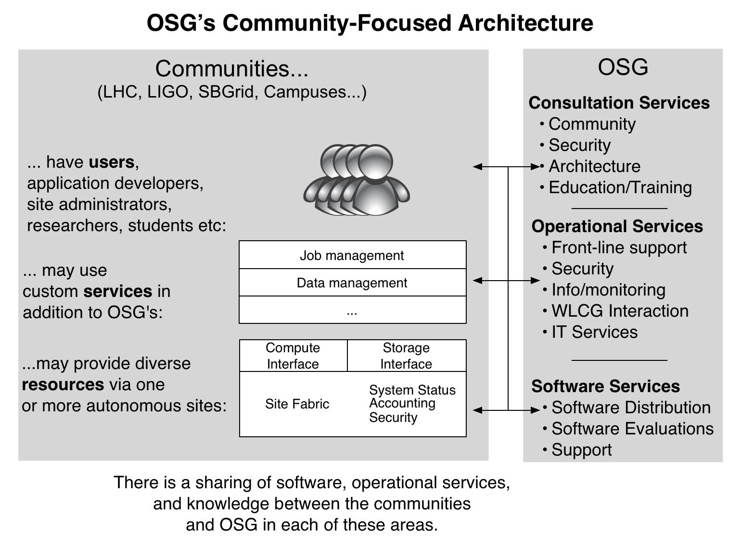
OSG’s Community Focus

Slide 4
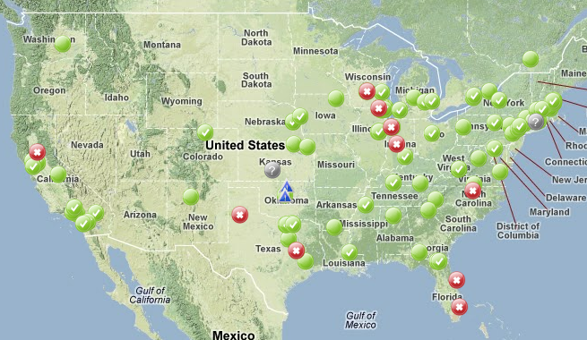
Where is OSG?

Slide 5
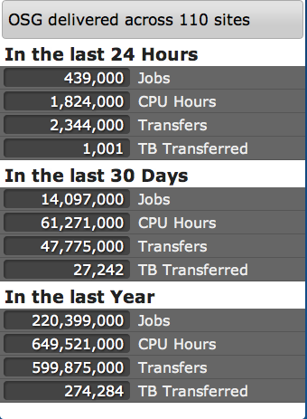
How big is OSG?
From http://display.grid.iu.edu/

Slide 6
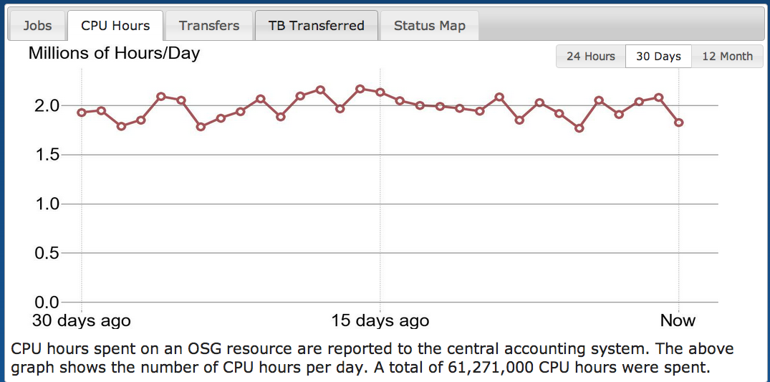
How big is OSG?
From http://display.grid.iu.edu/

Slide 7
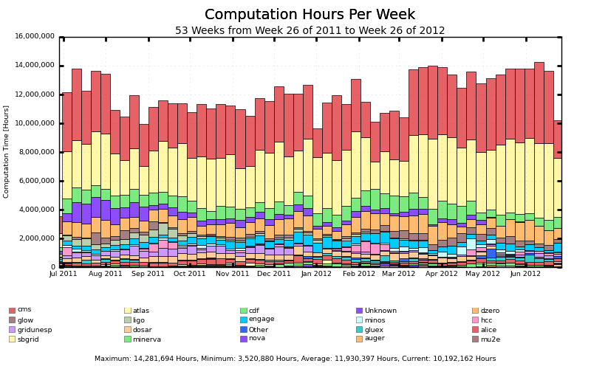
Who uses OSG?

Slide 8
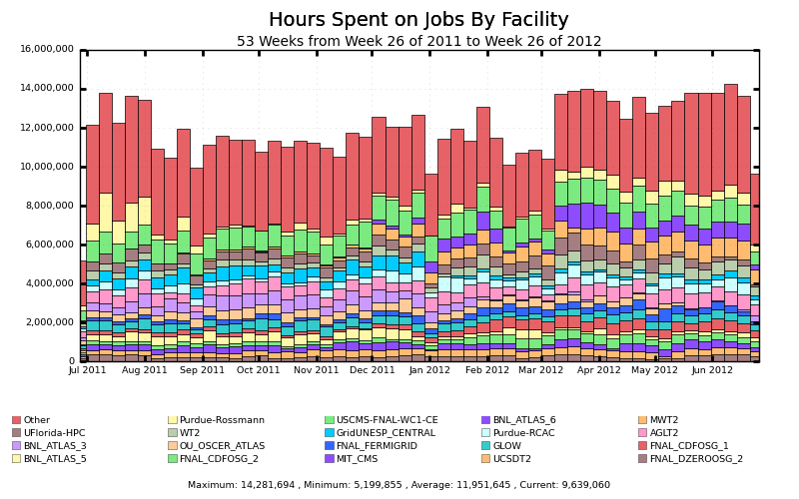
Who contributes to OSG?

Slide 9
How do you use OSG?
Step 1: Make sure you can use HTC
Do you have a problem that needs HTC?
Do you have local computing resources?
  Use them first
  You get local support
  You gain experience with HTC
When you need more resources, OSG is a good option to grow

Slide 10
How do you use OSG?
Step 2: You must be in a Virtual Organization (VO)
A VO is:
  A collection of people and/or resources with a common purpose
  Usually a scientific collaboration
  People + their computing & storage
Which VO?
  About 60 VOs in OSG: you might already be affiliated
  Make your own for your collaboration
  Join the “OSG” VO: miscellaneous

Slide 11
How do you use OSG?
Step 3: Get access to glidein VO Frontend
OSG runs a glidein factory, but you need a submission point (i.e. condor_schedd)
Called a VO Frontend (see Igor’s talk)
Larger VOs set up their own frontend
Smaller VOs can use an OSG supplied frontend
  We’re in a transition period right now
  This will probably be hosted at UCSD in the near future
Sites need to authorize your VO

Slide 12
How do you contribute to OSG?
Usually contribution is based on VO needs
  Scientific collaboration wants to share within the collaboration: OSG provides the tools
  Other VOs can utilize unused capacity
Some sites are simply generous and share
Install and maintain the OSG software on:
  Front end job submission computer
  Storage interface computer (optional)
  Authorization service (optional)
Everyone is welcome, but it takes effort to do it (25% of a person’s effort?)

Slide 13
Autonomy
OSG provides:
  Software
  Support
  Central Services
Sites and VOs are autonomous:
  They make decisions about their sites
  They decide when to install, upgrade
  They make operational decisions
This is HTC: if we mandate less, more people will join and we will have access to more resources

Slide 14
What is XSEDE?
XSEDE is a comprehensive set of advanced, heterogeneous
high-end digital services,
integrated into a
general-purpose infrastructure.
Notes:
Next generation general purpose NSF funded infrastructure providing digital services to the academic science and engineering research community. Provide a stable platform for computational sciences across all platforms. In addition to traditional numerical computations, includes visualization, data management, high throughput networking. Everything you need to get your science done.
Integrating services for TEOS, AUSS, CMS, and TIS;
explain judiciously: In TG we had every activity spread of every site (for the most part). In XSEDE we are centralizing various activities with smaller participation as it makes sense from other site and homing those activities where it made sense.

Slide 15
NSF eXtreme Digital (XD) Program
NSF’s Transition from TeraGrid to XD
High-Performance Computing and Storage Services
High-Performance Remote Visualization and Data Analysis Services
eXtreme Digital Resources for Science and Engineering (XSEDE)

Slide 16
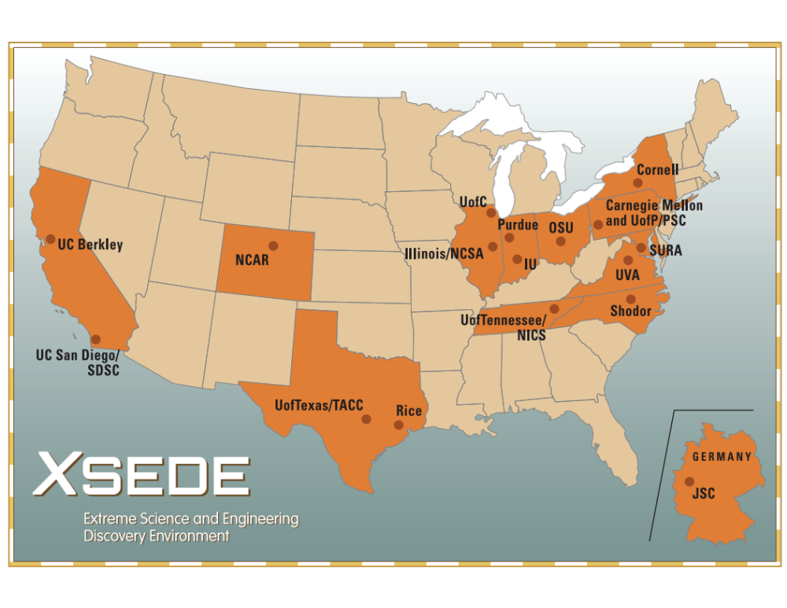

Slide 17
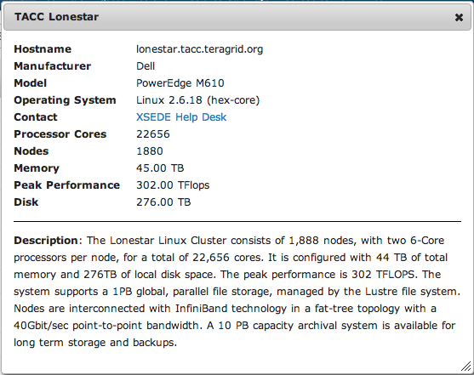
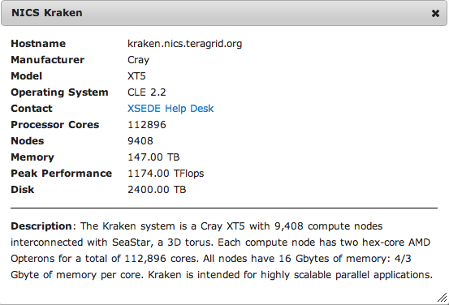
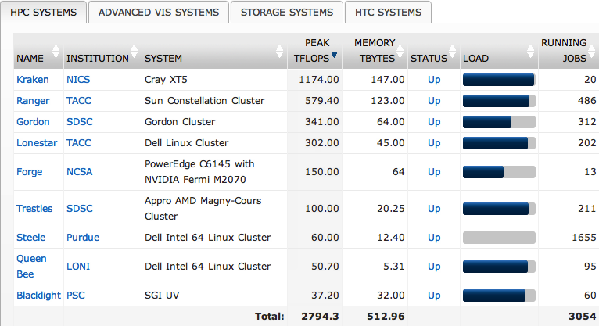
XSEDE HPC Systems
(From: portal.xsede.org)

Slide 18
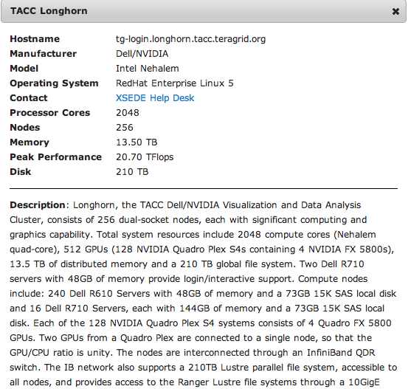
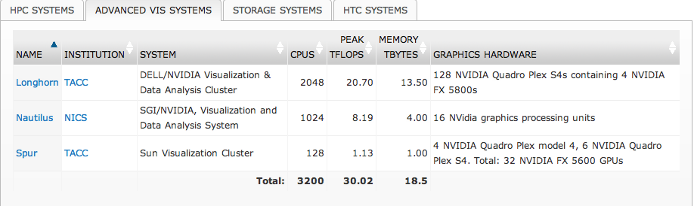
XSEDE Visualization Systems

Slide 19
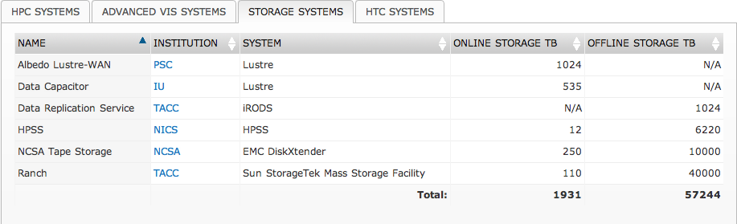
XSEDE Storage Systems

Slide 20
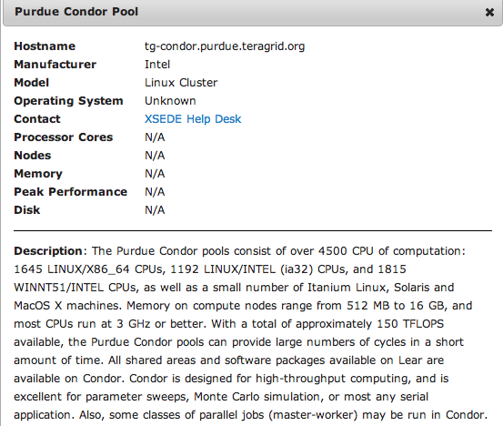
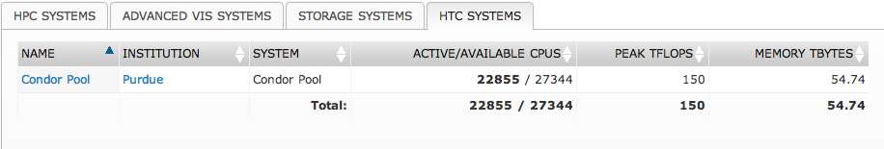
XSEDE: HTC Systems

Slide 21
XSEDE Vision
The eXtreme Science and Engineering Discovery Environment (XSEDE):
  enhances the productivity of scientists and engineers by providing them with new and innovative capabilities.
Thus, XSEDE:
  facilitates scientific discovery while enabling transformational science and engineering, and innovative educational programs.
XSEDE fulfills this vision by creating an advanced, capable, and robust cyberinfrastructure supported by the combined expertise of a distributed team of leading CI (cyberinfrastructure) professionals.
Notes:
Providing capabilities and services beyond flops (floating point operations per second: computing speed). Innovation and impact. NSF sees computational science as fundamental, not just the typical experimental and theoretical research.
We provide the integrated environment allowing for the coherent use of the various resources and services supported by NSF.

Slide 22
XSEDE Characteristics:
XSEDE forms the foundation of a national cyberinfrastructure (CI) ecosystem
  Its comprehensive suite of advanced digital services work with other high-end facilities and campus-based resources
XSEDE integrates diverse digital resources
  Its open architecture allows continued addition of new technology capabilities and services
Notes:
In a nutshell, provides resources for the full workflow of addressing science computationally.

Slide 23
XSEDE is about . . . .
Increasing productivity
  leading to more science
  making the difference between a feasible project and an impractical one
Transformative impact through
  active, formal requirements gathering processes to
    understand the needs of the community
  new and expanded extended collaborative support that includes
    external short-term contracting for expertise beyond the current team
    Novel and Innovative Projects: supports novel science areas, demographic diversity, innovative technologies, science gateway development, data repositories, and campus bridging
Notes:
We want the resources to be responsive to you (the researchers) needs. User-centric. Federating with campuses all the way up to high end facilities (national laboratories). Sometimes including industry partners.

Slide 24
And…
  National Training and Education and Outreach programs with the scope and scale to:
    increase diversity of topics, modes of delivery, and reach to new communities and audiences
    broaden participation among under-represented communities
    campus bridging for effective use of CI (cyberinfrastructure) resources
      integrate with campuses through expanded Champions program and additional bridging activities
    establish academic certificate and degree programs
      institutional incorporation of CS&E curricula; professional development certificate
      prepare undergraduates, graduates and future K-12 teachers
Notes:
We want our scientists to be successful. We do a lot to ensure that they are successful.

Slide 25
XSEDE Components
  Coordination and Management Service
  Technology Audit and Insertion Service
  Extended Collaborative Support Service
  Training, Education and Outreach Service

Slide 26
Best of all you can use it for FREE!

Slide 27
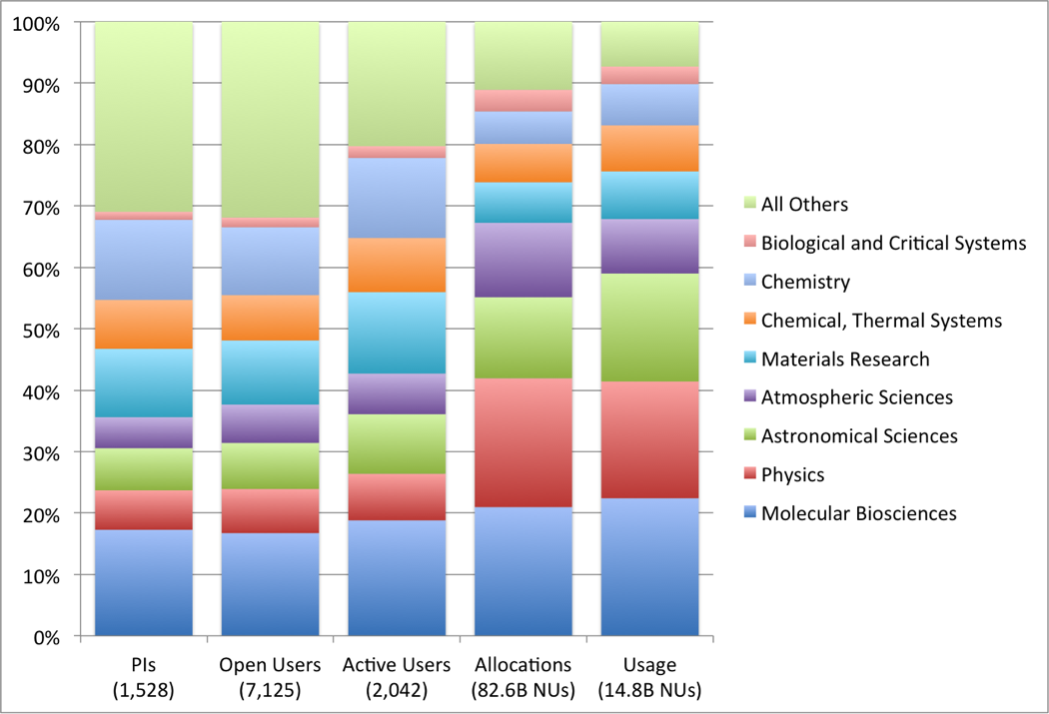
Who Uses XSEDE?
End of quarter XSEDE open user accounts by type, excluding XSEDE staff.
Category | Users
Graduate Student | 2,368
Faculty | 1,336
Postdoctoral | 1,008
University Research Staff | 506
Undergraduate Student | 505
High school | 5
Others | 328
Quarterly XSEDE user, allocation, and usage summary by field of science, in order by usage, excluding staff projects.
Note: PIs, users may appear under more than one field of science.

Slide 28


Science Highlights 1:
PI: Markus Buehler
Institution: MIT
“We found that the structure of spider silk at the nanoscale can explain why this material is as strong as steel, even though the “glue” of the hydrogen bonds holding spider silk together at the molecular level is 100 to 1,000 times weaker than steel’s metallic bonds.” says Buehler.
Excerpts from “TeraGrid Science Highlights 2010”

Slide 29
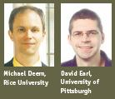

Science Highlights 2:
PI: Michael Deem, David Earl
Institution: Rice University, University of Pittsburgh
Identified millions of potentially new zeolites by searching computationally for properly configured, hypothetically stable structures.
Zeolites are used to make everything from gasoline and asphalt to aquarium filters, laundry detergent and medical-grade oxygen.
Excerpts from “TeraGrid Science Highlights 2010”

Slide 30
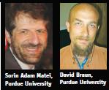
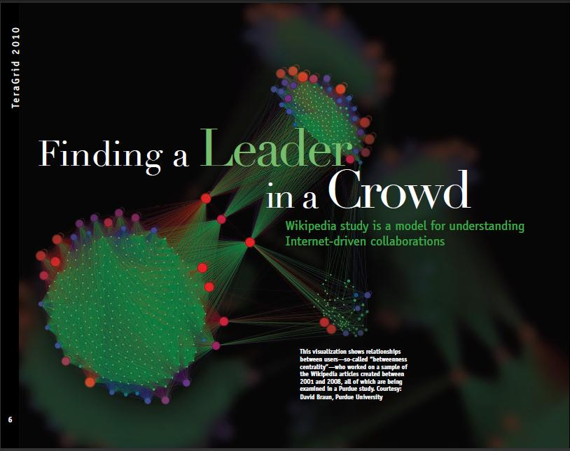
Science Highlights 3:
PI: Sorin Matei, David Braun
Institution: Purdue University
Purdue researchers led by Sorin Adam Matei are analyzing the entire collection of articles produced in Wikipedia from 2001-2008, and all their revisions – a computationally demanding task made possible by TeraGrid resources.
“We looked at how article production is distributed across users’ contributions relative to each other over time. The work includes visualizations of patterns to make them easier to discern,” says Matei.
Excerpts from “TeraGrid Science Highlights 2010”

Slide 31
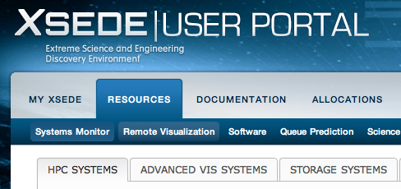
How do you use XSEDE?
Step 1: The basics
Setup an XSEDE User Portal Account
  https://portal.xsede.org/
  You can do it right now: it’s free and easy
Review available resources and determine which will match the needs of your research
  Resources -> Systems Monitor

Slide 32
How do you use XSEDE?
Step 2: Startup Allocation
Submit a request (anytime)
Easy to get—lightly reviewed
Small: 200K hours
Use to investigate the resources where your code will run
Use to benchmarking your code to determine the best resource and how many SUs you will need to complete your research

Slide 33
How do you use XSEDE?
Step 3: Research Allocation
Write and submit a full research allocation request
Can be submitted quarterly
Peer-reviewed
Can be very large
You should know exactly what resources you need

Slide 34
How do you use XSEDE?
Step 4: Use
Log into individual resources
  Can log in via User Portal (built in ssh + authentication)
  Can download application to login (ssh + authentication)
  Can request direct ssh access from individual sites
When you run out:
  You will be unable to submit more jobs
  It is possible to request extensions to your allocation

Slide 35
Differences between XSEDE and OSG
Authentication
  OSG : certificates obtained by user, member of VO
  XSEDE : User has certificate but never sees it. Transparent access via MyProxy with name/password
System Access:
  OSG:
    Access based on VO membership
    Jobs submitted remotely (usually glideins)
  XSEDE
    Access based on allocations
    Direct login to resource to submit jobs (via User Portal or gsissh or ssh)

Slide 36
Differences (2)
Amount of Compute Cycles:
  OSG : only limited by excess cycles on available resources
  XSEDE : based on granted allocations (different amounts available for request based on allocation type with research allocation requests peer reviewed)
Job Types:
  OSG: serial or single-node parallel
  XSEDE: serial, shared memory, large parallel, large data
Other:
  XSEDE: Can request an allocation of “people” resources (ECSS) to assist with technical aspects of project/code
  OSG: Can access all systems via a single submit host

Slide 37
Questions? Comments?

