Slide 1
Distributed Xrootd
Derek Weitzel & Brian Bockelman

Slide 2
Outline
Motivation
Data Access and Xrootd Concepts
WLCG Demonstrator Project
Sample T3 sites
Interacting with Users

Slide 3
Motivation
Data scalability for the next LHC run in 2013
Tiered architecture = many copies
Explicit data placement implies we must be smarter than our users and know future usage patterns
This is a common problem, internet companies have found solutions a decade ago.
Common solution = Caching

Slide 4
Data Access
We want to work on improving end-user data access. Goals:
Reliability: The end-user should never see an I/O error or failure propagated up to their application unless no USCMS site can serve the file. Failures should be caught as early as possible and I/O retried or rerouted to a different site (possibly degrading the service slightly).
Transparency: All actions of the underlying system should be automatic for the user – catalog lookups, redirections, reconnections. There should not be a different workflow for accessing the data ``close by" versus halfway around the world. This implies the system serves user requests almost instantly; opening files should be a ``lightweight" operation.
Usability: All CMS application frameworks (CMSSW, FWLite, bare ROOT) must natively integrate with any proposed solution. The proposed solution must not degrade the event processing rate significantly.
Global: A CMS user should be able to get at any CMS file through the Xrootd service.
To achieve these goals, we are investigating xrootd-based technology.

Slide 5
Xrootd Concepts
Getting access to data:
User contacts a redirector.
Redirector searches through all the nodes which subscribe to it to see who has the data.
Selects the “Best Node” to serve the file.
Client is redirected to the correct data node.
Originally, this was done within a site – the “redirector” was the headnode and the “data server” was a big disk server.

Slide 6
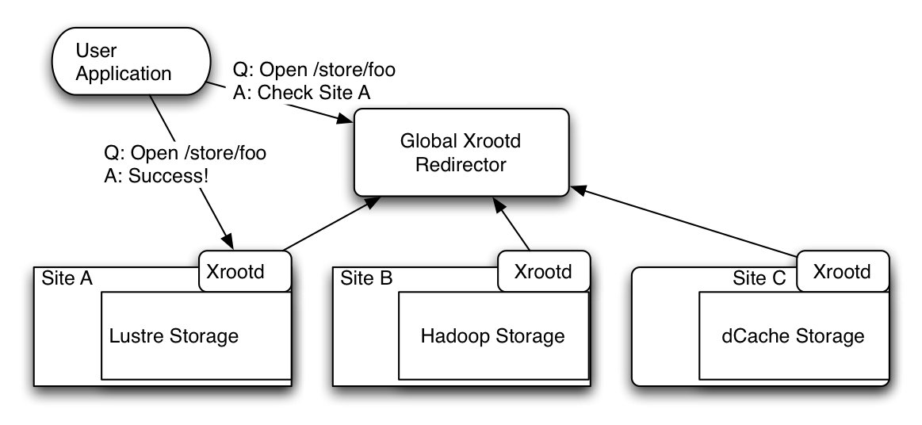
Xrootd Concepts

Slide 7
Xrootd Concepts
In fact, we can make the redirector a global node and the “data server” an entire site, as demonstrated in the previous slide.
This is a one-layer tree: you can actually have an arbitrary number of layers.
Xrootd will first query “down the tree” to look for close-by replicas; if none are found, it goes “up the tree” to find others in the cluster.
In order to provide high reliability, the concepts of multiple parent nodes was added – meaning Xrootd is really providing a resilient network to find data. Can be an arbitrary graph, not necessarily a tree.

Slide 8
WLCG Demonstrator Project Deliverables
Create a global-scale data access architecture architecture targeted for user analysis jobs.
Based upon xrootd, using both remote streaming and local caches.
Discover and understand the weak points of the xrootd software which would prevent the system from moving into production for CMS.
Improve CMSSW I/O to decrease sensitivity to latency (reduce # of reads by a factor of 10).
Target T3s and physicist workstations as initial consumers of this architecture.
Understand effects of the new architecture on the network and storage system.

Slide 9
CMSSW Deliverables
Fault tolerant file opens
If a file is not found locally, try another method (such as reading from global xrootd).
Resistant to latency
Reduce number of reads (good for the soul)
Grouping reads into 1 transaction with storage (“vector reads”)
Issuing reads before needing data (prefetching)

Slide 10
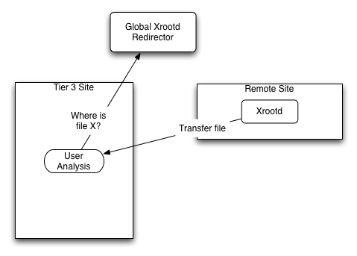
Sample T3 Configs - Diskless
Deployed at T3_US_Omaha!

Slide 11
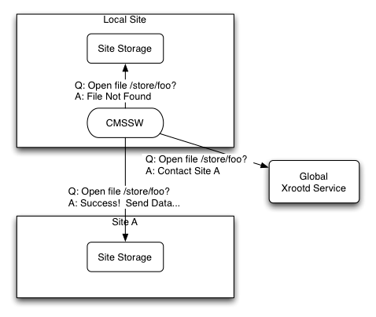
Sample T3 Config – Remote Fallback
Requires capabilities coming in CMSSW_3_9_0

Slide 12
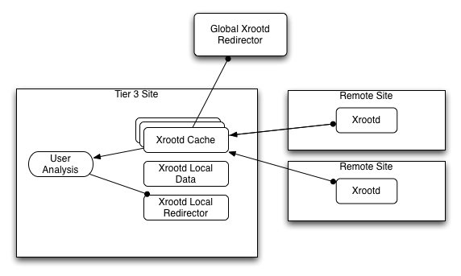
Sample T3 Configs –Full Xrootd Deploy
Deploying at T3_US_UCR!

Slide 13
Sample T3 Configs
Note that you don’t need to switch your site to xrootd except in the last picture.
However, the last case is the most tightly integrated and has the best caching.
So, you can benefit and participate with hardly any work on your side

Slide 14
Interacting with Users
Any CMSSW user tool already works with this.
Doesn’t require grid software (Mac friendly!)
But does require grid certificate!
(Demo with Fireworks, network permitting)

Slide 15
Documentation
https://twiki.cern.ch/twiki/bin/view/Main/CmsXrootdArchitecture

