Slide 1




Lecture 4
Grid Data Management

Slide 2
Credits
Ben Clifford benc@ci.uchicago.edu
based on slides from
Bill Allcock allcock@mcs.anl.gov
Jaime Frey jfrey@cs.wisc.edu
Scott Koranda skoranda@uwm.edu

Slide 3
Motivation: The Data Problem
Motivate our discussion with the large physics experiments (part of GriPhyN and Grid2003)
  Laser Interferometer Gravitational Wave Observatory
    Detect spacetime ripples from blackholes & other sources
    Generates data at 10 MB per second, just under 1 TB per day
  Sloan Digital Sky Survey
    Catalog more stars and galaxies then ever before
    More than 15 TB of data catalogs
  Compact Muon Solenoid and ATLAS
    Detect the Higgs Boson (a fundamental particle)
    100 MB per second, about 1 Petabyte per year (per detector)

Slide 4
Really Two Data Problems
The amount of data
  High-performance tools needed to manage the huge raw volume of data
    Store it
    Move it
  Measure in terabytes, petabytes, and ???
The number of data files
  High-performance tools needed to manage the huge number of filenames
    10¹² filenames is expected soon
    Collection of 10¹² of anything is a lot to handle efficiently

Slide 5
Motivation?
Why is the Grid community concerned with data/file management?
Why might you be concerned with data/file management?

Slide 6
Data Questions on the Grid
Questions for which you want Grid tools to address
Where are the files I want?
How to move data/files to where I want?

Slide 7
Data Questions on the Grid
Questions for which you want Grid tools to address
Where are the files I want?
How to move data/files to where I want?

Slide 8
How to move data/files?
Requirements
  Fast – as fast as networks and protocols allow
    I2 sites should expect at least 10 MB/s sustained
  Secure
    Server must only share files with strongly authenticated clients
    No passwords in the clear or similar
  Robust
    Fault tolerant, time-tested protocol

Slide 9
GridFTP
Extension to well known File Transfer Protocol (FTP)
  http://www.globus.org/datagrid/deliverables/C2WPdraft3.pdf
Extensions include
  Strong authentication, encryption via Globus GSI
  Multiple, parallel data channels
  Third-party transfers
  Tunable network & I/O parameters
  Server side processing, command pipelining

Slide 10
Necessary Semantics…
GridFTP is the protocol
A server or client that implements the GridFTP protocol is GridFTP-enabled or Grid-enabled
  Often hear “the GridFTP server…” or “the GridFTP client…”
  Correct is “the GridFTP-enabled server from the Globus team” or the particular client being used
  Let it slide…easier to use the slang…but
  Distinction more important soon as groups outside of Globus release GridFTP-enabled clients & servers

Slide 11

A file transfer
We know file is at site A (because that is where it is archived)
We want it at site B (because that is where we want to compute)
Site B
Site A

Slide 12
A file transfer with GridFTP
FTP server running at one site (site A)
FTP client running at other site (site B)
Control channel
Data channel
Control channel
Server
Site B
Site A
Data channel

Slide 13
Basic Definitions
Control Channel
  TCP link over which commands and responses flow
  Low bandwidth; encrypted and integrity protected by default
Data Channel
  Communication link(s) over which the actual data of interest flows
  High Bandwidth; authenticated by default; encryption and integrity protection optional

Slide 14
A file transfer with GridFTP
Control channel can go either way
  Depends on which end is client, which end is server
Data channel is still in same direction
Control channel
Site B
Site A
Server
Data channel

Slide 15
Third party transfer
Controller can be separate from src/dest
Client
Control channels
Server
Site B
Site A
Server
Data channel

Slide 16
Third party transfer
Controller can be separate from src/dest
Useful when moving data from one remote site to another

Slide 17
globus-url-copy
Globus-url-copy is commandline client for gridftp (and other protocols)
Already seen this in exercises
globus-url-copy gsiftp://gridlab1/home/benc/foo file:///tmp/a

Slide 18
URLs
globus-url-copy gsiftp://gridlab1/home/benc/foo file:///tmp/a
Gsiftp – GridFTP server
  Specify hostname (optionally port)
  Directory and filename
File – local filesystem
  No hostname
  Just local filename

Slide 19
Going fast – parallel streams
Use several data channels
Control channel
Server
Site B
Site A
Data channels

Slide 20
Going fast – striped transfers
Use several servers at each end
Shared storage at each end
Server
Server
Site A
Server
Server
Server
Server

Slide 21
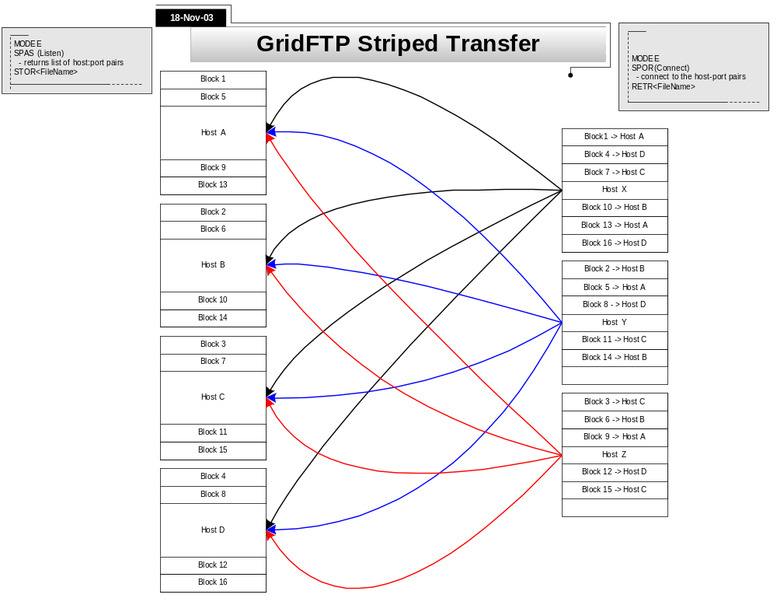

Slide 22
Going fast –buffers and windows
Using large TCP windows
$ globus-url-copy -vb -p 4 -tcp-bs 1048576 gsiftp://ldas-cit.ligo.caltech.edu:15000/usr1/grid/largefile file:/tmp/largefile
514392064 bytes 6609.67 KB/sec avg 8639.71 KB/sec inst
Using large memory buffers
$ globus-url-copy -vb -p 4 -bs 1048576 -tcp-bs 1048576 gsiftp://ldas-cit.ligo.caltech.edu:15000/usr1/grid/largefile file:/tmp/largefile
523304960 bytes 7300.56 KB/sec avg 9311.99 KB/sec inst
Speed depends on network weather – what else is happening on the network.

Slide 23
Debugging
Use –dbg to see control channel communication
$ globus-url-copy -dbg gsiftp://hydra.phys.uwm.edu/tmp/file1 file:/tmp/file1
debug: starting to get gsiftp://hydra.phys.uwm.edu/tmp/file1
debug: connecting to gsiftp://hydra.phys.uwm.edu/tmp/file1
debug: response from gsiftp://hydra.phys.uwm.edu/tmp/file1:
220 hydra.phys.uwm.edu GridFTP Server 1.12 GSSAPI type Globus/GSI wu-2.6.2 (gcc32dbg, 1069715860-42) ready.
debug: authenticating with gsiftp://hydra.phys.uwm.edu/tmp/file1
debug: response from gsiftp://hydra.phys.uwm.edu/tmp/file1:
230 User skoranda logged in.
debug: sending command:
FEAT
debug: response from gsiftp://hydra.phys.uwm.edu/tmp/file1:
211-Extensions supported:
REST STREAM
ESTO
ERET
MDTM
SIZE
PARALLEL
DCAU
211 END
<snip>

Slide 24
GridFTP clients
“Roll your own”
Add functionality directly to your applications
  Your application find and download its own data?
  Your application deliver output data files when finished computing?
Globus Toolkit offers APIs to code against
  C
  Java
  Python

Slide 25
Hints for Experts
To make GridFTP go really fast
use fast disks/filesystems
  filesystem should read/write > 30 MB/second
configure TCP for performance
  See TCP Tuning Guide at
  http://www-didc.lbl.gov/TCP-tuning/
patch your Linux kernel with web100 patch
  See http://www.web100.org
  Important work-around for Linux TCP “feature”
understand your network path

Slide 26
Data Questions on the Grid
Questions for which you want Grid tools to address
Where are the files I want?
How to move data/files to where I want?

Slide 27
What data/files are where?
Requirements
  Catalog 10⁸ files and their locations
    What files are where (possibly at more then one place)
    Across multiple sites within a Grid
    Mappings from logical filenames (LFNs) to physical filenames (PFNs) or URLs
  No single point of failure
    No central catalog/server to be single point of failure

Slide 28
Globus Replica Location Service
One solution to this is…
Globus RLS
  Maps logical filenames to physical filenames
  Two components
    LRC (Local replica catalog)
    RLI (Replica location index)

Slide 29
Logical and Physical Filenames
Logical Filenames
  Names a file with interesting data in it
  Doesn’t refer to location (which host, or where inside a host)
Physical Filenames
  Refers to a file on some filesystem somewhere
  Often use gsiftp:// URLs to specify

Slide 30
Two catalogs in RLS
Local Replica Catalog (LRC)
  Stores mappings from LFNs to PFNs
  Interaction:
    Q: Where can I get filename ‘experiment_result_1’.
    A: You can get it from gsiftp://gridlab1/home/benc/r.txt
  Undesirable to have one of these for whole grid
  Lots of data
  Single point of failure

Slide 31
Two catalogs in RLS
Replica Location Index (RLI)
  Stores mappings from LFNs to LRCs
  Interaction:
    Q: Who can tell me about filename ‘experiment_result_1’.
    A: You can get more info from the LRC at gridlab1
    (then go to ask that LRC for more info)
  Failure of one RLI or LRC doesn’t break everything
  RLI stores reduced set of information, so can cope with many more mappings

Slide 32
Globus RLS
site A
rls://serverA:39281
LRC
file1
file2
file1→ gsiftp://serverA/file1
file2→ gsiftp://serverA/file2
RLI
file3→ rls://serverB/file3
file4→ rls://serverB/file4
site B
rls://serverB:39281
LRC
file3
file4
file3→ gsiftp://serverB/file3
file4→ gsiftp://serverB/file4
RLI
file1→ rls://serverA/file1
file2→ rls://serverA/file2

Slide 33
Globus RLS
Quick Review
  LFN → logical filename (think of as simple filename)
  PFN → physical filename (think of as a URL)
  LRC → your local catalog of maps from LFNs to PFNs
    H-R-792845521-16.gwf → gsiftp://dataserver.phys.uwm.edu/LIGO/H-R-792845521-16.gwf
  RLI → your local catalog of maps from LFNs to LRCs
    H-R-792845521-16.gwf → LRCs at MIT, PSU, Caltech, and UW-M
  LRCs inform RLIs about mappings known
  Find files on your Grid by querying RLI(s) to get LRC(s), then query LRC(s) to get URL(s)

Slide 34
Globus RLS: Server Perspective
Listens on port 39281 (default) for clients
Responds to client queries
  what LFNs in local catalog, the LRC?
  what other LRCs know about LFNs?
  checks against access control list for each client
Accepts publishing of new LFNs into LRC
  add files to local catalog
Sends updates of LRC to other servers
  tell remote RLI catalogs what LFNs you have mappings for locally

Slide 35
Globus RLS: Server Perspective
Listens on port 39281 (default) for clients
  Server address is URL
    rls://dataserver.phys.uwm.edu
    rls://dataserver.phys.uwm.edu:39281
    rls://dataserver
  Uses a host certificate to identify itself
    must run as root if host cert is owned by root
    often copy host cert/key to other non-root limited privilege account and configure to use that copy

Slide 36
Globus RLS: Server Perspective
Mappings LFNs → PFNs kept in database
  Uses generic ODBC interface to talk to any (good) RDBM
  MySQL, PostgreSQL, Oracle, DB2,...
  All RDBM details hidden from administrator and user
    well, not quite
    RDBM may need to be “tuned” for performance
    but one can start off knowing very little about RDBMs

Slide 37
Globus RLS: Server Perspective
Mappings LFNs → LRCs stored in 1 of 2 ways
table in database
  full, complete listing from LRCs that update your RLI
  requires each LRC to send your RLI full, complete list
    as number of LFNs in catalog grows, this becomes substantial
    10⁸ filenames at 64 bytes per filename ~ 6 GB
in memory in a special hash called Bloom filter
  10⁸ filenames stored in as little as 256 MB
    easy for LRC to create Bloom filter and send over network to RLIs
  can cause RLI to lie when asked if knows about a LFN
    only false-positives
    tunable error rate
    acceptable in many contexts

Slide 38
RLS command line tools
globus-rls-admin
  administrative tasks
    ping server
    connect RLIs and LRCs together
globus-rls-cli
  end user tasks
    query LRC and RLI
    add mappings to LRC

Slide 39
Globus RLS: Client Perspective
Two ways for clients to interact with RLS Server
globus-rls-cli simple command-line tool
  query
  create new mappings
“roll your own” client by coding against API
  Java
  C
  Python

Slide 40
Globus-rls-cli
Simple query to LRC to find a PFN for LFN
Note more then 1 PFN may be returned
$ globus-rls-cli query lrc lfn H-R-714024224-16.gwf rls://dataserver:39281
H-R-714024224-16.gwf: file://localhost/netdata/s001/S1/R/H/714023808-714029599/H-R-714024224-16.gwf
H-R-714024224-16.gwf: file://medusa-slave001.medusa.phys.uwm.edu/data/S1/R/H/714023808-714029599/H-R-714024224-16.gwf
H-R-714024224-16.gwf: gsiftp://dataserver.phys.uwm.edu:15000/data/gsiftp_root/cluster_storage/data/s001/S1/R/H/714023808-714029599/H-R-714024224-16.gwf
Server and client sane if LFN not found
$ globus-rls-cli query lrc lfn "foo" rls://dataserver
LFN doesn't exist: foo
$ echo $?
1

Slide 41
Globus-rls-cli
Wildcard searches of LRC supported
  probably a good idea to quote LFN wildcard expression
$ globus-rls-cli query wildcard lrc lfn "H-R-7140242*-16.gwf" rls://dataserver:39281
H-R-714024208-16.gwf: gsiftp://dataserver.phys.uwm.edu:15000/data/gsiftp_root/cluster_storage/data/s001/S1/R/H/714023808-714029599/H-R-714024208-16.gwf
H-R-714024224-16.gwf: gsiftp://dataserver.phys.uwm.edu:15000/data/gsiftp_root/cluster_storage/data/s001/S1/R/H/714023808-714029599/H-R-714024224-16.gwf

Slide 42
Globus-rls-cli
Bulk queries also supported
obtain PFNs for more then one LFN at a time
$ globus-rls-cli bulk query lrc lfn H-R-714024224-16.gwf H-R-714024320-16.gwf rls://dataserver
H-R-714024320-16.gwf: gsiftp://dataserver.phys.uwm.edu:15000/data/gsiftp_root/cluster_storage/data/s001/S1/R/H/714023808-714029599/H-R-714024320-16.gwf
H-R-714024224-16.gwf: gsiftp://dataserver.phys.uwm.edu:15000/data/gsiftp_root/cluster_storage/data/s001/S1/R/H/714023808-714029599/H-R-714024224-16.gwf

Slide 43
Globus-rls-cli
Simple query to RLI to locate a LFN to LRC map
  then query that LRC for the PFN
$ globus-rls-cli query rli lfn H-R-714024224-16.gwf rls://dataserver
H-R-714024224-16.gwf: rls://ldas-cit.ligo.caltech.edu:39281
$ globus-rls-cli query lrc lfn H-R-714024224-16.gwf rls://ldas-cit.ligo.caltech.edu:39281
H-R-714024224-16.gwf: gsiftp://ldas-cit.ligo.caltech.edu:15000/archive/S1/L0/LHO/H-R-7140/H-R-714024224-16.gwf

Slide 44
Globus-rls-cli
Bulk queries to RLI also supported
$ globus-rls-cli bulk query rli lfn H-R-714024224-16.gwf H-R-714024320-16.gwf rls://dataserver
H-R-714024320-16.gwf: rls://ldas-cit.ligo.caltech.edu:39281
H-R-714024224-16.gwf: rls://ldas-cit.ligo.caltech.edu:39281
Wildcard queries to RLI may not be supported!
  no wildcards when using Bloom filter updates
$ globus-rls-cli query wildcard rli lfn "H-R-7140242*-16.gwf" rls://dataserver
Operation is unsupported: Wildcard searches with Bloom filters

Slide 45
Globus-rls-cli
Create new LFN → PFN mappings
  use create to create 1st mapping for a LFN
  $ globus-rls-cli create file1 gsiftp://dataserver/file1 rls://dataserver
  use add to add more mappings for a LFN
  $ globus-rls-cli add file1 file://dataserver/file1 rls://dataserver
  use delete to remove a mapping for a LFN
    when last mapping is deleted for a LFN the LFN is also deleted
    cannot have LFN in LRC without a mapping
  $ globus-rls-cli delete file1 file://file1 rls://dataserver

Slide 46
Globus-rls-cli
LRC can also store attributes about LFN and PFNs
  size of LFN in bytes?
  md5 checksum for a LFN?
  ranking for a PFN or URL?
  extensible...you choose attributes to create and add
  can search catalog on the attributes
  attributes limited to
    strings
    integers
    floating point (double)
    date/time

Slide 47
Globus-rls-cli
Create attribute first then add values for LFNs
$ globus-rls-cli attribute define md5checksum lfn string rls://dataserver
$ globus-rls-cli attribute add file1 md5checksum lfn string 42947c86b8a08f067b178d56a77b2650 rls://dataserver
Then query on the attribute
$ globus-rls-cli attribute query file1 md5checksum lfn rls://dataserver
md5checksum: string: 42947c86b8a08f067b178d56a77b2650

Slide 48
Bloom filters
LRC-to-RLI flow can happen in two ways:
  LRC sends list of all its LFNs (but not PFNs) to the RLI. RLI stores whole list.
    Answer accurately: “Yes I know” / “No I don’t know”
    Expensive to move and store large list
  Bloom filters
    LRC generates a Bloom filter of all of its LFNs
    Bloom filter is a bitmap that is much smaller than whole list of LFNs
    Answers less accurately: “Maybe I know” / “No I don’t know”. Might end up querying LRCs unnecessarily (but we won’t ever get wrong answers)
    can’t do a wildcard search

Slide 49
Other topics
RFT
Metadata Catalog
Stork

Slide 50
Reliable file transfer
Client
RFT
Control channels
Server
Site B
Site A
Server
Data channel

Slide 51
What is RFT ?
RFT Client
SOAP Messages
Notifications
(Optional)
RFT Service
GridFTP Server
GridFTP Server
Master
DSI
Protocol Interpreter
Data Channel
Data
Channel
Protocol Interpreter
Master
DSI
IPC Link
IPC Link
IPC
Receiver
Slave
DSI
Data Channel
Data
Channel
Slave
DSI
IPC
Receiver

Slide 52
What is RFT ? (Cont.)
WS-RF compliant High performance data transfer service
  Soft state.
  Notifications/Query
Reliability on top of high performance provided by GridFTP.
  Fire and Forget.
  Integrated Automatic Failure Recovery.
    Network level failures.
    System level failures etc.

Slide 53
RFT Implementation Details
Provides following operations
  start()
  getStatus(source_url)
  getStatusSet(from,offset)
  Cancel()
Provides following Resource Properties
  RequestStatusType with faults.
  OverallStatusType with faults.
  Other Aggregation RPs for total bytes, total files etc.
Uses Database to store and retrieve the state.

Slide 54
Who is Using RFT ?
Two types of users
  Embedded (As part of other services)
  Stand-Alone.
GRAM
  Stage-in, Stage-out, Clean-up
Data Replication Service
TeraGrid
  Tgcp
LiGO (Proposed)

Slide 55
Three Data Questions on the Grid
What data/files exist?
What data/files are where?
How do I move data/files from A to B?

Slide 56
Metadata Catalog
Metadata catalog
  store data about...data!
  help answer question about what data exists
MCS from Globus still a research project
  One realization of a metadata catalog
  other projects offer solutions with different capabilities and limitations
  very active research on what type of service a metadata catalog should offer
  how should metadata information flow from site to site?
  is there a single solution for most uses on the Grid?

Slide 57
Metadata Catalog
One scenario useful in a Data Grid
  data generated/collected into files at some detector site
  location of data files published into RLS
    H-R-714024224-16.gwf → gsiftp://someserver/path/to/H-R-714024224-16.gwf
  existence of data files and important metadata published into metadata catalog
    H-R-714024224-16.gwf →
      data from detector in Hanford, WA
      raw data file contains all data (no downsampling)
      data starts at GPS time 714024224
      file contains 16 seconds of data
      detector was in “science” mode with good noise properties
      a simulated pulsar signal was being injected at the time
      the operator on duty was D. Brown
      the calibration parameters are α = 1.5643 and β = 2.22984
      and so on...

Slide 58
Metadata Catalog
To run an application that analyzes the data on the Grid
  Query metadata catalog for LFNs that contain data of interest
    Q: “Show me files where interferometer was locked and calibration had α < 1.6 for GPS times from 714024240 to 714024340”
    A:
      H-R-714024224-16.gwf
      H-R-714024240-16.gwf
      H-R-714024256-16.gwf
      H-R-714024272-16.gwf
      H-R-714024288-16.gwf
      H-R-714024304-16.gwf
      H-R-714024320-16.gwf
      H-R-714024336-16.gwf
  Query RLI catalog to find out where those LFNs/files are known about
    $ globus-rls-cli query rli lfn H-R-714024224-16.gwf rls://dataserver
    H-R-714024224-16.gwf: rls://ldas-cit.ligo.caltech.edu:39281

Slide 59
Metadata Catalog
  Query LRC catalog to get URLs for those files of interest
    $ globus-rls-cli query lrc lfn H-R-714024224-16.gwf: rls://ldas-cit.ligo.caltech.edu:39281
    H-R-714024224-16.gwf: gsiftp://ldas-cit.ligo.caltech.edu:15000/archive/S1/L0/LHO/H-R-7140/H-R-714024224-16.gwf
  Move files from storage to analysis site using GridFTP
    globus-url-copy –p 4 gsiftp://ldas-cit.ligo.caltech.edu:15000/archive/S1/L0/LHO/H-R-7140/H-R-714024224-16.gwf gsiftp://hydra.phys.uwm.edu/skoranda/analysis1/H-R-714024224-16.gwf

Slide 60
Summary
Metadata catalog, Globus RLS, and Globus GridFTP provide powerful way to manage data on the Grid and do more science
  figure out what data/files are needed
  find it
  move it
  do science with it!

Slide 61
But…
What about a higher-level tool?
We want something that will…
  Locate the data
  Send data to processing sites
  Share the results with other sites
  Allocate and de-allocate storage
  Clean-up everything
  Do these reliably, efficiently, and without human supervision

Slide 62
Stork
A scheduler for data placement activities in the Grid
What Condor is for computational jobs, Stork is for data placement
Stork comes with a new concept:
  “Make data placement a first class citizen in the Grid.”

Slide 63
The Concept
Allocate space for input & output data
Stage-in
Stage-in
Execute the Job
Stage-out
Execute the job
Release input space
Stage-out
Release output space
Individual Jobs

Slide 64
The Concept
Allocate space for input & output data
Stage-in
Stage-in
Execute the Job
Stage-out
Execute the job
Release input space
Stage-out
Data Placement Jobs
Release output space
Computational Jobs

Slide 65
The Concept
Condor
Job
Queue
DaP A A.submit
DaP B B.submit
Job C C.submit
…..
Parent A child B
Parent B child C
Parent C child D, E
…..
DAG specification
C
DAGMan
Stork
Job
Queue
D
F
A
B
C
E
E

Slide 66
Why Stork?
Stork understands the characteristics and semantics of data placement jobs.
Can make smart scheduling decisions, for reliable and efficient data placement.
Integrates seamlessly with Condor-G

Slide 67
Failure Recovery and Efficient Resource Utilization
Fault tolerance
  Just submit a bunch of data placement jobs, and then go away..
Control number of concurrent transfers from/to any storage system
  Prevents overloading
Space allocation and De-allocations
  Make sure space is available

Slide 68
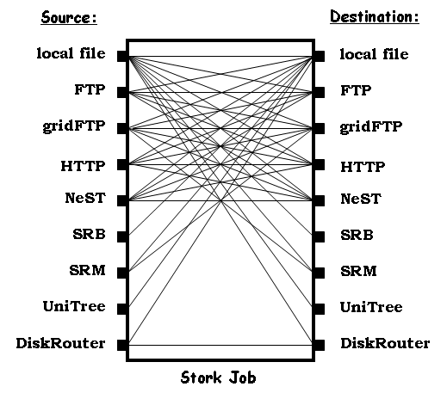
Support for Heterogeneity
Protocol translation using Stork memory buffer.

Slide 69
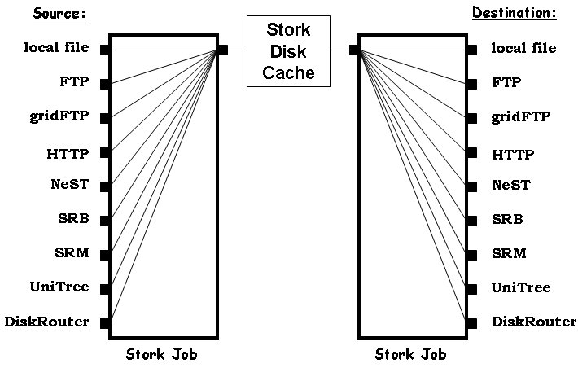
Support for Heterogeneity
Protocol translation using Stork Disk Cache.

Slide 70
Flexible Job Representation and Multilevel Policy Support
[
Type = “Transfer”;
Src_Url = “srb://ghidorac.sdsc.edu/kosart.condor/x.dat”;
Dest_Url = “nest://turkey.cs.wisc.edu/kosart/x.dat”;
……
……
Max_Retry = 10;
Restart_in = “2 hours”;
]

Slide 71
Run-time Adaptation
Dynamic protocol selection
  [
  dap_type = “transfer”;
  src_url = “drouter://slic04.sdsc.edu/tmp/test.dat”;
  dest_url = “drouter://quest2.ncsa.uiuc.edu/tmp/test.dat”;
  alt_protocols = “nest-nest, gsiftp-gsiftp”;
  ]
  [
  dap_type = “transfer”;
  src_url = “any://slic04.sdsc.edu/tmp/test.dat”;
  dest_url = “any://quest2.ncsa.uiuc.edu/tmp/test.dat”;
  ]

Slide 72
Run-time Adaptation
Run-time Protocol Auto-tuning
  [
  link = “slic04.sdsc.edu – quest2.ncsa.uiuc.edu”;
  protocol = “gsiftp”;
  bs = 1024KB; //block size
  tcp_bs = 1024KB; //TCP buffer size
  p = 4;
  ]

