Slide 1
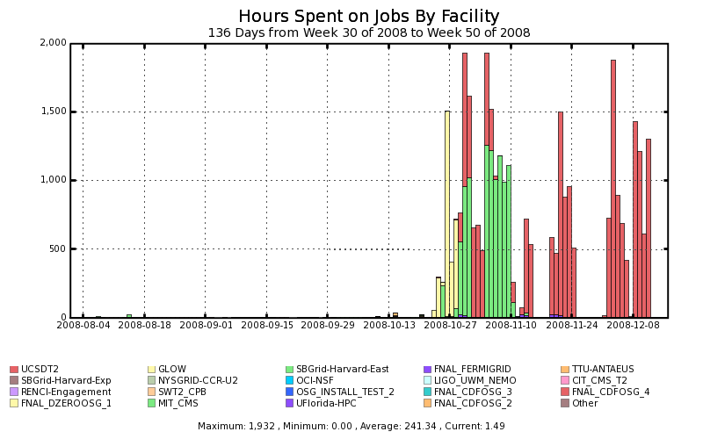
SBGrid Production volume
(During Joint SBGrid-OSG Taskforce)
Enabled startup on
4 Taskforce-Sites
Initiation
phase

Slide 2
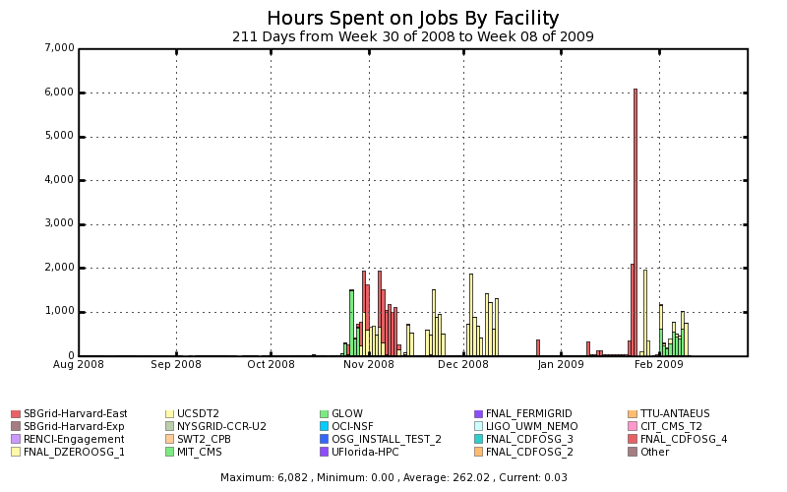
SBGrid Production volume
(Sustained, overall till Feb’09)
Enabled startup on
4 Taskforce-Sites
Initiation
phase

Slide 3
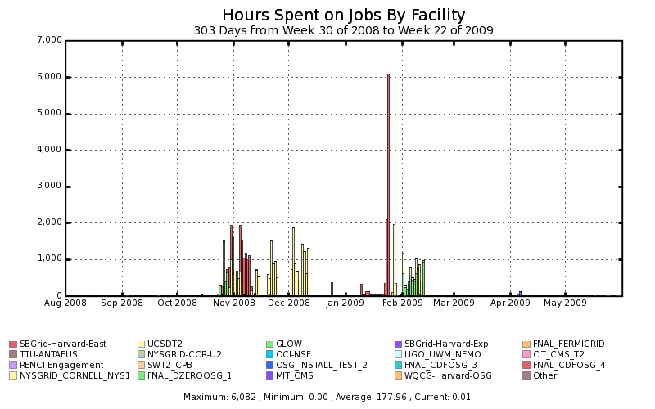
SBGrid Production volume
(Overall till May’09)
Enabled startup on
4 Taskforce-Sites
Initiation
phase
CAUTION:
LOW

