Slide 1
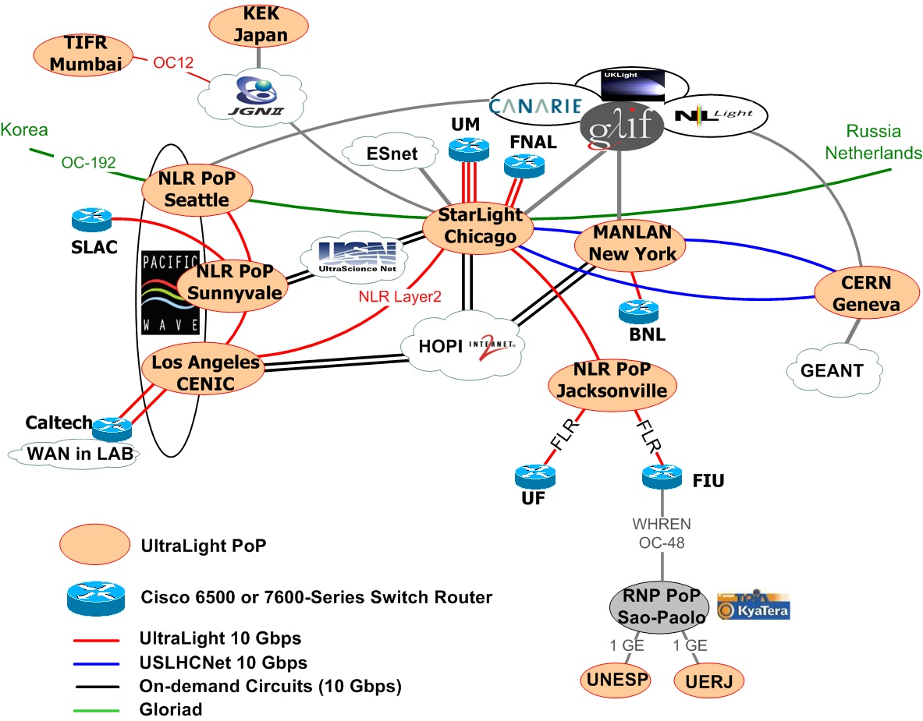
Storage
Activites in UltraLight
R. Cavanaugh
University of Florida
Open Science Grid Consortium Meeting
21-23 August, 2006

Slide 2
UltraLight is
Application driven Network R&D
A global network testbed
  Sites: CIT, UM, UF, FIT, FNAL, BNL, VU, CERN, Korea, Japan, India, etc
  Partners: NLR, I2, CANARIE, MiLR, FLR, etc
Helping to understand and establish the network as a managed resource
  Synergistic with
    LambaStation, Terapaths, OSCARS, etc

Slide 3
Why UltraLight is interested in Storage
UltraLight (optical networks in general) moving towards a managed control plane
  Expect light-paths to be allocated/scheduled to data-flow requests via policy based priorities, queues, and advanced reservations
  Clear need to match “Network Resource Management” with “Storage Resource Management”
    Well known co-scheduling problem!
    In order to develop an effective NRM, must understand and interface with SRM!
End systems remain the current bottle-neck for large scale data transport over the WAN
  Key to effective filling/draining of the pipe
  Need highly capable hardware (servers, etc)
  Need carefully tuned software (kernel, etc)

Slide 4
UltraLight Storage Technical Group
Lead by Alan Tacket (Vanderbilt, Scientist)
Members
  Shawn McKee (Michigan, UltraLight Co-PI)
  Paul Sheldon (Vanderbilt, Faculty Advisor)
  Kyu Sang Park (Florida, PhD student)
  Ajit Apte (Florida, Masters student)
  Sachin Sanap (Florda, Masters student)
  Alan George (Florida, Faculty Advisor)
  Jorge Rodriguez (Florida, Scientist)

Slide 5
A multi-level program of work
End-host Device Technologies
  Choosing right H/W platform for the price ($20K)
End-host Software Stacks
  Tuning storage server for stable and high throughput
End-Systems Management
  Specifying quality of service (QoS) model for Ultralight storage server
  SRM/dCache
  LSTORE (& SRM/LSTORE)
Wide Area Testbeds (REDDnet)

Slide 6
End-Host Performance
(early 2006)
Slide from Shawn McKee
disk to disk over 10Gbps WAN: 4.3 Gbits/sec (536 MB/sec) - 8 TCP streams from CERN to Caltech; windows, 1TB file, 24 JBOD disks
Quad Opteron AMD848 2.2GHz processors with 3 AMD-8131 chipsets: 4 64-bit/133MHz PCI-X slots.
3 Supermicro Marvell SATA disk controllers + 24 SATA 7200rpm SATA disks
  Local Disk IO – 9.6 Gbits/sec (1.2 GBytes/sec read/write, with <20% CPU utilization)
10GE NIC
  10 GE NIC – 9.3 Gbits/sec (memory-to-memory, with 52% CPU utilization, PCI-X 2.0 Caltech-Starlight)
  2*10 GE NIC (802.3ad link aggregation) – 11.1 Gbits/sec (memory-to-memory)
  Need PCI-Express, TCP offload engines
  Need 64 bit OS? Which architectures and hardware?
Efforts continue to try to prototype viable servers capable of driving 10 GE networks in the WAN.

Slide 7
Choosing Right Platform
(more recent)
Slide from Kyu Park
Considering two options for the motherboard
  Tyan S2892 vs. S4881
  S2892 considered stable
  S4881 have independent Hypertransport path for each processor and chipsets
  One of the chipset (either AMD chipset for PCI-X tunneling or chipset for PCIe) should be shared by two I/O devices (RC or 10GE NIC)
RAID controller: 3ware 9550X/E (claimed achieving high throughput ever)
Hard disk: Considering the first perpendicular recording, high density (750GB) hard disk by Seagate

Slide 8
Evaluation of External
Storage Arrays
Slide from Kyu Park
Evaluating external storage arrays solution by Rackable System, Inc.
  Maximum sustainable throughput for sequential read/write
  Impact of various tunable parameters of Linux v2.6.17.6, CentOS-4
  LVM2 Stripe Mapping (RAID-0) test
  Single I/O (2 HBAs, 2 RAID cards, 3 Enclosures) vs. two I/O nodes test
Characteristics
  Enforcing “full stripe write (FSW)” by configuring small array (5+1) instread of large array (8+1 or 12+1) does make difference for RAID 5 setup
Storage server configuration
  Two I/O nodes (2 x DualCore AMD Opteron 265, AMD-8111, 4GB, Tyan K8S Pro S2882)
  OmniStoreTM External Storage Arrays
    StorView Storage Management Software
    Major components: 8.4 TBytes, SATA disks
      RAID: Two Xyratex RAID Controllers (F5420E, 1GB Cache)
      Host connection: Two QLogic FC Adapter (QLA2422), dual port (4Gb/s)
      Three enclosures (12 disks/enclousure) inter-connected by SAS expansion (daisy chain),
Full Stripe write saves parity update operation (read parity-XOR calculation-write)
  For a write that changes all the data in a stripe, parity can be generated without having to read from the disk, because the data for the entire stripe will be in the cache

Slide 9
Tuning Storage Server
Slide from Kyu Park
Tuning storage server
  Identifying tunable parameters space in the I/O path for disk-to-disk (D2D) bulk file transfer
  Investigating the impact of tunable parameters for D2D large file transfer
For the network transfer, we tried to reproduce the previous research results
Try identify the impact of tunable parameters for sequential read/write file access
Tuning does make big difference according to our preliminary results

Slide 10
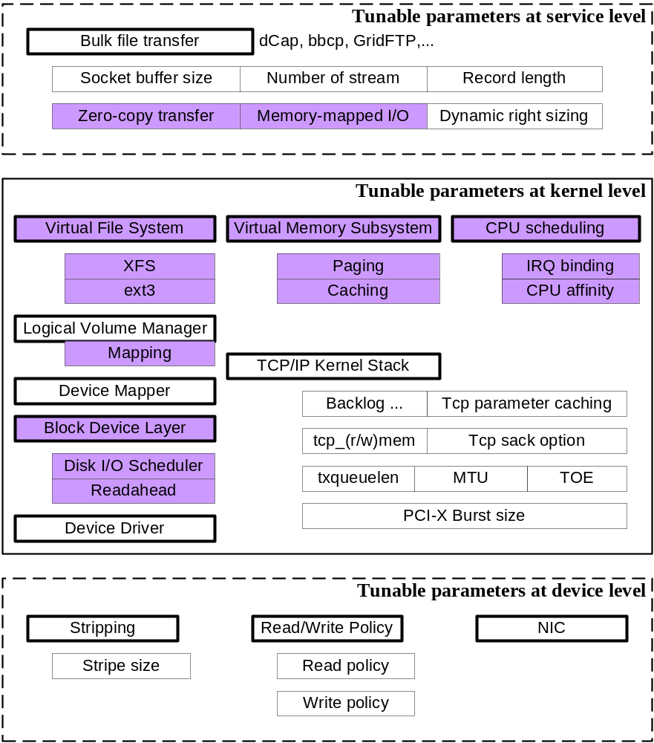
Tunable Parameter Space
Slide from Kyu Park
Multiple layers
  Service/AP level
  Kernel level
  Device level
Complexity of tuning
  Fine tuning is very complex task
  Now investigating the possibility of auto-tuning daemon for storage server

Slide 11
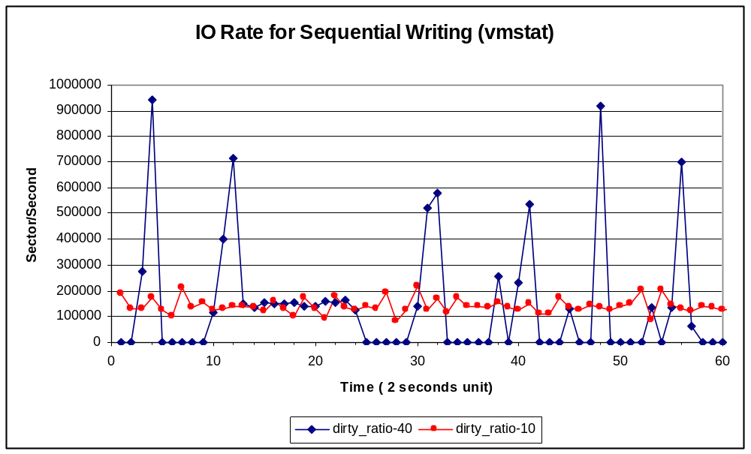
Simple Example: dirty_ratio
Slide from Kyu Park
For the stable writing (at receiver), tunable parameters for writeback plays an important role
  Essential for preventing network stall because of buffer overflow (caching)
  We are investigating the signature of transfer for network congestion and storage congestion over 10GE pipe
With the default value (40) of dirty ratio, sequential writing is stalled for almost 8 seconds which can lead to subsequent network stall
/proc/sys/vm/dirty_ratio: A percentage of total system memory, the number of pages at which a process which is generating disk writes will itself start writing out dirty data. This means that if 40% of total system memory is flagged dirty then the process itself will start writing dirty data to hard disk

Slide 12
SRM/dCACHE
(Florida Group)
Slide from Kyu Park
Investigating SRM specification
Testing SRM implementation
  SRM/DRM
  dCache
QoS UltraLight Storage Server
  Identified as critical; work still in very early stage
    Required, in order to understand and experiment with “Network Resource Management”
  SRM only provides an interface
    Does not implement policy based management
    Interface needs to be extended to include ability to advertise “Queue Depth” etc
  Survey existing research on QoS of storage service

Slide 13
L-Store
(Vanderbilt Group)
Slide from Alan Tackett
L-Store provides a distributed and scalable namespace for storing arbitrary sized data objects.
Provides a file system interface to the data.
Scalable in both Metadata and storage.
Highly fault-tolerant. No single point of failure including a storage depot.
Each file is striped across multiple storage elements
Weaver erasure codes provide fault tolerance
Dynamic load balancing of both data and metadata
SRM Interface available using GridFTP for data transfer
  See Surya Pathak’s talk
Natively uses IBP for data transfers to support striping across multiple devices (http://loci.cs.utk.edu/)

Slide 14
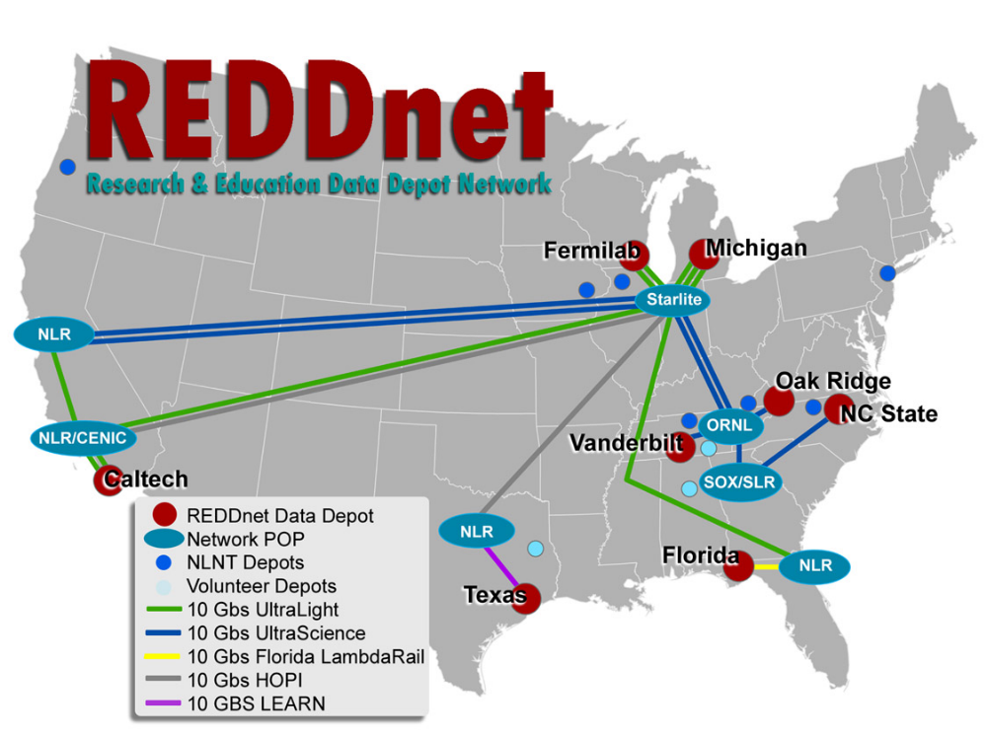
Slide from Alan Tackett
REDDnet
Research and Education Data Depot Network
Runs on Ultralight
NSF funded project
8 initial sites
Multiple disciplines
  Sat imagery (AmericaView)
  HEP
  Terascale Supernova Initative
  Structural Biology
  Bioinformatics
Storage
  500TB disk
  200TB tape

Slide 15
REDDnet Storage
Building block
Slide from Alan Tackett
Fabricated by Capricorn Technologies
  http://www.capricorn-tech.com/
1U, Single dual core Athlon 64 x2 proc
3TB native (4x750GB SATA2 drives)
1Gb/s sustained write throughput

Slide 16
Clyde
Generic testing and validation framework
Slide from Alan Tackett
Used for L-store and REDDnet testing
Can simulate different usage scenarios that are “replayable”
Allows for strict, structured testing to configurable modeling of actual usage patterns
Generic interface for testing of multiple storage systems individually or in unison
Built in statistic gathering and analysis
Integrity checks using md5sums for file validation

Slide 17
Conclusion
UltraLight is interested in and is investigating
  High Performance single server end-systems
    Trying to break the 1 GB/s disk-to-disk barrier
  Managed Storage end-systems
    SRM/dCache
    LSTORE
  End-system tuning
    LISA Agent (did not discuss in this talk)
    Clyde Framework (statistics gathering)
  Storage QOS (SRM)
    Need to match with expected emergence of Network QOS
UltraLight is now partnering with REDDnet
  Synergistic Network & Storage Wide Area Testbed

