Slide 1
CSIU Submission of BLAST jobs via the Galaxy Interface
Rob Quick rquick@iu.edu
Open Science Grid – Operations Area Coordinator
Indiana University – Manager High Throughput Computing
Computational Sciences at Indiana University (CSIU) – VO Manager

Slide 2
Motivation
What is BLAST?
Submission to OSG
Galaxy UI

Slide 3
National Center for Genome Analysis Support (NCGAS)
“The mission of the National Center for Genome Analysis Support is to enable the biological research community of the US to analyze, understand, and make use of the vast amount of genomic information now available. NCGAS focuses particularly on transcriptome- and genome-level assembly, phylogenetics, metagenomics/transcriptomics and community genomics.”

Slide 4
Mason Cluster
Mason at Indiana University
  Large memory computer cluster (512G per node)
  Configured to support data-intensive, high-performance computing tasks for researchers using genome assembly software
    Suitable for assembly of data from next-generation sequencers
    Large-scale phylogenetic software
    Other genome analysis applications
  Require large amounts of computer memory.

Slide 5
What is BLAST?
Basic Local Alignment Search Tool
  One of the most widely used bioinformatics programs
  Algorithm for comparing biological sequence information
  Compares a query sequence to a library of sequences
  Allows comparison of an unknown sequence to known similar genes

Slide 6
BLAST Vitals
Input – Query Sequence
  1 to 70k+ sequences
Output – Plain text, XML, or HTML query report
Application – blastp, blastx, blastn (each 26M)
Database – ~35G Uncompressed
  13 Sub Sections each ~2.5GB
  Updated ~monthly by NCBI

Slide 7
BLAST on OSG
We’ve experimented with several options
  Application
    Sent with Job (non-trivial size)
    Local Installation
    OASIS (OSG wide HTTP FS)
  Database
    Validation and Installation Job
    Splitting into smaller DB sub-sections
      Reassembly of output

Slide 8
Test Case
38k queries - 3 Acanthamoeba RNA-Seq
  Split into 10 query jobs and condor submission file created
  Tested different submission techniques
    Galaxy → BOSCO → OSG_XSEDE → Glidein
    Galaxy → AMPQ → OSG_XSEDE → Glidein
    Pegasus based workflow
    Condor_g submission

Slide 9
Some Behavior Issues
Execution Time
  Jobs submitted to the same resource share the DB
  Sometimes 3-4 hours to run 10 Queries
Memory Growth
  Memory usage grows over time (leak in blastp?)
    Some sites kill at memory sizes over 2.5G
Merging Outputs
  Size of output

Slide 10
Converging on Solution
Generate Segmented BLAST DB and publish on osg-xsede
Construct workflow using Condor DAG
BLAST app shipped with job
BLAST db downloaded by each job (only the segment necessary)
Execute with –dbsize to simulate full DB run
Merged with –xml output as part of the DAG
Galaxy will submit DAG workflow to local condor queue which forwards to osg-xsede

Slide 11
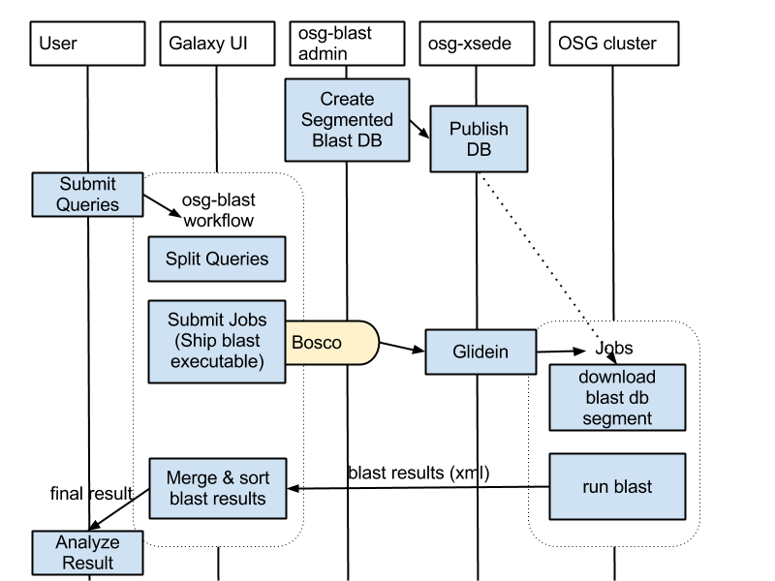
Architecture Flow

Slide 12
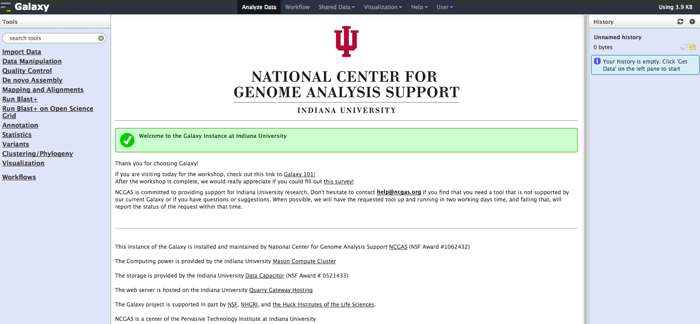
Galaxy UI at IU

Slide 13
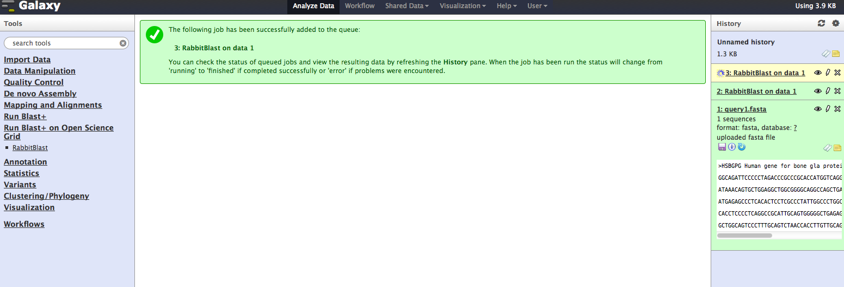
Galaxy UI at IU

Slide 14
Galaxy Interaction
BOSCO instance runs on the Galaxy UI server
  DAG is submitted to local Condor Queue
  Galaxy Node → osg-xsede → glidein factory
  Wait for execution
  Format and delivery of data
Other work on Galaxy node uses local PBS Queue

Slide 15
Other Notes
OSG Accounting Project = IU_GALAXY
  46k cpu/hr testing Sept 16-30
38k queries run in ~6hrs
Targeting this work for publication in a peer reviewed bioinformatics journal
We will submit this work to Galaxy as a possible branch

Slide 16
Acknowlegements
Soichi Hayashi
Carrie Genote
Le-Shin Wu
Scott Teige
Rich LeDuc
Derek Weitzel
Bill Barnett

