Slide 1

Grid computing using
Alina Bejan
University of Chicago

Slide 2
Grid computing
Aims to “enable resource sharing and coordinated problem solving in dynamic, multi-institutional virtual organizations”
(Foster, Kesselman)
Grids provide a distributed computing paradigm / infrastructure that spans VOs, with the goal of enabling federated resource sharing in dynamic distributed environments

Slide 3
How grids operate
Use federated resources (commodity machines):
  Compute
  Storage
  Network
These resources are:
  Heterogeneous
  Dynamic
  Geographically distributed

Slide 4
Different computational models
Supercomputers
  Tightly coupled massively parallel applications
  Expensive, hard to get to
  Use MPI, PVM
Cluster computing
  Involves homogenous machines interconnected by high speed network with locally accessible storage in one administrative domain
  Also leverages cheaper commodity computing and storage hardware
Grid computing
  Integrating existing distributed resources, pertaining to different organizations, running different platforms
  Suitable for loosely coupled applications

Slide 5
Open Science Grid (OSG)
takes High Throughput Computing to the next level, to transform data-intensive science through a cross-domain, self-managed nationally distributed cyber-infrastructure.
brings together campuses and communities, and facilitates the needs of Virtual Organizations at all scales.
The OSG Consortium includes
  universities
  national laboratories
  scientific collaborations
  software developers
working together to meet these goals
Notes:
The Open Science Grid (OSG), a major national grid infrastructure, provides scientists with more than 70 production sites offering over 20,000 CPUs and 4 Petabytes of storage to advance their research. This organization includes members from particle and nuclear physics, astrophysics, bioinformatics, gravitational-wave science and computer science collaborations, all contributing to the development of the OSG and benefiting from advances in grid technology. Applications in other areas of science, such as mathematics, medical imaging and nanotechnology can also gain from the interactions with OSG through its partnership with local and regional grids or their communities’ use of the Virtual Data Toolkit software stack.
We invite you to learn more about grid and high throughput computing and its implications in various research areas through this intensive OSG course that introduces the techniques of grid and distributed computing for science and engineering with hands-on training in the use of large-scale grid computing resources.
The workshop will focus on enabling the use of OSG and TeraGrid cyberinfrastructure to perform large-scale computations and data-intensive processing in different application domains. Participants will learn how to use grids of thousands of processors and will be able to continue to use these resources for their research after the course completion.

Slide 6
What is a grid?
Grid is a system that:
  coordinates resources that are not subject to centralized control,
  using standard, open, general-purpose protocols and interfaces,
  to deliver nontrivial qualities of service
  (based on Ian Foster’s definition in http://www.gridtoday.com/02/0722/100136.html)
Notes:
Different definitions.
Let’s consider Ian Foster's three point checklist – a grid is an infrastructure that brings resources together without imposing central control. Computers, storage space, network connections, databases are examples of resources.
Why are open protocols important? So that you can use different software – you don't have to buy special programs to use it and be bound by certain licensing limitations. Offers freedom and flexibility in working on your own terms, allowing you (the grid user) to make decisions about your local infrastructure.
A major advantage is that a grid is capable of delivering non-trivial qualities of service – basically it means that it doesn't just break at the first opportunity. Reliability is important especially for large scale problems as those that are usually scheduled on grids.

Slide 7
Grids consist of distributed clusters
Grid Client
Grid Site 1:
Fermilab
Grid
Storage
Compute
Cluster
Application
& User Interface
Grid
Service
Middleware
Grid Client
Middleware
Grid Site 2:
Sao Paolo
Grid
Storage
Compute
Cluster
Grid
Protocols
Grid
Service
Middleware
Resource,
Workflow
& Data Catalogs
…Grid Site N:
UWisconsin
Grid
Storage
Compute
Cluster
Grid
Service
Middleware
Notes:
This is a key slide
Clusters are a form of distributed computing
Grids are distributed sets of clusters, so distributed computing takes place at two levels: within each cluster, and between clusters
(we define distributed computing as anything that involves IPC beyond a host boundary)
DROP THIS LIST: COVER ON NEXT SLIDE
Security to control access and protect communication (GSI)
Directory to locate grid sites and services: (VORS, MDS)
Uniform interface to computing sites (GRAM)
Facility to maintain and schedule queues of work (Condor-G)
Fast and secure data set mover (GridFTP, RFT)
Directory to track where datasets live (RLS)

Slide 8
Why grids ?
An example as motivation …

Slide 9
Scaling up Science:
Citation Network Analysis in Sociology
Work of James Evans, University of Chicago, Department of Sociology

Slide 10
Scaling up the analysis
Query and analysis of 25+ million citations
Work started on desktop workstations
Queries grew to month-long duration
With data distributed across
U of Chicago TeraPort cluster:
  50 (faster) CPUs gave 100 X speedup
  Many more methods and hypotheses can be tested!
Higher throughput and capacity enables deeper analysis and broader community access.
Notes:
This work illustrates eScience on a Cluster – scaling up from desktop workstations to clusters:
From 30 days to about a third of a day.
Deeper inquiry is now possible.

Slide 11
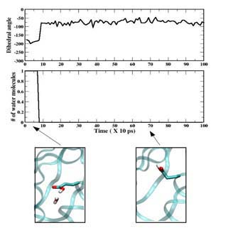
Grids work like a CHARMM for molecular dynamics
Understanding the mathematics of molecular movement helps researchers simulate slices of the atomic world
But when accurate nanosecond simulations pose a serious challenge, how can you simulate full microseconds of complex molecular dynamics?

Slide 12
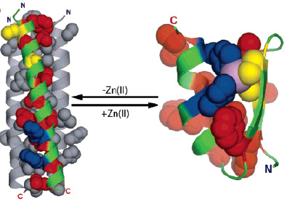
Designing Proteins from Scratch
Scientists use OSG to design proteins that adopt specific 3D structures and more ambitiously bind and regulate target proteins important in cell biology and pathogenesis

Slide 13
Which sciences can benefit ?
particle and nuclear physics
astrophysics
bioinformatics
gravitational-wave science
computer science
mathematics
medical imaging
nanotechnology
potentially any other science …

Slide 14
Virtual Organization (VO) Concept
Logical entity
Members share the resources as if they belong to same organization

Slide 15

Research Participation
  Majority from physics : Tevatron, LHC, STAR, LIGO.
  Used by 10 other (small) research groups.
  90 members, 30 VOs,
Contributors:
  - 80 sites / 50 organizations
  5 DOE Labs : BNL, Fermilab, NERSC, ORNL, SLAC.
  65 Universities.
  5 partner campus/regional grids.
Accessible resources:
  43,000+ cores
  6 Petabytes disk cache
  10 Petabytes tape stores
  14 internetwork partnership
Usage
  15,000 CPU WallClock days/day
  1 Petabyte data distributed/month.
  100,000 application jobs/day.
  20% cycles through resource sharing, opportunistic usage.
Notes:
OSG
What:
National computing infrastructure for science (NSF/DoE)
Consortium
Resources:
70+ sites
Connected via Inet2, NLR.... from 10 Gbps – 622 Mbps
Compute & Storage Elements
Most Linux clusters, most are shared (Campus grids)
Usage:
A lot of opportunistic usage

Slide 16
The OSG project research
Has two components:
  To enable scientific discovery by providing a state of the art production distributed infrastructure for science
  To advance the state of the art in distributed computing through experimental computer science through a large scale production quality distributed system

Slide 17
OSG’s grids
Grids can be
  Campus, Community, Regional, National, International
OSG scope includes bridging, and interfacing between them

Slide 18
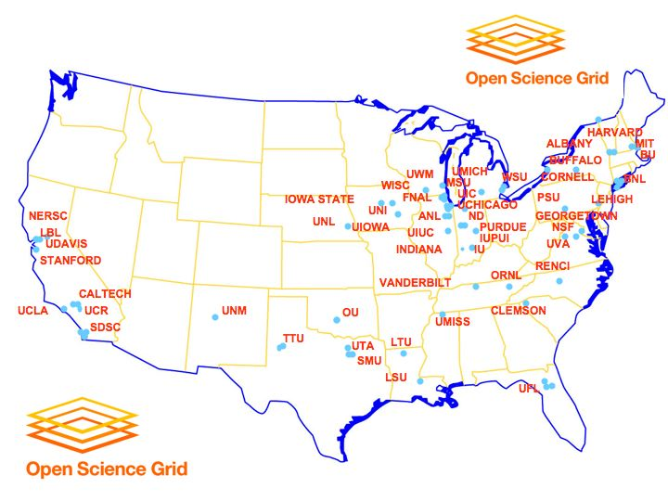
OSG sites

Slide 19
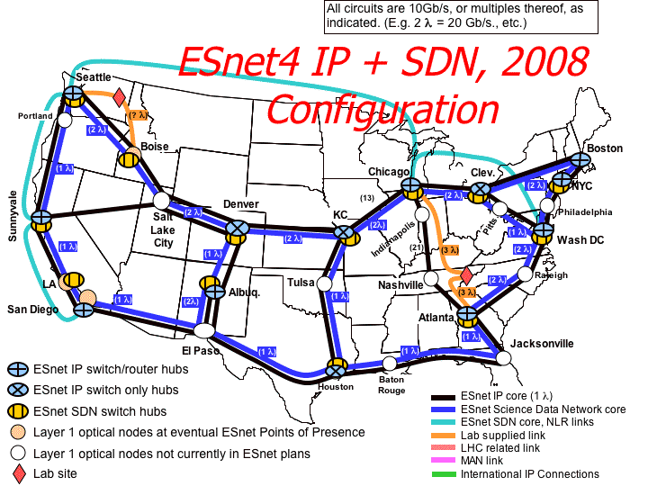
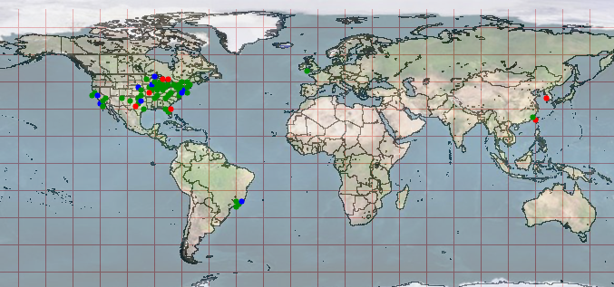
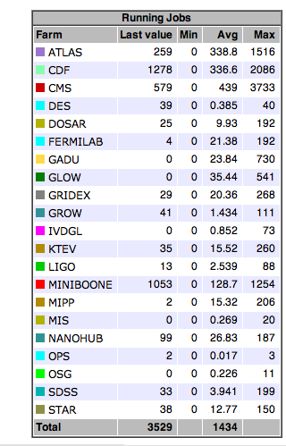
OSG Snapshot
96 Resources across
production & integration infrastructures
Using production & research networks
Snapshot of Jobs on OSGs
Sustaining through OSG submissions:
3,000-4,000 simultaneous jobs .
~100K jobs/day
~50K CPUhours/day.
Peak test jobs of 15K a day.
30 Virtual Organizations +6 operations
Includes 25% non-physics.
~30,000 CPUs (from 30 to 4000)
~6 PB Tapes
~4 PB Shared Disk

Slide 20
Globus and Condor play key roles
Globus Toolkit provides the base middleware
  Client tools
  APIs (scripting languages, C, C++, Java, …) to build your own tools, or use direct from applications
  Web service interfaces
  Higher level tools built from these basic components, e.g. Reliable File Transfer (RFT)
Condor provides both client & server scheduling
  In grids, Condor provides an agent to queue, schedule and manage work submission

Slide 21
To efficiently use a Grid, you must locate and monitor its resources.
Check the availability of different grid sites
Discover different grid services
Check the status of “jobs”
Make better scheduling decisions with information maintained on the “health” of sites
GIS: VORS -> myOSG

Slide 22
Example:
Virtual Organization Resource Selector - VORS http://vors.grid.iu.edu/
Custom web interface to a grid scanner that checks services and resources on:
  Each Compute Element
  Each Storage Element
Very handy for checking:
  Paths of installed tools on Worker Nodes.
  Location & amount of disk space for planning a workflow.
  Troubleshooting when an error occurs.

Slide 23
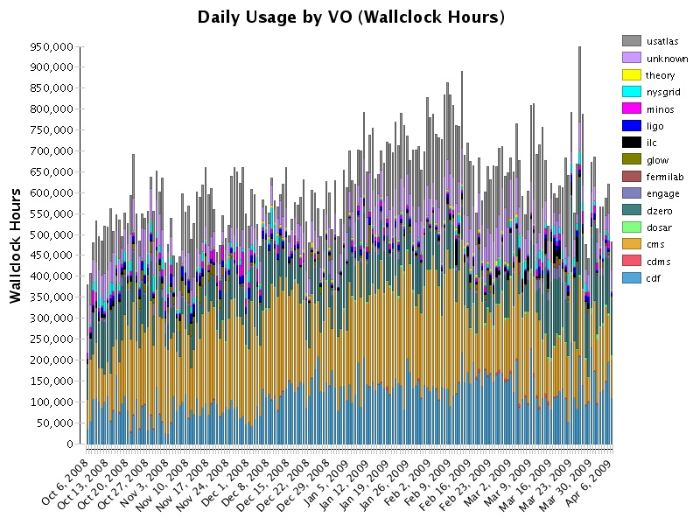
Gratia -- job accounting system http://gratia-osg.fnal.gov:8880/gratia-reporting/

Slide 24
Conclusion: Why Grids?
New approaches to inquiry based on
  Deep analysis of huge quantities of data
  Interdisciplinary collaboration
  Large-scale simulation and analysis
  Smart instrumentation
  Dynamically assemble the resources to tackle a new scale of problem
Enabled by access to resources & services without regard for location & other barriers
Notes:
What’s possible when we put these paradigms together?
eScience
Grids as a platform
Can explore a large parameter space at a finer granularity
Business is catching up:
Applications in bandwidth provision and management
Applications in service provision
Applications in medicine and health services
Applications in engineering
Best example of eBiz-eSci synergy – Oracle Grid interfaces.

Slide 25
Grids:
Because Science needs community …
Teams organized around common goals
  People, resource, software, data, instruments…
With diverse membership & capabilities
  Expertise in multiple areas required
And geographic and political distribution
  No location/organization possesses all required skills and resources
Must adapt as a function of the situation
  Adjust membership, reallocate responsibilities, renegotiate resources

Slide 26
Getting Started with OSG
I want to use OSG resources
I want to get my application running on OSG
I want information about adapting my campus IT facility to form a campus grid
I want to federate or partner my grid with OSG
I want to make resources available to OSG
I want to help build OSG

Slide 27
I want to use OSG resources
Must join a VO:
  Individual/small for independent research
    Join OSG VO
  Join an existing member VO (see the list of current OSG VOs )
  Form new VO for your research community
Run VO specific applications

Slide 28
Want to get my app running on OSG
Engagement team
  Dedicated effort
  Genetics, library science, earthquake simulation, video processing, physics; Examples:
    Production running using 20,000+ CPU hours of the CHARMM molecular dynamic simulation to the problem of water penetration in staphylococcal nuclease using opportunistically available resources across 10+ OSG sites ( see Grids work like a CHARMM for molecular dynamics)
    Improvement of the performance of the nanoWire application from the nanoHub project on OSG/TeraGrid, such that stable running of batches of 500 jobs across more than 5 sites is routine; (see Keeping up with Moore's Law)
    Adaptation and production running opportunistically using 100,000+ CPU hours of the Rosetta application from the Kuhlman Laboratory in North Carolina across more than 13 OSG sites (see Designing proteins from scratch)
    Production runs of the Weather Research and Forecast (WRF) application using more 150,000 CPUhours on the NERSC OSG site at Lawrence Berkeley National Laboratory (LBNL)

Slide 29
Want to form a campus grid
You have a campus IT facility
  Want to make it a campus grid
  And federate it with OSG
OSG is committed to including US universities in the national cyberinfrastructure.
  The OSG middleware and operational framework enables any site to participate as an OSG resource, provided it is a well maintained resource that users can count on
Technically there are no hurdles in having every US university and college contribute resources to OSG and use OSG resources in return.
  See module on Thursday
Several campuses have done so very well: Purdue University, University of Wisconsin- Madison, and Clemson University
Several other universities participate in OSG through individual research groups.

Slide 30
I want to federate or partner my grid with OSG
OSG Consortium envisions a world-wide grid formed of a number of different federations of grids (analogous to the Internet as a network of networks)
Federation, therefore, is a natural concept within OSG
We are interested in partnerships with other grids trying to develop richer methods and tools for federation.

Slide 31
I want to make resources accessible to OSG
Recommended that you join a VO
Minimal requirements
  sufficient to assure interoperability, stability
  set of "standard" services which define the requirements on interfaces and capabilities.
Register resource with GOC
  See module on Thursday

Slide 32
I want to learn more about grids
Join the Education VO
  www.opensciencegrid.org/Education
  eot@opensciencegrid.org
  Account, cert
  Online course
  Experiment with job submissions

Slide 33
Thank you !
Questions ?

Slide 34

Grid Resources in the US
OSG
TeraGrid
Research Participation
  Majority from physics : Tevatron, LHC, STAR, LIGO.
  Used by 10 other (small) research groups.
  90 members, 30 VOs,
Contributors:
  5 DOE Labs
    BNL, Fermilab, NERSC, ORNL, SLAC.
  65 Universities.
  5 partner campus/regional grids.
Accessible resources:
  43,000+ cores
  6 Petabytes disk cache
  10 Petabytes tape stores
  14 internetwork partnership
Usage
  15,000 CPU WallClock days/day
  1 Petabyte data distributed/month.
  100,000 application jobs/day.
  20% cycles through resource sharing, opportunistic use.
Research Participation
  Support for Science Gateways
  over 100 scientific data collections (discipline specific databases)
Contributors:
  11 Supercomputing centers
  Indiana, LONI, NCAR, NCSA, NICS, ORNL, PSC, Purdue, SDSC, TACC and UC/ANL
Computational resources:
  > 1 Petaflop computing capability
  30 Petabytes of storage (disk and tape)‏
  Dedicated high performance internet connections (10G)
  750 TFLOPS (161K-cores) in parallel computing systems and growing
Notes:
OSG
What:
National computing infrastructure for science (NSF/DoE)
Consortium
Resources:
70+ sites
Connected via Inet2, NLR.... from 10 Gbps – 622 Mbps
Compute & Storage Elements
Most Linux clusters, most are shared (Campus grids)
Usage:
A lot of opportunistic usage

