Slide 1
Area Coordinator Report for Operations
Rob Quick
4/10/2008

Slide 2
Overview
Current Initiatives
  WLCG SAM Reporting
    Working with ATLAS and CMS Tier 2 resources to get WLCG SAM availability reporting in place. See timeline matrix on next slide.
    Defining scheduled maintenance transport with WLCG SAM for reliability statistics.
  RSV Version 2
    New SE and GUMS probes.
    Major changes in configuration and proxy usage.
    Reporting daily statistics to OSG Facility group.
  OIM Registration Database
    User interface nearing completion, demo after Area Coordinators meeting today. See slide 4 for details.
  GOC Operations Hardware Reorganization
    Organic growth has led to many hardware inconsistencies at the GOC. Project plan is currently being written.
  ITB 0.9.0 Release and Testing
    GOC services will all need to be tested with the new 0.9.0 ITB release in preparation for OSG 1.0.0.
    GOC also participates in the testing and documentation of the new middleware release.
  WLCG Collaboration Meeting
    April 21-24 at CERN. Will be working directly with SAM developers on WLCG statistics.
  Everyday Operations
    This often gets missed in these reports, but we are experience upward trends from last year.
      1st quarter of 2008 has seen 36% ticket load increase from the previous quarter, and 16% increase from the first quarter of 2007.
Accomplishments
  Initial WLCG SAM Availability Reporting
  New TWiki in testing phase
  OIM Ready for Demo

Slide 3
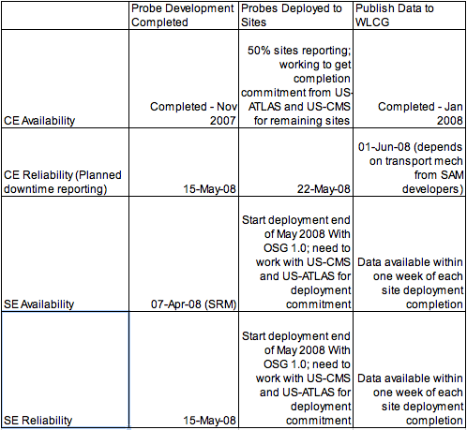
WLCG SAM Reporting Timeline

Slide 4
WBS
Measurements and Metrics
WBS | Agency | TaskName | Start | Finish | %Complete
1.2 | No | Operations | 10/1/07 | 9/30/08 | 50%
1.2.1 | No | Maintain and evolve OSG services | 10/1/07 | 9/30/08 | 50%
1.2.1.1 | No | OSG services (VOMS, GRATIA accounting, VOMS monitoring, ticketing system, etc.) | 10/1/07 | 9/30/08 | 50%
1.2.1.3 | No | Evolve and Deploy OSG Information Management (OIM) implementation | 10/1/07 | 12/20/07 | 60%
1.2.1.4 | No | Services that represent obligations to external partners (BDII, site validation reports,….) | 10/1/07 | 9/30/08 | 50%
1.2.2 | No | Manage OSG software deployment process | 10/1/07 | 9/30/08 | 50%
1.2.2.1 | No | Inventory software patch levels at each resource on a daily basis | 9/3/07 | 3/1/08 | 20%
1.2.2.2 | No | Announce availability of software and security patches | 10/1/07 | 9/30/08 | 50%
1.2.2.3 | No | Distribute and support installation of OSG two major software releases | 10/1/07 | 9/30/08 | 50%
1.2.2.4 | No | Gather feedback from sites on software deployment process and convey key messages to Facility team | 10/1/07 | 10/1/07 | 0%
1.2.3 | No | Process and insure resolution on all trouble tickets in a timely manner | 10/1/07 | 9/30/08 | 50%
1.2.3.1 | No | Monthly reporting of metrics of GOC tickets | 10/1/07 | 9/30/08 | 50%
1.2.4 | No | Evaluate operations with TeraGRID and make recommendations on Inter-operability | 10/1/07 | 8/31/08 | 10%
1.2.5 | No | Evolve and maintain functional testing probes, repository, publication | 10/15/07 | 5/31/08 | 33%
1.2.5.1 | No | Provide reliable and accurate transmission of test information, of appropriate sites, to systems in WLCG | 10/15/07 | 12/15/07 | 66%

Slide 5
OIM Demo Information
Breeze address: http://breeze.iu.edu/osgoimdemo/
  You will need the Adobe Acrobat Connect Add-In for your browser. When you connect to the above address it will ask you to install if it is not already installed on your machine.
  Login in as Guest
  We will review the steps for a new user to register themselves, a resource, a support center, and a VO. We will also look at editing information and a possible menu driven interface.

