Slide 1
SRM at Clemson
Michael Fenn

Slide 2
What is a Storage Element?
Provides grid-accessible storage space.
Is accessible to applications running on OSG through either GridFTP and/or SRM interface.
Has GIP setup and configured properly which publishes its information.
Has well-defined policy for cleanup and usage.
Is registered with OSG.

Slide 3
Architecture
Firebox: Dell PowerEdge: Head node and VPN server
Oiltank1-9: Dell PowerEdge: storage node
Birdnest: Xen VM, hosting CE and SE, VPN client
  Why bother with VPN?
  We have a unique situation where the grid head node is not co-located with the rest of the cluster

Slide 4
Distributed Filesystem
After researching multiple distributed filesystems, we settled on PVFS.
Simple configuration and easy to add extra clients.
Server runs in userspace and client requires only a kernel module.

Slide 5
PVFS Server Setup
./configure
make
make install
PVFS then provides a command to help create your server config file
  /usr/bin/pvfs2-genconfig /etc/pvfs2-fs.conf
Script will prompt for your desired protocol, servers, and other configuration options.

Slide 6
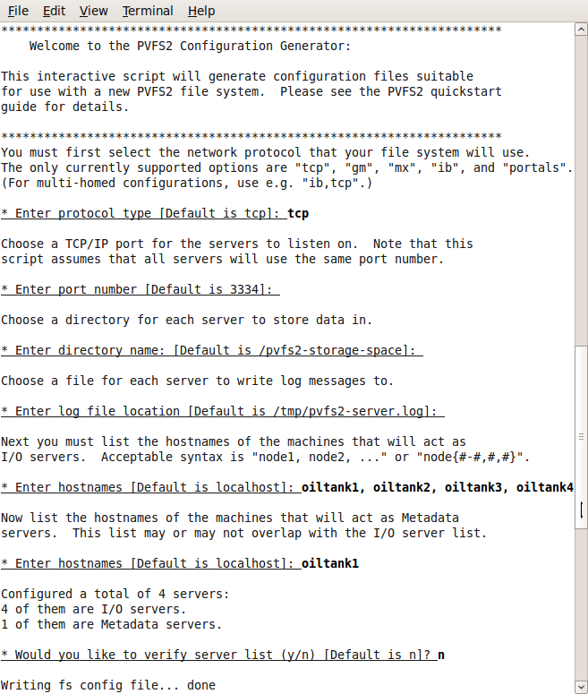

Slide 7
PVFS Server Setup
This same config file can be distributed to each of the desired storage nodes at /etc/pvfs-fs.conf
To initialize the server and allow it to allocate space, run
  /usr/sbin/pvfs2-server /etc/pvfs2-fs.conf -f
To start the server normally, simply omit '-f'

Slide 8
PVFS Client Setup
./configure –with-kernel-source=/path/to/kernelsrc
make just_kmod
insmod /usr/src/pvfs2/src/kernel/linux-2.6/pvfs2.ko
mkdir /mnt/pvfs2/
Will need to make file /etc/pvfs2tab with form:
  tcp://testhost:3334/pvfs2-fs /mnt/pvfs2 pvfs2 defaults,noauto 0 0
pvfs2-client -p ./pvfs2-client-core
mount -t pvfs2 tcp://testhost:3334/pvfs2-fs /mnt/pvfs2

Slide 9
Grid Interfaces
GridFTP-based SE is simply a file system directory accessible via GSI-authenticated FTP.
  Provides no space management functions
  Limited permission management functions.
SRM/dCache - This is a full implementation of a Storage Element
  Enforces stronger constraints
  Can manage a space spanning more volumes.

Slide 10
Grid Interfaces -- BeStMan
SRM/BeStMan - BeStMan is a full implementation of SRM v2.2, developed by Lawrence Berkeley National Laboratory, for a small disk based storage and mass storage systems.
Works on top of existing disk-based UNIX file system.
Works with any existing file transfer service, such as gsiftp, http, https, bbftp and ftp.
Requires minimal administrative efforts on the deployment and updates.
Source: https://twiki.grid.iu.edu/bin/view/Documentation/AboutStorageElements

Slide 11
SRM/BeStMan at Clemson
We had an existing filesystem, so BeStMan best fit our situation.
Available for easy installation from the VDT
  pacman -get ITB:Bestman
Configure BeStMan depending on your site setup and needs.
Our config is on the next slide

Slide 12
SRM/BeStMan at Clemson
  $ ./configure
  --with-java-home=/opt/osg-1.0/jdk1.6
  --with-srm-home=/opt/osg-1.0/bestman
  --with-srm-owner=daemon
  --enable-sudofsmng
  --with-cacert-path=/opt/osg-1.0/globus/TRUSTED_CA
  --with-certfile-path=/etc/grid-security/http/httpcert.pem
  --with-keyfile-path=/etc/grid-security/http/httpkey.pem
  --with-eventlog-path=/opt/osg-1.0/vdt-app-data/bestman/logs
  --with-cachelog-path=/opt/osg-1.0/vdt-app-data/bestman/logs
  --with-http-port=10080 --with-https-port=10443
  --with-replica-storage-path=/mnt/pvfs2/sereplica
  --with-replica-storage-size=1000000
  --enable-gums
  --with-gums-url=https://osggums.cs.clemson.edu:8443/gums/services/GUMSAuthorizationServicePort
  --with-gums-dn=/DC=org/DC=doegrids/OU=Services/CN=http/birdnest.cs.clemson.edu
Red options required for GUMS authentication
Explanations of the options are available in the Administration guide.
Source: https://twiki.grid.iu.edu/bin/view/ReleaseDocumentation/Bestman

Slide 13
Testing the SRM Interface
SRM commands used to test our install
First you should create a proxy from a submit host on which you are registered so that you can run commands on the site.
  voms-proxy-init -voms Engage -valid 72:00
This will create a proxy cert for the Virtual Organization Engage which will be valid for 72 hours.
https://twiki.grid.iu.edu/bin/view/Integration/ITB092/Bestman

Slide 14
Testing the SRM Interface
Pinging the server:
  srm-ping srm://birdnest.cs.clemson.edu:10443/srm/v2/server
Using ls:
  srm-ls srm://birdnest.cs.clemson.edu:10443/srm/v2/server\?SFN=/mnt/pvfs2/sedata/engage/test.txt
SFN is the path to the file or directory which you have interest in.
Remember to escape the ? in Bash!

Slide 15
Testing the SRM Interface
Make a directory:
  srm-mkdir srm://birdnest.cs.clemson.edu:10443/srm/v2/server\?SFN=/mnt/pvfs2/sedata/engage/testdir/
Delete a directory:
  srm-rmdir srm://birdnest.cs.clemson.edu:10443/srm/v2/server\?SFN=/mnt/pvfs2/sedata/engage/testdir/

Slide 16
Testing the SRM Interface
SRM commands expect full URLs, including filenames
  Will not infer that the source and destination filenames are the same
Transfering files to the storage node
  srm-copy file:///home/user/test.txt srm://birdnest.cs.clemson.edu:10443/srm/v2/server\?SFN=/mnt/pvfs2/sedata/engage/test.txt
Transfering file from the storage node
  srm-copy srm://birdnest.cs.clemson.edu:10443/srm/v2/server\?SFN=/mnt/pvfs2/sedata/engage/test.txt file:///home/user/test.txt

Slide 17
Registering for SRM Daily Tests
Go to http://datagrid.lbl.gov/
Select storage site registration and fill out the form.
You will need to know the service endpoint on your server.
  Ex: srm://birdnest.cs.clemson.edu:10443/srm/v2/server/
You will also need to know the path which will be write accessible to those using your SE.
  Ex: /mnt/pvfs2/sedata/
Within a few days you will be contacted through email for verification and to make sure your site is setup correctly.
If the test run is successful, you will be registered for daily storage test reporting.
http://datagrid.lbl.gov/v22/srmtester-ftest.v22.php?sitename=CIRG-CU-SRM&date=03-18-2009_09_20&vo=OSG

