Slide 1
OSG Grid Workshop in KNUST, Kumasi, Ghana August 6-8, 2012 following the AFRICAN SCHOOL OF FUNDAMENTAL PHYSICS AND ITS APPLICATIONS July 15-Aug 04, 2012

Slide 2
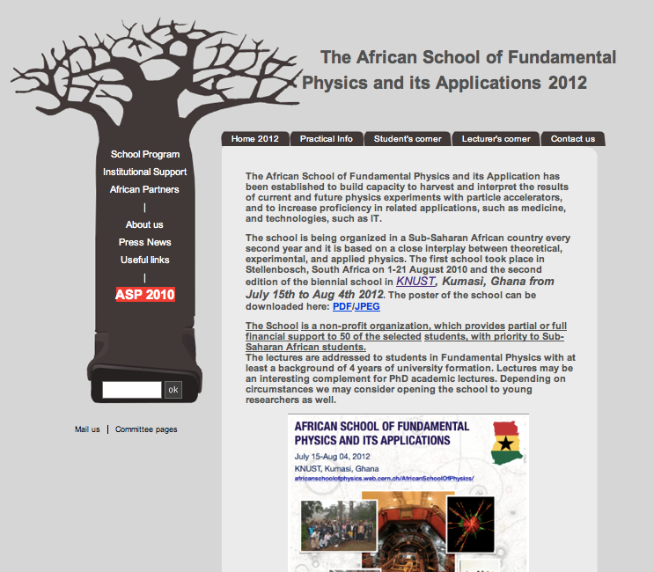
ASP2012 Webpage

Slide 3
In conjunction with ASP2012, the Distributed Organization of Scientific and Academic Research (DOSAR) proposes to offer a three-day grid computing school in Ghana on Aug. 6 – Aug. 8 at KNUST.
DOSAR has partnered successfully in the past with institutions in Brazil and South Africa to establish customized grid sites and conduct tutorials on grid applications and operation.
We have used the OSG software stack to establish these fully operational sites.

Slide 4
Since the African School focuses on increasing proficiency in physics and related applications such as information technology, through our partnership, we would like to reach many students within Ghana and other African countries with emphasis on grid computing installation, maintenance, and applications.
DOSAR envisions a partnership that both includes and reaches beyond student education.
This grid computing school would help build a scientific computing cloud within Ghana and will enhance the partnership by bringing in open source software to run grid applications for academic scientific research, including collaboration with LHC experiments and their high energy physics work.

Slide 5
In order to maximize the effectiveness of the grid computing school, preceding the African School, we would assess the existing facilities and suggest any necessary additions.
We would then aid in the installation of the software needed to run grid applications and the suggested hardware.
We propose to host a workshop to build expertise in Ghana on expanding and maintaining the grid site a week adjacent to the African School of Physics.
Sessions on these topics would also be presented at the African School, including presentations designed for students by DOSAR experts.

Slide 6
The grid school curriculum will focus on the OSG approach to grid computing, in a good balance between lectures and hands-on practices.
The content of this school is very general and open to everyone involved in science and is willing to learn how to use grid computing to improve their research performance.
The school’s curriculum is designed for PhD students, senior investigators, and scientific team leaders.
In order to ensure the effectiveness of the school, students will be required to have some basic knowledge of Linux commands.
We are coordinating with the ASP organizers and KNUST collaborators to secure a room with a sufficient number of computers.

Slide 7
DAY 1: The Basics
09:00 - 09:30 Welcome and Introduction
09:00 Introductions, Welcome & Logistics
09:15 Overview of the workshop
09:30 – 10:00 Use of Computing Grid in Tevatron Experiments
10:00 – 10:30 Use of Computing Grid in LHC Experiments
10:30 - 10:45 Coffee break
10:45 - 11:45 Introduction to OSG Grid computing
11:45 - 13:00 Introduction to OSG Grid Computing (II)
13:00 - 14:30 Lunch
14:30 - 16:00 Getting ready – Part I
14:30 Installing the client
15:30 Getting a grid certificate from DOE
16:00 - 16:15 Coffee break
16:15 - 17:30 Getting ready – Part II: Joining a VO
17:30 - 18:00 Security on the Grid

Slide 8
DAY 2: Job Management and the Use of Grid Computing
09:00 - 10:45 Introduction to Job Management
09:00 Discovery, Match Making and Brokerage
10:00 Introduction to Condor-G
10:30 - 10:45 Coffee break
10:45 - 12:30 Running jobs on the Grid: hands-on
12:30 - 14:00 Lunch
14:00 - 15:30 Combined Lecture: Turning science problems into High Throughput Computing (HTC) jobs + Decomposing and running large jobs
15:30 - 15:45 coffee break
15:45 - 17:30 Pilots-based frameworks
15:45 Introduction to pilots
16:00 glideinWMS
16:30 glideinWMS: hands-on

Slide 9
DAY 3: Data Management
09:00 - 10:30 Storage and Data Management
09:00 Storage, File Catalogs, and Data Transfer
10:30 - 10:45 Coffee break
10:45 - 12:30 Data Management: hands-on
12:30 - 14:00 Lunch
14:30 - 15:30 GOC services from the point of view of Users.
16:00 - 17:00 Lecture: Expanding the HTC horizon with High Throughput Parallel Computing
17:00 - 17:30 Survey and Discussions

Slide 10
FastLane Proposal 1219715 submitted last week to NSF for travel support
The proposed list of U.S. personnel to be supported by this proposal is:
Horst Severini, University of Oklahoma (expert in ATLAS grid computing and OSG International Outreach Co-coordintor)
Joel Snow, Langston University (expert in Dzero grid computing)
Jose Caballero, Brookhaven National Laboratory (OSG International Outreach Coordinator)
Tanya Levshina, Fermi National Accelerator Laboratory ( OSG Storage services)
Robert Quick, Indiana University - Purdue University Indianapolis (Grid Operations services)
Alain Roy, Univ. of Wisconsin, Madison (OSG Software)
Julia Gray, Stony Brook University ( Overall Organization)
Zeno Dixon Greenwood, Louisiana Tech University (Organizer)
Patrick Skubic, University of Oklahoma (Lecturer in use of grid in D0)
Jae Yu, University of Texas at Arlington (Lecturer in use of grid in ATLAS)

Slide 11
About DOSAR http://www.dosar.org/
The Distributed Organization for Scientific and Academic Research (DOSAR) is a 'grass-roots' grid organization that focuses on community and campus based grids and promotes a wide range of interdisciplinary and educational activities within the organization and its member institutions.
Research
ATLAS and U.S. ATLAS
CMS
D∅
Projects
coLinux-based Condor Pool; Grid computing outreach
DOSAR Members
Bellarmine University
Iowa State University
University of Johannesburg
Langston University
Louisiana State University (CCT)
Louisiana Tech University
University of Mississippi
University of Oklahoma
Universidade Estadual Paulista (UNESP) (SPRACE, GridUNESP)
University of South Alabama
Susquehanna University
University of Texas at Arlington

Slide 12
Science that is being enabled
HEP: D0, ATLAS, CMS
Paleontology
Cluster development

