Slide 1

Swift
Fast, Reliable, Loosely Coupled Parallel Computation
TG07 Tutorial – June 4, 2007
Ben Clifford, Tibi Stef-Praun, Mike Wilde
swift-user@ci.uchicago.edu
Computation Institute
University of Chicago
Joint work of Ben Clifford, Ian Foster, Mihael Hategan, Veronika Nefedova, Ioan Raicu, Tibi Stef-Praun, Mike Wilde, Yong Zhao

Slide 2
Goals of using grids through scripting
Provide an easy on-ramp to the grid
Utilize massive resources with simple scripts
  Leverage multiple grids like a workstation
Empower script-writers to empower end users
Track and leverage provenance in the science process
Notes:
This slide shows goals of both the VDS and of Swift – motivation for using a scripting language to integrate loosely coupled applications – in what’s often called a “workflow – via scripting languages to “express your work”
Easy on ramp: make it easy to get started – easy to “grid enable both users and communities” – learn one scripting language and you can do real work!
Also: enable script-proficient developers in a new collaboration to provide canned scripts that enable end-users to do powerful work right off the bat. An example is whats being done by RENCI as part of the OSG community engagement effort by John McGee and Mats Rynge: create scripts that “do it all” for the user. Swift is ideal for this type of activity.
Utilize massive resources: encapsulate – and PERFECT – the complex steps needed to make distributed resources appear to the user as if they were LOCAL, and MORE UNIFORM
(much like a compiler hides the details of a modern complex CPU chip)
More like a workstation: same as the previous points – hide the distribution and complexity
Track and leverage provenance: to keep better track of what was done – for debugging, validation, reproduction, communication
Focus: 80% on easy to run, 20% on making it easy to track data derivation
the large value is productivity and easy of use, but the same approach that gives us this productivity – namely, the uniformly specified interfaces that make location independent computing possible – also facilitate provenance tracking.

Slide 3
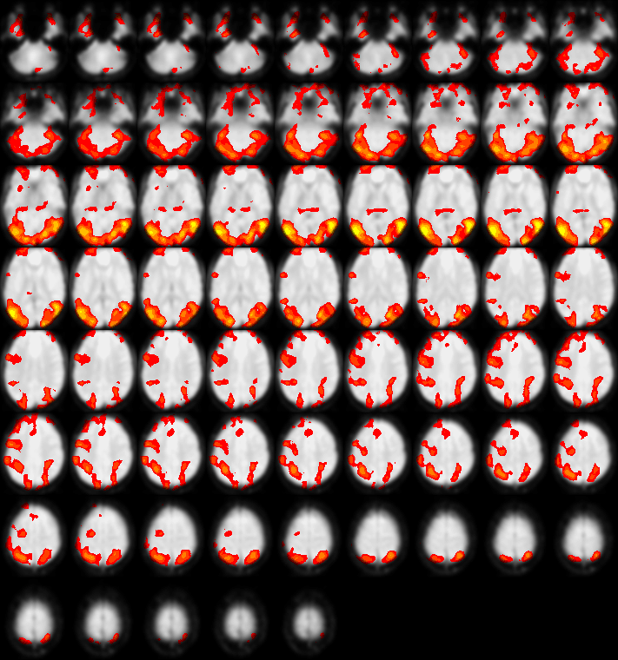
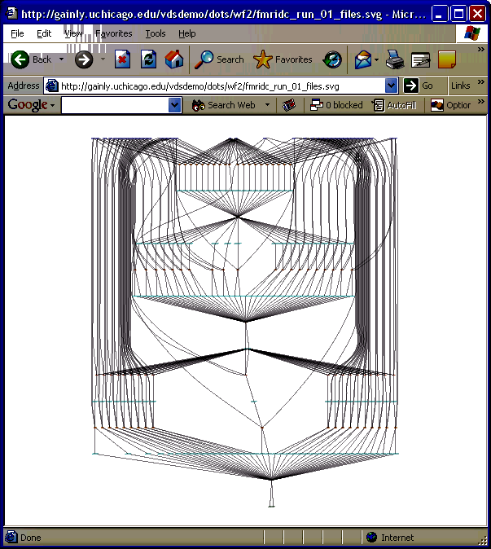

Case Study:
Functional MRI (fMRI) Data Center
Large datasets
  90,000 volumes / study
  100s of studies
Wide range of analyses
  Testing, production runs
  Data mining
  Ensemble, Parameter studies
http://www.fmridc.org
Notes:
Data sharing, publishing, reproducing results, making new discovery

Slide 4
Three Obstacles to Creating a Community Resource
Accessing messy data
  Idiosyncratic layouts & formats
  Data integration a prerequisite to analysis
Implementing complex computations
  Expression, discovery, reuse of analyses
  Hiding the complexity of distributed parallel systems
  Scaling to large data, complex analyses
Making analysis a community process
  Collaboration on both data & programs
  Provenance: tracking, query, application
Notes:
Discover, access, analyze distributed data sources
Share data products and resources

Slide 5
VDS – The Virtual Data System
Introduced Virtual Data Language - VDL
  A location-independent parallel language
Several Planners
  Pegasus: main production planner
  Euryale: experimental “just in time” planner
  GADU/GNARE – user application planner (D. Sulahke, Argonne)
Provenance
  Kickstart – app launcher and tracker
  VDC – virtual data catalog
Notes:
History – Swift has its origins in the Virtual Data System, so we’ll summarize VDS briefly and explain the motivation for a new system.
A uniques aspect of VDL is “location independence” the location of the work was not specified in the workflow itself, but rather determined automatically at run time.

Slide 6
VDL/VDS Limitations
Missing language features
  Data typing & data mapping
  Iterators and control-flow constructs
Run time complexity in VDS
  State explosion for data-parallel applications
  Computation status hard to provide
  Debugging information complex & distributed
Performance
  Still many runtime bottlenecks

Slide 7
The Swift Solution
XDTM
Accessing messy data
  Idiosyncratic layouts & formats
  Data integration a prerequisite to analysis
Implementing complex computations
  Expression, discovery, reuse of analyses
  Hiding complexity of distributed systems
  Scaling to large data, complex analyses
Making analysis a community process
  Collaboration on both data & programs
  Provenance: tracking, query, application
SwiftScript
Karajan
+Falkon
VDC
Notes:
Discover, access, analyze distributed data sources
Share data products and resources

Slide 8
Swift System
Clean separation of logical/physical concerns
  XDTM specification of logical data structures
+ Concise specification of parallel programs
  SwiftScript, with iteration, etc.
+ Efficient execution on distributed resources
  Lightweight threading, dynamic provisioning, Grid interfaces, pipelining, load balancing
+ Rigorous provenance tracking and query
  Virtual data schema & automated recording
→ Improved usability and productivity
  Demonstrated in numerous applications
Notes:
XDTM: XML Data Typing and Mapping
Also note: uses several components of the VDS: APIs and formats for site and transformation description databases; kickstart application and XML provenance record.

Slide 9
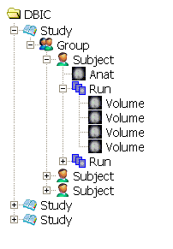







The Messy Data Problem (1)
Scientific data is often
logically structured
  E.g., hierarchical structure
  Common to map functions
  over dataset members
  Nested map operations can scale to millions of objects

Slide 10
The Messy Data Problem (2)
Heterogeneous storage format & access protocols
  Same dataset can be stored in text file, spreadsheet, database, …
  Access via filesystem, DBMS, HTTP, WebDAV, …
Metadata encoded in directory and file names
Hinders program development, composition, execution
./group23
drwxr-xr-x 4 yongzh users 2048 Nov 12 14:15 AA
drwxr-xr-x 4 yongzh users 2048 Nov 11 21:13 CH
drwxr-xr-x 4 yongzh users 2048 Nov 11 16:32 EC
./group23/AA:
drwxr-xr-x 5 yongzh users 2048 Nov 5 12:41 04nov06aa
drwxr-xr-x 4 yongzh users 2048 Dec 6 12:24 11nov06aa
. /group23/AA/04nov06aa:
drwxr-xr-x 2 yongzh users 2048 Nov 5 12:52 ANATOMY
drwxr-xr-x 2 yongzh users 49152 Dec 5 11:40 FUNCTIONAL
. /group23/AA/04nov06aa/ANATOMY:
-rw-r--r-- 1 yongzh users 348 Nov 5 12:29 coplanar.hdr
-rw-r--r-- 1 yongzh users 16777216 Nov 5 12:29 coplanar.img
. /group23/AA/04nov06aa/FUNCTIONAL:
-rw-r--r-- 1 yongzh users 348 Nov 5 12:32 bold1_0001.hdr
-rw-r--r-- 1 yongzh users 409600 Nov 5 12:32 bold1_0001.img
-rw-r--r-- 1 yongzh users 348 Nov 5 12:32 bold1_0002.hdr
-rw-r--r-- 1 yongzh users 409600 Nov 5 12:32 bold1_0002.img
-rw-r--r-- 1 yongzh users 496 Nov 15 20:44 bold1_0002.mat
-rw-r--r-- 1 yongzh users 348 Nov 5 12:32 bold1_0003.hdr
-rw-r--r-- 1 yongzh users 409600 Nov 5 12:32 bold1_0003.img

Slide 11
➔ XML Dataset Typing and
Mapping (XDTM)
Describe logical structure by XML Schema
  Primitive scalar types: int, float, string, date, …
  Complex types (structs and arrays)
Use mapping descriptors for mappings
  How dataset elements are mapped to physical representations
  External parameters (e. g. location)
Use XPath for dataset selection
Provide standard mapper implementations
  String, File System, CSV File, etc.
XDTM: XML Dataset Typing and Mapping for Specifying Datasets [EGC05]

Slide 12
SwiftScript
Typed parallel programming notation
  XDTM as data model and type system
  Typed dataset and procedure definitions
Scripting language
  Implicit data parallelism
  Program composition
  from procedures
  Control constructs
  (foreach, if, while, …)
Clean application logic
Type checking
Dataset selection, iteration
Discovery by types
Type conversion
A Notation & System for Expressing and Executing Cleanly Typed Workflows on Messy Scientific Data [SIGMOD05]

Slide 13
fMRI Type Definitions in SwiftScript
type Study {
Group g[ ];
}
type Group {
Subject s[ ];
}
type Subject {
Volume anat;
Run run[ ];
}
type Run {
Volume v[ ];
}
type Volume {
Image img;
Header hdr;
}
type Image {};
type Header {};
type Warp {};
type Air {};
type AirVec {
Air a[ ];
}
type NormAnat {
Volume anat;
Warp aWarp;
Volume nHires;
}
Simplified version of
fMRI AIRSN Program (Spatial Normalization)

Slide 14
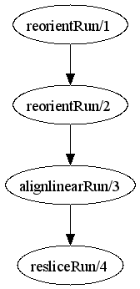
fMRI Example Workflow
(Run resliced) reslice_wf ( Run r)
{
Run yR = reorientRun( r , "y", "n" );
Run roR = reorientRun( yR , "x", "n" );
Volume std = roR.v[1];
AirVector roAirVec =
alignlinearRun(std, roR, 12, 1000, 1000, "81 3 3");
resliced = resliceRun( roR, roAirVec, "-o", "-k");
}
(Run or) reorientRun (Run ir, string direction, string overwrite)
{
foreach Volume iv, i in ir.v {
or.v[i] = reorient (iv, direction, overwrite);
}
}
Collaboration with James Dobson, Dartmouth

Slide 15
AIRSN Program Definition
(Run or) reorientRun (Run ir,
string direction) {
foreach Volume iv, i in ir.v {
or.v[i] = reorient(iv, direction);
}
}
(Run snr) functional ( Run r, NormAnat a,
Air shrink ) {
  Run yroRun = reorientRun( r , "y" );
  Run roRun = reorientRun( yroRun , "x" );
  Volume std = roRun[0];
  Run rndr = random_select( roRun, 0.1 );
  AirVector rndAirVec = align_linearRun( rndr, std, 12, 1000, 1000, "81 3 3" );
  Run reslicedRndr = resliceRun( rndr, rndAirVec, "o", "k" );
  Volume meanRand = softmean( reslicedRndr, "y", "null" );
  Air mnQAAir = alignlinear( a.nHires, meanRand, 6, 1000, 4, "81 3 3" );
  Warp boldNormWarp = combinewarp( shrink, a.aWarp, mnQAAir );
  Run nr = reslice_warp_run( boldNormWarp, roRun );
  Volume meanAll = strictmean( nr, "y", "null" )
  Volume boldMask = binarize( meanAll, "y" );
  snr = gsmoothRun( nr, boldMask, "6 6 6" );
}

Slide 16
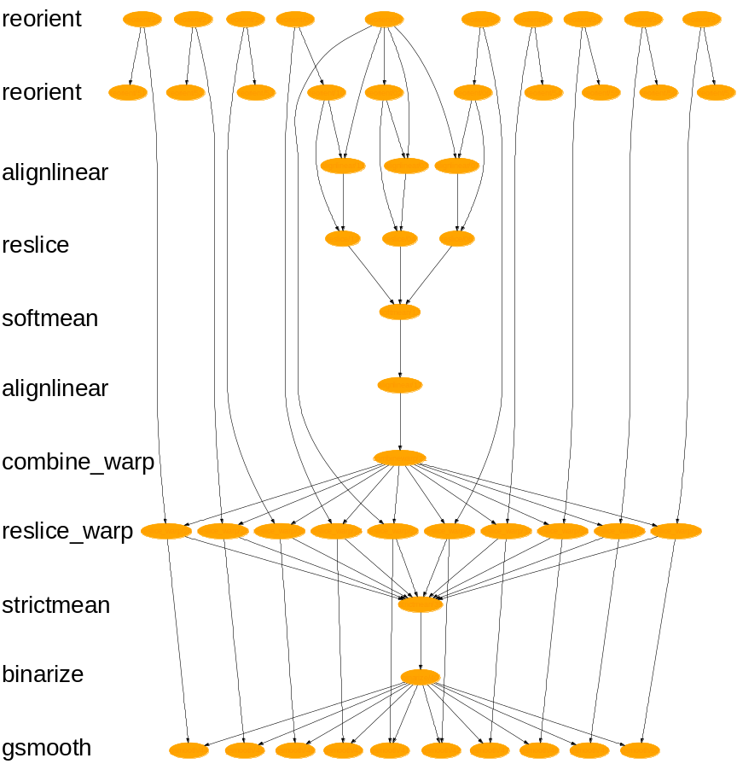
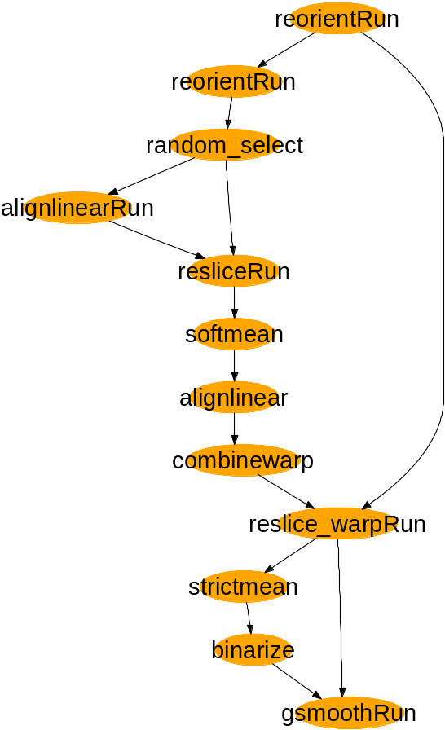
SwiftScript Expressiveness
Lines of code with different workflow encodings
AIRSN workflow:
AIRSN workflow expanded:
fMRI Workflow | Shell Script | VDL | Swift
ATLAS1 | 49 | 72 | 6
ATLAS2 | 97 | 135 | 10
FILM1 | 63 | 134 | 17
FEAT | 84 | 191 | 13
AIRSN | 215 | ~400 | 34
Collaboration with James Dobson, Dartmouth [SIGMOD Record Sep05]

Slide 17

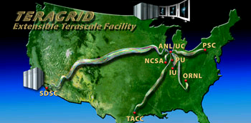

Swift Architecture
Specification
Scheduling
Execution
Provisioning
Abstract
computation
Execution Engine
(Karajan w/
Swift Runtime)
Virtual Node(s)
Falkon
Resource
Provisioner
Virtual Node(s)
file1
SwiftScript
Compiler
Swift runtime
callouts
launcher
C
C
C
App
F1
C
Provenance
data
file2
Virtual Data
Catalog
Status reporting
launcher
App
F2
Amazon
EC2
Provenance
data
file3
SwiftScript
Provenance
collector
Notes:
Note that current version has not yet integrated the VDC from the VDS VDL implementation.
One advantage of this is simplicity for the user. When we integrate it back in, its likely that we’ll make it optional to retain this simplicity, especially for users less interested in provenance storage.
Explain: what is the format of the abstract workflow.

Slide 18
Swift uses
Karajan Workflow Engine
Fast, scalable lightweight threading model
Suitable constructs for control flow
Flexible task dependency model
  “Futures” enable pipelining
Flexible provider model allows for use of different run time environments
  Job execution and data transfer
  Flow controlled to avoid resource overload
Workflow client runs from a Java container
Java CoG Workflow, Gregor von Laszewski, Mihael Hatigan, 2007
Notes:
Fast scalable threading model
quote numbers from Mihael and Yong’s measurements
Flexible model of task dependencies – "tuple space", enables pipelining
The Karajan “futures” model is like Linda Tuple Space – in which synchronization is accomplished by threads that exchange messages in the form of tuples to synchronize.
Flow control to avoid resource overload
Karajan implements throttling on both job submission and data transfer to avoid overrunning target resources (GRAM, GridFTP services)

Slide 19
Swift Runtime System
Runtime system for SwiftScript
  Translate programs into task graphs
  Schedule, monitor, execute task graphs on local clusters and/or distributed Grid resources
  Annotate data products with provenance metadata
Grid scheduling and optimization
  Lightweight execution engine: Karajan
  Falkon: lightweight dispatch, dynamic provisioning
  Grid execution: site selection, data movement
  Caching, pipelining, clustering, load balancing
  Fault tolerance, exception handling
A Virtual Data System for Representing, Querying & Automating Data Derivation [SSDBM02]
Swift: Fast, Reliable, Loosely-Coupled Parallel Computation [SWF07]

Slide 20
Using Swift
site
list
Worker Nodes
Data
app
list
f1
f1
f2
f3
launcher
SwiftScript
App
a1
swift
command
App
a1
App
a2
f2
launcher
Workflow
Status
and logs
App
a2
Provenance
data
f3
Notes:
Note that current version has not yet integrated the VDC from the VDS VDL implementation.
One advantage of this is “separation of layers” is simplicity for the user. When we integrate it back in, its likely that we’ll make it optional to retain this simplicity, especially for users less interested in provenance storage, and for new users that may not have ready access to a DBMS to hold the VDC.
To do: Animate and color this slide

Slide 21
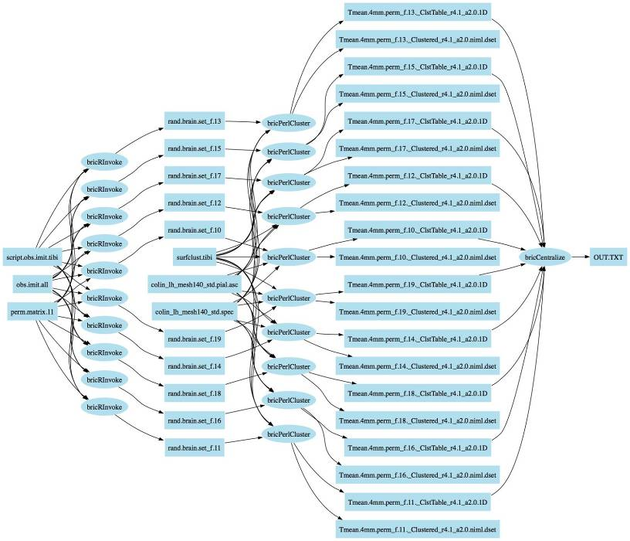
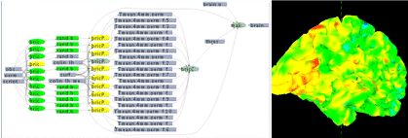
Application example:
ACTIVAL: Neural activation validation
Identifies clusters of neural activity not likely to be active by random chance: switch labels of the conditions for one or more participants; calculate the delta values in each voxel, re-calculate the reliability of delta in each voxel, and evaluate clusters found. If the clusters in data are greater than the majority of the clusters found in the permutations, then the null hypothesis is refuted indicating that clusters of activity found in our experiment are not likely to be found by chance.
Work by S. Small and U. Hasson, UChicago.
Notes:
10-second slide:
DON’T read this – just say it in a few words: “To illustrate Swift I’ll present as an example a workflow which we call “ACTIVAL” that uses statistical analysis (with R) to validate observed activations in a functional MRI study”.
ACTIFIND is our name for this algorithm (its not a formal neuroscience name)

Slide 22
SwiftScript Workflow ACTIVAL – Data types and utilities
type script {} type fullBrainData {}
type brainMeasurements{} type fullBrainSpecs {}
type precomputedPermutations{} type brainDataset {}
type brainClusterTable {}
type brainDatasets{ brainDataset b[]; }
type brainClusters{ brainClusterTable c[]; }
// Procedure to run "R" statistical package
(brainDataset t) bricRInvoke (script permutationScript, int iterationNo,
brainMeasurements dataAll, precomputedPermutations dataPerm) {
app { bricRInvoke @filename(permutationScript) iterationNo
@filename(dataAll) @filename(dataPerm); }
}
// Procedure to run AFNI Clustering tool
(brainClusterTable v, brainDataset t) bricCluster (script clusterScript,
int iterationNo, brainDataset randBrain, fullBrainData brainFile,
fullBrainSpecs specFile) {
app { bricPerlCluster @filename(clusterScript) iterationNo
@filename(randBrain) @filename(brainFile)
@filename(specFile); }
}
// Procedure to merge results based on statistical likelhoods
(brainClusterTable t) bricCentralize ( brainClusterTable bc[]) {
app { bricCentralize @filenames(bc); }
}
Notes:
Replace this sequence with one that uses better typenames

Slide 23
ACTIVAL Workflow – Dataset iteration procedures
// Procedure to iterate over the data collection
(brainClusters randCluster, brainDatasets dsetReturn) brain_cluster
(fullBrainData brainFile, fullBrainSpecs specFile)
{
int sequence[]=[1:2000];
brainMeasurements dataAll<fixed_mapper; file="obs.imit.all">;
precomputedPermutations dataPerm<fixed_mapper; file="perm.matrix.11">;
script randScript<fixed_mapper; file="script.obs.imit.tibi">;
script clusterScript<fixed_mapper; file="surfclust.tibi">;
brainDatasets randBrains<simple_mapper; prefix="rand.brain.set">;
foreach int i in sequence {
randBrains.b[i] = bricRInvoke(randScript,i,dataAll,dataPerm);
brainDataset rBrain = randBrains.b[i] ;
(randCluster.c[i],dsetReturn.b[i]) =
bricCluster(clusterScript,i,rBrain, brainFile,specFile);
}
}
Notes:
Point out that this is the heart of the algorithm – and that the parallelism comes from the foreach.
Show how the datasets flow in the body of the foreach
QUESTION: why do we create the variable “rBrain”? Whats the data structuring concept being used here? (in green, above)

Slide 24
ACTIVAL Workflow – Main Workflow Program
// Declare datasets
fullBrainData brainFile<fixed_mapper; file="colin_lh_mesh140_std.pial.asc">;
fullBrainSpecs specFile<fixed_mapper; file="colin_lh_mesh140_std.spec">;
brainDatasets randBrain<simple_mapper; prefix="rand.brain.set">;
brainClusters randCluster<simple_mapper; prefix="Tmean.4mm.perm",
suffix="_ClstTable_r4.1_a2.0.1D">;
brainDatasets dsetReturn<simple_mapper; prefix="Tmean.4mm.perm",
suffix="_Clustered_r4.1_a2.0.niml.dset">;
brainClusterTable clusterThresholdsTable<fixed_mapper; file="thresholds.table">;
brainDataset brainResult<fixed_mapper; file="brain.final.dset">;
brainDataset origBrain<fixed_mapper; file="brain.permutation.1">;
// Main program – executes the entire workflow
(randCluster, dsetReturn) = brain_cluster(brainFile, specFile);
clusterThresholdsTable = bricCentralize (randCluster.c);
brainResult = makebrain(origBrain,clusterThresholdsTable,brainFile,specFile);
Notes:
Explain the dataset declarations and the two mappers used here.
Simple_mapper
Fixed_mapper
Point out that entire datasets are being passed as arguments.

Slide 25
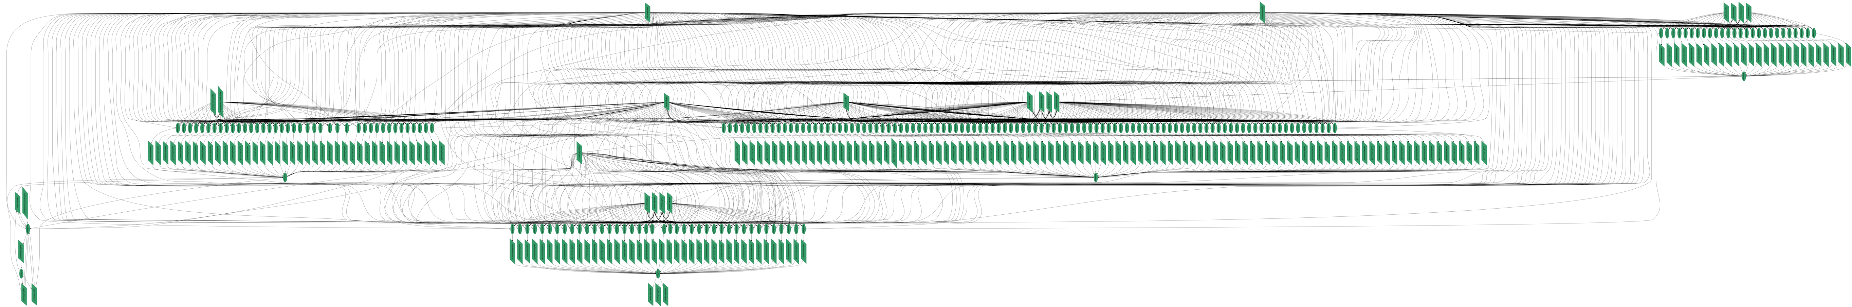
Swift Application:
Economics “moral hazard” problem
~200 job workflow using Octave/Matlab and the CLP LP-SOLVE application.
Work by Tibi Stef-Praun, CI, with Robert Townsend & Gabriel Madiera, UChicago Economics

Slide 26
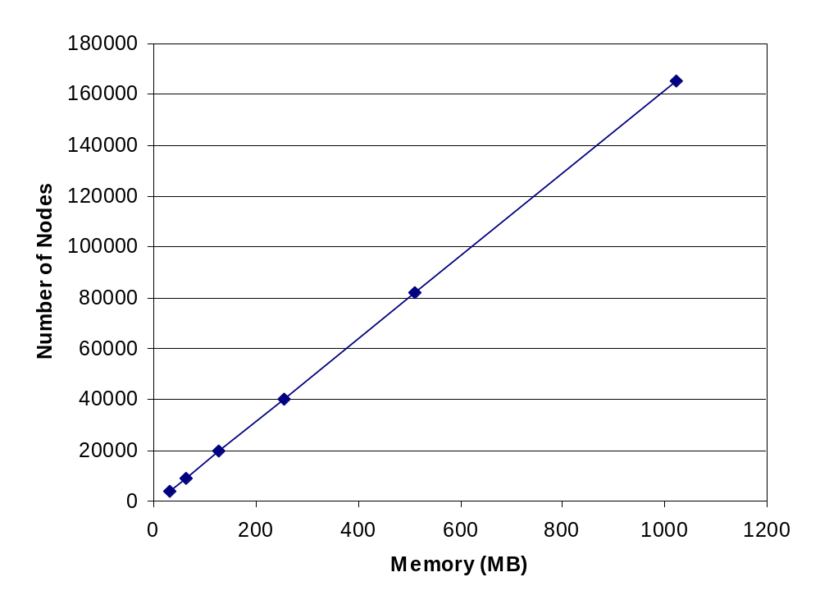
Lightweight Threading - Scalability

Slide 27
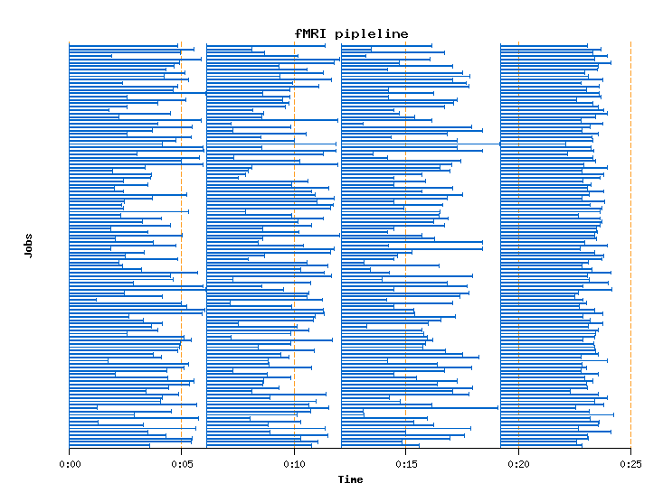
Karajan Futures
Enable Pipelining
(Dispatch is performed here via GRAM+PBS)

Slide 28
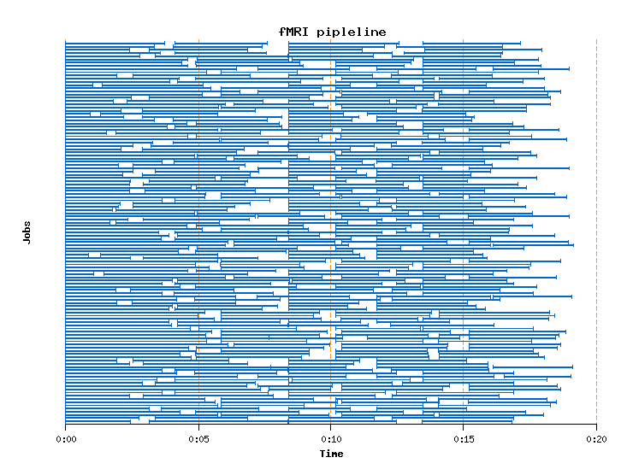
Karajan Futures
Enable Pipelining
(Dispatch is performed here via GRAM+PBS)

Slide 29
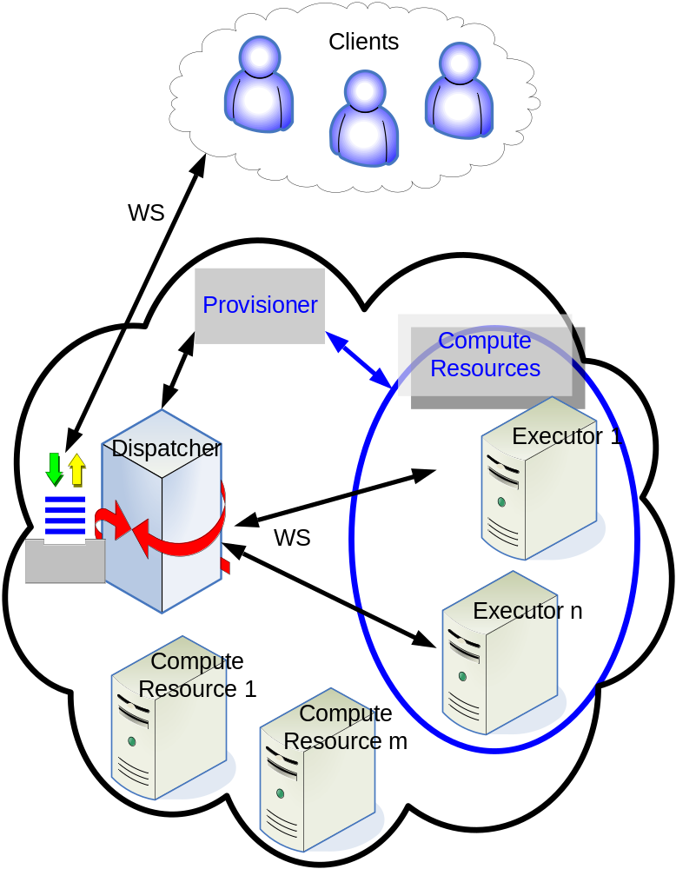
Swift Can Use Falkon
Lightweight Execution Service
Falkon dynamic provisioner:
  Monitors demand (incoming user requests)
  Manages supply: selects resources; creates executors (via Globus GRAM+LRM)
  Various decision strategies for acquisition and release
Falkon executor
  Streamlined task dispatch
  440 tasks/sec max
Dispatch to other executors
also supported—e.g., GRAM
Falkon: Fast and Light-weight Task Execution Framework, Ioan Raicu et al. 2007

Slide 30
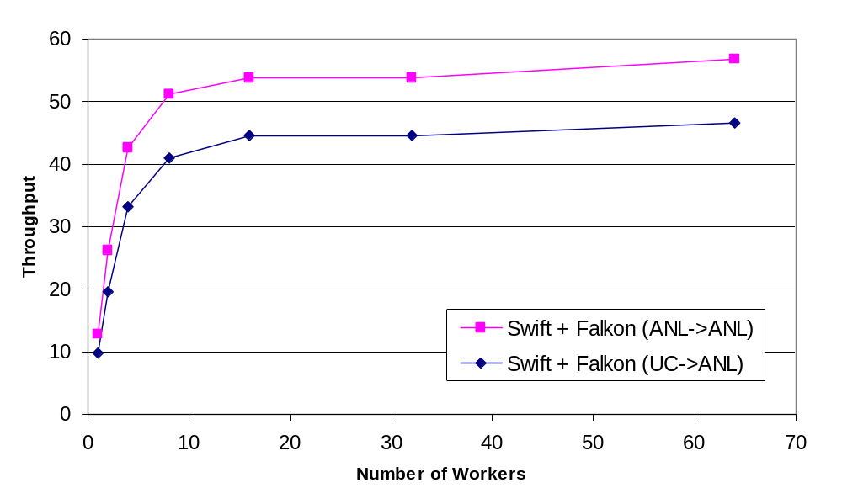
Swift Throughput via Falkon

Slide 31
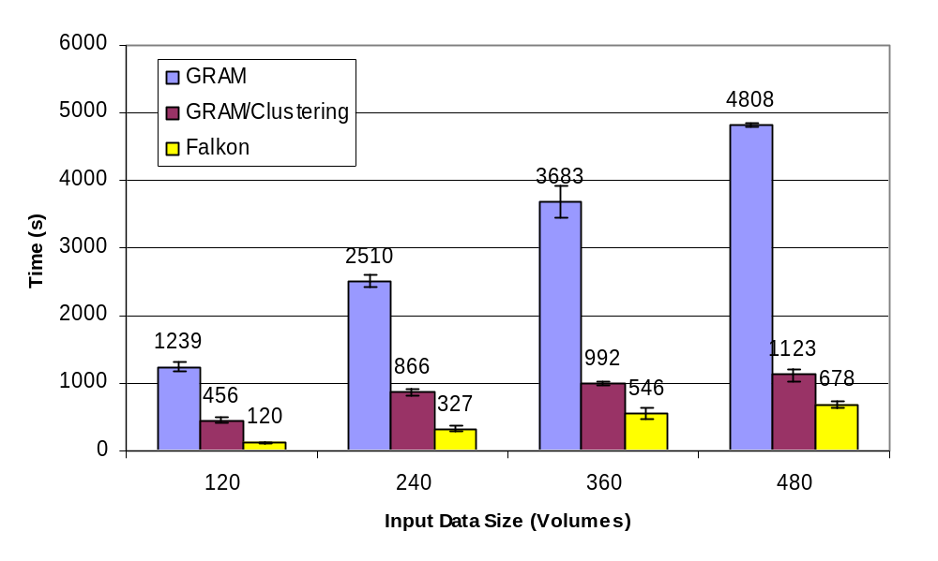
Swift Application Performance: fMRI Task Graph
Notes:
We submitted from the UChicago host to the UC/ANL teragrid site and measured the total execution time. A 120-volume input involves 480 computations for the four stages, whereas the 480-volume input has 1960 computation tasks. The GRAM/PBS submission had low throughput although it could have potentially used all available nodes (62 nodes to be exact as we only used the IA64 compute cluster). We can however bundle small jobs using the clustering mechanism in Swift, and we show the execution time was reduced by more than four times (jobs were bundled into eight groups) with GRAM and clustering, as the overhead is amortized by the bundled jobs. The Falkon execution service (with eight worker nodes) further reduced the execution time.

Slide 32
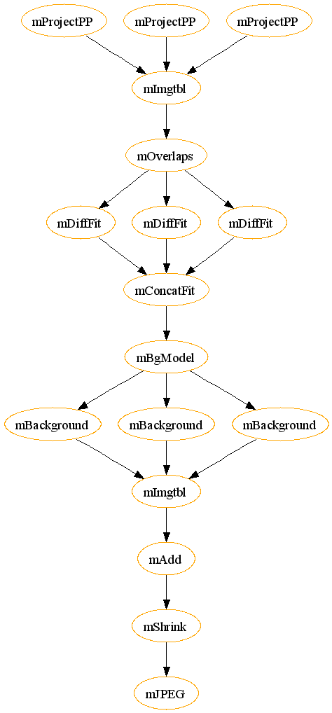
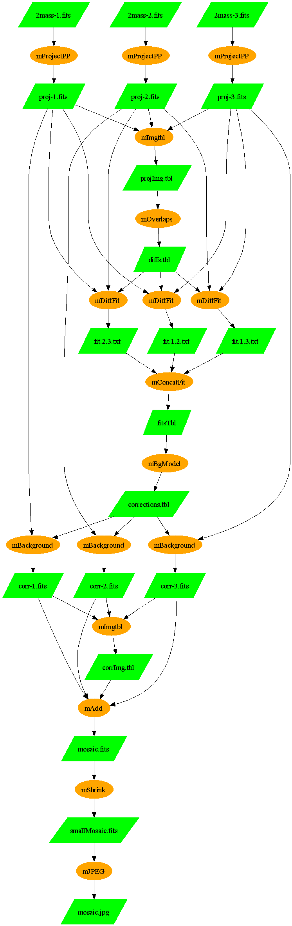

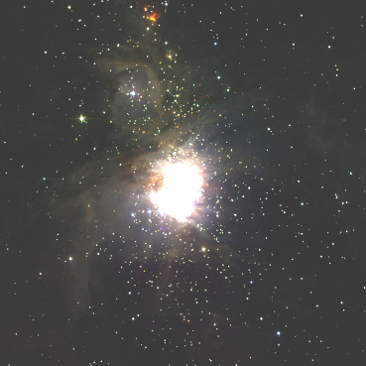
Swift
Application
B. Berriman, J. Good (Caltech)
J. Jacob, D. Katz (JPL)
Notes:
The workflow shows the most basic montage workflow. This one does not show the other mAdd stage (mSubset -> mAdd ->mImgtbl ) -> mAdd

Slide 33
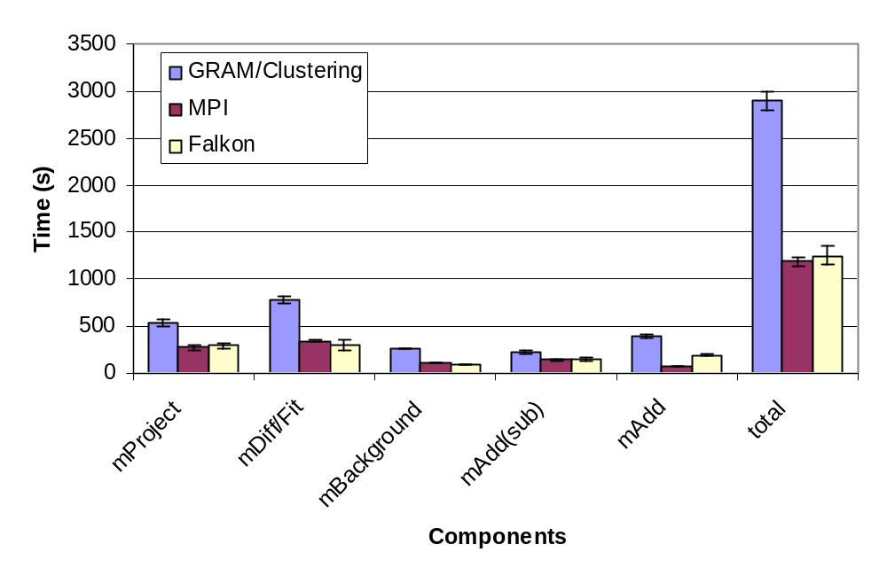
Montage
Notes:
This is a mid-sized montage workflow for M16 3x3 square degrees, with 442 images been co-added.
The GRAM submission was run with clustering enabled (a maximum of 30 jobs bundled, so use close to 16 nodes).
Both MPI and Falkon used 16 nodes.
All resources were requested from PBS.
The workflow involves 13 stages, we show only the parallel stages in the graph, the other stages are all one-task serial execution. GRAM had more overhead for executing such stages, where MPI and Falkon were almost the same.
The last stage mAdd was parallelized in the MPI version, but not for the version for GRAM or Falkon.
We did do stage-in in the workflow, the MPI run did not involve data transfer.

Slide 34
Other Swift Applications
Include …
Application | #Jobs/computation | Levels
ATLAS* HEP Event Simulation | 500K | 1
fMRI AIRSN Image Processing | 100s | 12
FOAM* Ocean/Atmosphere Model | 2000 (250 8-CPU jobs) | 3
GADU* Genomics: (14M seq. analyzed) | 40K | 4
fMRI Aphasia Study | 500 | 4
NVO/NASA Montage | 1000s | 16
QuarkNet/I2U2*⁺ Physics Science Education | 10s | 3-6
RadCAD: Radiology Classifier Training | 1000s | 5
SIDGrid: EEG Wavelet Proc, Gaze Analysis, … | 100s | 20
SDSS* Coadd, Cluster Search | 40K, 500K | 2, 8
* Using predecessor Virtual Data System (VDS)
+ Collaborative science learning & education: 18 experiments,
51 universities/labs, 500+ schools, 100,000 students

Slide 35
Future Work
XDTM
  Support for services as well as applications
  Greater abstraction in mappers; databases
SwiftScript
  Exceptions
  Event-driven dispatch & execution
Falkon
  Scale to more resources; data caching
  Support for service workloads
VDC
  Integration into Swift; collaboration support
  Experiments at scale

Slide 36
Acknowledgements
Swift effort is supported by NSF (I2U2, iVDGL), NIH, UChicago/Argonne Computation Institute
Swift team
  Ben Clifford, Ian Foster, Mihael Hategan, Veronika Nefedova, Ioan Raicu, Mike Wilde, Yong Zhao
Java CoG Kit
  Mihael Hategan, Gregor Von Laszewski, and many collaborators
User contributed workflows and application use
  I2U2, ASCI Flash, U.Chicago Molecular Dynamics,
  U.Chicago Radiology, Human Neuroscience Lab

Slide 37
Swift: Summary
Clean separation of logical/physical concerns
  XDTM specification of logical data structures
+ Concise specification of parallel programs
  SwiftScript, with iteration, etc.
+ Efficient execution (on distributed resources)
  Karajan+Falkon: Grid interface, lightweight dispatch, pipelining, clustering, provisioning
+ Rigorous provenance tracking and query
  Virtual data schema & automated recording
→ Improved usability and productivity
  Demonstrated in numerous applications
http://www.ci.uchicago.edu/swift

Slide 38
Thank You!
Questions???

