Slide 1

Security Risks in the Grid
Elisa Heymann
Computer Architecture and Operating Systems Department
Universitat Autònoma de Barcelona
elisa@cs.wisc.edu
Barton P. Miller
James A. Kupsch
Computer Sciences Department
University of Wisconsin
bart@cs.wisc.edu
UW-Madison
July 22, 2010
1
Notes:
Vulnerability Assessment and Secure Coding Practices
1

Slide 2


Who we are
Bart Miller
Jim Kupsch
Rohit Koul
Wenbin Fang
Elisa Heymann
Eduardo Cesar
Jairo Serrano
Guifré Ruiz

Slide 3
What should you expect
Users
Understand the risks
Prevention
Administrators
Understand SW configuration
Manage processes, resources, privileges
Developers
Secure programming techniques

Slide 4
What do we do
Make grid software more secure
Make a good assessment more automated
Teach tutorials:
Security risks
Vulnerability assessment
Secure programming

Slide 5
Roadmap
Introduction: Some fun?
Talk the talk
What the bad guys can do to you
What can you do?

Slide 6

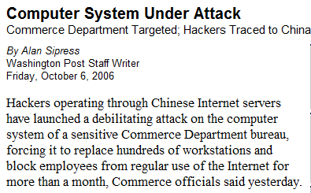
Why do we do it

Slide 7
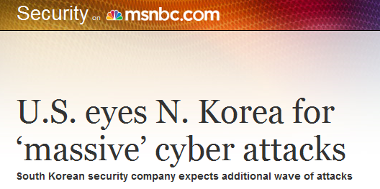
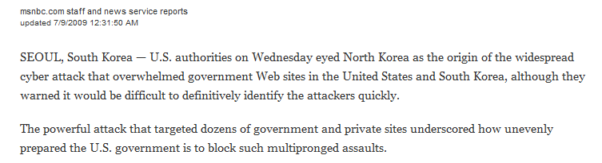
Why do we do it

Slide 8

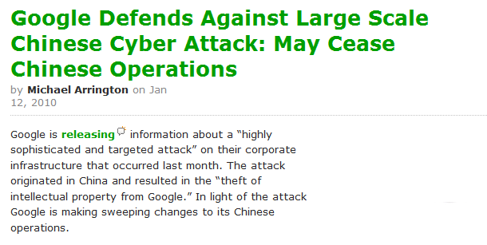
Why do we do it

Slide 9
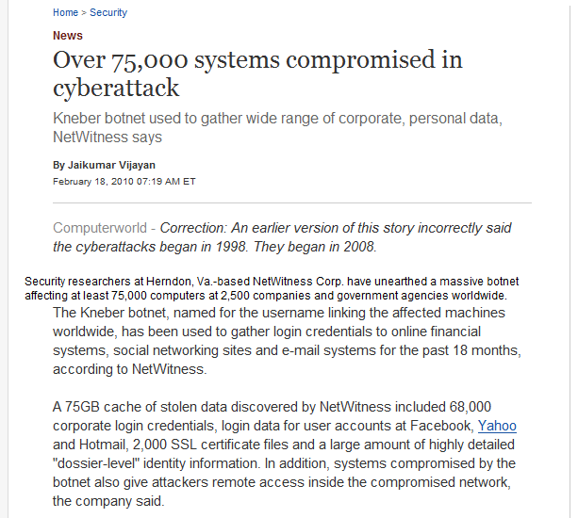

Why do we do it

Slide 10
Why do we do it
Machines belonging to a grid site are accessible from the Internet
Those machines are continuously probed:
Attackers trying to brute-force passwords
Attackers trying to break Web applications
Attackers trying to break into servers and obtain administrator rights

Slide 11
Why do we do it
SW has vulnerabilities
Grid SW is complex and large
Vulnerabilities can be exploited by legal users or by others

Slide 12
Why do we do it
Attacker chooses the time, place, method, …
Defender needs to protect against all possible attacks (currently known, and those yet to be discovered)

Slide 13
Security
Security is a permanent process
Security cannot be proven
Security is difficult to achieve and expensive, and only to 100%-ε
Security involves:
Managers
Developers
Admins
Users
Notes:
A system is secure if its resources are used and accessed as intended under all circumstances.

Slide 14
Admin Perspective
Just to get a feeling …
Condor configured to track processes
When the job exits no processes are left behind
SLOT1_USER = condor_user1
SLOT2_USER = condor_user2
STARTER_ALLOW_RUNAS_OWNER = False
DEDICATED_EXECUTE_ACCOUNT_REGEXP =
condor_user1 || condor_user2
Notes:
STARTER_ALLOW_RUNAS_OWNER. True the job will run under the jobs owner’s account. False will run as SLOTN_USER or nobody.

Slide 15
Admin Perspective
Just to get a feeling …
Depending on how Condor is installed, daemons run as root or as a non-roor user

Slide 16
Admin Perspective. Root Install
Real UIDs
Central Manager
root
4. Negotiation
Cycle
negotiator
collector
condor
user
1. Machine ClassAd
4.Negotiation
Cycle
5. Report Match
5. Report
Match
Execute Host
Submit Host
startd
3. Job ClassAd
7. fork
Starter
User
startd
schedd
6. Claim Host
1. Job Description File
schedd
starter
2. Job ClassAd
7. Fork
Shadow
8. Establish Communication Path
9. Set policy and fork User Job
submit
shadow
User Job

Slide 17
Admin Perspective. Non-Root Install
Real UIDs
Central Manager
root
4. Negotiation
Cycle
negotiator
collector
condor
user
1. Machine ClassAd
4.Negotiation
Cycle
5. Report Match
5. Report
Match
Execute Host
Submit Host
startd
3. Job ClassAd
7. fork
Starter
User
startd
schedd
6. Claim Host
1. Job Description File
schedd
starter
2. Job ClassAd
7. Fork
Shadow
8. Establish Communication Path
9. Set policy and fork User Job
submit
shadow
User Job

Slide 18
Developer Perspective
Just to get a feeling … An example
Find as many potential vulnerabilities as you can (there may be more than one)
Assume:
pointer arguments are never NULL
strings are always NULL terminated

Slide 19
/* Safely Exec program: drop privileges to user uid and group
* gid, and use chroot to restrict file system access to jail
* directory. Also, don't allow program to run as a
* privileged user or group */
void ExecUid(int uid, int gid, char *jailDir,
char *prog, char *const argv[])
{
if (uid == 0 || gid == 0) {
FailExit("ExecUid: root uid or gid not allowed");
}
chroot(jailDir); /* restrict access to this dir */
setuid(uid); /* drop privs */
setgid(gid);
fprintf(LOGFILE, "Execvp of %s as uid=%d gid=%d\n",
prog, uid, gid);
fflush(LOGFILE);
execvp(prog, argv);
}

Slide 20
Security in a Nutshell Basic Concepts
Authentication
Cryptography
Certificates
Authorization Delegation

Slide 21
Authentication
Ability to identify each user of the system
Ability to identify the processes running
Prove identity using
What you have (key, card)
What you know (password)
What you are (fingerprint, retina pattern)
Notes:
Password vulnerabilities: easy to guess, accidentally exposed, sniffed, illegally transferred from an authorized used to an unauthorized one.
What you have: possession
What you are: attribute

Slide 22
Cryptography
Limits the potential senders and receivers of a message
Based on secrets (keys)
Used for authentication
Enables the receiver to verify that the message was created by some specific sender
Digital signature
Allows to check if the message was modified (integrity)
Public key, Private key (sender private key and receiver sender’s public key)
Notes:
Authentication is used to verify the claimed identity of a user, client, server, …
Digital signature: prevents repudiation.

Slide 23
Cryptography
Encryption
Enables the sender to ensure that only a specific receiver can read the message (confidentiality)
Symmetric encryption (secret shared key)
Asymmetric encryption
Public key, Private key (using the receiver’s public key)

Slide 24
Certificates
Obtained and signed from a Certification Authority
Used to verify the validity of a public key
Comparable to capabilities
List the access rights of the holder over resources
Identity, attribute, value
Should be protected by a digital signature
Hierarchical trust model
Certificate Revocation List
Restricted lifetime of certificates
Notes:
Capabilities: the resources that can be accessed by a subject.
When a client checks a certificate, it will check the CRL to see if the certificate has been revoked or not. Trade-off: time between publishing CRL cannot be too long, and overhead for getting a CRL from the certification authority.

Slide 25
Delegation
Passing identity and access rights from one process to another
Implemented through a proxy
Token associated to privileges and restrictions
Chain of delegations
Notes:
Token that allows the owner to operate with the same privileges and restrictions as the subject that granted the token

Slide 26

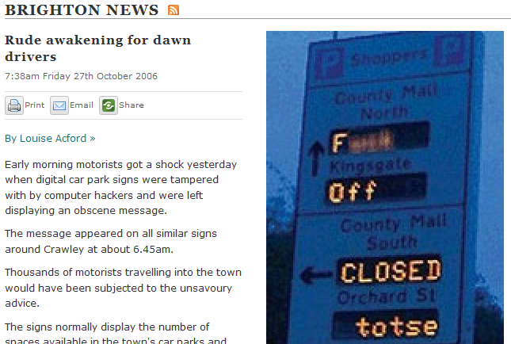
User Perspective What the bad guys can do
Attacks from inside

Slide 27
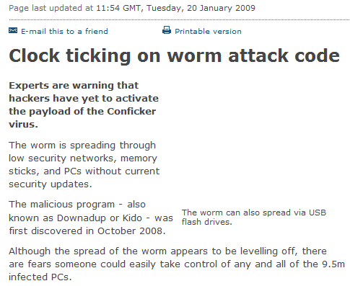
User Perspective What the bad guys can do
Attacks from outside

Slide 28
User Perspective What the bad guys can do
Gain root access
Privilege escalation
Gain other user access (admin, condor)
Hijack machines
Attack the process running there

Slide 29
User Perspective What the bad guys can do
Injections
Command
SQL
Directory traversal
Log
Denial of Service (DoS)

Slide 30

User Perspective What the bad guys can do
Hijack machines
Process escapes Condor control: keep forking and exiting to escape detection.
?
Evil Job PID n
Evil Job PID 3
Evil Job PID 2
Evil Job PID 1
. . .
fork
fork
fork
30

Slide 31
User Perspective What the bad guys can do
Hijack machines
startd
Condor Execute Host
startd
Condor Execute Host
starter
starter
IDLE MACHINE
switchboard
switchboard
switchboard
user job
procd
user job
procd
user job
user job
user job
user job
31

Slide 32
User Perspective What the bad guys can do
Hijack machines
startd
Condor Execute Host
starter
switchboard
switchboard
user job
new
user job
procd
ATTACK
32

Slide 33
User Perspective What the bad guys can do
Hijack machines (con’d):
Condor believes the job is gone
The remaining process can do anything to new user jobs running on that machine
This is the same problem that the Condor team fixed years ago
33

Slide 34
User Perspective What the bad guys can do
Denial of Service
An attacker can prevent updates in the Condor-Quill database
condor_qedit 1.0 `perl –e ‘print “x”x2001’` foo
34
Notes:
Atributtes are assumed to be 2000 characters long or less. Condor doesn’t check that limit.
Quill gets an error submitting the query to the database, then stops reading the log file and updating the database.
Condor_qedit: modifies job attributes in the Condor job queue.

Slide 35
User Perspective What the bad guys can do
GRATIA: The OSG Accounting System
Maintains a Grid-wide view of resource utilization.
Job Submission (Priority in the batch queue, CPU time, Memory usage)
Storage (Disk usage, Tape storage)
Accounting Information easily available to people (web interface) and to applications (Web Services)
35

Slide 36
User Perspective What the bad guys can do
Background
Gratia Condor Probe deletes debug files in /tmp, does some computation and then re-creates the debug files in /tmp.
Gratia Condor Probe has weak validation mechanism (does not validate the job parameters properly)
Symbolic links and Open
If files are created using O_CREAT without O_EXCL flag and the final component of the file path is a symbolic link, the file is created where the symbolic link points.
36

Slide 37
User Perspective What the bad guys can do
Background
Gratia Condor Probe deletes debug files in /tmp, does some computation and then re-creates the debug files in /tmp.
Symbolic links and Open
If files are created using O_CREAT without O_EXCL flag and the final component of the file path is a symbolic link, the file is created where the symbolic link points.
What happens if we create a symbolic link to the pathname after the operation that deletes the files, but before the one that opens and creates them. Can we win this race?
37

Slide 38
User Perspective What the bad guys can do
Can we exploit the weakness in validation mechanism to make it write something “meaningful” to a “useful” system file?
Background
Gratia Condor Probe has weak validation mechanism (does not validate the job parameters properly)
Symbolic links and Open
If files are created using O_CREAT without O_EXCL flag and the final component of the file path is a symbolic link, the file is created where the symbolic link points.
38

Slide 39
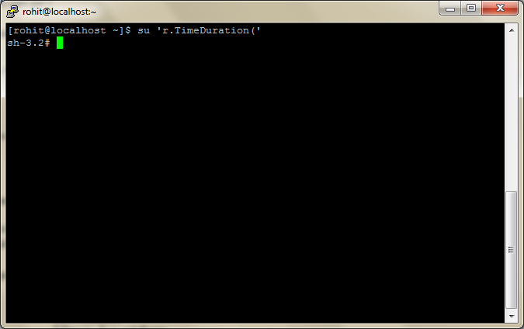
Gratia-Probe-2010-002

Slide 40
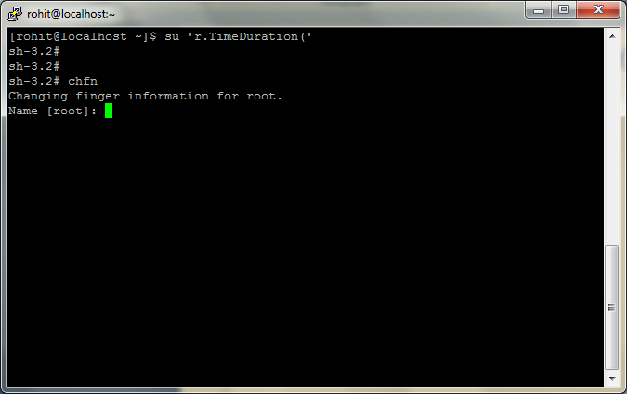
Gratia-Probe-2010-002

Slide 41
What can you do?
Users
Choose good passwords
Take care of your certificates
Never share identities
Report strange behavior
Sys Admins
Minimal privileges
Configuration settings
Check log files
Upgrades
41
Notes:
Users: standard things

Slide 42
What can you do?
Developers
Learn secure programming
Managers
Prioritize security, invest in it, and have assessment and response strategies
42
Notes:
Users: standard things

Slide 43
Security Risks in the Grid
Elisa Heymann
Computer Architecture and Operating Systems Department
Universitat Autònoma de Barcelona
elisa@cs.wisc.edu
Barton P. Miller
James A. Kupsch
Computer Sciences Department
University of Wisconsin
bart@cs.wisc.edu
UW-Madison
July 22, 2010
This research funded in part by Department of Homeland Security grant FA8750-10-2-0030 (funded through AFRL). Past funding has been provided by NATO grant CLG 983049, National Science Foundation grant OCI-0844219, the National Science Foundation under contract with San Diego Supercomputing Center, and National Science Foundation grants CNS-0627501 and CNS-0716460.
43
Notes:
Vulnerability Assessment and Secure Coding Practices
43

Slide 44






Studied Systems
Condor, University of Wisconsin Batch queuing workload management system
SRB, SDSC Storage Resource Broker - data grid
MyProxy, NCSA Credential Management System
glExec, Nikhef Identity mapping service
CrossBroker, Universitat Autònoma de Barcelona Resource Manager for Parallel and Interactive Applications
Gratia Condor Probe, NCSA Feeds Condor Usage into Gratia Accounting System
Condor Quill, University of Wisconsin

Slide 45


Studied Systems
Wireshark (in progress)
Network Protocol Analyzer
Condor Privilege Separation, University of Wisconsin (in progress) Restricted Identity Switching Module
VOMS Admin, Instituto Nazionale di Fisica Nucleare (in progress) Virtual Organization Management Service

