Slide 1
GlideinWMS Training @ IU
Site Debugging
by Jeff Dost (UCSD)

Slide 2
Types of Issues we debug
Validation Errors
Held Glideins
RunDiff
Authentication issues
Glideins not starting
Black Hole WNs
Communication Errors
Internal errors

Slide 3
Validation Errors
Detected with analyze_entries daily email report
Percent validation errors are listed per site over last 24 hours
frontend_UCSDCMS_cmspilot:
strt fval 0job | val idle wst badp | waste time total
CMS_T3_MX_Cinvestav_proton_work 40% 7% 78% | 8% 17% 25% 94% | 77 306 | 155
CMS_T2_US_Nebraska_Red_gw1 35% 1% 89% | 2% 5% 7% 90% | 70 923 | 214
CMS_T2_US_Nebraska_Red_gw2 50% 3% 93% | 4% 7% 10% 86% | 60 557 | 210
CMS_T2_US_Nebraska_Red 34% 0% 80% | 1% 4% 5% 49% | 45 902 | 146

Slide 4
Validation Errors
Validation error message can typically be found in glidein stderr / stdout logs
Worker node hostname is listed in stdout log

Slide 5
Handling Validation Errors
Most of the time a validation error identifies a problem with the expected environment setup on the workernode
If this is the case we open a GOC or Savannah ticket
  CMS prefers we open Savannah tickets whenever possible if it was a CMS glidein
Typically validation errors are due to simple misconfiguration. Admins quickly fix the issue once notified.

Slide 6
Held Glideins
Debugging held glideins is generally more difficult
Hard to determine if a glidein is held due to a local problem or a problem at the remote side at the site
GRAM hold reasons are well defined but CREAM hold reasons are difficult to interpret

Slide 7
Factory Held Glidein Removal Policy
Glideins held with particular GRAM hold reasons are known to never be recoverable
  It is safe to remove these
The factory constantly checks for these GRAM errors and just removes the stuck glideins if possible.
The factory doesn't touch held glideins it doesn't know what to do with
  We have to check these manually and act if needed
*note there's no CREAM equivalent

Slide 8
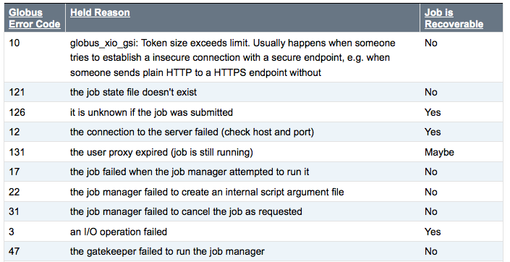
Globus Hold Reasons

Slide 9
RunDiff
Phenomenon where factory loses track of running glidiens
Can be seen in web monitoring
  Factory reports total number of glideins submitted that are still running at a site and haven't terminated
  Frontend reports how many of the running glideins are registered (known at the user collector)
  RunDiff = # Running - # Registered

Slide 10
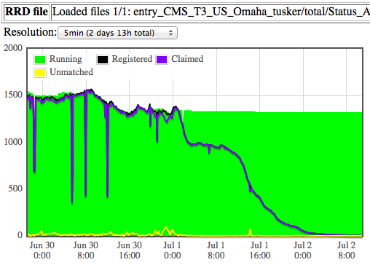
RunDiff
RunDiff is one of the hardest issues to debug because it requires digging to determine the real picture

Slide 11
RunDiff Causes
If site has Condor jobmanager and has a policy that calls condor_hold
  Gridmanager loses track because there is no GRAM state to represent “held” jobs
  Even on release the glideins really go idle and eventually start up again, but the gridmanager never gets the message
  From the factory point of view these jobs “run” indefinitely and never recover
  Temporary solution – set periodic hold removal in glidein submit files for condor sites

Slide 12
RunDiff Causes
Site comes back up out of downtime
Factory thinks there are still glideins running on the queue from before the downtime and is unaware that the admins cleared them out
If this looks obvious we just remove them
It is not always easy to remove them because it is not always clear from factory which glideins are “RunDiff” glideins and which are registered

Slide 13
RunDiff Causes
Network issues between glidein and user collector
Typically one can see packet loss errors in glidein StartdLogs
A common cause for this was if sites block UDP packets at firewall level
We now have factories running 100% TCP connections so this is less common in practice
  Still see on occasion if sites have other advanced firewall or packet filtering policies in place

Slide 14
Authentication Issues
Two common issues:
  Glidein proxy denied at site; Goes held with:
    Globus error 7: an authorization operation failed
    Site may have changed VO policy
    Pilot proxy lifetime may have expired
  Factory not correctly whitelisting new frontend
    Typically just human error on Frontend or Factory config during registration process

Slide 15
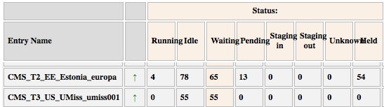
Glideins not starting
First it helps to define two different types of idle:
  Waiting – idle on the factory machine; hasn't made it to remote side yet
  Pending – made it to remote side but is idle in the site job manager
  The sum is the total number idle as reported in our monitoring:

Slide 16
Glideins not starting
Stuck Pending for a long time
  Typically means a site issue, we open a ticket in this case
Stuck Waiting for a long time
  Glidein never made it to the site and is likely a local problem on the factory node
  Can simply happen if site is down for maintenance
  May mean site is permanently decommissioned
  Sometimes gridmanagers just get stuck. In this case we remove old glideins and restart them

Slide 17
Black Hole WNs
glidein stderr / stdout logs are empty
It is likely a black hole if the glidein terminates minutes or even seconds after it started
  Glideins try to run for at least 20 minutes even on failure
We typically open a ticket to notify site and give relevant lines in condor logs
Unfortunately no information can tell us which WN it occurs on since logs are empty

Slide 18
Communication Errors
Between Factory and Frontend
  Most common is authentication errors described earlier
  Likely see errors in Factory CollectorLog
Between glidein and User Pool
  As discussed in RunDiff topic, likely to see errors in glidein StartdLog

Slide 19
Internal Errors
Neither Condor nor GlideinWMS are perfect; we discover bugs from time to time
We have working relationships with both Condor and GlideinWMS developers
As soon as we can verify we have found a bug we contact the relevant support team
Bug fixes are usually pushed within a few version updates
  If not and fix is urgent, developers supply us with temporary patches

