Slide 1
OSG Status & Accomplishments
Kent Blackburn
California Institute of Technology
Open Science Grid Joint Oversight Team Meeting
February 20th 2007

Slide 2
Outline
OSG Funding
Status of the OSG project & organization.
Status from the Resources Managers (of which I am one).
Milestones to date.
Usage of the infrastructure.
More specifics on usage, plans, technologies etc. in later talks.

Slide 3
OSG Funding
OSG is funded by 6 program offices - DOE ASCR, DOE HEP, DOE NP, NSF MPS, NSF OCI, NSF OISE.
Broadly speaking the funding supports (Ruth will cover the details):
  OCI : Engagement of new communities
  ASCR: CS aspects of Software (VDT, Security, Storage), Troubleshooting and Integration, Training and outreach.
  NP: Security and Integration
  OISE: Outreach, Interoperability - with Scandinavia.
  HEP/MPS: Operations, Software (VDT), Extensions, Security, Integration, Administration and Communications.

Slide 4
OSG Project Organization
Major focus of first six months of funded project on transitioning from an “ad-hoc” collaboration to a managed project.
  Better understood roles and responsibilities in the management chart
  Filled in missing roles e.g. User Support Coordinators; Identified other holes e.g. Site Coordinator.
  Agreement on Year 1 Project Plan, WBS, Change control process.
  Adjusted effort and funding profile based on need - e.g. ISI for LIGO deliverables.
  Wrote Statements of Work (SOWs) for 16 institutions

Slide 5
Statements of Work
Major accomplishment to get details of commitments and deliverables agreed to and “tied” to the WBS.
Process through the signatories much slower than we would have guessed.
Major changes by Institution SROs slows things down at the end:
  Caltech
  Reaction to “open source software” statement.
  Staff turnover.

Slide 6
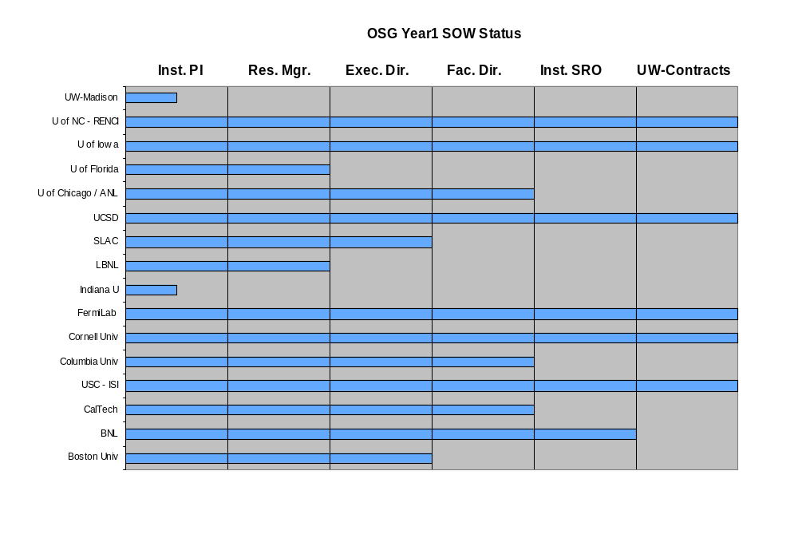
Status of
Statements Of Work
Progress on the Signature Trail

Slide 7
Resources Managers
“Resources Manager and Finance Board –manages all matters related to the costs and resources of the OSG program of work.”
Advises the Executive Director
Handles all change requests.
Responsibilities cover Consortium and External Project contributions also.
Responsibilities include agreements and OSG (VO) allocations.
Responsibilities helped by 1 FTE project staff- Project Associate.

Slide 8
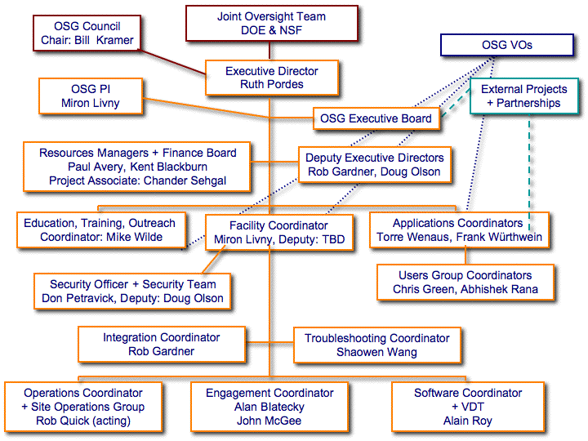
ORGANIZATION CHART

Slide 9
Finance Board
“The Finance Board evaluates contributions, including contributions pledged from the stakeholder organizations, for the relations with the funding agencies, for contract policies, and for all administrative matters. The Resources Manager is chair of the Finance Board.”
All important decisions are reported to the Executive Board and the OSG Council.
Requests for a change in the financial allocations can be made to the Finance Board by the Executive Board, stakeholder organizations, or project resource managers…, a Resource Change Proposal is submitted to the Executive Board for approval. Once agreed to by the Executive Board it is confirmed by the Council.
Initial change requests are for funding for EOT presentation at Taiwan Grid Conference (agreed to) and for $5K hardware for EOT training (in discussion).

Slide 10
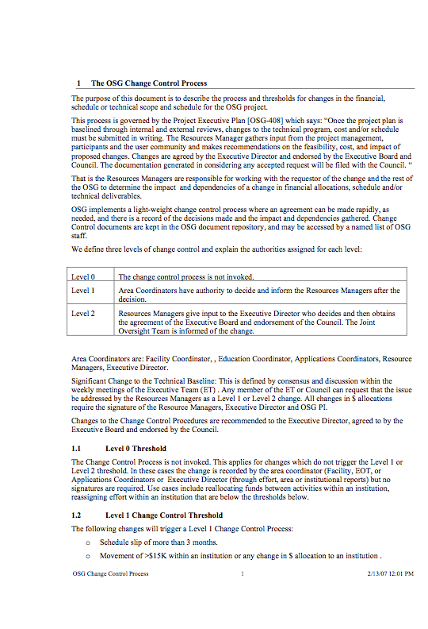
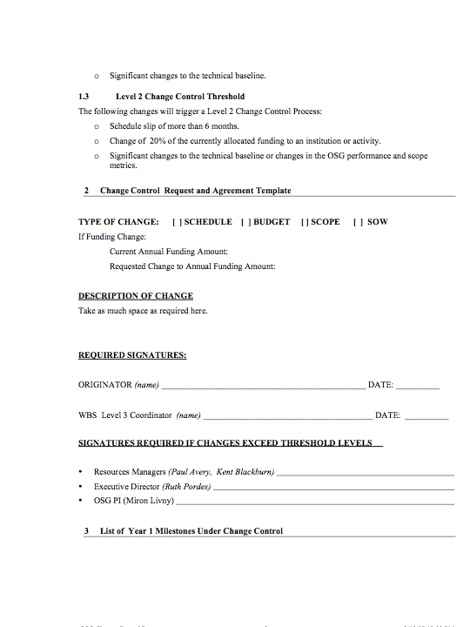
Change Control Process

Slide 11
Finance Board, Finances
First Finance Board meeting Dec 14th Caltech; Minutes are open
Agreed on ~Quarterly meetings + as-needed. Next meeting in April + some time at the all hands meeting.
Acknowledge very useful guidance and input from Jim Yeck to work of the Resources Managers and Finance Board.
Tracking expenditures quarterly.

Slide 12
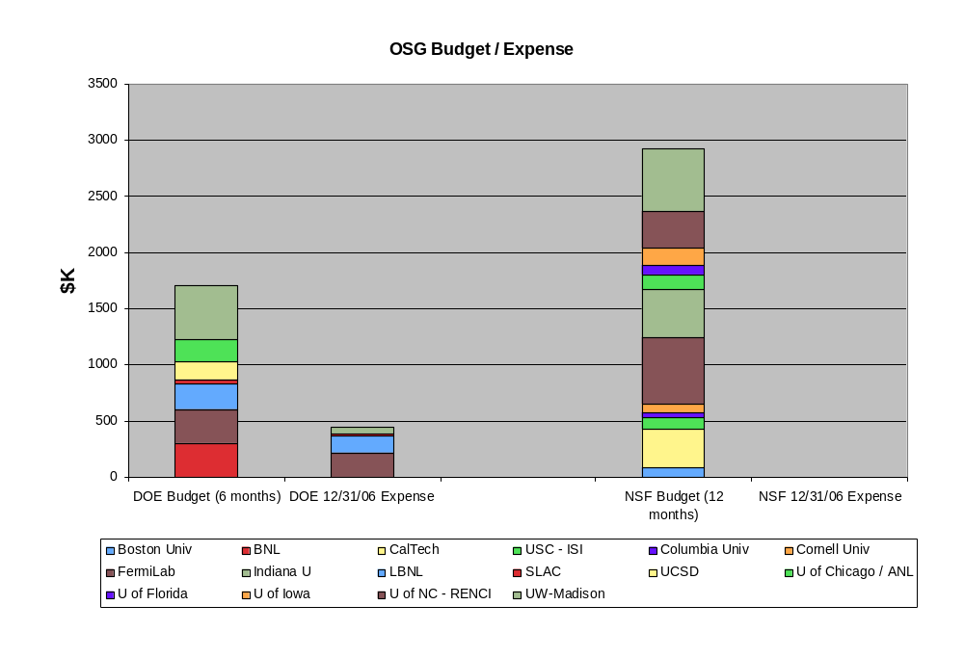
EXPENSES AS OF 12/31/06

Slide 13
Reporting Effort & Accomplishments
SOWs include agreement to monthly individual effort reports and quarterly Institutional PI reports (as well as area coordinators).
Reports posted.
Effort being tracked.
Six month project report submitted to Agencies.
Action item to rationalize reporting into useful and ongoing structure.

Slide 14
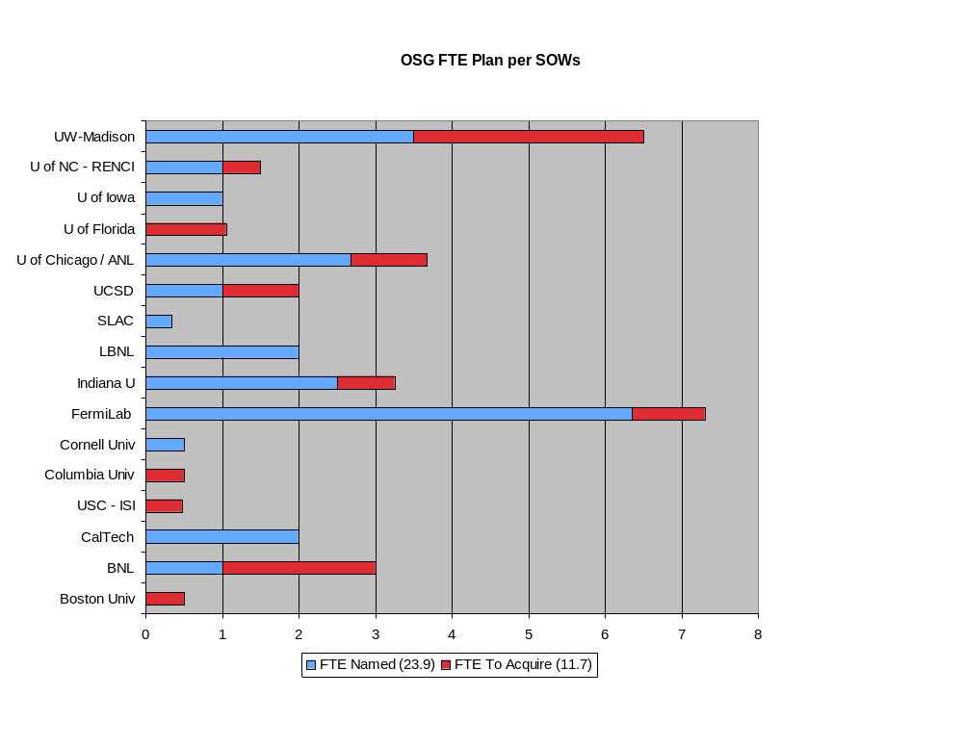
Status of FTE Availability
*
* Caltech will be replacing its existing two staff (not shown in count above)

Slide 15
Status of High Level Milestones to Date
- From the Project Plan & WBS
Milestones exist and are worked to.
Reasons for missing them get discussed and feedback into re-planning.
More detail in Ruth’s talk.
WBS
Name
Date
1.1.1.2
Define Operational Metrics for Year 1
1/1/07
Draft under review
1.1.3.1.1
√
Release Security Plan
1/1/07
1.1.5.2.3
Release OSG 0.6.0
2/27/07
Provisioning and final testing in progress

Slide 16
Overall Status of the OSG Infrastructure
Sustained use of the infrastructure continues with the throughput in number of jobs, data, and CPU^{x}hours/day increasing (with hiatus over new year).
We are working on improving validation tests to ensure VOs are indeed supported at sites that advertise such support.
In general the production infrastructure Runs Stably

Slide 17
VIRTUAL ORGANIZATIONS (2/1/07)
Collider Detector at Fermilab (CDF)
Compact Muon Solenoid (CMS)
CompBioGrid (CompBioGrid)
D0 Experiment at Fermilab (DZero)
Dark Energy Survey (DES)
Distributed Organization for Scientific and Academic Research (DOSAR)
Engagement (Engage)
Fermi National Accelerator Center (Fermilab)
Functional Magnetic Resonance Imaging (fMRI)
Geant4 Software Toolkit (geant4)
Genome Analysis and Database Update (GADU)
Georgetown University Grid (GUGrid)
Great Plains Network (GPN)
Grid Exerciser (GEx) (GridEx)
Grid Laboratory of Wisconsin (GLOW)
Grid Research and Education Group at Iowa (GROW)
Group Researching Advances in Software Engineering at Buffalo (NYSGrid)
Interactions in Understanding the Universe Initiative (i2u2)
International Virtual Data Grid Laboratory (iVDGL)
Laser Interferometer Gravitational-Wave Observatory (LIGO)
nanoHUB Network for Computational Nanotechnology (NCN) (nanoHUB)
Northwest Indiana Computational Grid (NWICG)
Open Science Grid (OSG)
OSG Monitoring Information System (MIS)
OSG Operations Group (Ops)
Sloan Digital Sky Survey (SDSS)
Solenoidal Tracker at RHIC (STAR)
United States ATLAS Collaboration (USATLAS)
Non-physics
Partner Grids
VO crosses OSG & TeraGrid

Slide 18
US ATLAS, US CMS, WLCG
Torre’s talk gives
  the ATLAS and CMS accomplishments.
  Network and data movement use (LHC & LIGO)
The US LHC management stated in their Jan review that OSG has met the throughput and performance needs for the 2006 data challenges, and has performed above the level expected by the fractional US contributions to their whole distributed systems.

Slide 19
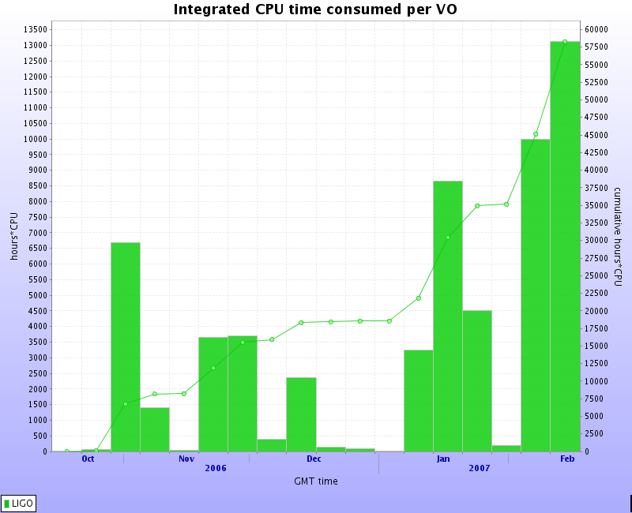
LIGO
Making steady progress migrating in-house applications onto the OSG Grid
Working closely with Pegasus developers at ISI to enhance workflow planning in support of LIGO workflows on the OSG
  Pegasus workflow planner enhancements acknowledging OSG accepted for publication
Seeing steady increases in utilization of opportunistic cycles on the OSG

Slide 20
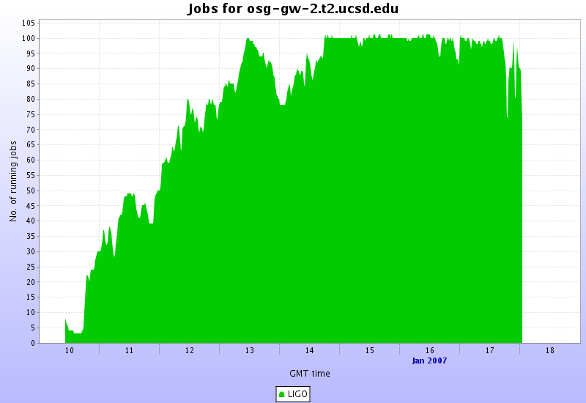
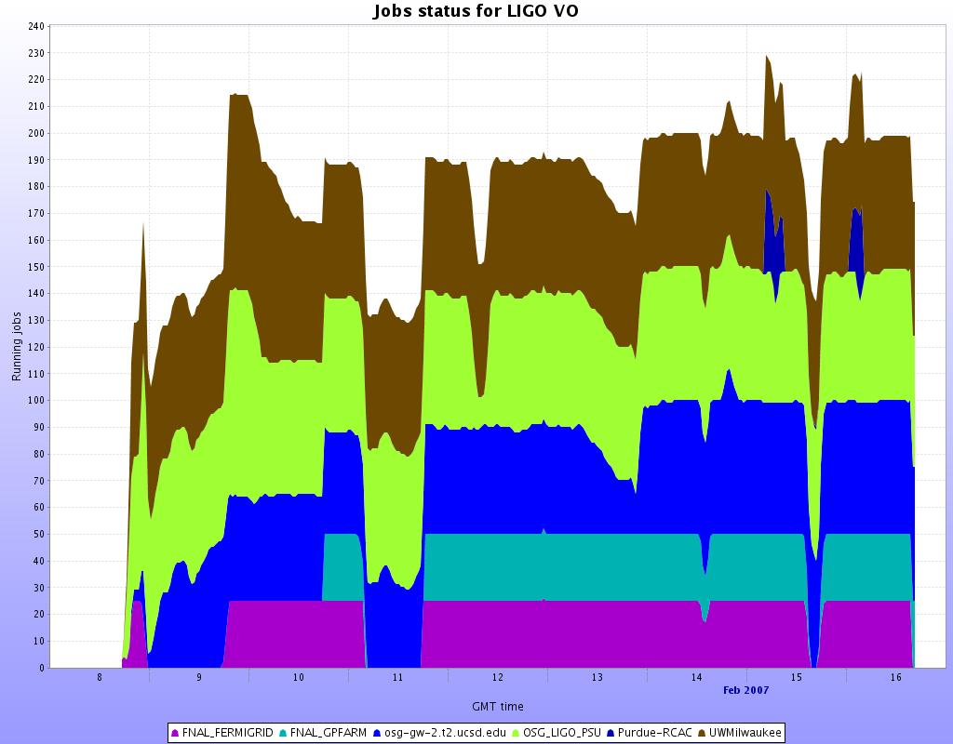
LIGO Milestones
Opportunistic use of OSG adapting LIGO workflows.
Completed First LIGO Milestone in January.
  Sustained workflow at >25 job slots for one week at UCSD Tier-2 site.
  Joint OSG collaborative project with LIGO, DISUN, ISI.
  Exercised newly provided Pegasus functionality provided by USC-ISI.
Just completed the second milestone well ahead of June timeline.
  Sustained multi-site workflows at >100 job slots for one week .

Slide 21
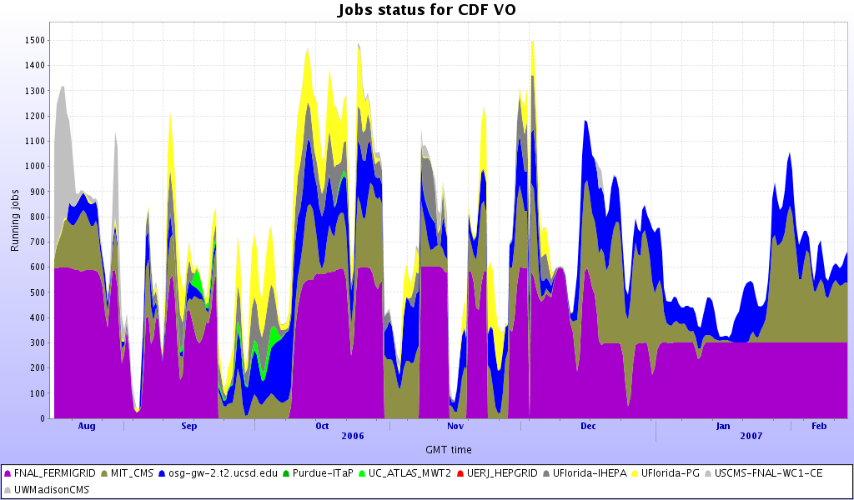
CDF
CDF continuous using of OSG for monte carlo production and acknowledge the benefit to the scientific output.
~38 CPU ^{x} years a month average across 10 OSG sites, 5 of which are “opportunistic use”. (some/many dips due to monitoring problems?)

Slide 22
CDF first to agree on process for acknowledging OSG contributions
Begin forwarded message:
From: Ashutosh Kotwal kotwal@phy.duke.edu
Date: February 9, 2007 9:52:12 AM.
Subject: Re: Citations of OSG use and benefit
Dear Ruth,
This is a good idea.CDF has been using OSG resources heavily for some time for all MC production. Therefore I would think that most, if not all, recent CDF papers can be listed. Regards
,Ashutosh
On Fri, 9 Feb 2007, Ruth Pordes wrote:
Dear all,we have started a web page to list papers that rely on OSG science use and benefit. We will be reporting on this page at the upcoming Joint Oversight Team meeting in 10 days. http://www.opensciencegrid.org/?pid=1000077.
Please could you send any such publications to the osg-webmasters to include on the page?Also, if you look the page includes the citation that we are asking groups to include on such papers. the CDF spokespeople have agreed to this. We appreciate your taking this up internally with your collaborations and experiments. Anne will also be talking to people about this at the all hands meeting.
Citing OSG in your PublicationsWhenever you make use of Open Science Grid resources, services or tools, we would be grateful to have you acknowledge this use in any resulting publications.
We suggest the following or similar text:"This research was done using resources provided by the Open Science Grid, which is supported by the National Science Foundation and the U.S. Department of Energy's Office of Science."thanksRuth--

Slide 23
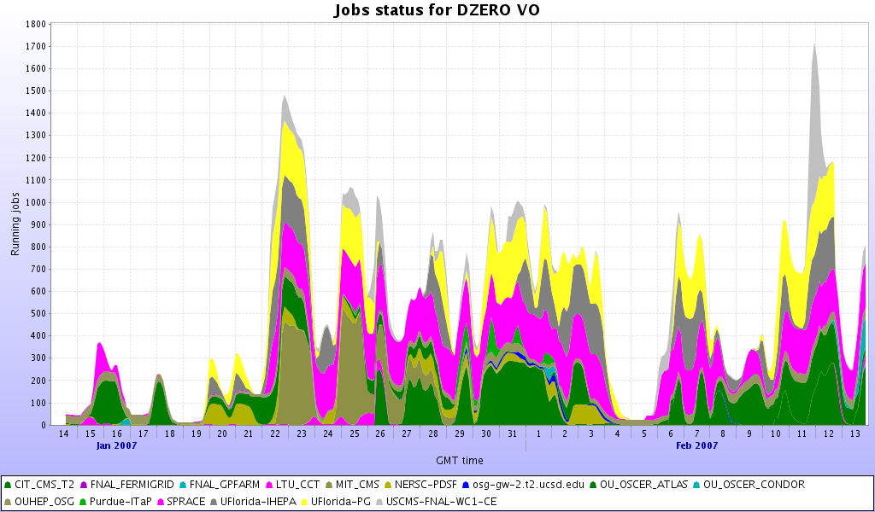
D0 Production Reprocessing - Looking for Maximum Throughput on EGEE and OSG
Message to Council: D0 is starting a reprocessing run that will effectively be able to use between 1500 and 3000 CPUs over the Open Science Grid over three months. Requires:
  Support for two types of jobs will be running production and merging, production jobs last 6-12 hours and merging jobs are slightly longer.
  Worker nodes to have outgoing network access.
  Worker nodes should have about 6GB of scratch storage space per job.
  4 TB of total disk space over the OSG to store input and output files. This space can be distributed among participating sites.
  For prestaging of our raw data it would be desirable to have at least 1 TB of disk cache at each site connected with 1 Gbit link to all CPUs.
Testing on 15 sites.
Now running at ~60% efficiency,
They will be conducting some
error analysis soon and report
findings to us.

Slide 24
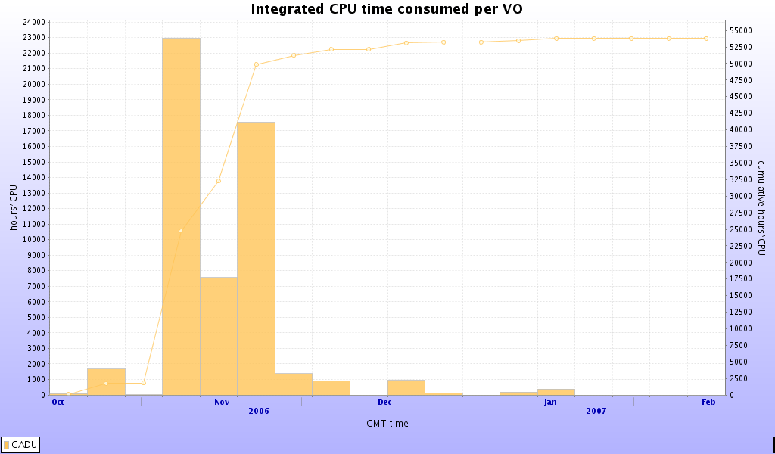
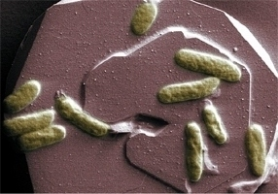
“small” “opportunistic” benefit - reaping behind the big guys: 1) GADU
Production Run in Nov 2006 across ~20sites.
Three tools, each tool divided into approximately 40K jobs each running for about ~ 2 1/2 hours. Used >20 sites on OSG and TeraGrid.
Research Highlight on OSG web site
http://www.opensciencegrid.org/?pid=1000165
“Margie Romine, a microbiologist at the Pacific Northwest National Laboratory in Richland, Washington, has used GADU to help her study the genetic code of the bacterium Shewanella oneidensis MR-1, whose metal- and radionuclide-reducing capability can impact the movement of such materials in the environment”.

Slide 25
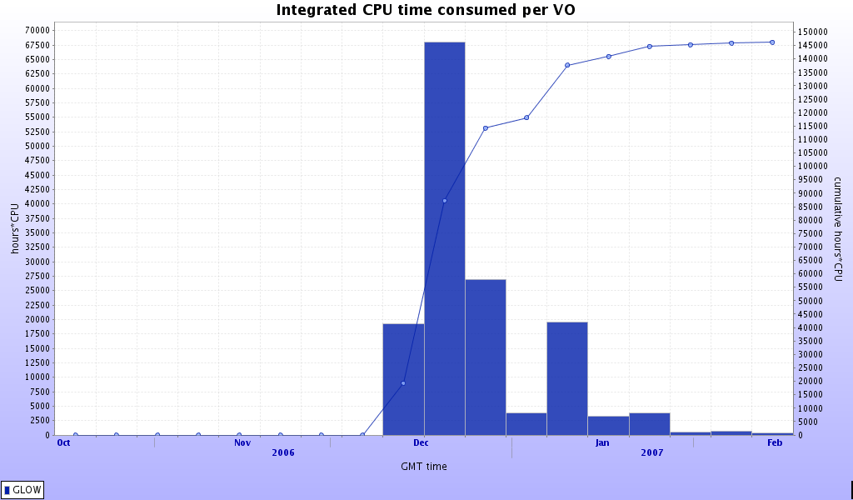

2) FOOTBALL POOL PROBLEM
A further run as needed to improve the statistics from earlier this year
Image courtesy of Jeff Linderoff

Slide 26
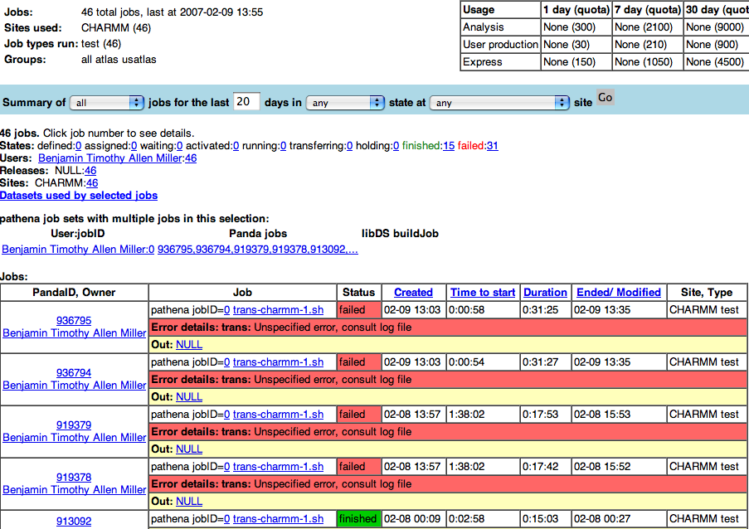
3) Molecular Chemistry
CHARMM -
  single investigator support under OSG VO, using generalized PANDA workload management; currently under test.
Monitoring

Slide 27
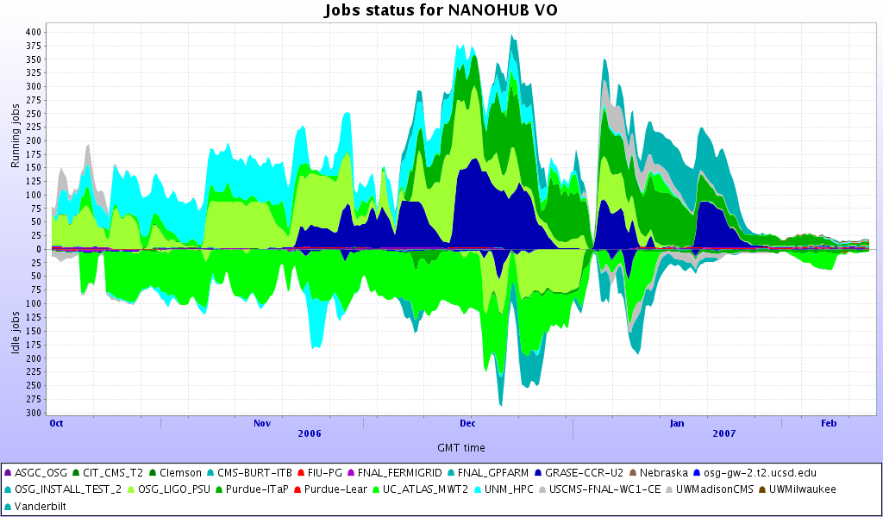
4) Nanohub
Challenge in the application: runs for up to 40 days; no application level checkpointing; Input/output sandboxes not robust.
Monitoring of completed runs

Slide 28
Other Status:
Software, etc. - Miron’s talk
EOT, etc. - Mike’s talk
Partnerships - Ruth’s talk
Engagement - John’s talk
The End

