Slide 1
2011 OSG Summer School
An introduction to
Overlay systems
Also known as
Pilot systems
by Igor Sfiligoi
University of California San Diego

Slide 2
Summary of past lessons
HTC is maximizing CPU use over long periods
  And getting lots of computation done
DHTC is HTC over many sites
Grid sites have a CE with an abstract API
Direct Grid submission requires job partitioning
  Job partitioning is hard

Slide 3
Overlay systems
Introduction to
Overlay systems
in the DHTC context

Slide 4


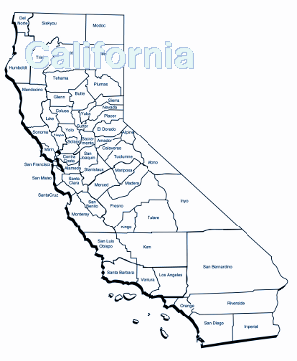


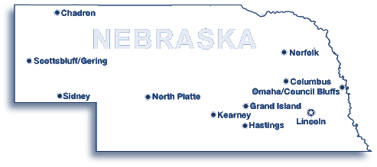
Why is job partitioning hard?
Intermediate queues with unknown policies
You would need to
know the future to
do correct partitioning
Grid_Submit
Grid_Submit
CE
CE
LSF
Condor
CE
PBS

Slide 5
If only we could have a global scheduler
No need to explicitly partition
Not going
to happen
Scheduler

Slide 6
Why we cannot have a global scheduler
Existing infrastructure
Local users, local policies
Money & politics
Being able to work when WAN goes down
...

Slide 7
What about a subset?
Can we convince the sites to lease some of the resources to a 3rd party HTC system?
Yes,
can be done
Scheduler

Slide 8
Resource leasing
The global scheduler owns
the leased resources
Just like
simple HTC
Scheduler

Slide 9
How do we lease in the Grid
Each Grid job is a lease
So let's submit
a HTC system
as a Grid job
Sites don't limit
what users submit
CE
Submit htc.jdl
Scheduler

Slide 10
Overlay system
We effectively create an overlay system
  A HTC system on top of another HTC system
The “HTC Grid job” is called
a Pilot job
Resource
provisioning
CE
Scheduler
Scheduler

Slide 11
Hiding the D from DHTC
Just a simple HTC from a user point of view
But didn't we
just move
the problem?
Scheduler
?
CE
CE
LSF
Condor
CE
PBS

Slide 12
Provisioning not as hard
Main problem in user job partitioning
  All jobs are important!
  User interested in when the last job finishes
In pilot job “partitioning”
  All jobs are the same
  User interested in the total number
  of resources provisioned
Much easier

Slide 13
Pilot systems in real life
glideinWMS
  Used by several OSG VOs,
  including CMS
PANDA
  Used mostly by ATLAS
DIRAC
  Not used in OSG, used by LHCb
Will concentrate
on glideinWMS

Slide 14
Overlay systems
A high level overview of
glideinWMS

Slide 15
What is glideinWMS
A pilot system based on Condor
  Condor as a global HTC system
  Additional glideinWMS processes used
  to create and submit the pilot jobs
Developed by CMS (as a generalization of CDF work)
  Based on original Condor glidein work
Home page:
http://tinyurl.com/glideinWMS

Slide 16
Glidein = Condor pilot
Glidein
  A properly configured
  condor_startd
  as a Grid job
CE
?
Scheduler
Schedd
Match
Collector
Startd
I am ready, give me work

Slide 17
Glidein pool
Just like a regular Condor pool for the user
Including
condor_status
Schedd
Collector
?
CE
CE
Startd
Startd
Startd
Startd
LSF
Condor
CE
Startd
PBS
Startd

Slide 18
glideinWMS
glideinWMS processes are the ones that actually configure and submit the glideins
  The user does not need to do anything
Condor-G used under the hood
CE
glideinWMS
Schedd-G
Scheduler
Schedd
Match
Collector
Startd
I am ready, give me work

Slide 19
Resource selection
Users may want to run only on
a subset of resources
  i.e. have some requirements
You don't want to provision resources that user jobs will not use!
  glideinWMS thus does matchmaking

Slide 20
glideinWMS matchmaking
Not as sophisticated as the rest of Condor
Policy centralized in glideinWMS
  No “requirements” expression in job ClassAd
On the plus side, very easy on users
  Just add an attribute
  Typical basic setup has
  +DESIRED_Sites=”...”
  (startd requirements contain stringListMember(GLIDEIN_Site,DESIRED_Sites)=?=True)

Slide 21
Architecture
Separates glidein submission from matchmaking
  Factory knows about sites and
  advertises their existence (w/attrs)
  Frontend does the matchmaking
  and regulates number of glideins
Can be N:M
Grid
glidein
factory
frontend
Schedd
Submit 1
Collector
Submit 2
glidein
factory
FE

Slide 22
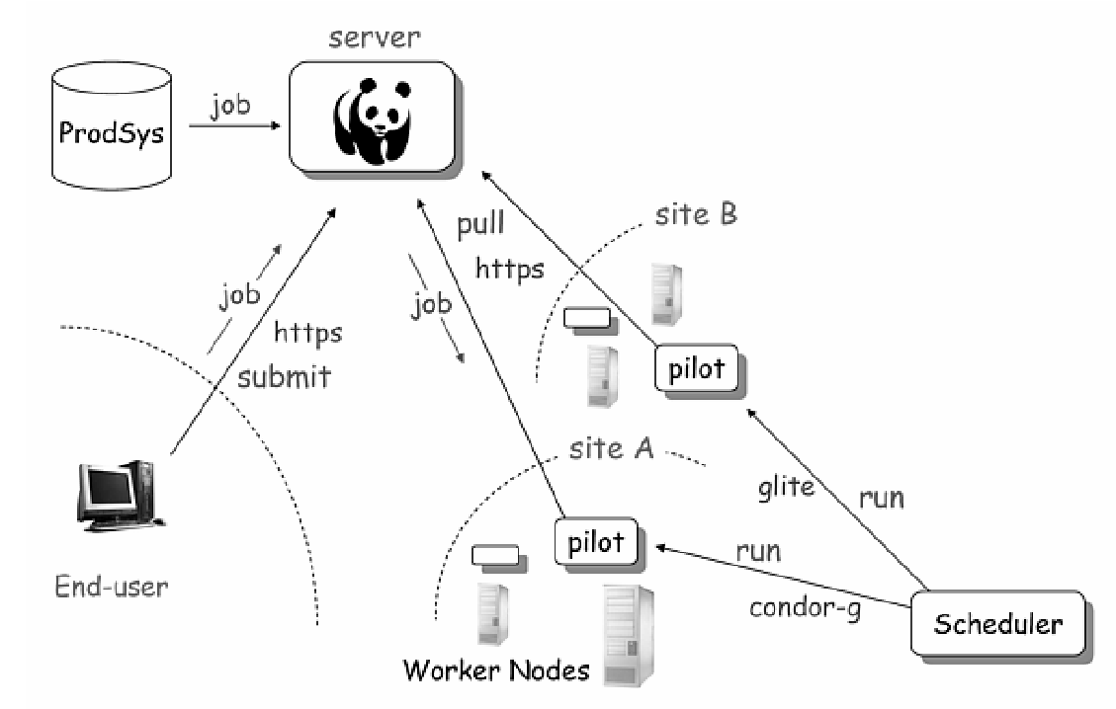
PANDA
High level overview, just for comparison
Heavily based on Web standards

Slide 23
Get your hands dirty
This is all the theory you need to know for now
Exercise time
Feel free to ask question

