Slide 1
Production Coordination
Area VO Meeting
Feb 11, 2009
Dan Fraser – Production Coordinator

Slide 2
OSG Health Monitoring
Overview
    http://t2.unl.edu/gratia/
Weekly Calls
    https://twiki.grid.iu.edu/bin/view/Production/WebHome
Data movement
    http://t2.unl.edu/gratia/xml/facility_transfer_volume
Job/Error ratios
    https://twiki.grid.iu.edu/bin/view/MeasurementsAndMetrics/ProductionGraphs

Slide 3
A New Visual for DOE
DOE Display
    http://display.grid.iu.edu/
Created by Brian Bockelman & Soichi Hayashi

Slide 4
Some Production Examples…
Effort from the entire team
  CERN BDII stale entries problem fixed
  GGUS-GOC Ticket automation
  LIGO Production at an all time high (Rob E.)
    Currently running at Rank #1 on OSG
    Looking into added stress to some NFS systems
  SBGRID now at ~3000 parallel jobs
  Zero length CRL problem resolved
  …

Slide 5
A View from the Production Coordinator
What are the biggest problems in OSG?
  Production is currently stable
    Need to keep it that way! (limit changes)
  Supporting VO’s I difficult
    How to get opportunistic storage
      Current method is to talk to each site…
      New strategies being explored (Tanya, Brian, Dan)
    Lowering the barrier for scaling across sites
      Site differences often require site-by-site investigation
      OSG operated Pilot capability could be a big win!!

Slide 6
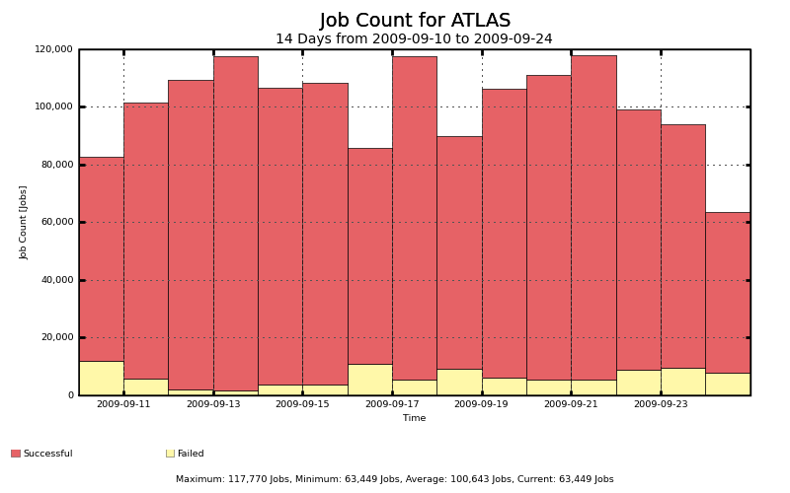
Job count (2 weeks)

Slide 7
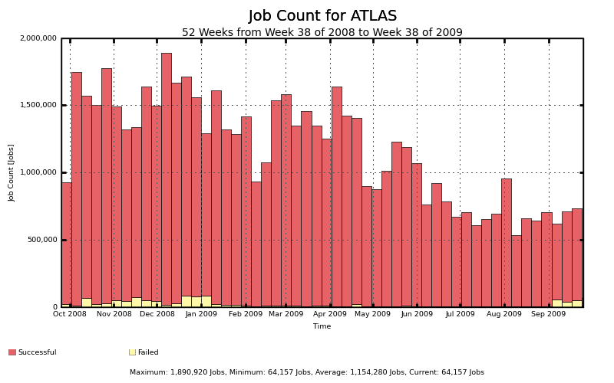

Slide 8
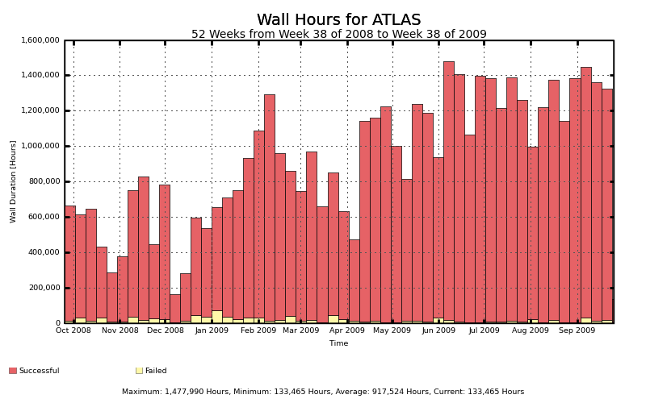
http://t2.unl.edu/gratia/xml/failed_dn_site_hours_bar?vo=atlas&title=Daily%20Atlas%20Wasted%20Hours%20By%20User%20and%20Site

Slide 9
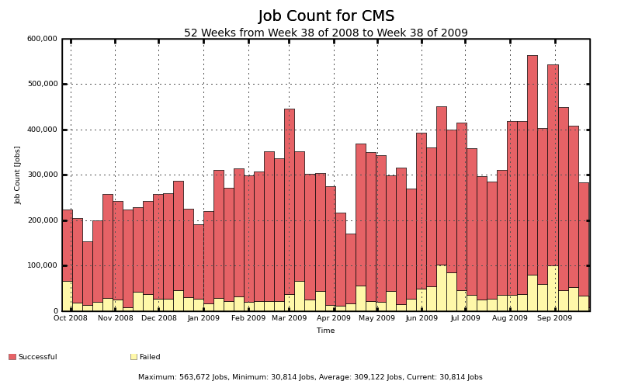

Slide 10
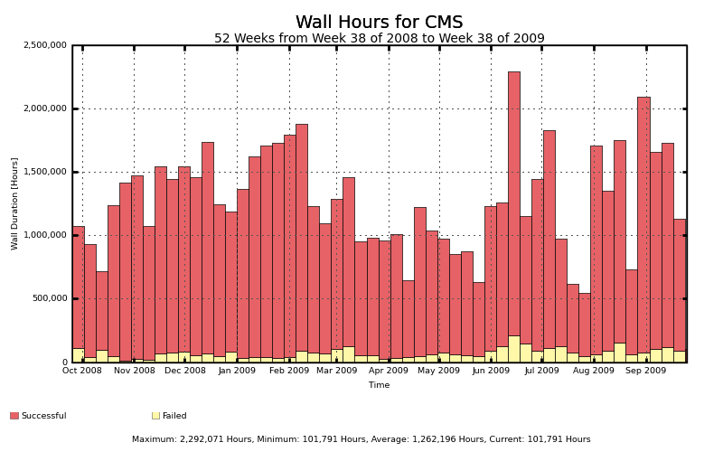
http://t2.unl.edu/gratia/xml/failed_dn_site_hours_bar?vo=cms&title=Daily%20CMS%20Wasted%20Hours%20By%20User%20and%20Site

Slide 11

Solving Production Problems
Solving problems is a TEAM sport
The weekly production call has key people from all the teams that are needed to solve problems
  CMS, Atlas, LIGO, VOs, Engage, Integration, Sites, STG, Security, Operations, Metrics
Problems accurately prioritized and channeled to the correct avenue
  Sometimes solved on the call.
Forewarning to prepare for upcoming issues.

Slide 12
Example Problems
Handling of job pre-emption (LIGO / D0)
VO Package Validation probe needed
  GIP “truth in advertising”
LIGO switch to GT2 and also Condor-G job submission
Condor scaling limits in GridMon (Atlas)
Globus LSF gatekeeper bug (D0/CMS)
Security Drill successes (for T1)
Gratia probe introduction & ITB testing

Slide 13
Example Issues cont.
STEP09 monitoring (partially successful)
IceCube management of opportunistic storage
Gratia file transfer data catch up
Transition from VORS to myOSG
New location for RSV probes and ability to update from the “production” cache
  Also, ensure that config_OSG does not update the probes automatically
Root Cause Analysis of CMS BDII outage

Slide 14
Example Issues cont.
Plan to localize data transfer information and upload summary transfer packets.
Globus memory leak was causing frequent reboots at BNL.
Site name mapping problem to enable different names internal to OSG.
OIM display difference (http vs https)
Site admin meeting & materials prep to help sites upgrade to OSG 1.2.

Slide 15
Example Issues cont.
Condor problem with directory creation in a multiple gateway scenario. (Nebraska)
Gratia collector problem with handling records that accumulate faster than they can be processed.
LIGO/Pegasus transition to use BDII data instead of central probe data.

