Slide 1

Summary of Recent iSGTW Activities
www.opensciencegrid.org
OSG Council Meeting Crowne Plaza Hotel, Chicago August 11, 2009
Paul Avery University of Florida avery@phys.ufl.edu

Slide 2
ISGTW: Statistics I (Subscribers)
5041
iSGTW Total Subscriptions
3837 (July 08)
EGEE meetings (free subscriptions)

Slide 3
Statistics II: # Page views/month

Slide 4
Statistics III: Unique visitors/month

Slide 5
June Reader Survey
Survey every ~6 months since June 2007
Use “Zoomerang” survey tool ($$)
9 questions (1 new) + 1 “comments” field
~14% response rate (355/ 2751)
Compare to 11% in 2008
Results shown on next page

Slide 6
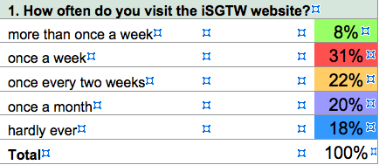
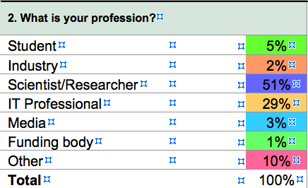
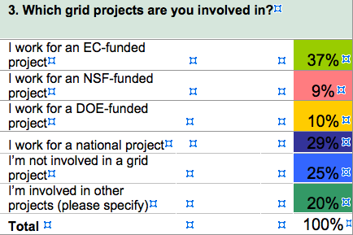
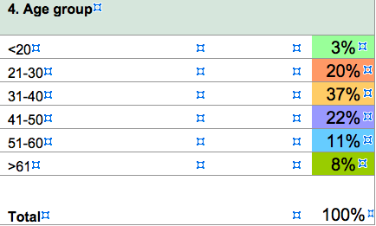

Slide 7
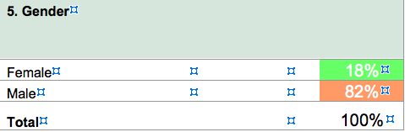
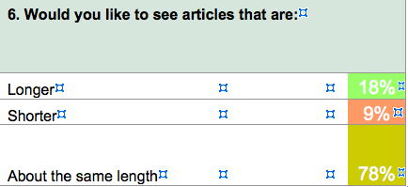
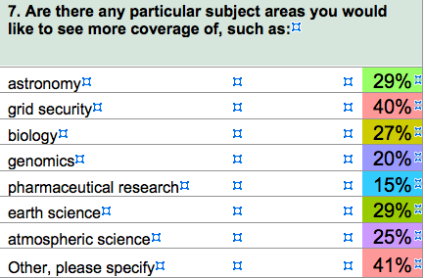
Really?

Slide 8
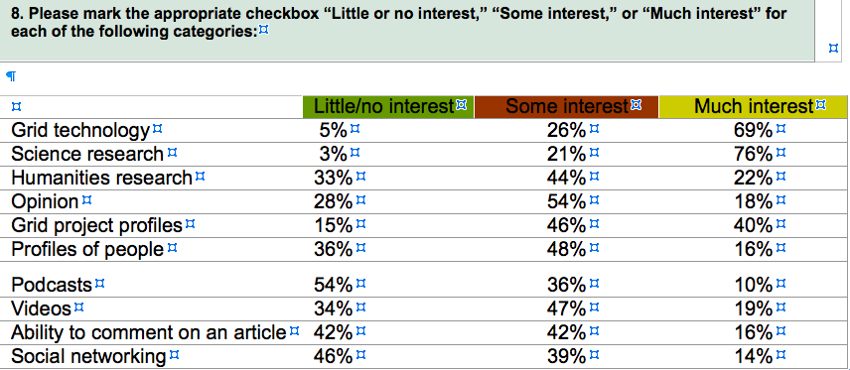

Slide 9
Comments from iSGTW Editors
For the first time, “science research,” with 211 responses (76%) placed at the top of the list for reader interest, even above the traditional favorite of “grid technology,” which had 190 responses of “much interest,”or 69%.
This seems to be in line with our observations noted about the responses to Question 7, which indicate that readers have more interest in what the grid can do for them in their research.

Slide 10
ISGTW Funding
Recent funding for U.S. iSGTW editor
0.7 FTE (Anne Heavey) + contract work (Amelia Williamson)
Current funding situation
U.S. supports 1.0 FTE (Miriam Boon) Welcome!!
EGEE supports 1.5 FTE
U.S. editor position funded from multiple sources
1/8 ASCR/DOE
1/8 HEP/DOE
1/4 iVDGL/NSF
1/4 OSG/NSF
1/4 OSG/DOE
Supplemental funds?
Do we want >1.0 FTE for U.S. side of iSGTW?
Can we get support from other sources?

