Slide 1
Introduction to Grid Computing

Slide 2
Ian Foster’s Grid Checklist (2002)
A Grid is a system that:
  Coordinates resources that are not subject to centralized control
  Uses standard, open, general-purpose protocols and interfaces
  Delivers non-trivial qualities of service
Notes:
Grid computing has also been called metacomputing, scalable global computing, internet computing

Slide 3
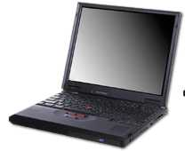
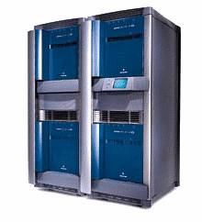
Components for Grid Computing
Distributed People
  Research communities who need to share data, or codes, or computers, or equipment to work on and understand common problems
  Example: Astrophysics Network: relativists, astrophysicists, computer scientists, mathematicians, experimentalists, data analysts
Distributed Resources
  Computers: supercomputers, clusters, workstations
  Storage devices, databases, networks
  Experimental equipment: telescopes/interferometers
Machine Network
CPU
CPU
CPU
CPU
DISK
Campus Network (LAN)
Machine Network
CPU
CPU
CPU
CPU
DISK
Campus Network (LAN)
Notes:
3

Slide 4
Components for Grid Computing
Software infrastructure
  Links all these together
  Low level: security, information, communication, …
  Middleware: data management, resource brokers, web portals, monitoring, workflow, …
Examples
  Globus
  Condor

Slide 5

Virtual Organizations
Groups of organizations that use the Grid to share resources for specific purposes
Support a single community
Deploy compatible technology and agree on working policies
  Security policies - difficult
Deploy different network accessible services:
  Grid Information
  Grid Resource Brokering
  Grid Monitoring
  Grid Accounting

Slide 6
Components for Grid Computing
Applications
Support for applications
  Standard toolkits
  SDKs/APIs
  Libraries
  Web portals
Application code
  Must be very portable
  Must be machine independent, location independent
  Lots of existing science code is not
Development tools (debuggers, profilers, …)

Slide 7
Nature of Large Scale Distributed Applications
Distributed data
  Stored in different places. Different access policies. Expensive to move around.
Distributed Resources
  Resources are distributed across multiple organizations
  Each resource looks different
Distributed Ownership
  Data and resources are owned by different organizations

Slide 8
Examples of Distributed Applications
High Energy Physics applications
  Monte Carlo simulations
  CMS experiment
Finding interesting astronomical patterns
  Sloan Digital Sky Survey
Coastal ocean monitoring and predicting
  SURA Coastal Ocean Observing and Prediction (SCOOP)
Prime number generator
  Cracking cryptography
Divide the application and run it on a distributed and decentralized environment

Slide 9
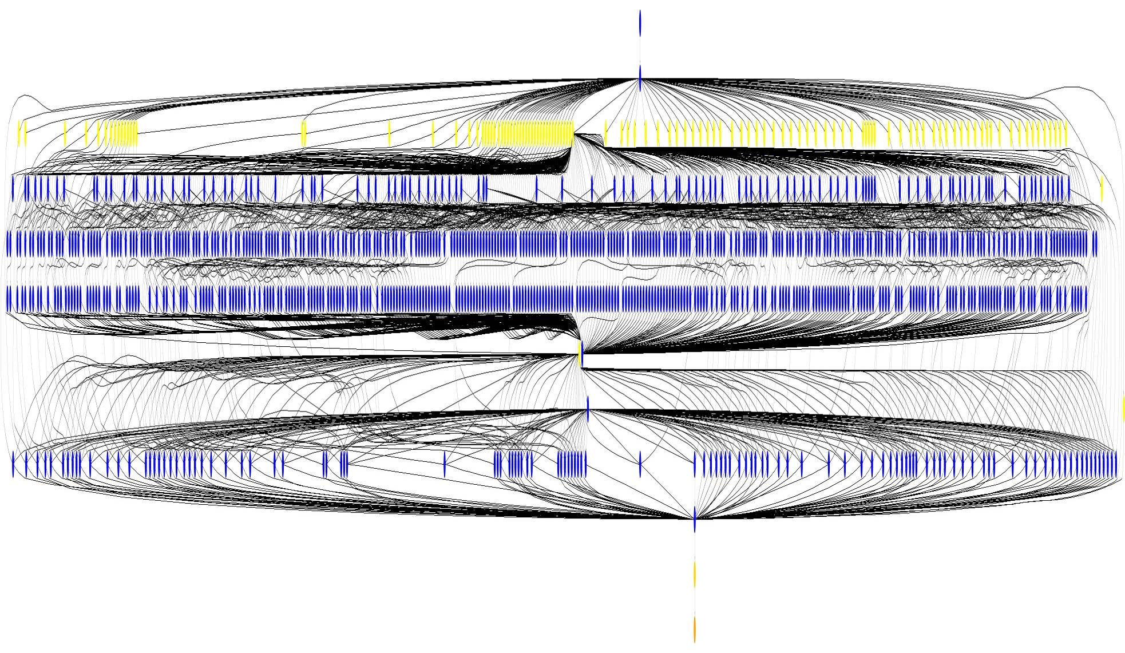
One typical application
Many HEP and Astronomy experiments consist of:
  Large datasets as inputs (find datasets)
  “Transformations” which work on the input datasets (process)
  The output datasets (store and publish)
The emphasis is on the sharing of the large datasets
Transformations are usually long and can be parallelized
Montage Workflow: ~1200 node workflow, 7 levels

Slide 10
Grid Application Types
Minimal communication (embarrassingly parallel)
Staged/linked/workflow
Access to certain resources
Fast throughput
Large scale
Adaptive
Real-time on demand
Speculative

Slide 11
Common Infrastructure
Most common core Grid infrastructure deployed today is called the Globus Toolkit.
Many higher level services are being researched and built using Globus
www.globus.org
Originally from Argonne National Lab and University of Southern California, in US.

Slide 12
The Open Grid Forum
Standards and best practices
Promoting Grid technologies and applications
Modelled around bodies such as IETF (internet engineering task force)
Working groups and research groups in many different areas
Meet 3 times a year
www.ogf.org

Slide 13
Definitions

Slide 14
Application Programming Interface (API) defines the interface.
Refers to definition, not implementation
  For example, there are many implementations of MPI
Specification often language-specific (or IDL)
  Routine name, number, order and type of arguments; mapping to language constructs
  Behavior or function of routine
Examples
  GSS API (security), MPI (message passing)

Slide 15
A Software Development Kit (SDK) is a particular instantiation of an API
An SDK consists of libraries and tools
  Provides implementation of API specification
One API can have multiple SDKs
Examples of SDKs
  MPICH

Slide 16
Protocols can have multiple APIs.
TCP/IP APIs include BSD sockets, Winsock, System V streams, …
The protocol provides interoperability
  Programs using different APIs can exchange information
  I don’t need to know remote user’s API
Application
Application
WinSock API
Berkeley Sockets API
TCP/IP Protocol: Reliable byte streams

Slide 17
An API can have multiple protocols
MPI provides portability: any correct program compiles & runs on a platform
Does not provide interoperability: all processes must link against same SDK
  E.g., MPICH and LAM versions of MPI
Application
Application
MPI API
MPI API
LAM SDK
MPICH-P4 SDK
LAM protocol
MPICH-P4 protocol
Different message formats, exchange sequences, etc.
TCP/IP
TCP/IP

Slide 18
APIs and protocols are both important
Standard APIs/SDKs are important
  They enable application portability
    Can move application to different places
  But w/o standard protocols, interoperability is hard
  Example: MPI
Standard protocols are important
  Between computers
  Enable interoperability
    Applications can talk to each other
  Enable shared infrastructure – example: the internet
  But w/o standard APIs/SDKs, application portability is hard (different platforms access protocols in different ways)

Slide 19
Security

Slide 20
Secure Sockets Layer SSL (TLS)
Encrypted communications over Internet
  Ensures that the information is sent unchanged, and only to the server you intended
SSL uses a private key to encrypt data
  Netscape and Internet Explorer support SSL
  Web sites use SSL to obtain confidential user information, such as credit card numbers.
  URLs that require an SSL connection start with https: instead of http:.
Also known as Transport Level Security
HTTP
FTP
Secure Socket Layer
(SSL)
TCP
IP

Slide 21
OpenSSL is an open source implementation of SSL and TLS
OpenSSL is used by:
  Apache HTTP Server for https support
  MySQL to provide secure database access.

Slide 22
OpenSSH is an implementation of the SSH protocol suite of tools
Encrypts all traffic, including passwords
Provides a variety of authentication methods.
Includes:
  ssh program - logins,
  scp – copy files
  sftp – general file transfer
Also other basic utilities: ssh-add, ssh-agent, ssh-keygen

Slide 23
Security: Terminology
Authentication: Establishing identity
Authorization: Establishing rights
Message protection
  Message integrity
  Message confidentiality
Non-repudiation
Digital signature
Accounting
Delegation

Slide 24
Authentication means identifying that you are whom you claim to be
Authentication stops imposters
Examples of authentication:
  Username and password
  Passport
  ID card
  Public keys or certificates
  Fingerprint

Slide 25
Authorization is what you are allowed to do
Is this device allowed to access to this service?
Read, write, execute permissions in Unix
ACLs provide more flexible control

Slide 26
Digital Signature
An electronic signature that authenticates the identity of the sender of a message, the signer of a document, or ensures that the contents of a message are intact.
Digital signatures are easily transportable, cannot be imitated by someone else, and can be automatically time-stamped.
The ability to ensure that the original signed message arrived means that the sender cannot easily repudiate it later.

Slide 27
Digital Certificate
The signer of a digital certificate says something like “I attached G.Allen’s public key to this digital certificate and then signed it with my private key”
Any user of G.Allen’s digital certificate must completely trust the competency and honesty of the person/organization who signed the certificate
For anyone to confidently use G.Allen’s digital certificate they must also trust that they have a validated copy of the signers public key
There is nothing secret about the contents of a digital certificate
Has expiration date
Analogy: Driving License issued by DMV (+ other countries)

Slide 28
Managing Digital Certificates
Digital certificate administrative frameworks are called “public key infrastructures” (PKIs).
Two major ones
  X.509 (standardized by IETF)
  Pretty Good Privacy (PGP)
Centrally controlled system for managing digital certificates in X.509 talk is a “certificate authority”

Slide 29
Certificate Authorities (CAs) exist only to sign user certificates
A small set of trusted entities
A CA signs its own certificate
The CA’s certificate is distributed in a trusted manner
Name: CA
Issuer: CA
CA’s Public Key
CA’s Signature

Slide 30
Hardware Components & Grids

Slide 31
Basic Elements
Distributed systems built from
  Computing elements (processors)
  Communication elements (networks)
  Storage elements (disk, attached or networked)
New elements
  Visualization/interactive devices
  Experimental and operational devices

Slide 32
Distributed Resources
Local workstations
Site Resources
Campus Resources
State Resources
National Centers
National Grids (OSG, TeraGrid)
International Grids (GGTC)

Slide 33
Compute Elements
Clock speed
Cache hierarchy
Floating point registers
Main memory
Internal bandwidths
...
Need powerful operating systems, compilers, applications to use all this

Slide 34
Supercomputers
Definition of supercomputer
  Machine on Top500.org?
  Machine costing over $1M?
  Most powerful machines
  One-of-a-kind
Top 3 (November 2006)
  IBM Blue Gene/L (US) 131k procs, 280 TF
  Cray Red Storm (US) 26k procs, 101 TF
  IBM BGW (US) 40k procs, 91 TF
Top 3 (2003)
  Earth Simulator (JAPAN) 5K procs/36 TF (6)
  ASCI Q (USA) 8K procs/14 TF (12)
  G5 Cluster (USA) 2k procs/12 TF (14)

Slide 35
Communication Elements
Links, routers, switches, name servers, protocols
Infrastructure evolves slowly (politics, large scale changes, money)
Gilder's Law: total bandwidth of communication systems doubles every six months
Change in LAN to desktops
  100 mbps shared
  100 mbps switched
  1 gbps
  10 gbps
Clusters: Gigabit ethernet (TCP/IP and MPICH/LAM) standard, Myrinet (own MPI drivers) better performance

Slide 36
Network Speeds
Analog modem: 57 kbps
GPRS: 114 kbps
Bluetooth: 723 kbps
T-1: 1.5 Mbps
Eth 10Base-X: 10Mbps
802.11b (WiFi) 11 Mbps
T-3: 45 Mbps
OC-1: 52 Mbps
Fast Eth 100Base-X: 100 Mbps
OC-12: 622 Mbps
GigEth 1000Base-X: 1 Gbps
OC-24: 1.2 Gbps
OC-48: 2.5 Gbps
OC-192: 10 Gbps
10 GigEth: 10 Gbps
OC-3072: 160 Gbps
Home internet
  Upload: 35 KB/s
  Download 250 KB/s

Slide 37
Storage Elements
Magnetic tape/Magnetic disk
Magnetic disk
  Properties: density/rotation/cost
  1970-1988 density improvements 29% per year
  1988-now density improvements 60% per year
  Standard in PCs: 500mb (1995), 2gb(1997), 100gb (2002)
  Performance not increasing so fast
    Peak transfer (~100mbs)
    Seek times (3-5ms) [bottleneck]
Grids: cost of storage negligible, high speed networks make large data libraries attractive

Slide 38
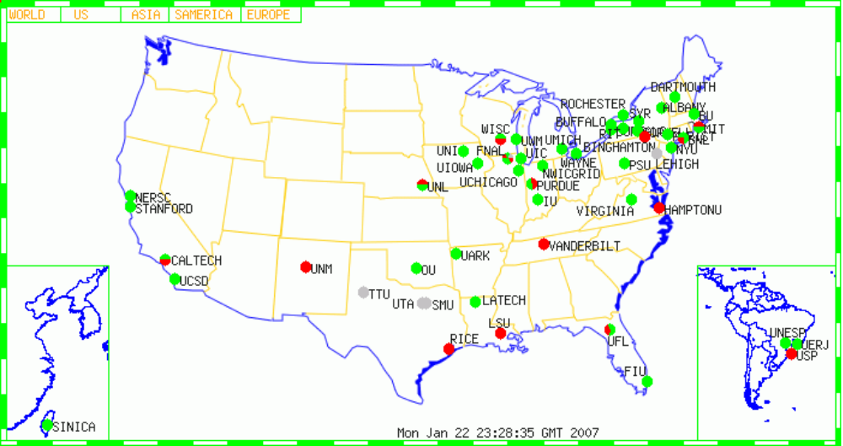
Open Science Grid (OSG) provides shared computing resources, benefiting a broad set of disciplines
A consortium of universities and national laboratories, building a sustainable grid infrastructure for science.
OSG incorporates advanced networking and focuses on general services, operations, end-to-end performance
http://www.opensciencegrid.org/

Slide 39
Introduction to Grid Middleware

Slide 40
Globus Toolkit and Condor
We will focus on Globus components as well as Condor in this workshop
Globus tools can be used in different ways:
  Client tools which you can use from a command line
  APIs (scripting languages, C, C++, Java, …) to build your own tools, or use direct from applications
  Web service interfaces
  Higher level tools built from these basic components, e.g. RFT

Slide 41
Grid Security is hard but crucial
Resources might be valuable
Problems being solved might be sensitive
Resources are located in distinct administrative domains
  Each resource has own policies, procedures, security mechanisms, etc.
Implementation must be broadly available & applicable
  Standard, well-tested, well-understood protocols; integrated with wide variety of tools

Slide 42
Security Services
Forms the underlying communication medium for all the services
Secure Authentication and Authorization
Single Sign-on
  User explicitly authenticates only once – then single sign-on works for all service requests
Uniform Credentials
Ex: GSI (Grid Security Infrastructure)

Slide 43
Grid Security Infrastructure (GSI)
Users:
  Easy to use
  Single sign-on: only type your password once
  Delegate proxies
Administrators:
  Can specify local access controls
  Have accounting

Slide 44
GSI builds on X.509 PKI
PKI allows you to know that a given key belongs to a given user
PKI builds off of asymmetric encryption:
  Each entity has two keys: public and private
  Data encrypted with one key can only be decrypted with other
  The public key is public
  The private key is known only to the entity
The public key is given to the world encapsulated in a X.509 certificate (Grid Certificate)

Slide 45
A GSI certificate includes four pieces of information:
Subject name
  Identifies the person or object that the certificate represents
The subject’s Public Key
Identity of the CA that signed the certificate
  Certifies that the public key and the identity belong to the subject
  Uses the digital signature of the named CA

Slide 46
Another CA certifies the link between the public key and the subject.
To trust the certificate and its contents, the CA's certificate must be trusted.
The link between the CA and its certificate must be established via a non-cryptographic method.

Slide 47

A Certificate is similar to a passport of driver’s license
Identity is signed by a trusted party
State of Illinois
Name
Issuer
Public Key
Signature
John Doe
755 E. Woodlawn
Urbana IL 61801
State of
Illinois
Seal
BD 08-06-65
Male 6’0” 200lbs
GRN Eyes

Slide 48


How Do You Get a Certificate?
User send public key to CA along with proof of identity
User generates
public/private
key pair
CA confirms identity, signs certificate and sends back to user
Cert
Request
Public Key
Cert
Certificate
Authority
State of Illinois
ID
Private Key encrypted on local disk

Slide 49
Applications that use GSI
Use GSI in Globus for:
  Submitting jobs
  Transferring data
  Querying information services (often turned off)
Other software using GSI:
  Condor
  GSI OpenSSH
  MyProxy

Slide 50
Grid Monitoring & Information Services

Slide 51
To efficiently use a Grid, you must monitor its resources.
Check the availability of different grid sites
Discover different grid services
Check the status of “jobs”
Make better scheduling decisions with information maintained on the “health” of sites

Slide 52
Monitoring provides information for several purposes
Operation of Grid
  Monitoring and testing Grid
Deployment of applications
  What resources are available to me? (Resource discovery)
  What is the state of the grid? (Resource selection)
  How to optimize resource use? (Application configuration and adaptation)
Information for other Grid Services to use

Slide 53
Monitoring information is either static or dynamic, broadly.
Static information about a site:
  Number of worker nodes, processors
  Storage capacities
  Architecture and Operating systems
Dynamic information about a site
  Number of jobs running on each site
  CPU utilization of different worker nodes
  Overall site “availability”
Time-varying information is critical for scheduling of grid jobs
More accurate info costs more: it’s a tradeoff.

Slide 54
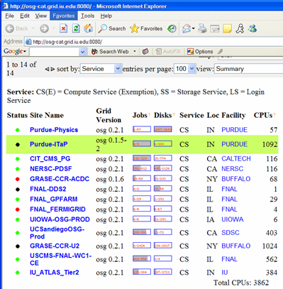
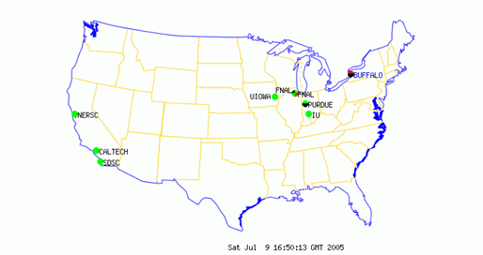

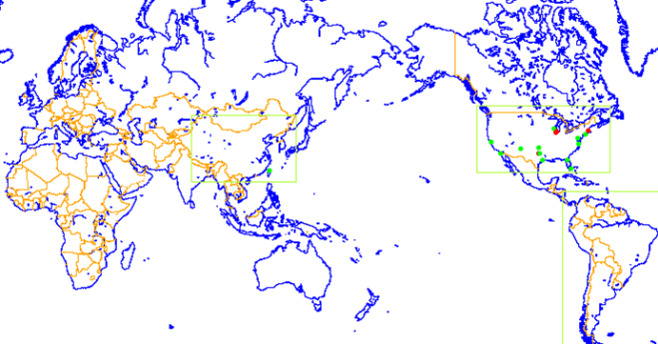

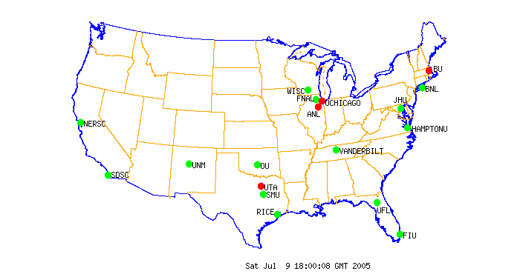
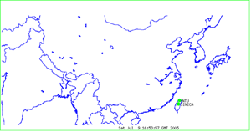
GridCat
http://osg-cat.grid.iu.edu
http://www.ivdgl.org/grid3/gridcat
http://www.ivdgl.org/gridcat/home/

Slide 55
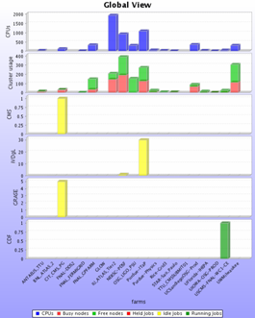
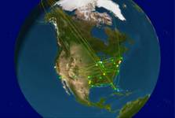
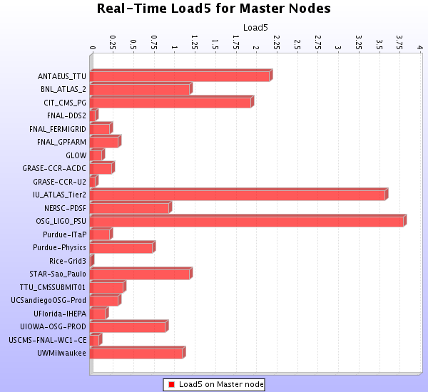
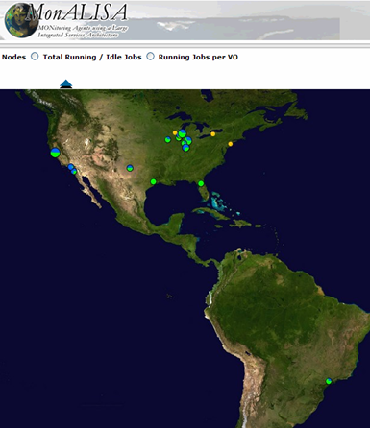
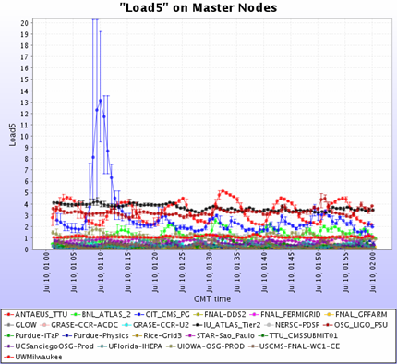
MonALISA
http://monalisa.caltech.edu/

Slide 56
Globus Monitoring and Discovery System
MDS is a grid information service
It provides:
  Uniform, flexible access to information
  Scalable, efficient access to dynamic data
  Access to multiple information sources
  Decentralized maintenance

Slide 57
Globus MDS
Handles static (e.g OS type) and dynamic (e.g current load) data
Access to data can be restricted with GSI (Grid Security Infrastructure) credentials and authorization features

Slide 58
MDS Hierachy
QUERY
Index
Virtual Organization
Level
QUERY
Index
Index
Site Level
QUERY
Resource
Resource
Resource
IP
IP
IP
IP
IP
IP
Resource Level

Slide 59
Data Management

Slide 60
Data management services provide a flexible mechanism to move and share data
Grids are used for analyzing and manipulating large amounts of data
  Metadata (data about data): What is the data?
  Data location: Where is the data?
  Data transport: How to move the data?

Slide 61
Data Movement
Issues
  How to move data
    Robustly
    Securely
    Faster
Solutions
  scp, globus-url-copy, wget
  GridFTP

Slide 62
GridFTP is a secure, efficient and standards-based data transfer protocol
Robust, fast and widely accepted
Globus GridFTP server
Globus globus-url-copy GridFTP client
Other clients exist (e.g., uberftp)

Slide 63
GridFTP is secure, reliable and fast
Security through GSI
  Authentication and authorization
  Can also provide encryption
Reliability by restarting failed transfers
Fast
  Can set TCP buffers for optimal performance
  Parallel transfers
  Striping (multiple endpoints)
Not all features easily accessible from basic client

Slide 64
File catalogues tell you where the data is
Replica Location Service (RLS)
Phedex
RefDB / PupDB

Slide 65
Requirements from a File Catalogue
Abstract out the logical file name (LFN) for a physical file
  maintain the mappings between the LFNs and the PFNs (physical file names)
Maintain the location information of a file

Slide 66
In order to avoid “hotspots”, replicate data files in more than one location
Effective use of the grid resources
Each LFN can have more than 1 PFN
Avoids single point of failure
Manual or automatic replication
  Automatic replication considers the demand for a file, transfer bandwidth, etc.

Slide 67
The Globus Replica Location Service (RLS)
Each RLS server usually runs
  Local Replica Catalog (LRC)
    What files do you have (directly know physical location), mapped to URLs or physical file names (PFN)
and/or
  Replica location index (RLI)
    Catalog of what LFNs other LRCs know about
Similar hierarchical structure to MDS.

Slide 68
Job Management

Slide 69
Job Management Services provide a standard interface to remote resources
Includes CPU, Storage and Bandwidth
Main component is the remote job manager
  Globus Resource Allocation Manager (GRAM)
Other needs:
  scheduling
  monitoring
  job migration
  notification

Slide 70
Job Management on a Grid
GRAM
Condor
VO
LSF
VO
User
Site A
Site C
PBS
fork
VO
VO
Site B
Site D
The Grid

Slide 71
GRAM: What is it?
Globus Resource Allocation Manager
Given a job specification:
  Create an environment for a job
  Stage files to and from the environment
  Submit a job to a local resource manager
  Monitor a job
  Send notifications of the job state change
  Stream a job’s stdout/err during execution

Slide 72
A “Local Resource Manager” is a batch system for running jobs across a computing cluster
In GRAM
Examples:
  Condor
  PBS
  LSF
  Sun Grid Engine
Most systems allow you to access “fork”
  Default behavior
  It runs on the gatekeeper:
    A bad idea in general, but okay for testing

Slide 73
The client describes the job in with GRAM’s Resource Specification Language (RSL)
Example:
  & (executable = a.out)
  (directory = /home/nobody )
  (arguments = arg1 "arg 2")
Use higher level tools (such as portals) to construct anything but simple RSL
See http://www.globus.org/gram/rsl_spec1.html

Slide 74
Managing your jobs
We need something more than just the basic functionality of the globus job submission commands
Some desired features
  Job tracking
  Submission of a set of inter-dependant jobs
  Check-pointing and Job resubmission capability
  Matchmaking for selecting appropriate resource for executing the job
Options: Condor, PBS, LSF, …

Slide 75
The Problem of Grid Scheduling
Decentralised ownership
  No one controls the grid
Heterogeneous composition
  Difficult to guarantee execution environments
Dynamic availability of resources
  Ubiquitous monitoring infrastructure needed
Complex policies
  Issues of trust
  Lack of accounting infrastructure
  May change with time

Slide 76





Based on:
Grid Intro and Fundamentals Review
Dr Gabrielle Allen
Center for Computation & Technology
Department of Computer Science
Louisiana State University
gallen@cct.lsu.edu
Grid Summer Workshop
June 26-30, 2006

